Slide 1


Spot it st. patrick’s DAY
Chair fitness edition

Slide 2


HOW TO PLAY:
LOOK AT PICTURES ON EACH SIDE OF THE LINE. THERE IS ONLY ONE ITEM THAT APPEARS IN BOTH PICTURES. WHEN YOU SEE IT, YELL “SPOT IT” AND THEN NAME THE IMAGE THAT APPEARS IN BOTH PICTURES.
PERFORM THE EXERCISE CHOSEN FOR THAT IMAGE FOR 30 SECONDS.

Slide 3


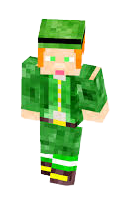


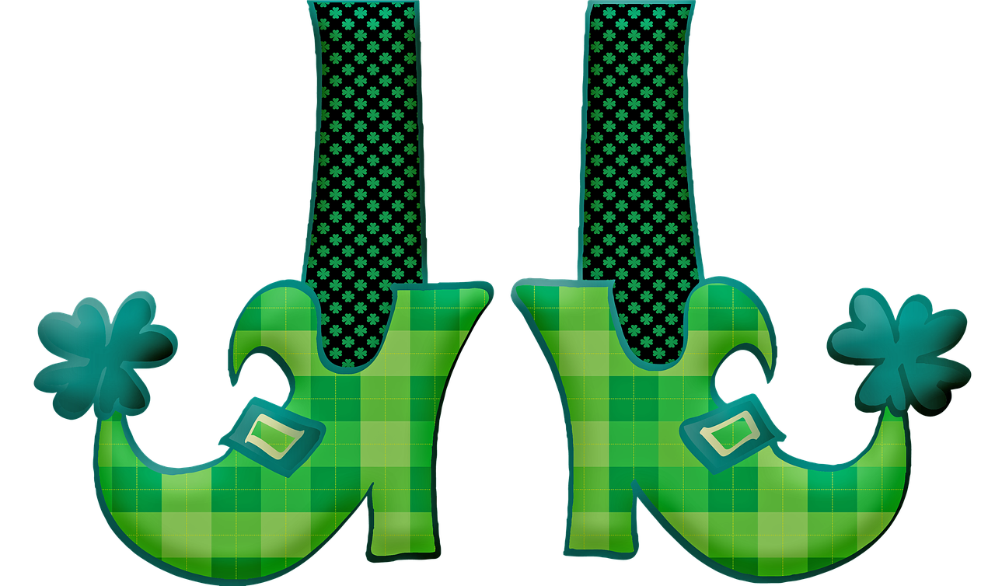





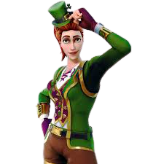



Slide 4


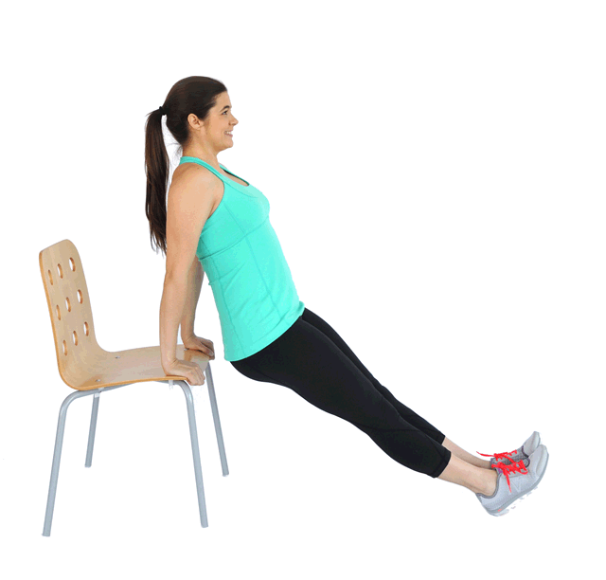
=STRAIGHT LEG
TRICEP DIP

Slide 5


Round 1
=STRAIGHT LEG
TRICEP DIP

Slide 6
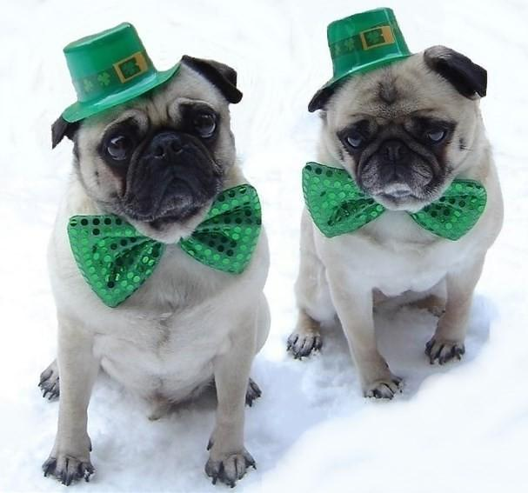

Slide 7
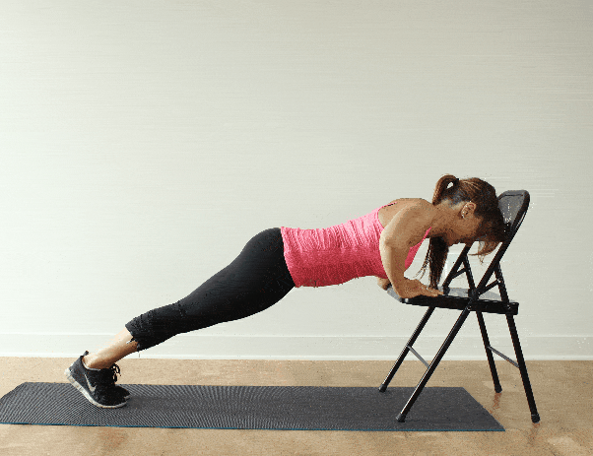
=INCLINE PUSH-UP

Slide 8
Round 2
=INCLINE PUSH-UP

Slide 9


Slide 10
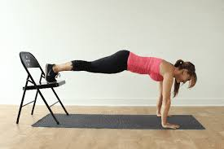
= DECLINE PUSH-UP

Slide 11
Round 3
= DECLINE PUSH-UP

Slide 12


Slide 13
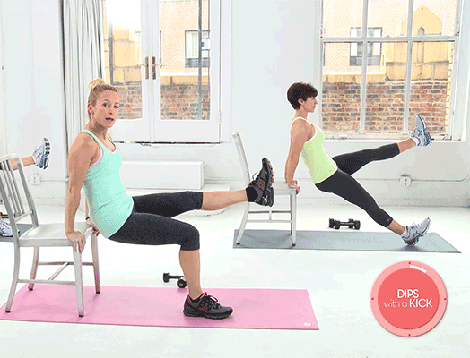
=TRICEP DIP ALTERNATING LEG KICK

Slide 14
Round 4
=TRICEP DIP ALTERNATING LEG KICK

Slide 15
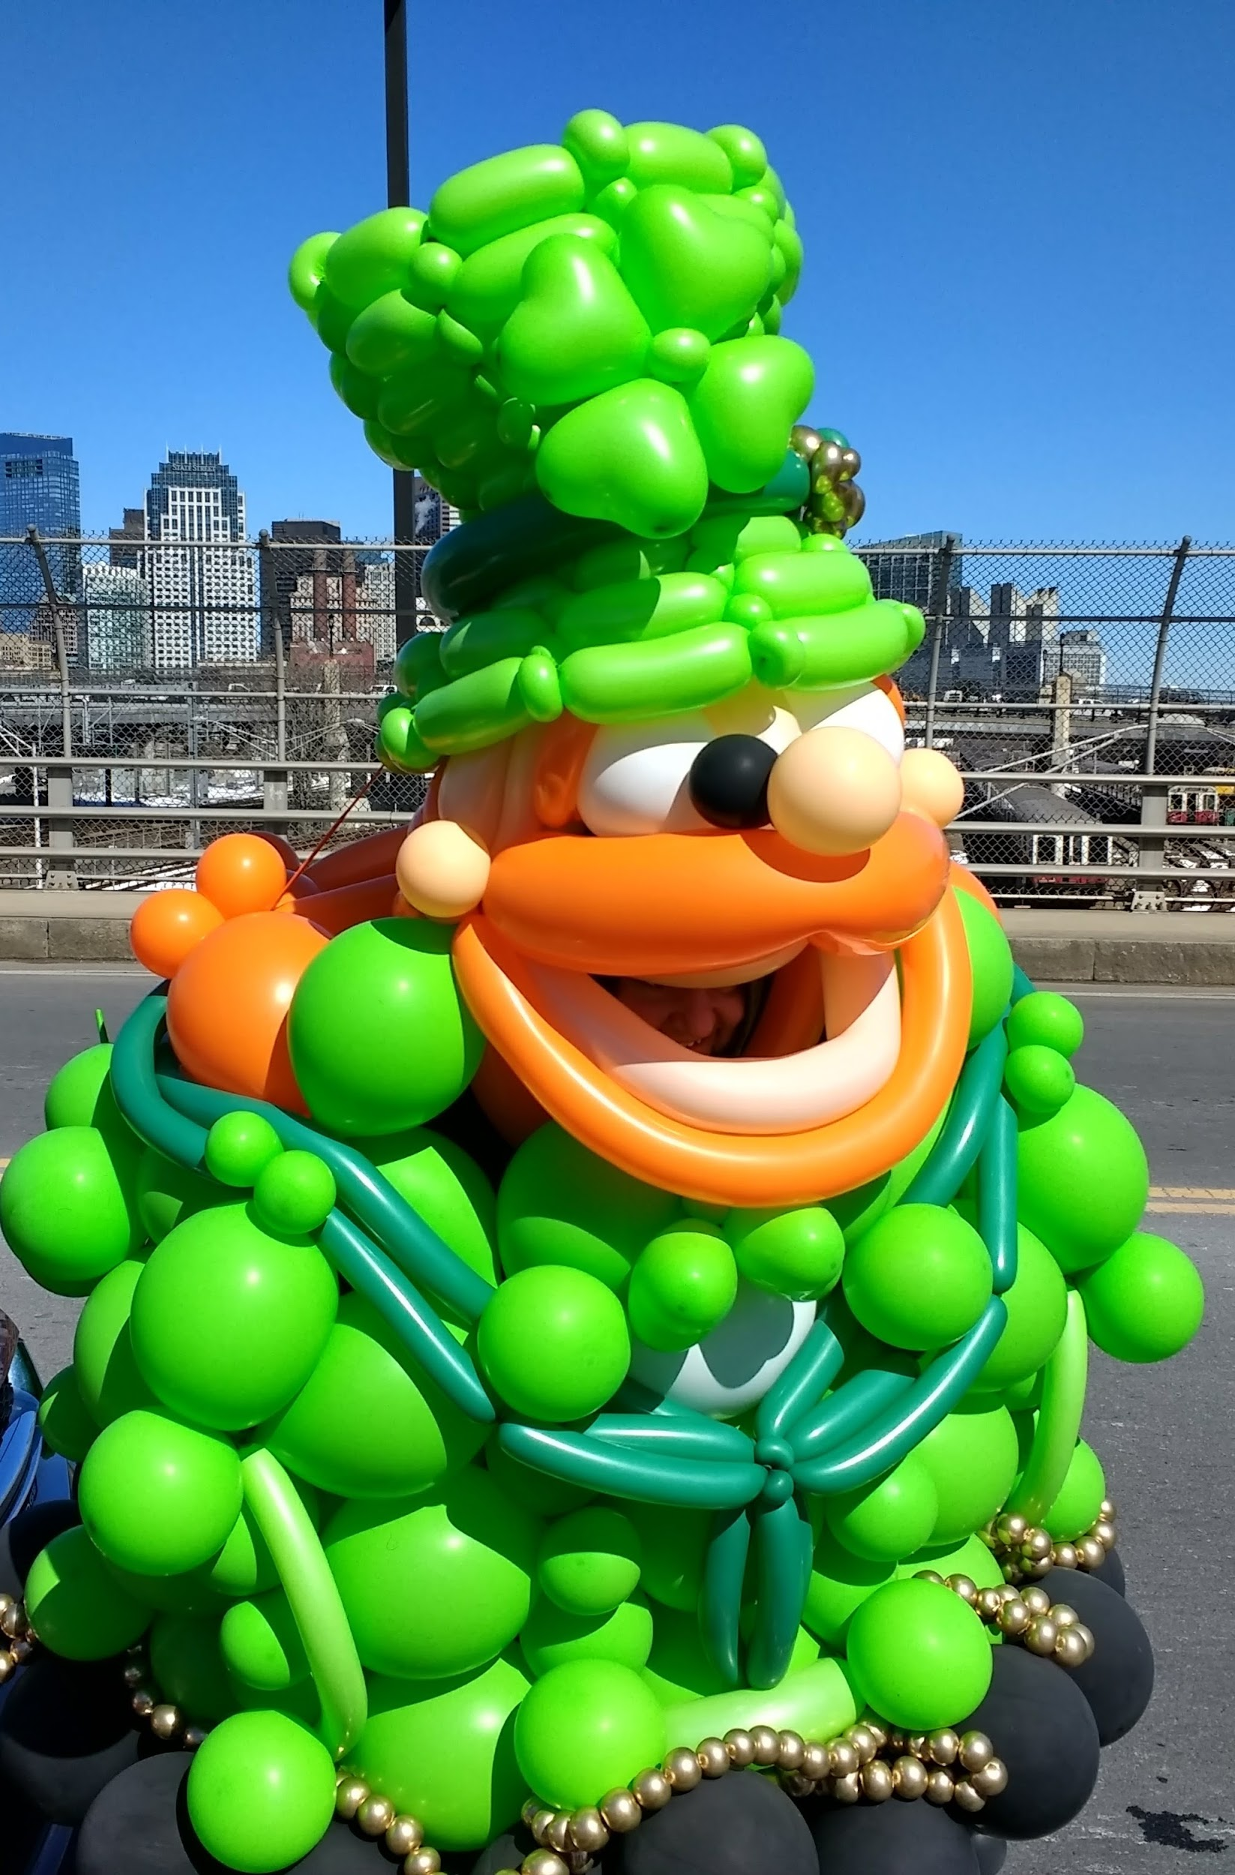

Slide 16
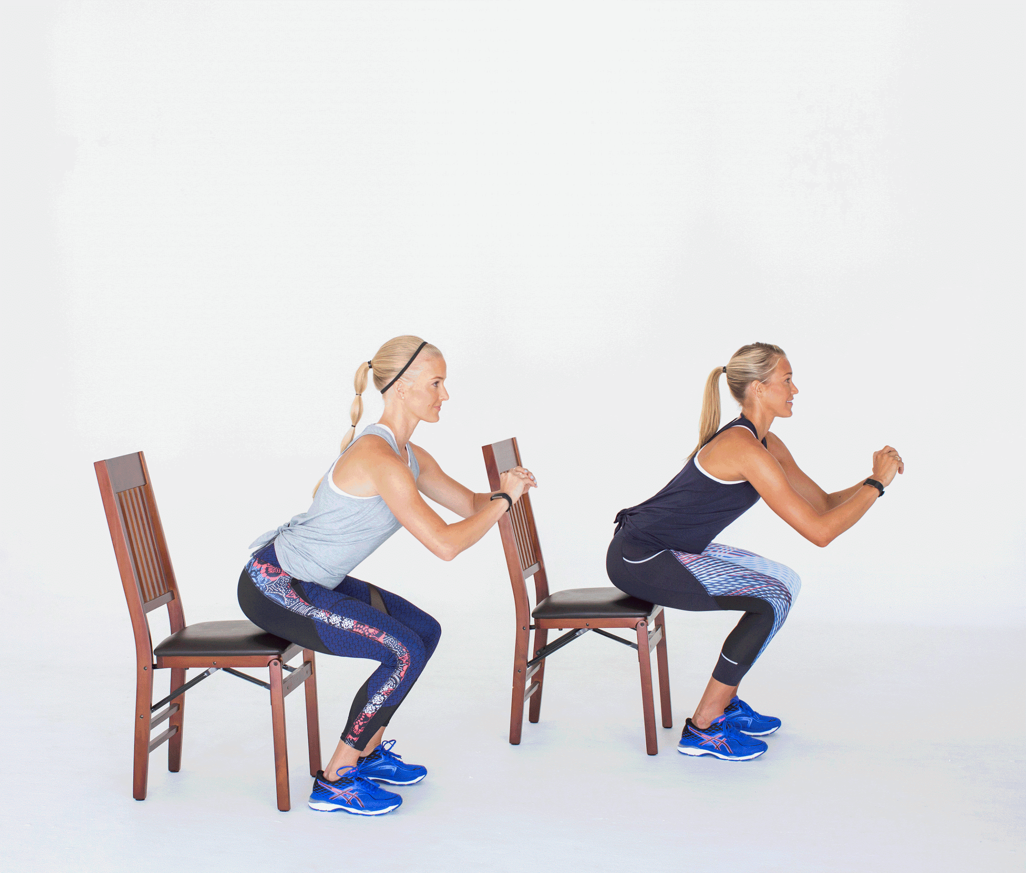
=SIT SQUAT JUMP

Slide 17
Round 5
=SIT SQUAT JUMP

Slide 18
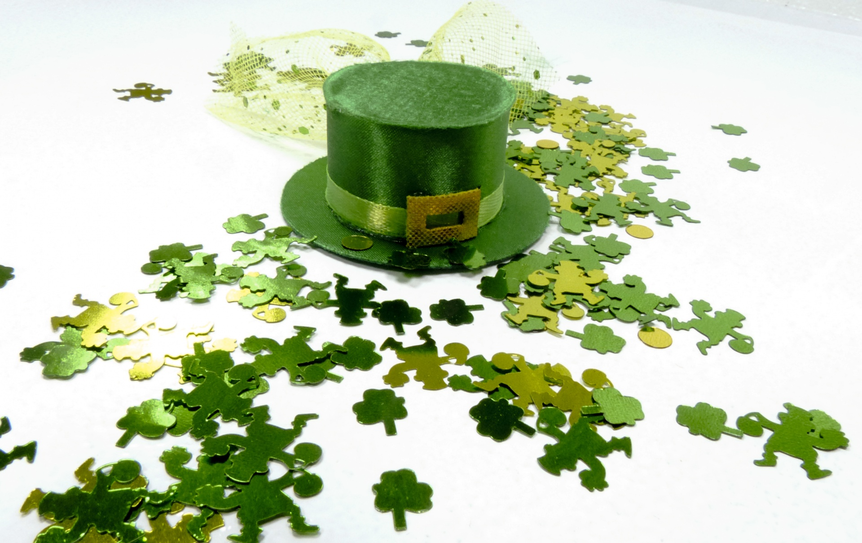

Slide 19
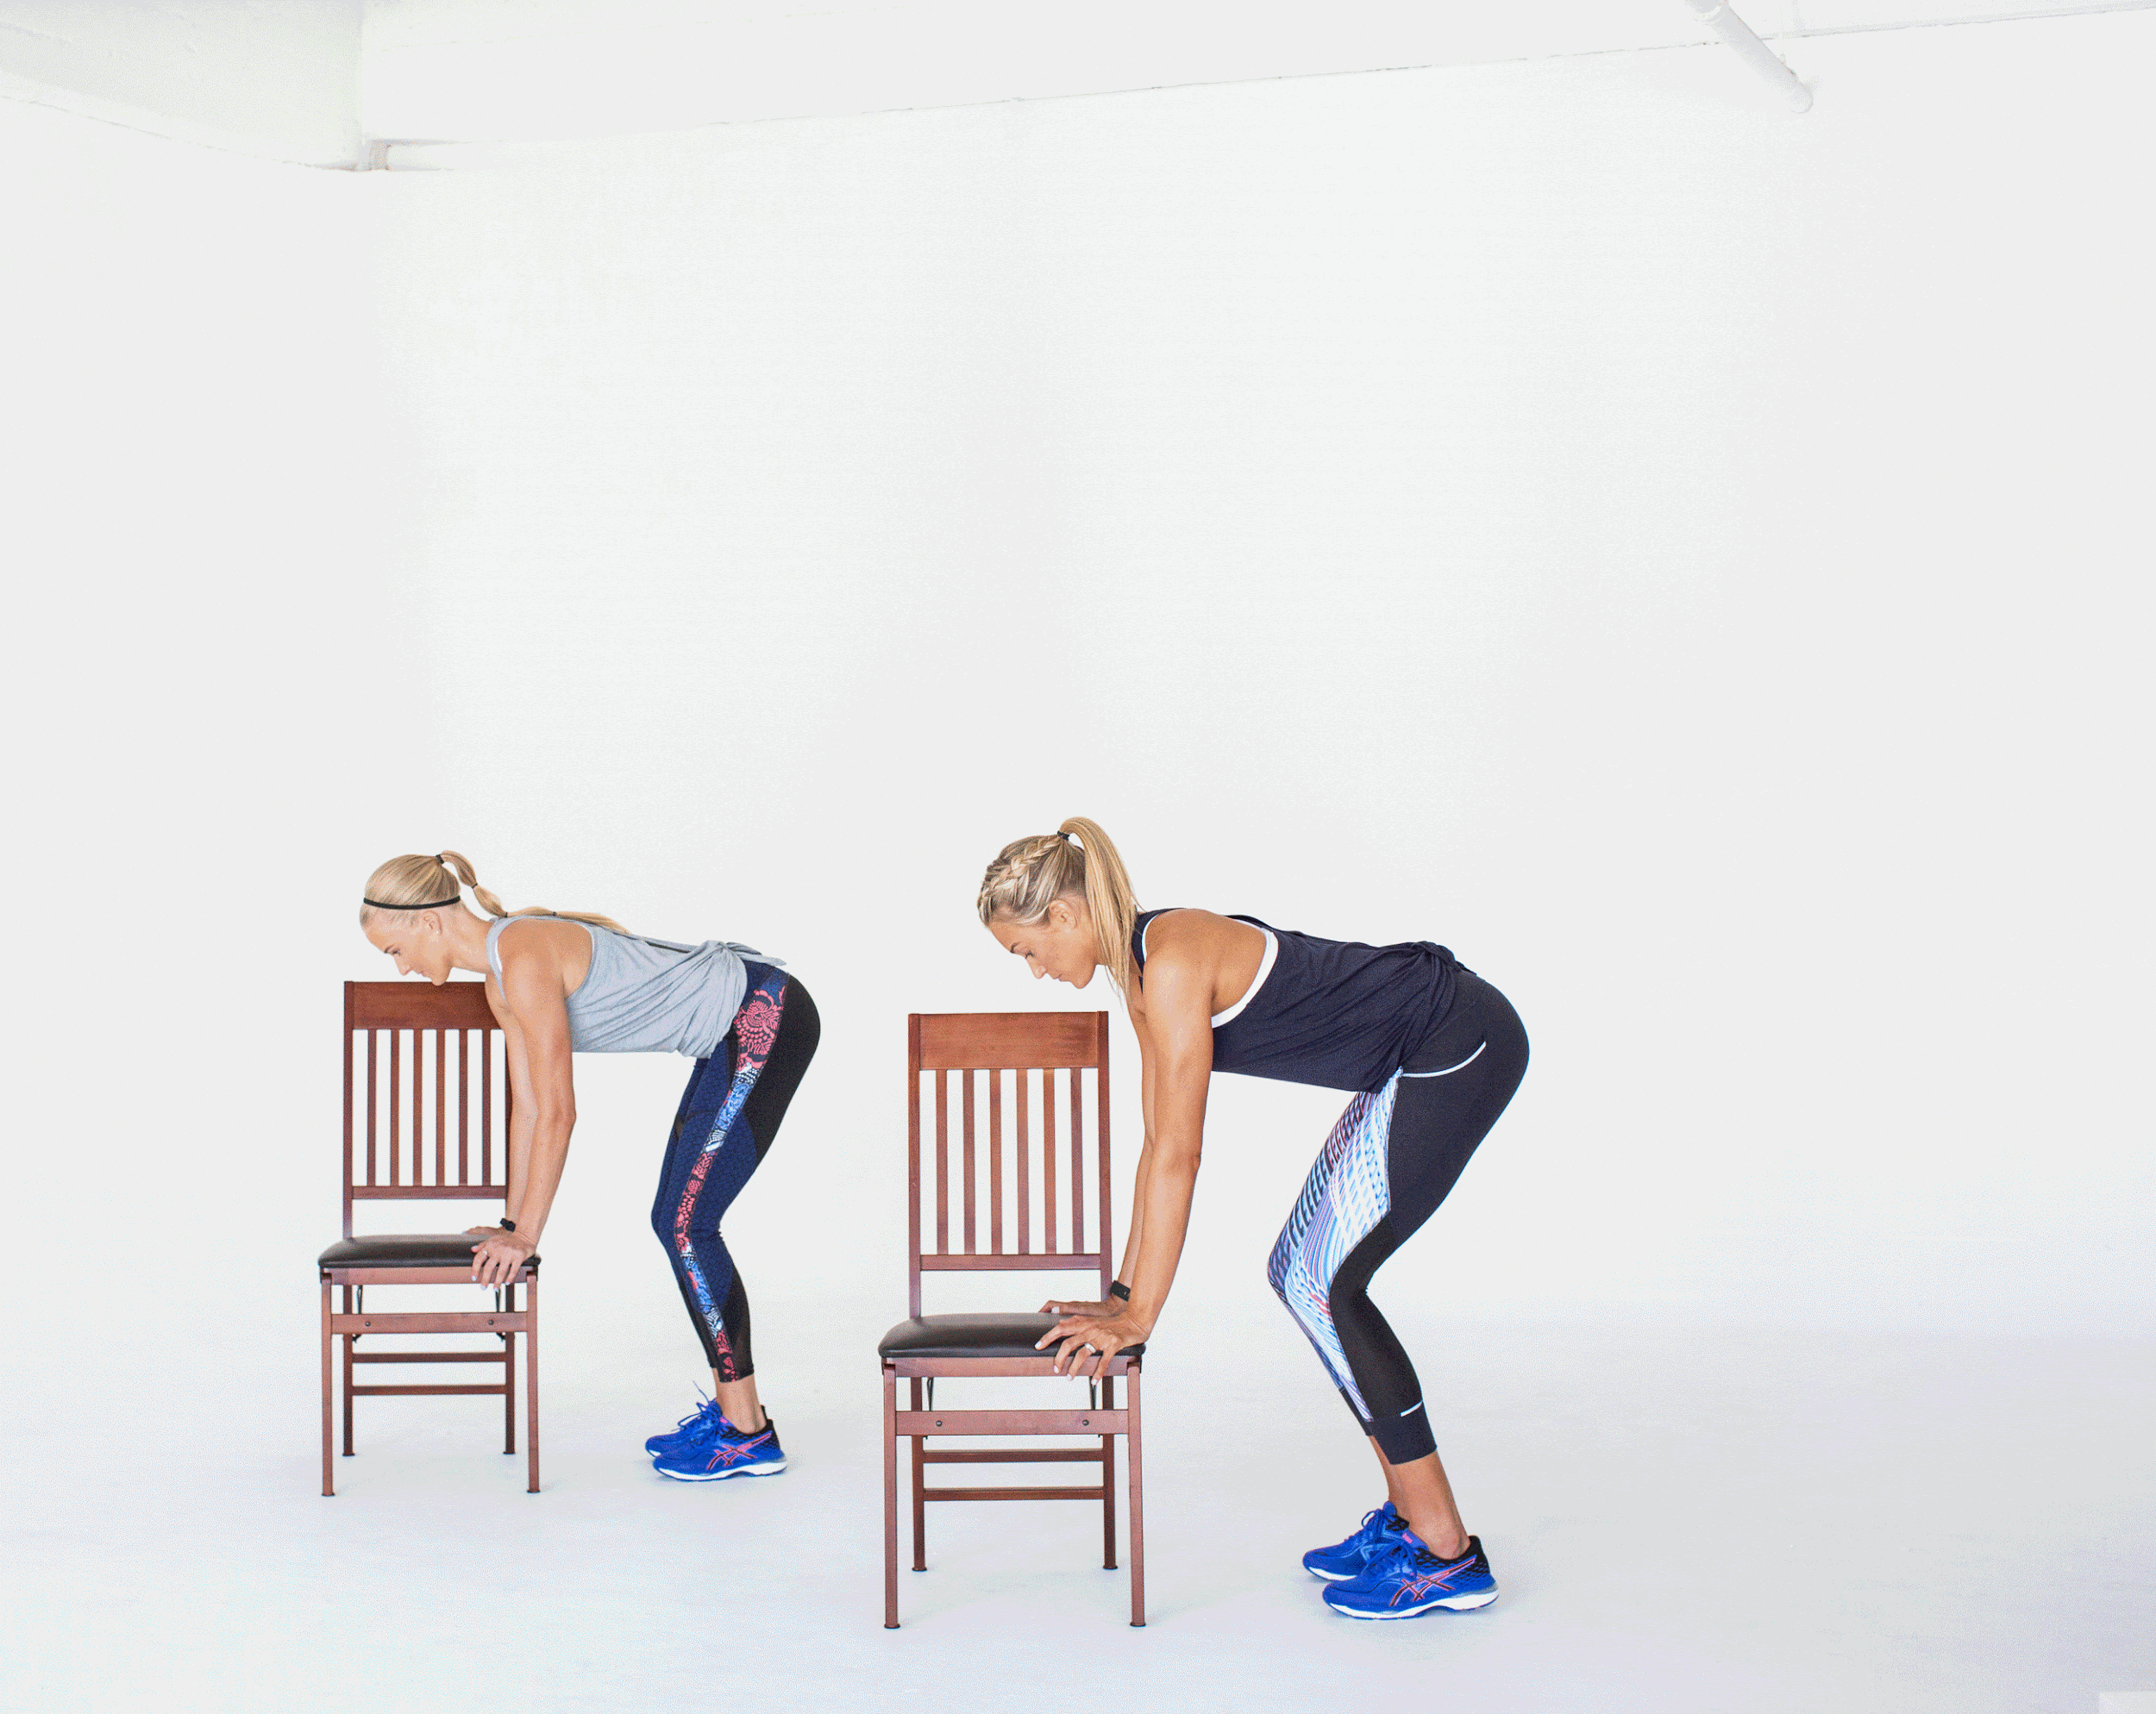
=CHAIR BURPEES

Slide 20
Round 6
=CHAIR BURPEES

Slide 21


Slide 22
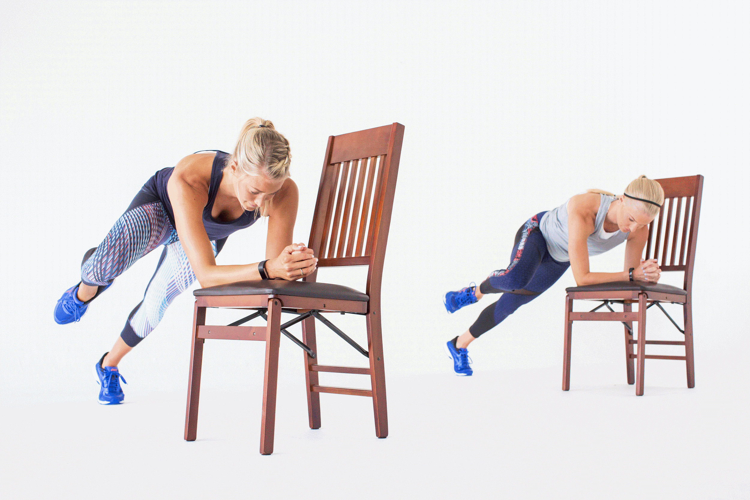
=INCLINE HOVER HIGH KNEES

Slide 23

Round 7
=INCLINE HOVER HIGH KNEES

Slide 24


Slide 25
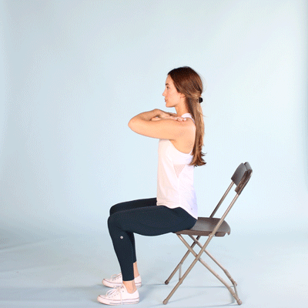
= CHAIR SQUATS

Slide 26
Round 8
= CHAIR SQUATS

Slide 27
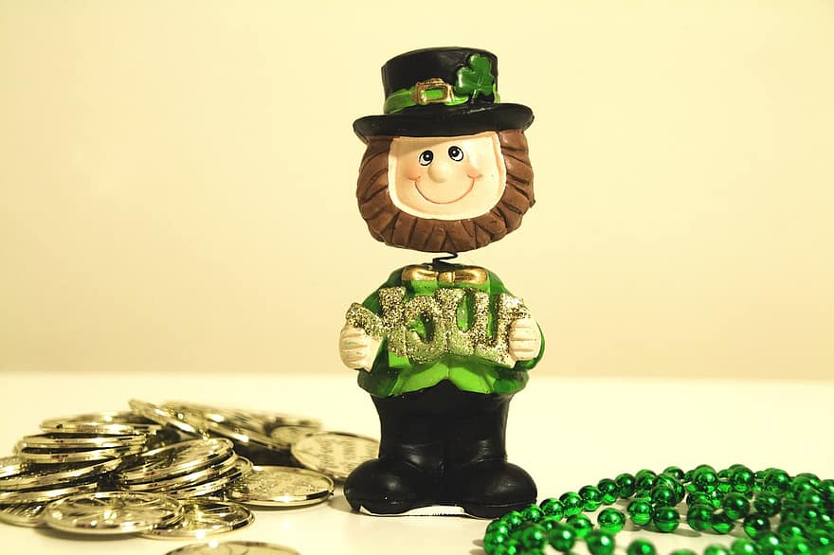

Slide 28
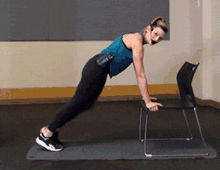
=INCLINE MOUNTAIN CLIMBERS

Slide 29
Round 9
=INCLINE MOUNTAIN CLIMBERS

Slide 30


Slide 31
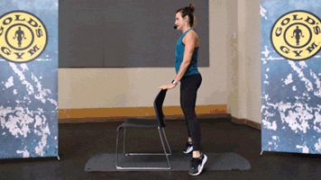
=SQUAT CALF RAISES

Slide 32
Round 10
=SQUAT CALF RAISES

Slide 33


Slide 34
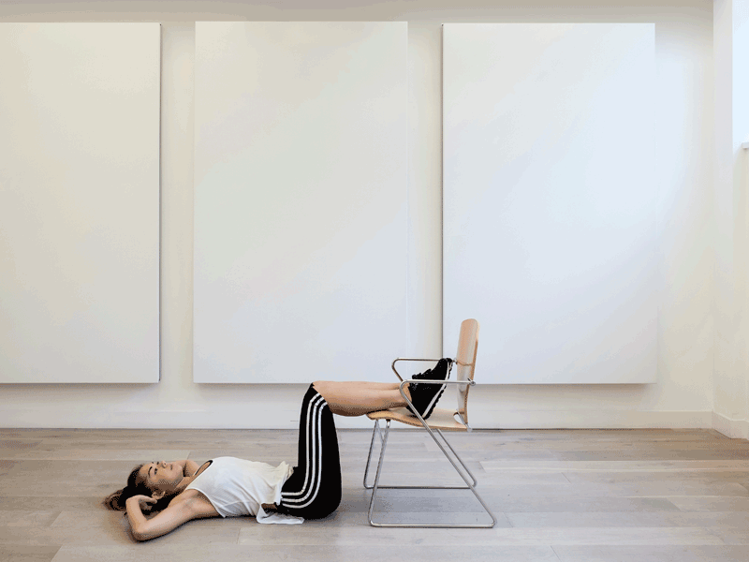
=CHAIR CRUNCHES

Slide 35
Round 11
=CHAIR CRUNCHES

Slide 36


Slide 37
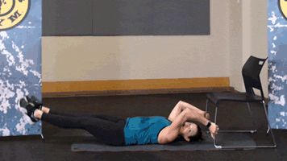
= LEG RAISES

Slide 38
Round 12
= LEG RAISES

Slide 39
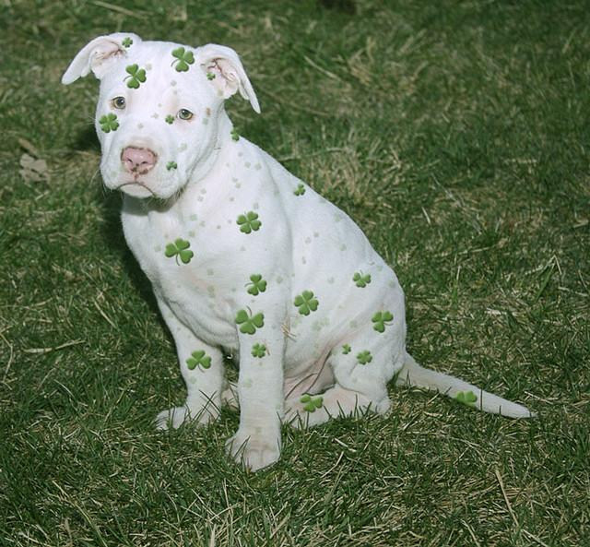
Cool- down #1
Heart cool-down: walk around until breathing is normal

Slide 40
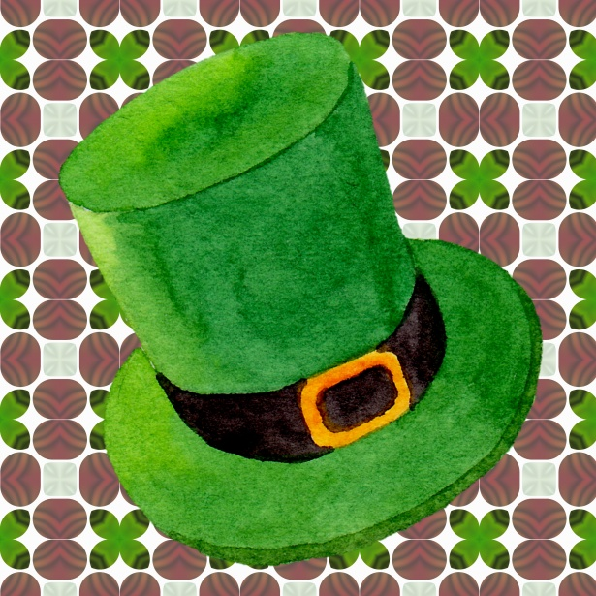
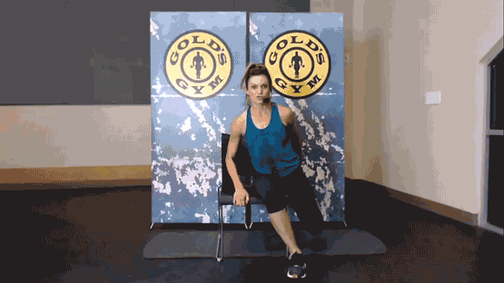
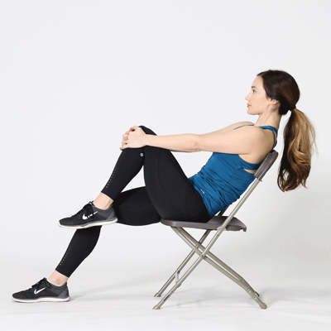
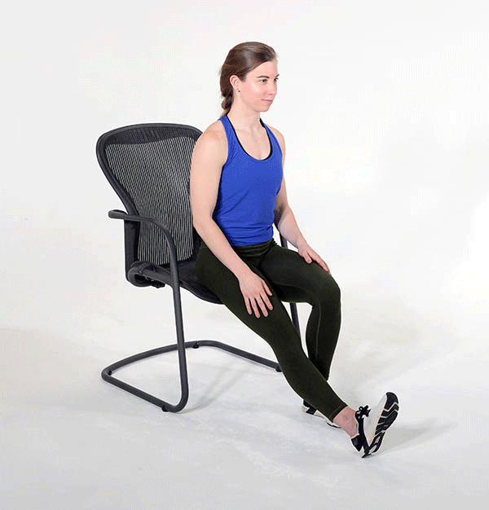
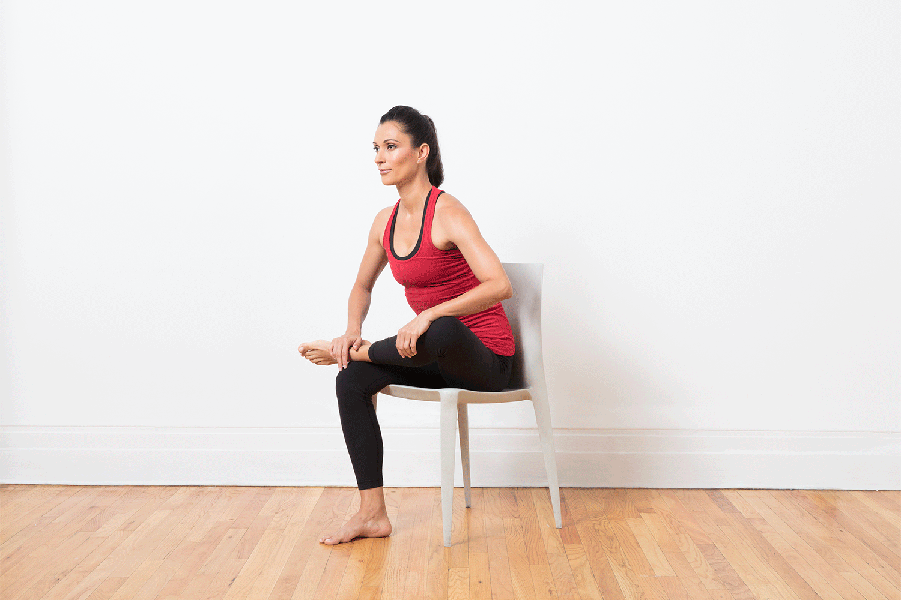
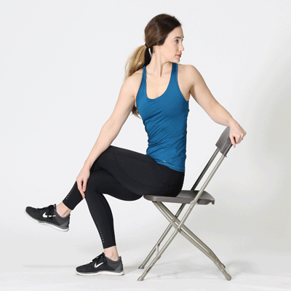
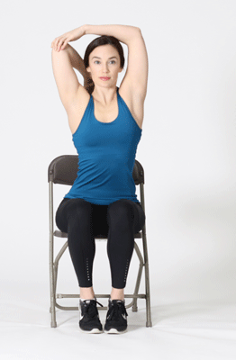
Cool- down #2
Muscle cool-down: Stretches

