Slide 1
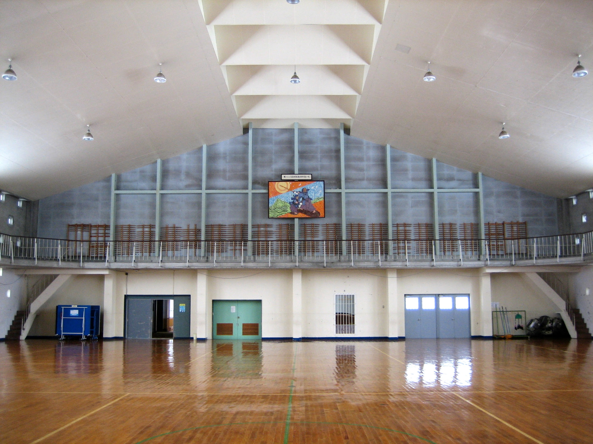

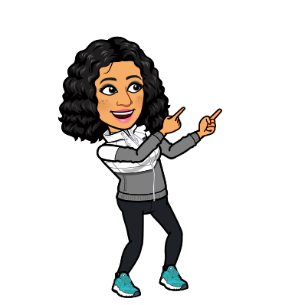

Today, I have 2 spin wheel workouts for you!
The 2 spin wheels next to me are linked to 2 different exercises. The 1st, is a scavenger hunt where you will go find the items that it lands on. The 2nd, are locomotor movements you can perform. Please feel free to spin again if it lands on something you do not feel comfortable doing.
Have Fun!

