Slide 1


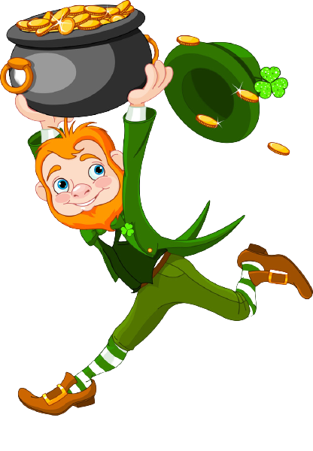

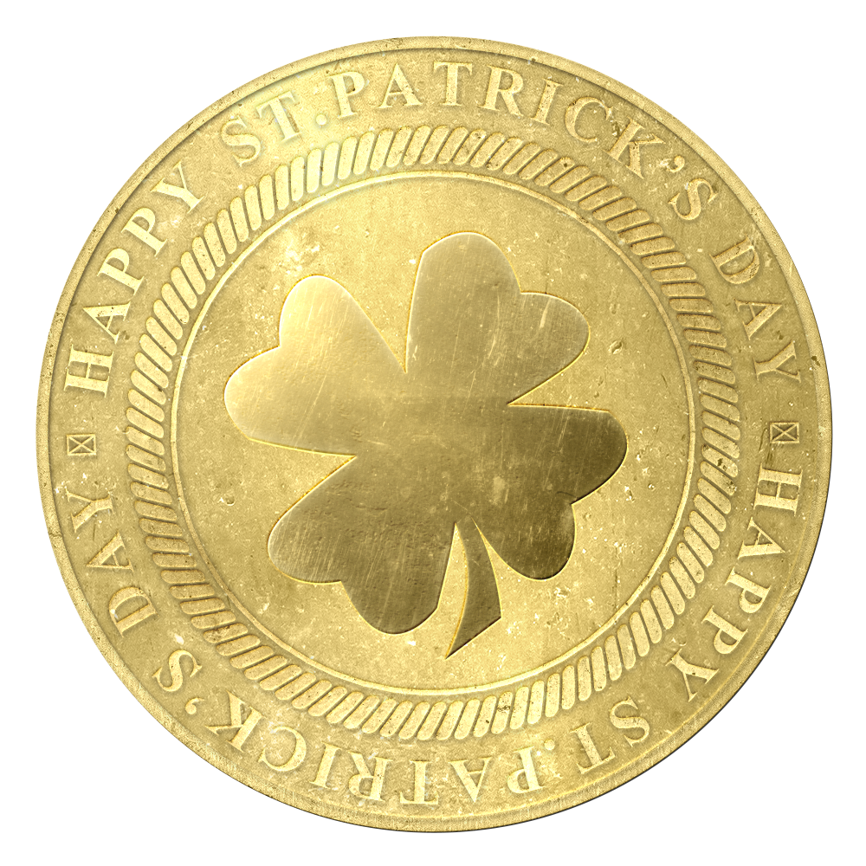
Hello! Happy St. Patrick’s Day! Can you help me catch the leprechaun? Collect a gold coin each time you answer a question correctly. Collect all the coins and you will catch the leprechaun! Good luck!
Click “Present” to begin.
Run, run as fast as you’re told, You can’t catch me and my pot of Gold

Slide 2

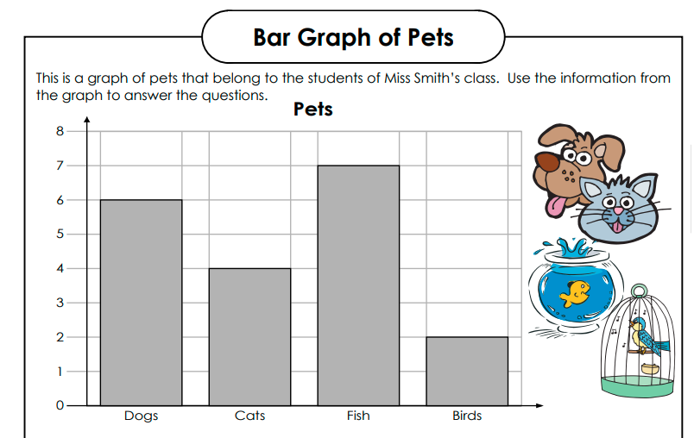
Bar Graph
How many students have birds AND Fish as pets?
9 students
7 students
8 students

Slide 3
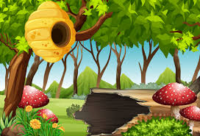

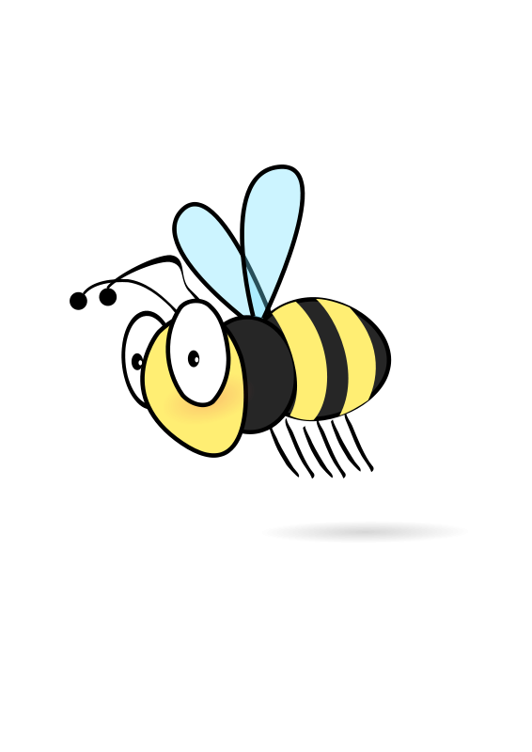

Oh no! No gold coins here, just some angry bees. Go back and try again!
Try again!

Slide 4




Yayyy! What luck! You got the correct answer. You have collected your first gold coin!

Slide 5
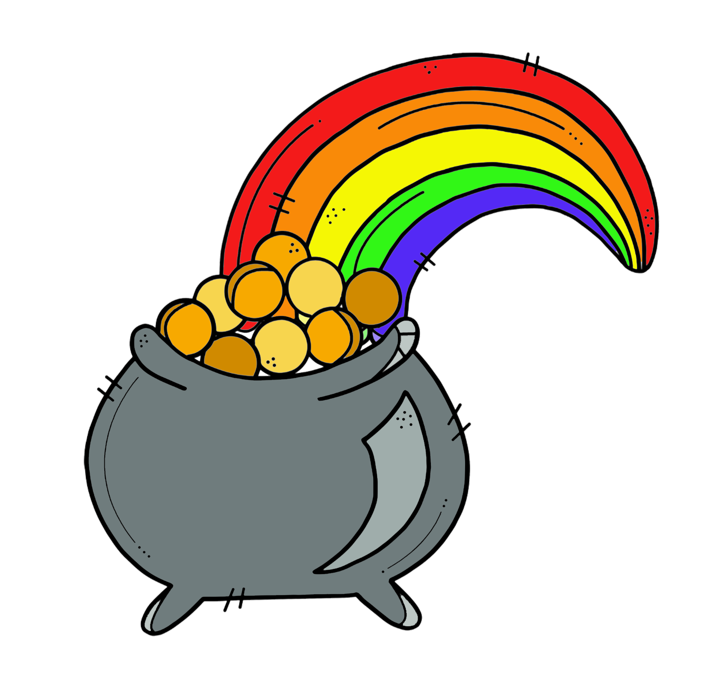
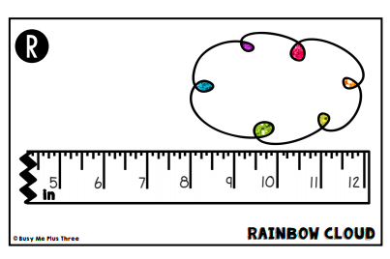
Broken Ruler
How long is the rainbow cloud?
12 inches
4 inches
8 inches

Slide 6
Oh no! No gold coins here, just some angry bees. Go back and try again!
Try again!

Slide 7
Yayyy! What luck! You got the correct answer. You have collected another gold coin!

Slide 8
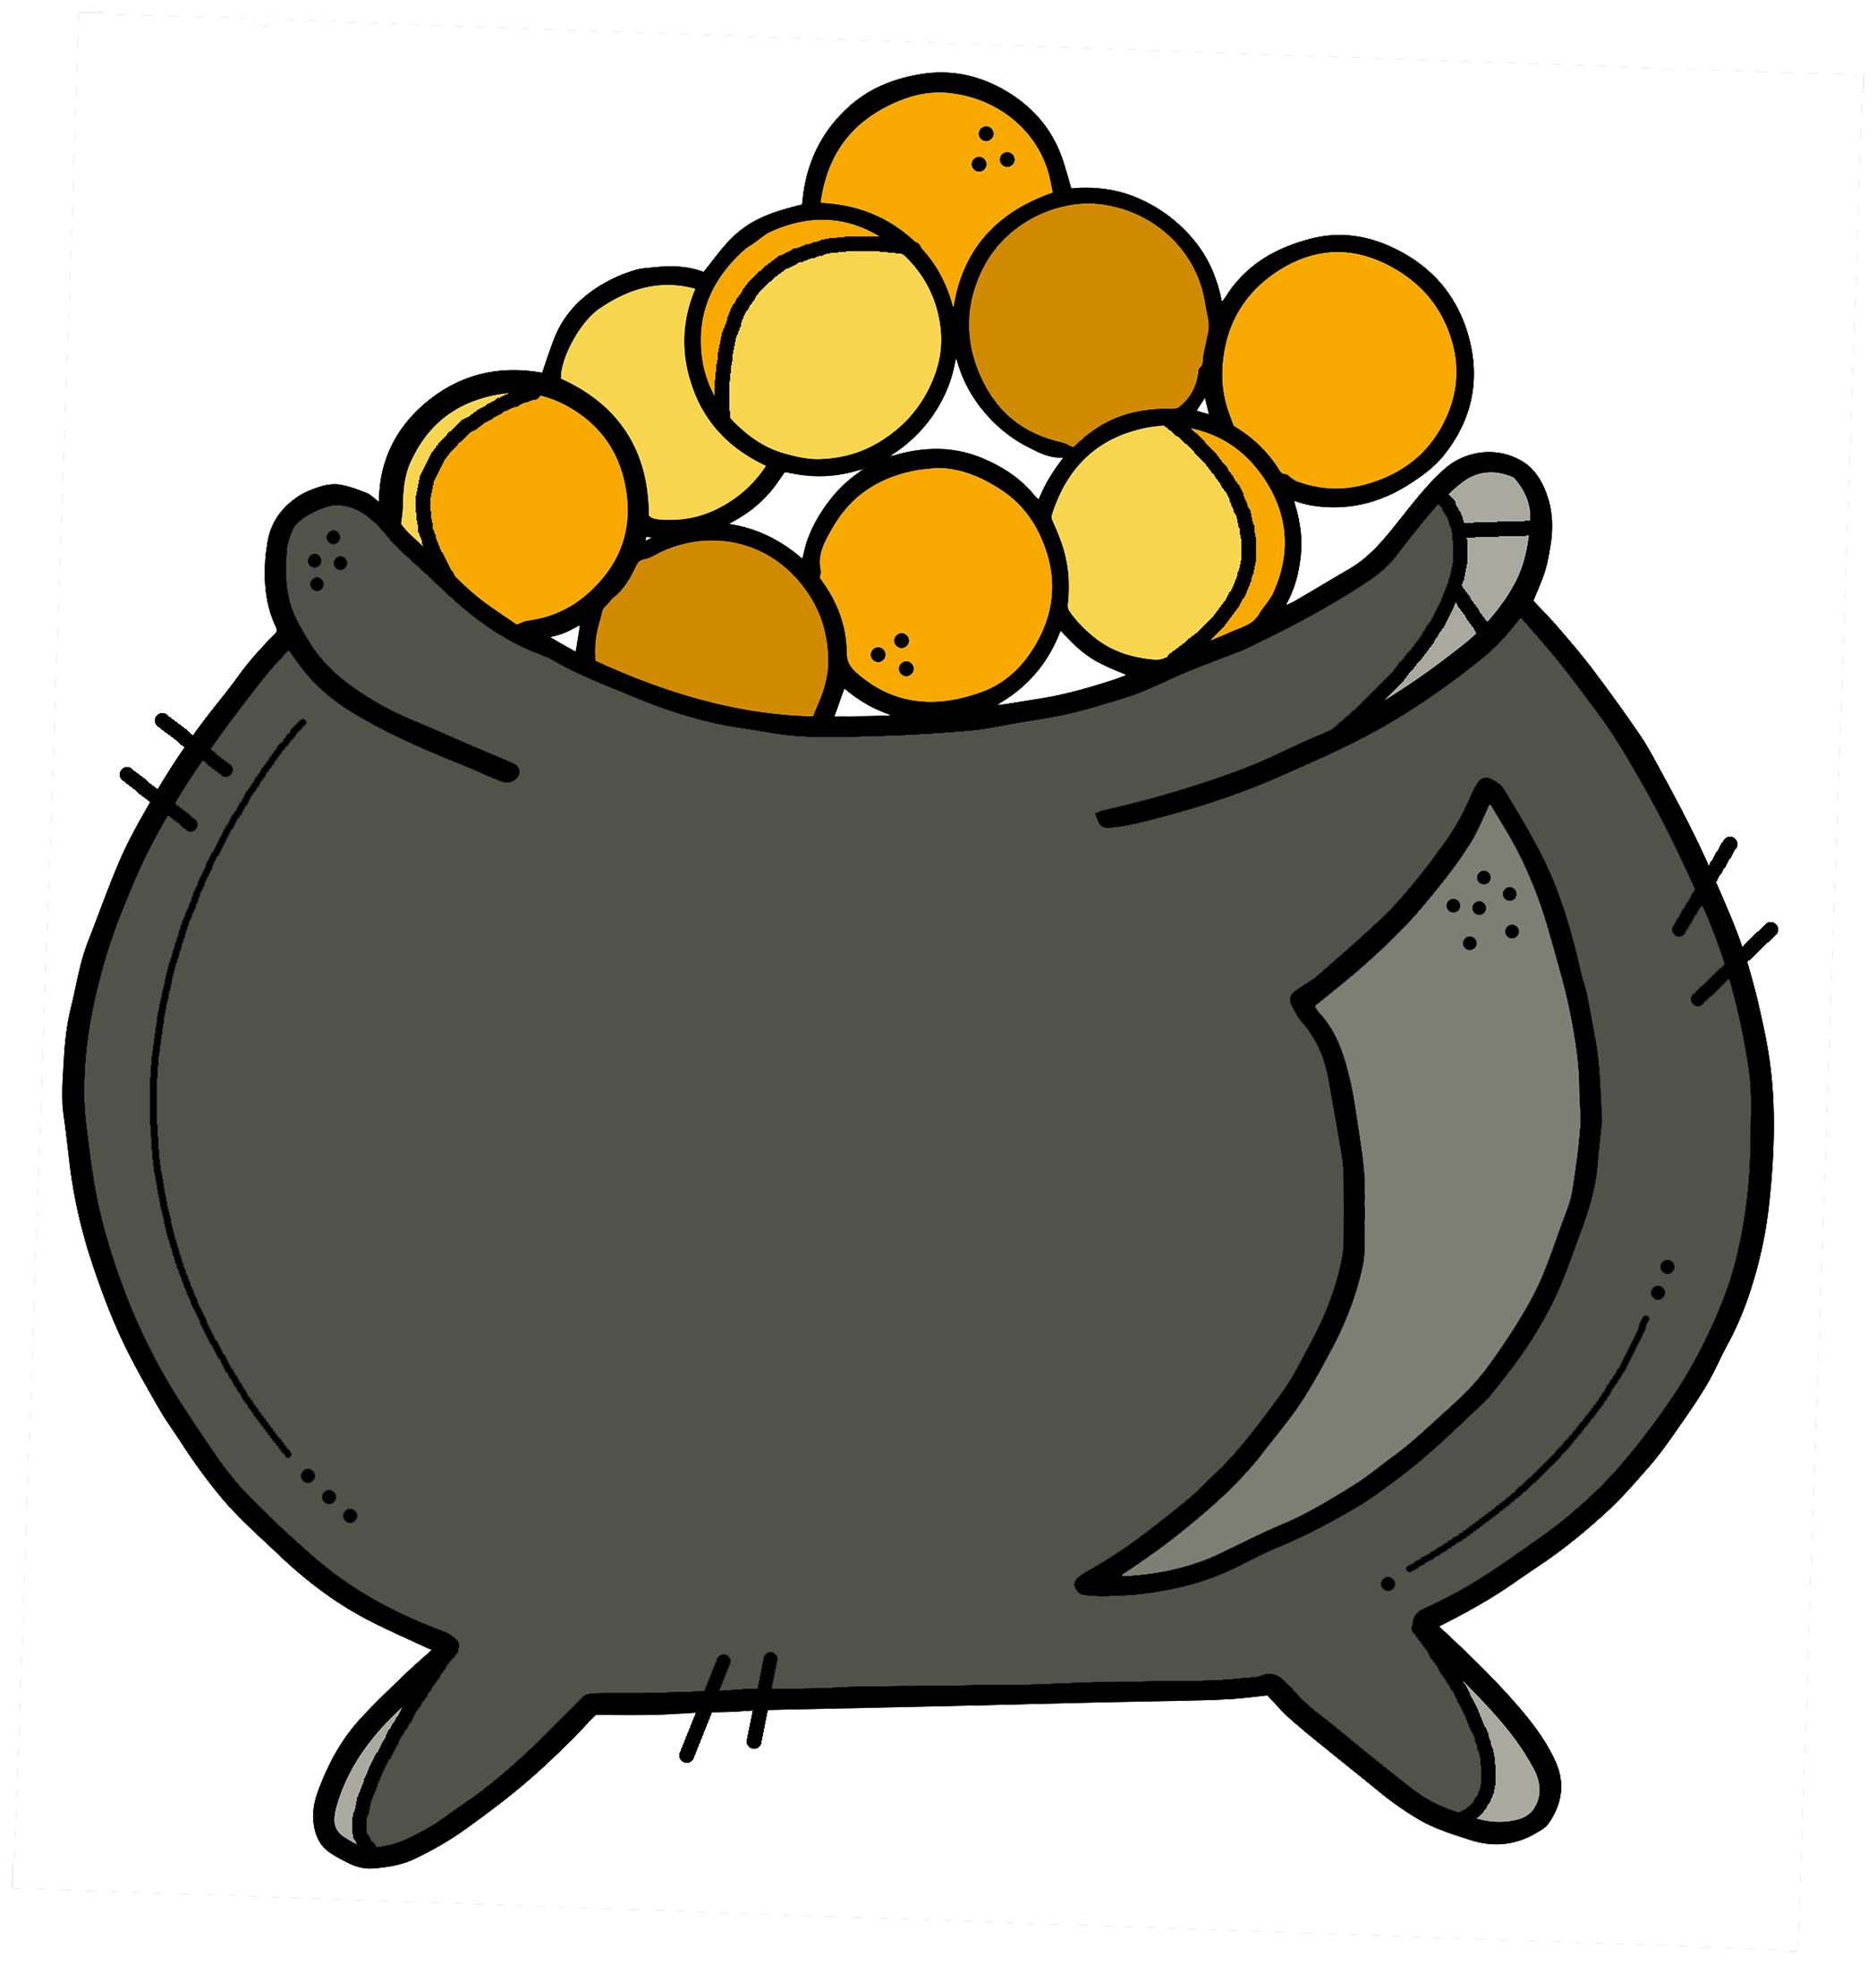
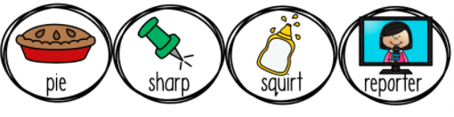
Nouns
Which ones are nouns?
pie & sharp
sharp & squirt
pie and reporter

Slide 9
Oh no! No gold coins here, just some angry bees. Go back and try again!
Try again!

Slide 10
Yayyy! What luck! You got the correct answer. You have collected another gold coin!

Slide 11


Tally Marks
Tally Marks
8
9
7
6
How many do the tally marks indicate?

Slide 12
Oh no! No gold coins here, just some angry bees. Go back and try again!
Try again!

Slide 13
Yayyy! What luck! You got the correct answer. You have collected another gold coin!

Slide 14
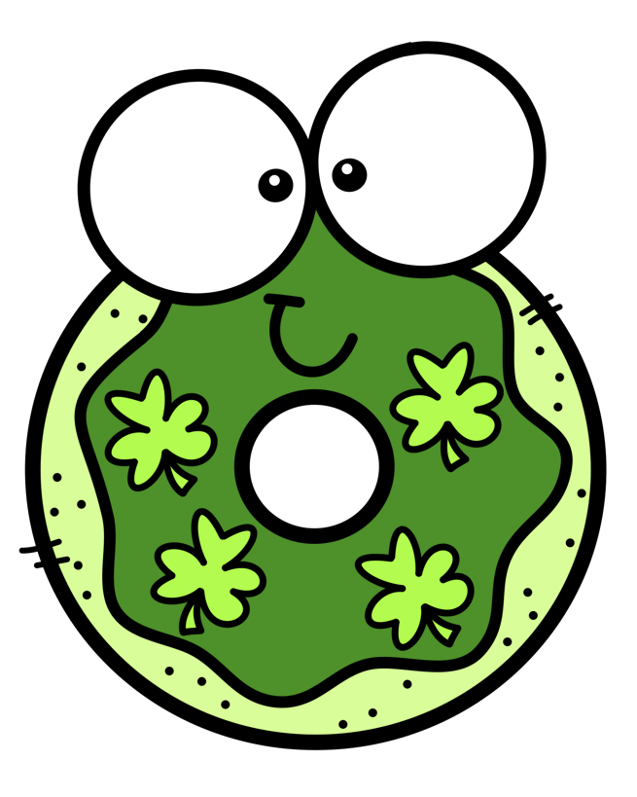



Pictographs
Favorite Doughnuts
How many more people were surveyed for this graph?
13
10
8

Slide 15
Oh no! No gold coins here, just some angry bees. Go back and try again!
Try again!

Slide 16
Yayyy! What luck! You got the correct answer. You have collected another gold coin!

Slide 17

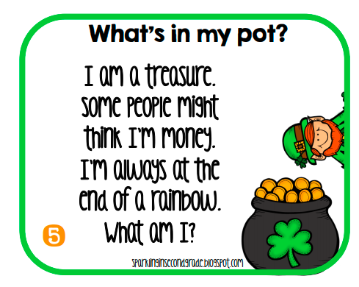
Inferencing
horseshoe
leprechaun
gold

Slide 18
Oh no! No gold coins here, just some angry bees. Go back and try again!
Try again!

Slide 19
Yayyy! What luck! You got the correct answer. You have collected another gold coin!

Slide 20
Figurative Language
What is the correct figure of speech in the sentence below? Click on the correct answer.
Simile
Metaphor
The gold in the pot sparkled like diamonds in the sun.
Personification
Alliteration
Onomatopoeia

Slide 21
Oh no! No gold coins here, just some angry bees. Go back and try again!
Try again!

Slide 22
Yayyy! What luck! You got the correct answer. You have collected another gold coin!

Slide 23


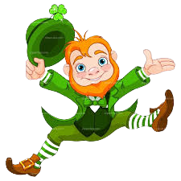

You did it! Congratulations! You collected all the gold coins! Let’s dance! Click me to celebrate! Then click NEXT!

Slide 24

Type the phrase, “Rock it like a shamrock” in the private comment and receive a homework pass for one assignment! No assessments or graded work though!
Click NEXT for some more fun!
Rock it like a SHAMROCK!

Slide 25
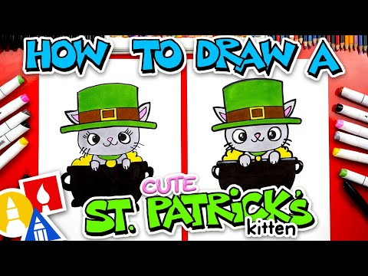



St. Patrick’s Day Fun

