Slide 1
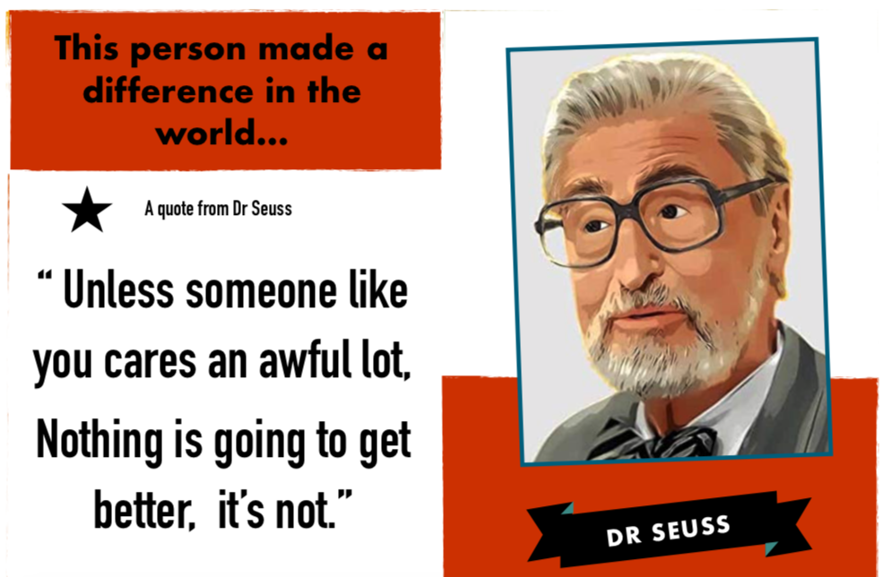
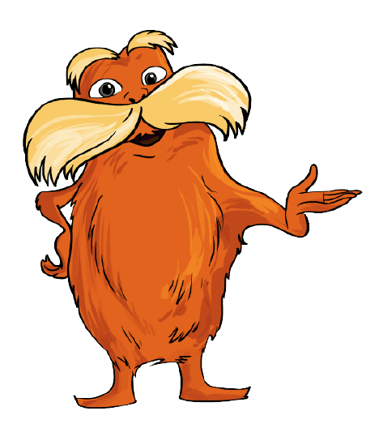

Poet
Author
Illustrator
Environmentalist
Mr Lecours as The Lorax

Slide 2
