Slide 1


Shamrock
Spelling

Slide 2
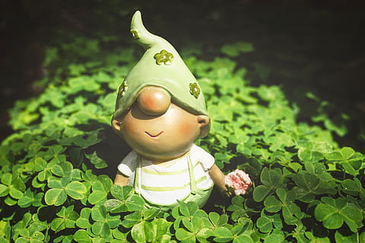
The leprechauns need your help to spell our spelling words this week!
Help them by dragging the correct letter shamrocks on to the pot of gold.

Slide 3
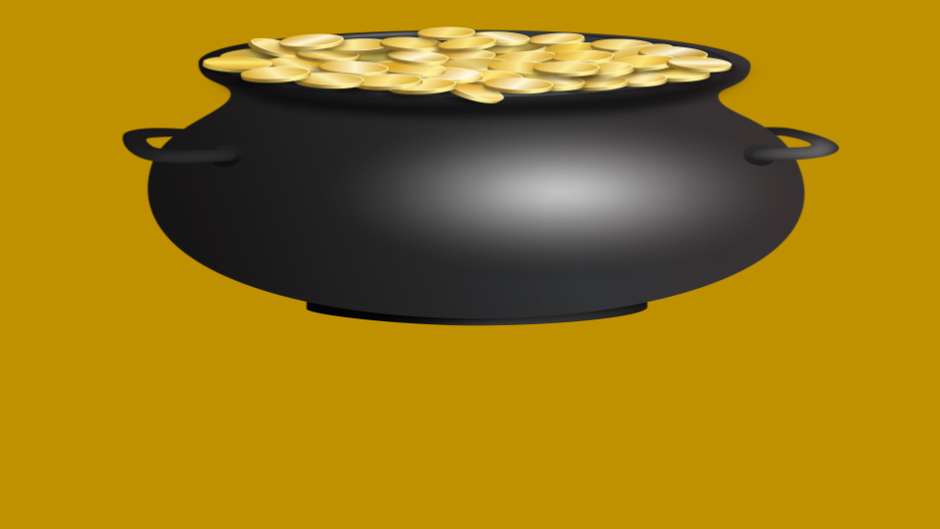


























word
Drag the letters below to spell the word in the white box.
a

Slide 4
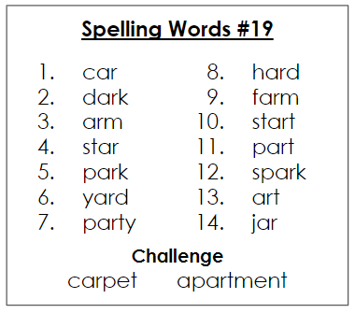
car
a

Slide 5
dark
a

Slide 6
arm
a

Slide 7
star
a

Slide 8
park
a

Slide 9
arm
a

Slide 10
party
a

Slide 11
hard
a

Slide 12
farm
a

Slide 13
start
a

Slide 14
park
a

Slide 15
spark
a

Slide 16
art
a

Slide 17
jar
a

Slide 18
carpet
a

Slide 19
apartment
a

Slide 21
Master Letters
a
Notes:
Master letters

Slide 22

Master Background
Notes:
Master background

