Slide 1

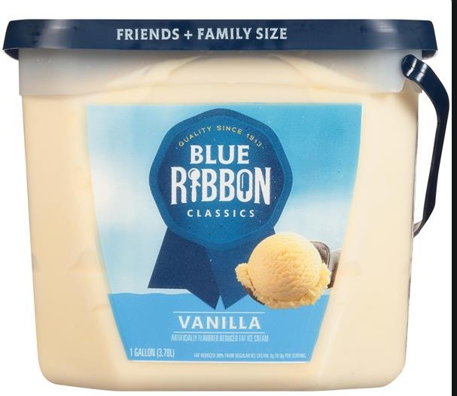
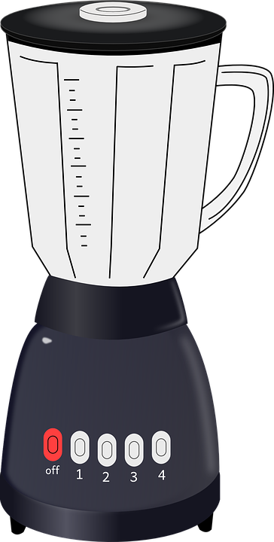
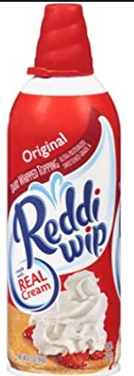
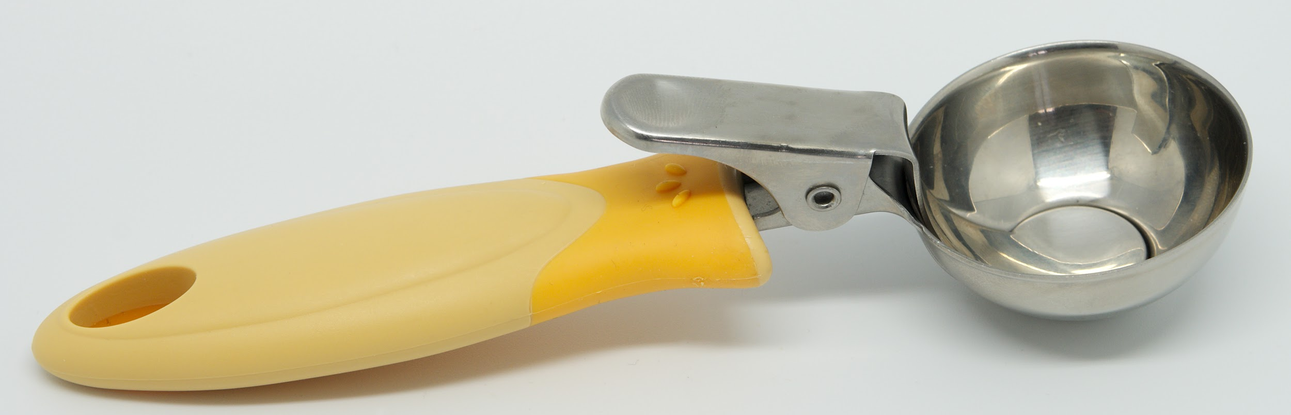

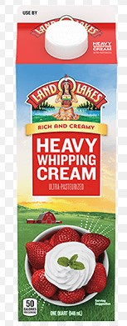
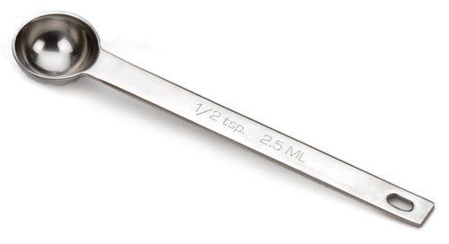
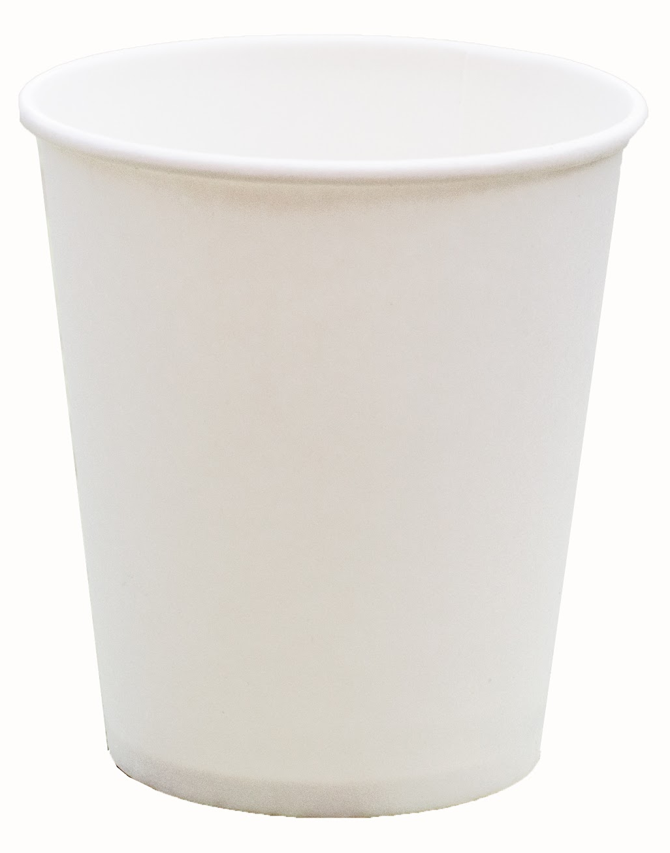
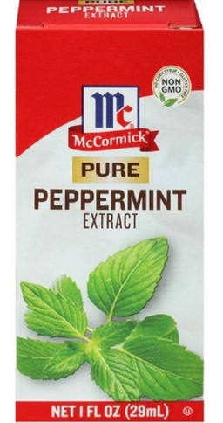
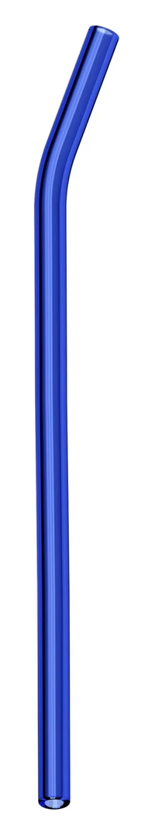
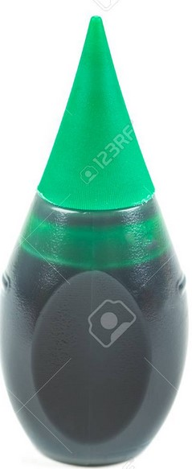
Shamrock Shake
Food items Cooking items
Vanilla Ice cream
Whip Cream
Heavy whipping cream
Peppermint Extract
Green food coloring
Blender
Ice cream scoop
¼ measuring cup
½ teaspoon
Cup
Straw

Slide 2
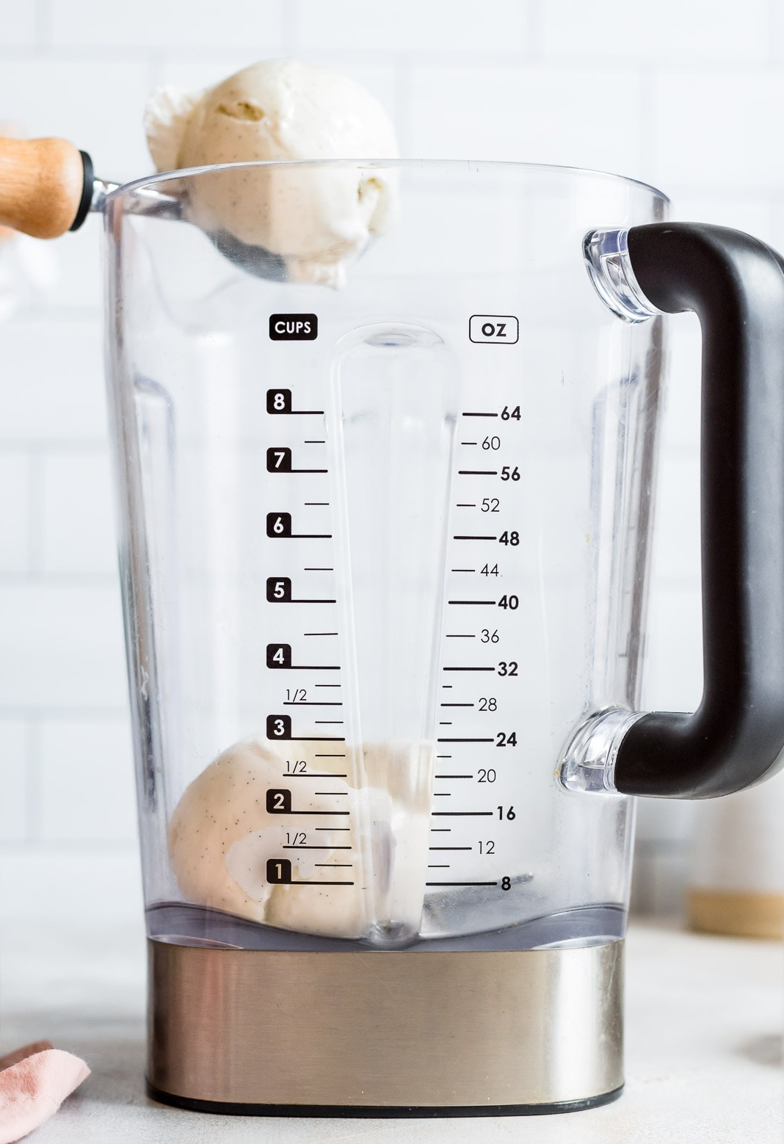
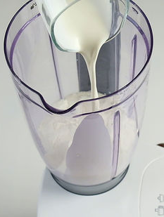
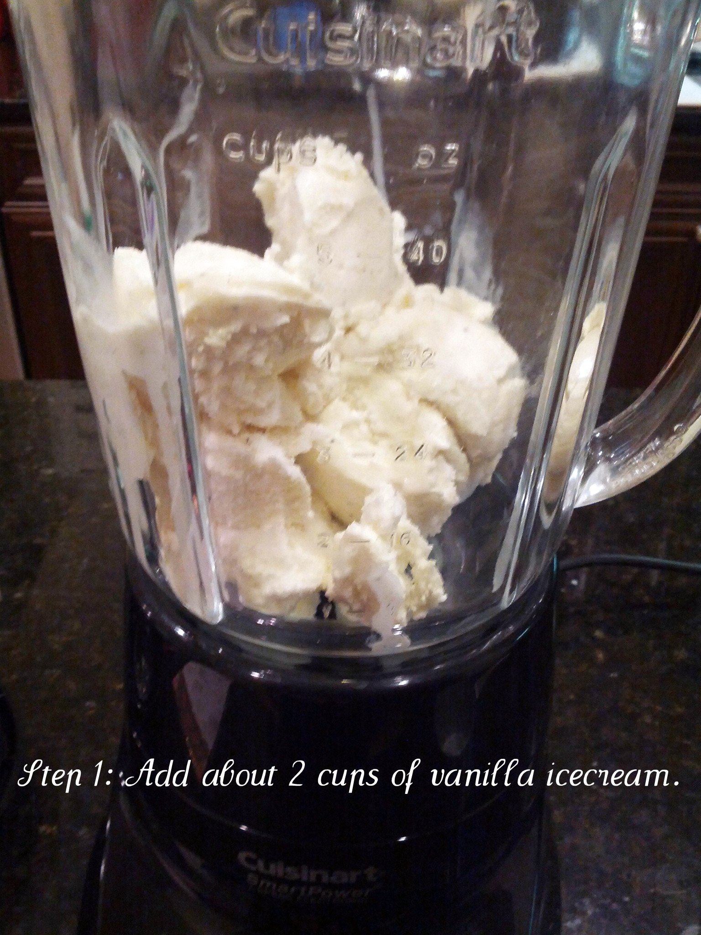
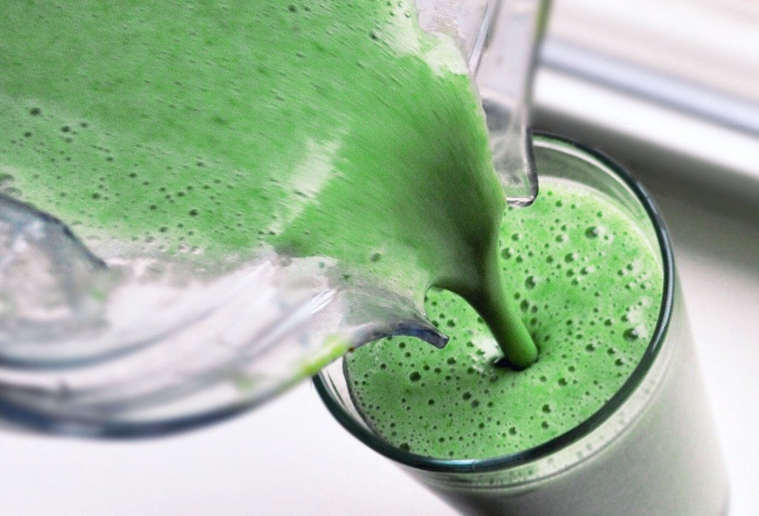
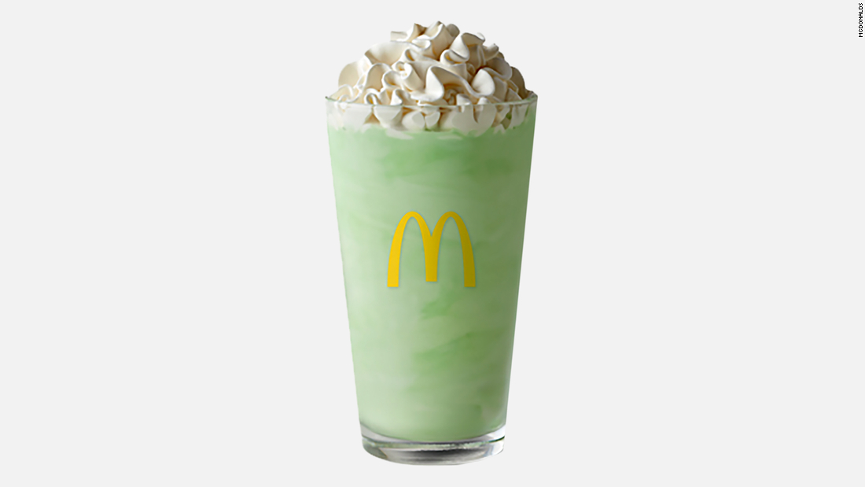
Shamrock Shake
In a blender add 3 scoops of vanilla ice cream.
Add ¼ cup of heavy whipping cream.
Add ½ teaspoon of peppermint extract.
Then add 6 drops of green food coloring.
Mix on high until completely smooth, then pour into a glass.
Top with whipped cream, add a straw and drink. Enjoy!

