Slide 1


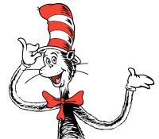









Here’s a fun thing! Say, a really fun thing!
All you need are 2 dice, and a nice writing thing!
Roll one of the die and follow along,
To start your own poem, I won’t steer you wrong!
Spin the other for the word you should rhyme,
You can always add others, if you have time!
That’s all! It’s easy, now you can start,
Don’t think too hard, just write from your heart!
Roll the first die to write a rhyming couplet poem about:
Roll the second die to use words that rhyme with:
The last thing you ate
the colour of your shirt
Something that you are wearing
your favourite animal
The item to your left right now
a snack food
The item you are writing with
Something you find in a kitchen
The first thing you see when you look outside
the colour of your pants
The last thing you had to drink
Something that makes you happy
Try once try twice even try three
Put it together to make poetry
Let’s see how you do a couplet (a nice rhyming pair)
It will be so nice to see what you share!

