Slide 1





































Robert Munsch

Slide 2



























Robert Munsch

Slide 3
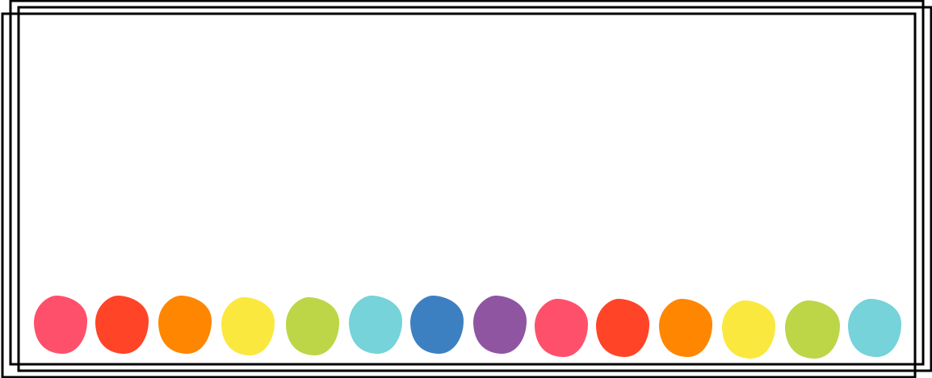
Looking for more libraries?
Check out my linktree....
https://linktr.ee/missrachelsf
Buy Me A Coffee ☕️
Vemno

