Slide 1

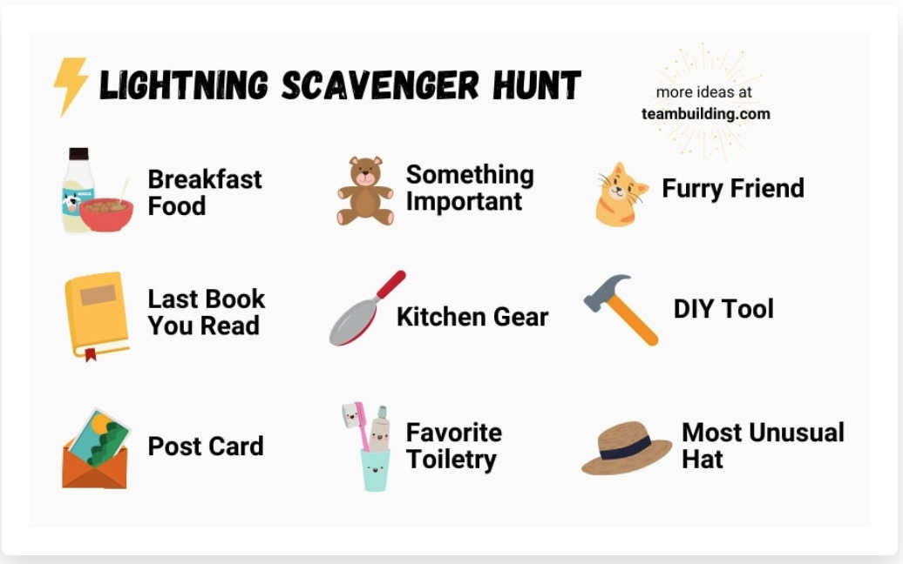
Relationship Builder
As a family, find as many of these items as you can. Bring them back to share with the group. You get one point per item.
*If you can’t find something for every category-that’s okay! Find something close!
Notes:
After giving the instructions, give families 3 minutes to work together to find as many items as possible from the list.

