Slide 1













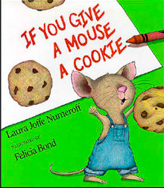





What are your favorite books?

