Slide 1

Read Across America
Creating and Celebrating a Nation of Diverse Readers
Mrs. Elsie
Notes:
*** Feel free to use in your classroom and share with educators. Please do not sell to anyone !!!

Slide 2

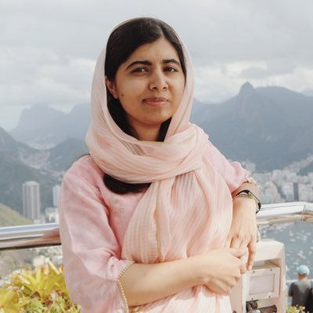

Day 1: Real Heroes take action!
Malala Yousafzai
Educational Campaigner
Notes:
Think of the heroes we’ve learned about that took action to make this world a better place OR of another real life hero you have read about. Dress like them or wear something to represent them. EXAMPLES: Frederick Douglas, Cesar Chavez, Martin Luther King Jr., Rosa Parks, Malala, Jane Goodall, Muhammed Ali, Mae Jemison, Frida Kahlo, Vice President Harris, Amanda Gorman, Ruby Bridges etc...

Slide 3
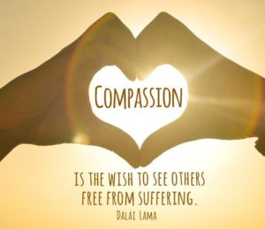
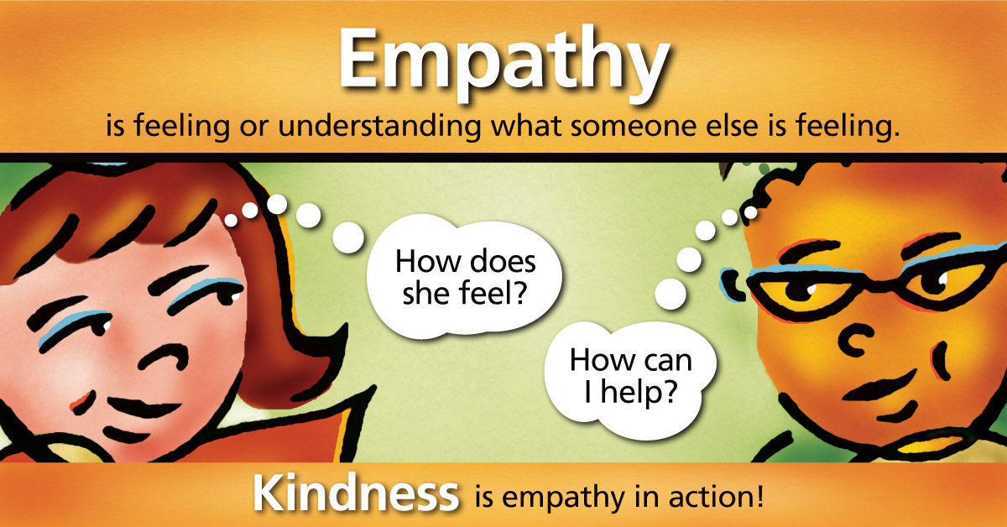
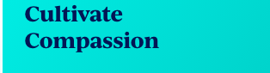

Slide 4
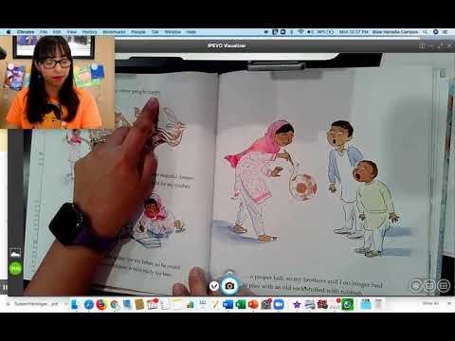

Malala’s Magic Pencil

Slide 5

What would you draw or erase if you had a magic pencil? Remember to think of others who are not as fortunate as you (homeless, sick, countries where there is war, etc…)

Slide 6

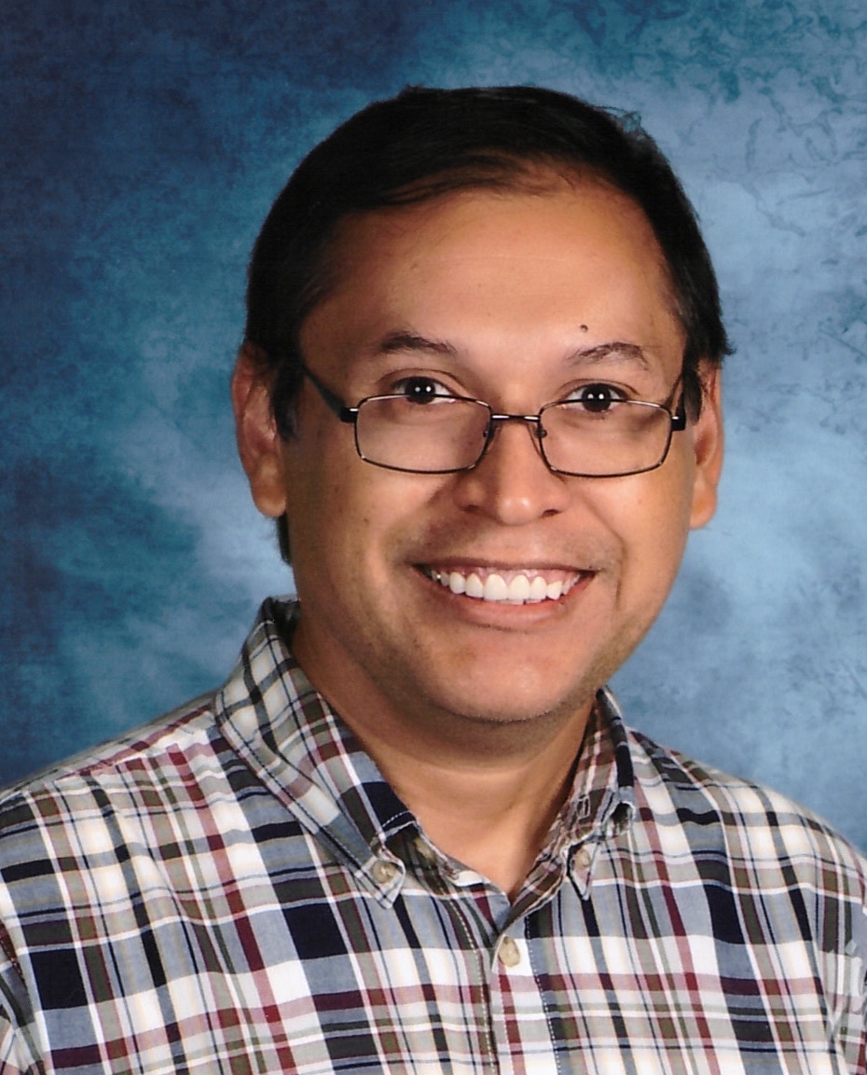

Day 2: Cultural Practices and Traditions
Rene Colato Lainez
Salvadorian Author
Notes:
Wear something that represents your family and/or culture OR bring an object that tells of a special tradition in your family/culture.

Slide 7




Slide 8
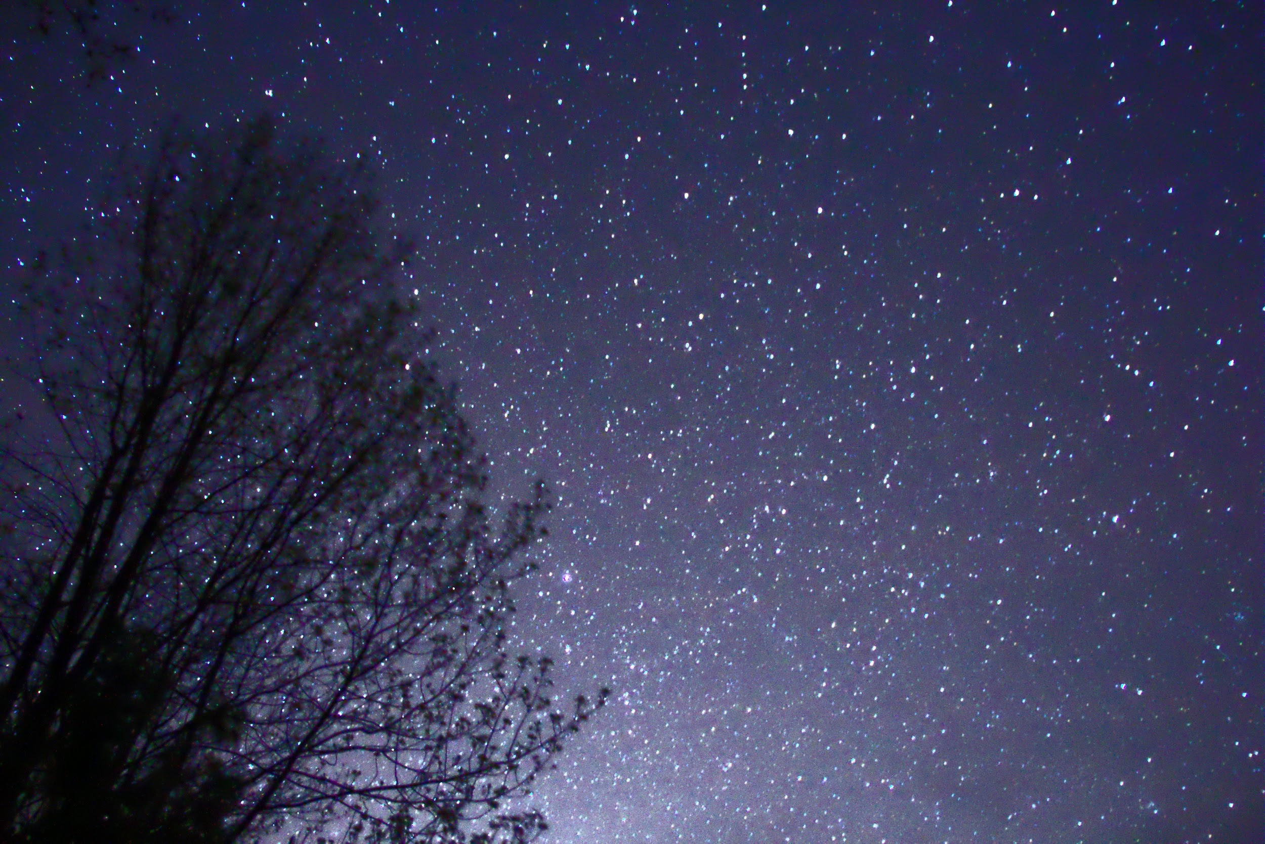
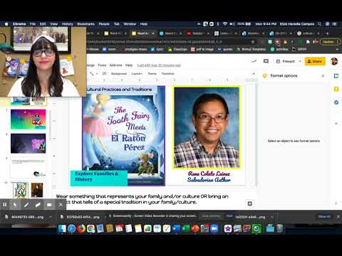


Slide 9
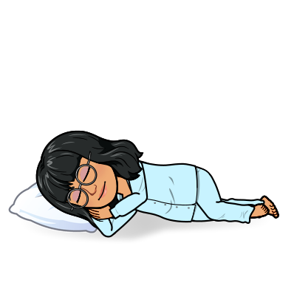
What do you do when you lose a tooth? Who taught you to do that? Is it a family tradition? What other traditions does your family have?

Slide 10

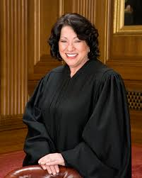

Day 3: Be brave, be different, be you!
Sonia Sotomayor
First Latina Supreme Court Justice
Notes:
Dress up to show off your uniqueness and talents. Ex: wear your favorite team jersey, karate uniform, ballet outfit, your favorite band t-shirt, your favorite hat!, the possibilities are endless!

Slide 11
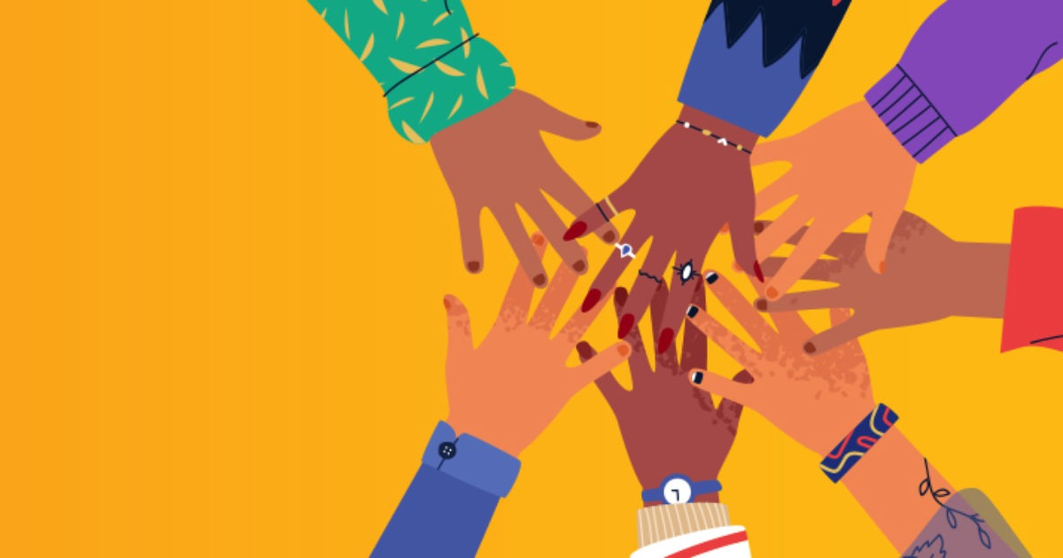


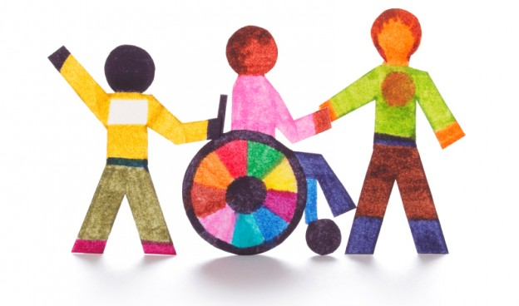

Slide 12
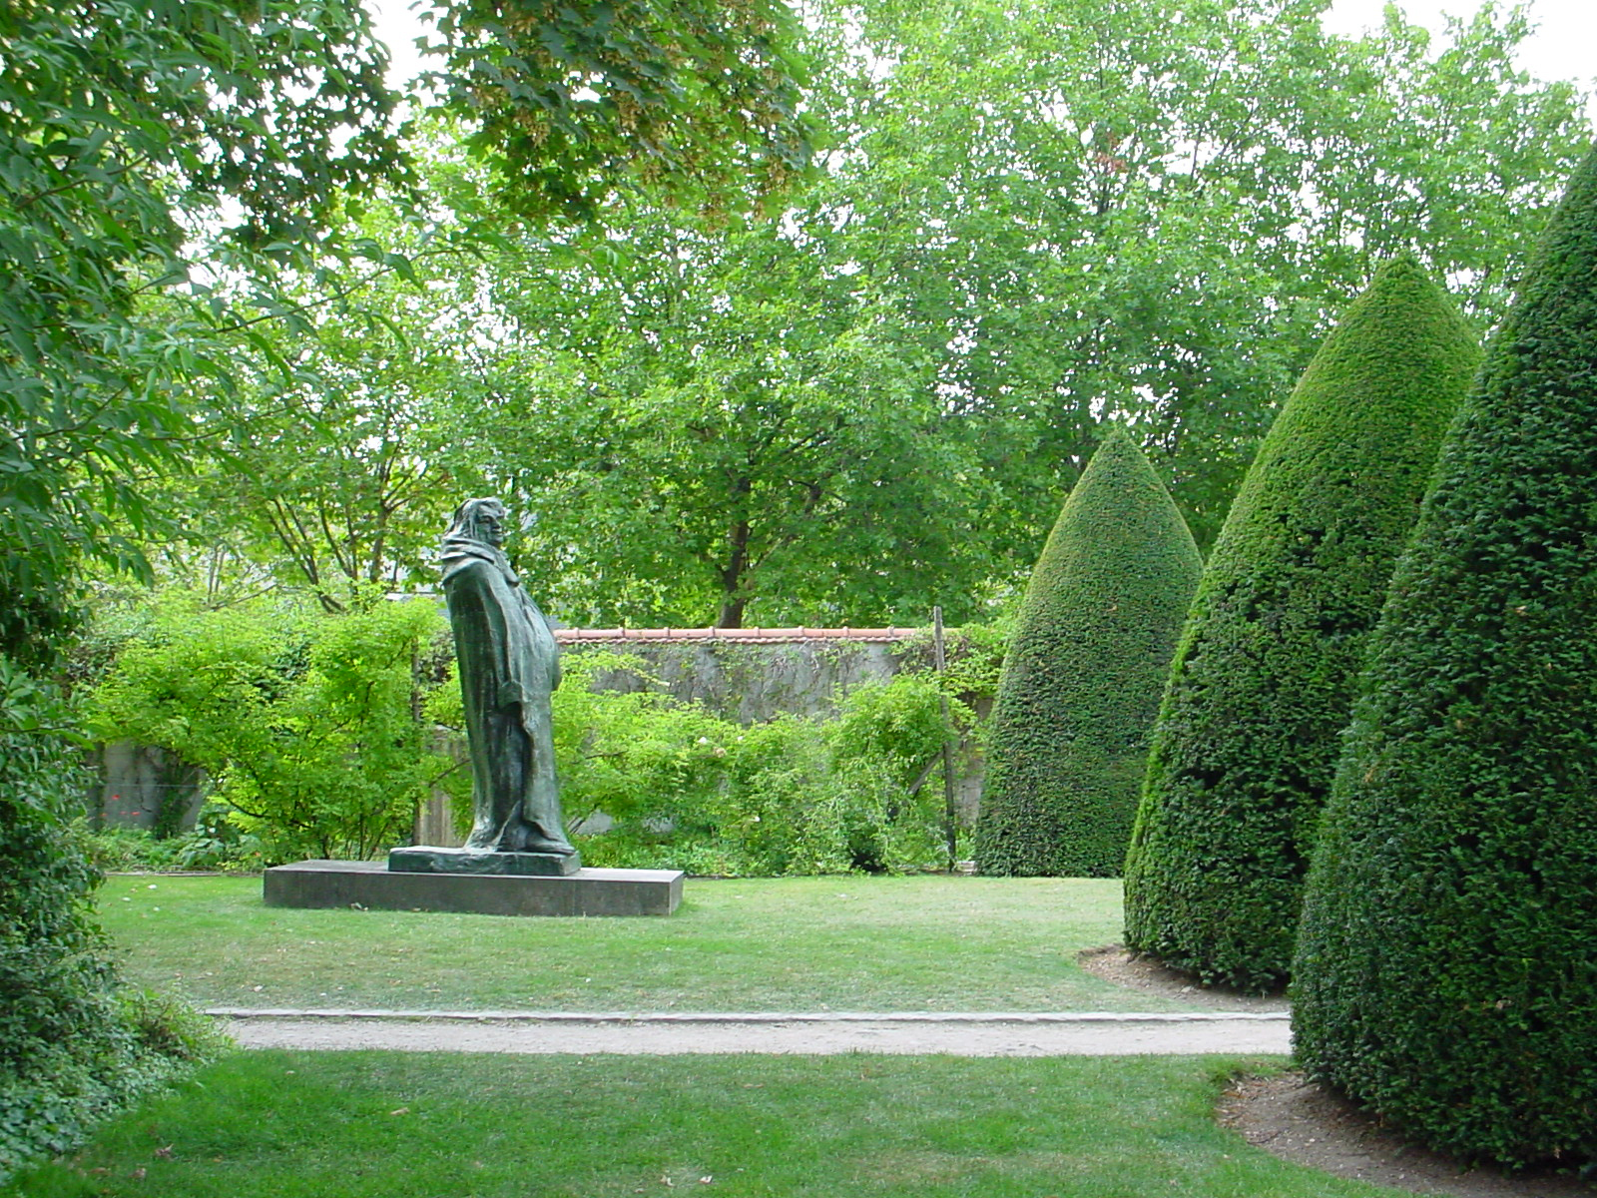

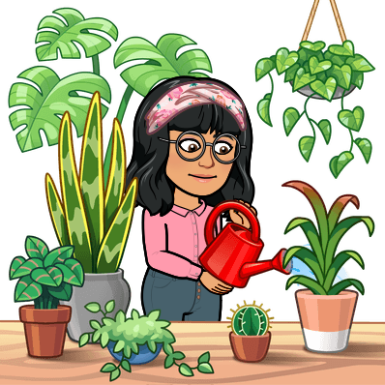

Slide 13
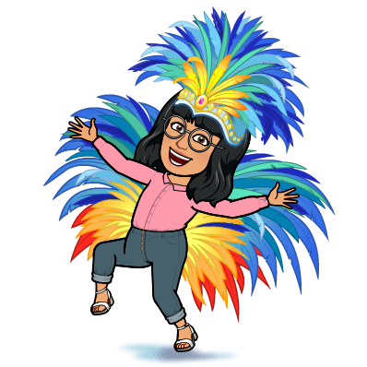
Name one way that you and your friends are different. How does that make being together better? How can you make others feel comfortable when they are different from you?

Slide 14

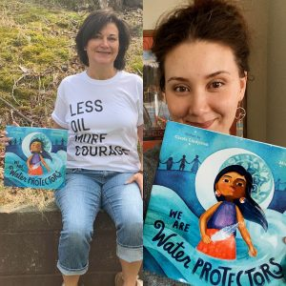


Day 4: Love nature and our planet
Carole Lindstrom/ Michaela Goade
Indigenous Author and Activist
Notes:
Dress in something that represents Nature or caring for the Earth.If you can’t think of anything, wear blue for water, green for plants or brown for soil.

Slide 15
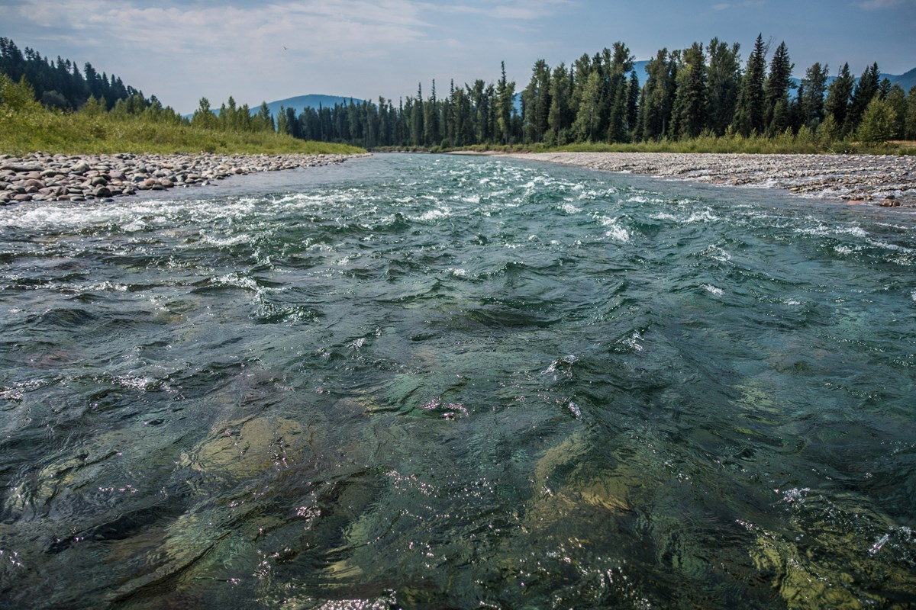
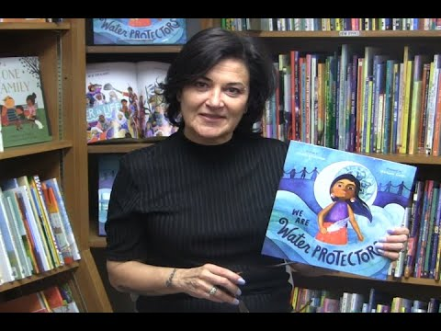


Slide 16
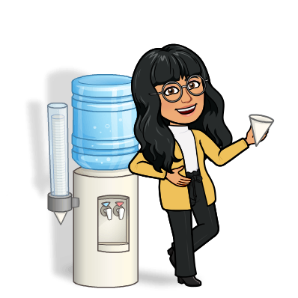
Where does the water you drink come from? What can we do to keep our pledge to take care of mother Earth?

Slide 17

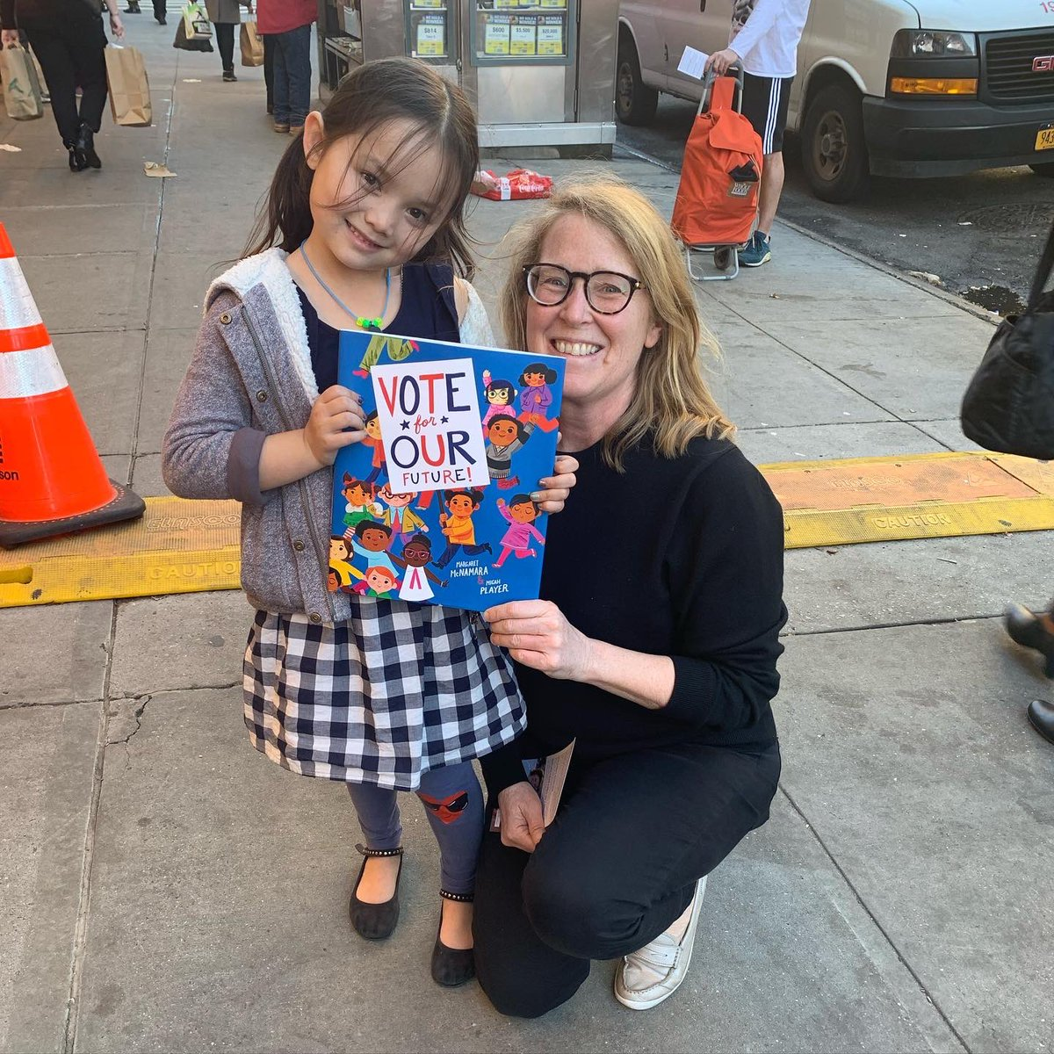
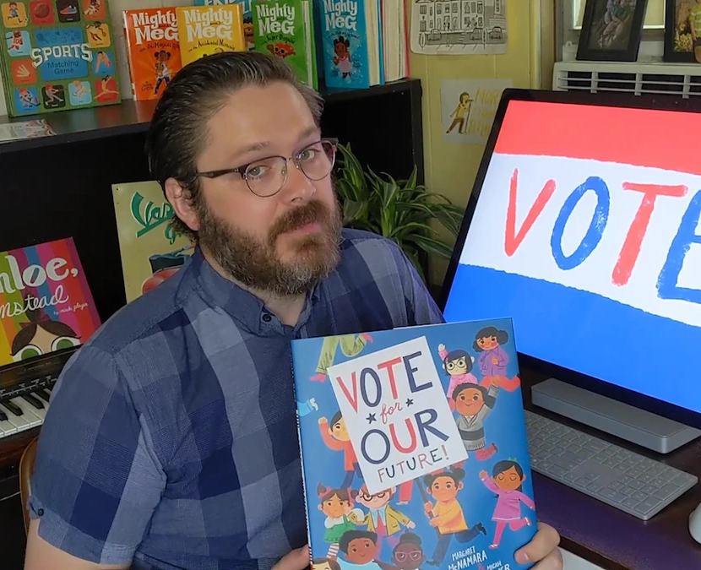

Day 5: Read Across America
Margaret McNamara & Micah Player
Author and Illustrator
Notes:
Wear Red, White, and Blue or something Patriotic.

Slide 18

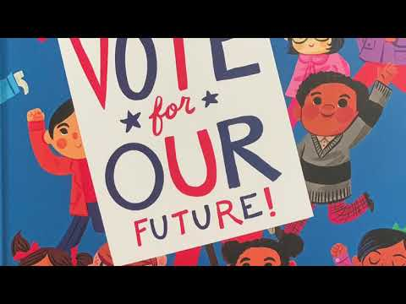
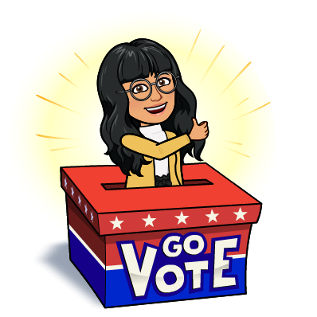

Slide 19

How does voting help people? What is important to you and your future? What can you do to be a good citizen now?

