Slide 3

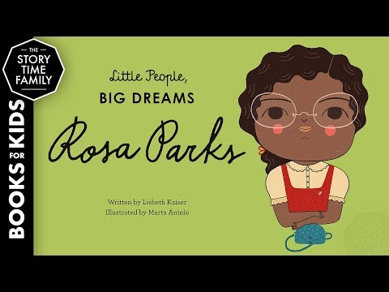
Rosa Parks
Alabama
On December 1, 1955, Rosa Parks boarded a bus in Montgomery, Alabama. Instead of going to the back of the bus, which was designated for African Americans, she sat in the front. When the bus started to fill up with white passengers, the bus driver asked Parks to move. She refused. Her resistance set in motion one of the largest social movements in history, the Montgomery Bus Boycott.

Slide 4

Susan Butcher
Alaska
American sled-dog racer and trainer Susan Butcher dominated her sport for more than a decade. She won the challenging Iditarod Trail Sled Dog Race in Alaska four times.
Susan Howlet Butcher was born on December 26, 1954, in Boston, Massachusetts. She began to train dogs at age 16. By 1972 she had moved to Colorado, where she attended Colorado State University in Fort Collins and raced a group of 50 Alaskan huskies owned by a local musher. Butcher moved to Alaska in 1975 to start her own kennel. A serious athlete from the outset, she broke onto the international mushing scene in 1979 after driving a team of huskies to the top of Denali (Mount McKinley).

Slide 5
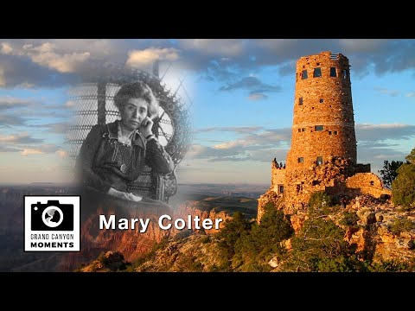
Mary Colter
Arizona
Mary Elizabeth Jane Colter (1869–1958) was an American architect and interior designer whose distinct architectural style was steeped in the imagery, culture, and landscape of the Southwest. As the primary architect for the Fred Harvey Company, she designed hotels, shops, and rest areas along one of the major routes of the Atchison, Topeka, and Santa Fe Railway from 1902 until her retirement in 1948. Colter’s most well-known projects include the buildings she created in Arizona’s Grand Canyon National Park—the Hopi House, Hermit’s Rest, Lookout Studio, and Desert View Watchtower.

Slide 6

Raye Montague
Arkansas
Raye Jean Montague (née Jordan; January 21, 1935 – October 10, 2018) was an American naval engineer. She was known for creating the first computer-generated rough draft of a U.S. naval ship. She was the first female program manager of ships in the United States Navy.

Slide 7

Kamala Harris
California
Kamala Harris is an American lawyer and politician. In 2016 she was elected to the United States Senate. Harris was the first Indian American to serve as a U.S. senator. She was also the second Black woman to do so. In 2020 Harris became the first Black and first Indian American to be elected vice president of the United States.

Slide 8

Temple Grandin
Colorado
Temple Grandin is a U.S. professor of animal science. She is one of the most famous and successful people with Autism. She has devoted her life to reducing the stress of both animals and people with Autism.

Slide 9
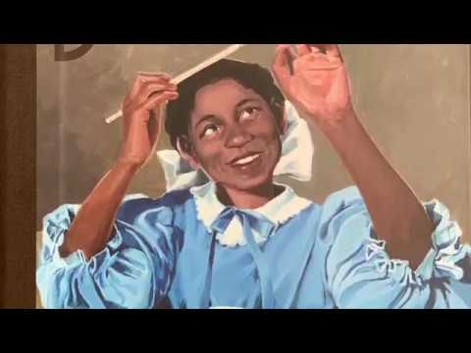
Laura Wheeler Waring
Connecticut
In 1922, at the height of the Harlem Renaissance, the Harmon Foundation was founded in New York City with the mission to honor African American artists and encourage awareness of their accomplishments. Six years later, the foundation hosted the first exhibit in history to showcase only African American artists, and Laura Wheeler Waring was among the artists whose work was included in this landmark exhibition. Years later, her work would find itself on the walls of galleries in Europe and across America. One of the major women artists of the Harlem Renaissance, today Waring is best known for her portraits of prominent African Americans and is celebrated as an artist of consummate skill and imagination. She is also remembered as a champion for arts education.

Slide 10

Eleanor Foraker
Delaware
Eleanor Foraker was a seamstress. She sewed the spacesuits for Apollo 11. She sewed the astronauts' metal and plastic spacesuits by hand. She said that she worked 80-hour weeks during the Apollo era and had no holidays, for three years straight!

Slide 11
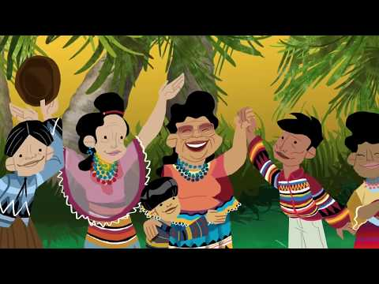
Florida
Betty Mae Jumper
Betty Mae Jumper, The first female chief of the Seminole Tribe of Florida, was born in South Florida’s Indiantown. She attended the Cherokee Indian School in North Carolina, and in 1949, became the first Seminole to earn a high school diploma. Jumper was the Seminoles’ first Health Director and is known as the tribal storyteller.

Slide 12
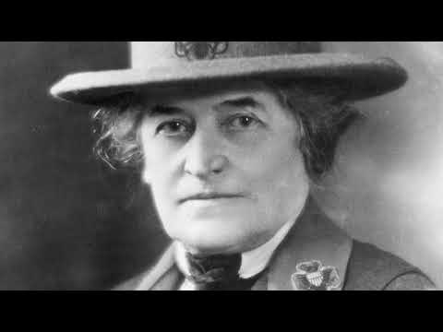
Georgia
Juliette Gordon Low
In 1912, Juliette Gordon Low (1860–1927) founded Girl Scouts of the USA, an organization that today serves millions of girl members and alumnae, and reflects the arc of her remarkable life.
A believer in the potential of all girls and the importance of fostering their individual growth, character, and self-sufficiency, Juliette is credited with establishing and nurturing a global movement that has changed the world.

Slide 13

Hawaii
Georgia O’Keeffe
Georgia O’Keeffe is one of the most significant artists of the 20th century, renowned for her contribution to modern art. By the mid-1920s, O’Keeffe was recognized as one of America’s most important and successful artists, known for her paintings of New York skyscrapers—an essentially American symbol of modernity—as well as her equally radical depictions of flowers. As an artist of national standing, Georgia O’Keeffe has been well known in America for many decades.

Slide 14
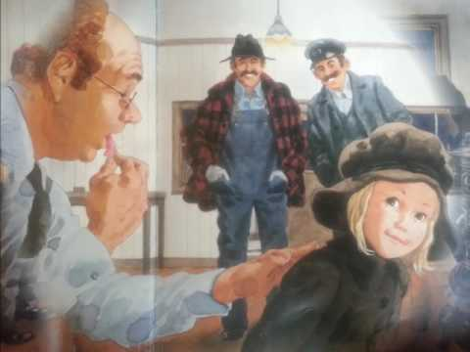
Idaho
Charlotte May Pierstorff
Back in the early 1900’s, people used to be able to put KIDS in the mail! (How crazy!)
A six year old Idaho girl named Charlotte May Pierstorff became so famous for being “mailed” that a children’s book was eventually written about her.
The name of that book was “Mailing May”.
Early on the morning of Feb. 19, 1914, May's mother told the mailman she had a package for him to mail. May was sick on the ride and got dizzy.
Just a few days later, a story came out in newspapers around the country saying it was illegal to mail children.

Slide 15

Illinois
Michelle Obama
Michelle LaVaughn Robinson Obama (born January 17, 1964) is a former First Lady of the United States and the wife of the 44th president of the U.S., Barack Obama. She is also a lawyer and an author. She is the first African American First Lady of the United States. Like many other First Ladies, Mrs. Obama has worked as a spokesperson for a cause. The cause she supports is better nutrition and exercise for children. She has done work with the Disney Channel and Nickelodeon to support this cause.

Slide 16

Indiana
Margaret Hamilton
Margaret Hamilton is an American computer scientist. She was one of the first computer software programmers. (Software is the instructions that tell the computer hardware what to do.) Hamilton was responsible for the software that allowed astronauts Neil Armstrong and Buzz Aldrin to land on the Moon. She is also credited with inventing the term software engineering.

Slide 17
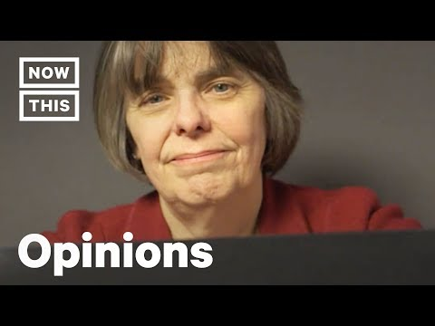
Iowa
Mary Beth Tinker
Mary Beth Tinker was a middle school student when a suspension for wearing a black armband in protest of the Vietnam War shot her name into the public consciousness.
As the plaintiff in a lawsuit against the Des Moines Public Schools, Tinker and her family experienced threats for their stance that she had a right to protest, but endured to take their case all the way to the Supreme Court.
The Supreme Court’s decision to side with Tinker is known to have set the high legal standard under which students’ first amendment rights are protected today.
Tinker travels the country talking about her fight and has made important connections with current youth advocates, including the students in Parkland.

Slide 18

Kansas
Amelia Earhart
Born in Atchison, Kansas, Earhart developed a passion for adventure at a young age, steadily gaining flying experience from her twenties.
In 1928, Earhart became the first female passenger to cross the Atlantic by airplane (accompanying pilot Wilmer Stultz), for which she achieved celebrity status. In 1932, piloting a Lockheed Vega 5B, Earhart made a nonstop solo transatlantic flight, becoming the first woman to achieve such a feat.
She received the United States Distinguished Flying Cross for this accomplishment.

Slide 19
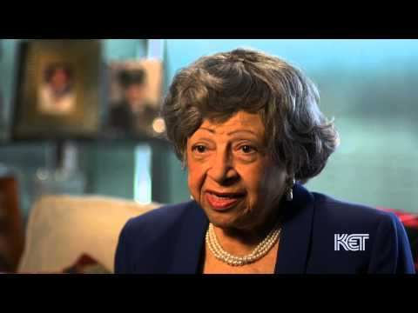
Georgia Davis Powers
Kentucky
Georgia Davis Powers, the first African American and first woman to be elected to the Kentucky Senate and served 21 years, spent her life fighting for equality.
Powers was influential in organizing the 1964 March on Frankfort for Civil Rights. She spent years advocating for fair housing and was a good friend of Martin Luther King Jr. She also worked with Jesse Jackson and Jackie Robinson in her civil rights efforts.

Slide 20
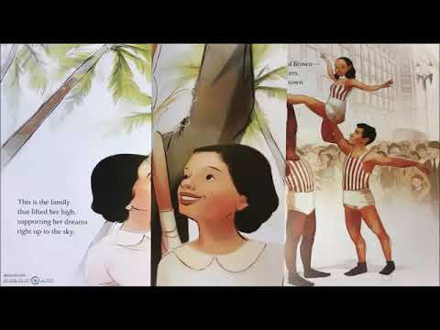
Janet Collins
Louisiana
Janet Collins broke color barriers in the 1950s when she became the first African American prima ballerina and one of the very few prominent black women in American classical ballet.

Slide 21
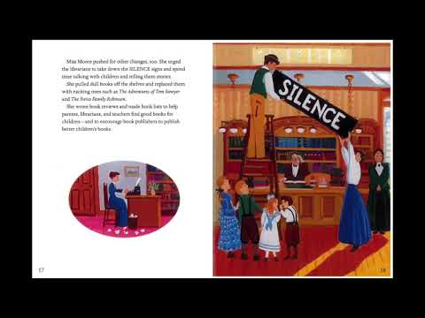
Anne Carroll Moore
Maine
In recognition of her pioneer library work with children and her many efforts to improve and promote children’s literature, Anne Carroll Moore received the Regina Medal from the Catholic Library Association in 1960. As the first supervisor of work with children for the New York Public Library, she helped promote public libraries as child-friendly places.

Slide 22
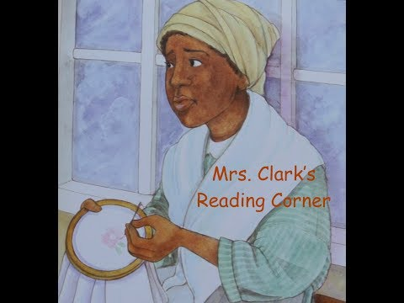
Harriet Tubman
Maryland
Harriet Tubman was born into northern slavery in Maryland in 1820 and her sense of independence led her to escape in 1849. She devoted her life to helping to rescue other slaves, including her own family and non-family members.
She worked with the ‘Underground Railroad’ which included hidden routes and homes to let escaped slaves move from location to location, offering food, shelter and clothes as they headed to freedom. Tubman played a major role in the abolitionist movement to allow Black Americans their freedom.

Slide 23

Jackie Kennedy
Massachusetts
Jacqueline Lee Bouvier "Jackie" Kennedy Onassis (July 28, 1929 – May 19, 1994), was the wife of President John F. Kennedy and First Lady of the United States from 1961 until his assassination in 1963. Jacqueline met John Kennedy in 1951, when he was a congressman from Massachusetts. She subsequently married Greek shipping magnate Aristotle Onassis. In later years, she enjoyed a successful career as a book editor.

Slide 24
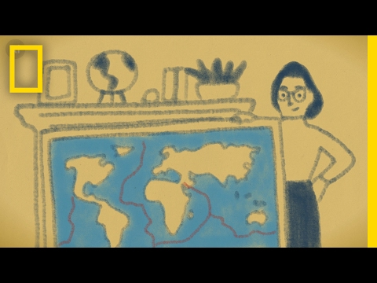
Marie Tharp
Michigan
Geologist Marie Tharp (born 1920) is known for her maps of ocean floors. These maps are helpful in showing the structure and evolution of the sea floors.
Marie Tharp is a mapmaker who charted the bottom of the ocean at a time when little was known about undersea geology. Her detailed maps showed features that helped other scientists understand the structure and evolution of the sea floor. In particular, Tharp's discovery of the valley that divides the Mid-Atlantic Ridge convinced other geologists that sea floor was being created at these ridges and spreading outward. The confirmation of "seafloor spreading" led to the eventual acceptance of the theory of continental drift, now called plate tectonics.

Slide 25
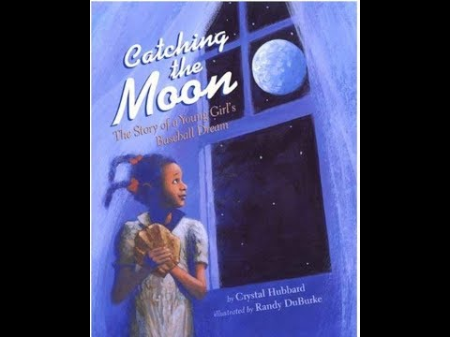
Marcenia Lyle
Minnesota
The first woman to play professional baseball as a regular on a big-league team was U.S. athlete Toni Stone. She played on men’s teams in the Negro leagues, making her big-league debut playing second base for the Indianapolis Clowns.
She was born as Marcenia Lyle in St. Paul, Minn., in 1921. She developed a love for the game while a child. At age 10 she played for a league sponsored by a cereal company, and at age 15 she began playing on a men’s semiprofessional team. After graduating from high school, Stone moved to California to live with her sister. There she played on an American Legion baseball team and later on the San Francisco Sea Lions. Stone then secured a position with the Negro league All Star team. In 1949 she began playing second base for the minor league New Orleans Creoles, and in 1953 she joined the Indianapolis Clowns, a team in the Negro American League.

Slide 26
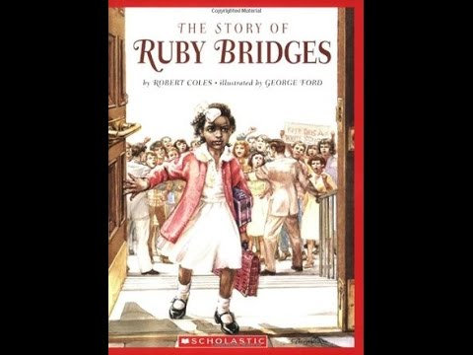
Ruby Bridges
Mississippi
In 1960, Ruby Bridges (September 8, 1954—present) walked through the doors of William Frantz Elementary School, in New Orleans, Louisiana. By doing so, she became the first African-American student to attend an all-white elementary school in the Southern United States.
On November 14, 1960, Ruby Bridges became a symbol of the U.S. civil rights movement. She was just 6 years old. Her simple act of going to an all-white school marked the beginning of integration for U.S. public schools.

Slide 27
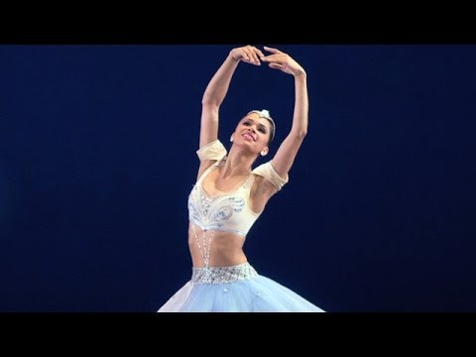
Misty Copeland
Missouri
Misty Copeland (born September 10, 1982) is a ballet dancer for American Ballet Theatre (ABT). She made history in 2007 as the third African American to be promoted to the rank of soloist in two decades. She is the fourth African-American soloist, and the first in two decades with ABT.
On June 30, 2015, Copeland became the first African American woman to be promoted to principal dancer in ABT's 75-year history.

Slide 28
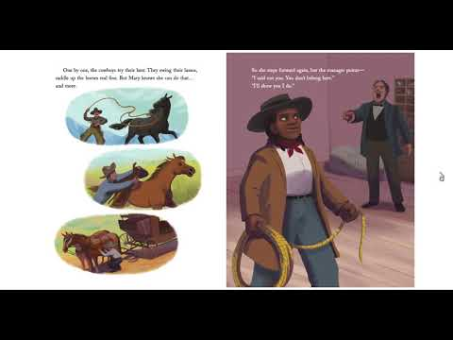
Mary Fields
Montana
Born around 1832, possibly in Tennessee, Mary Fields celebrated her birthday on March 15. The details of her life before she came to Montana in 1885 are difficult to trace—complicated by her birth into slavery and the fact that, although she was literate, she left no written record.
She was the first African-American female star-route mail carrier in the United States.She was not an employee of the United States Post Office Department.

Slide 29
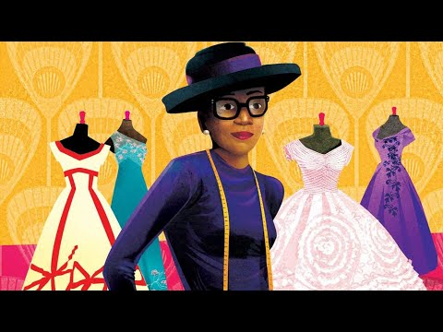
Ann Cole Lowe
Nebraska
Ann Cole Lowe was the first African American to become a noted fashion designer. Lowe’s one-of-a-kind designs were favored by wealthy and socially prominent women from the 1920s to the 1960s. In 1953, Lowe designed the ivory silk taffeta wedding dress worn by Jacqueline Bouvier when she married John F. Kennedy.

Slide 30
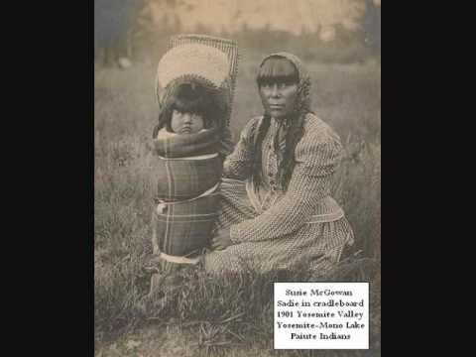
Sarah Winnemucca
Nevada
Sarah Winnemucca, also called Sarah Hopkins Winnemucca, original name Thoc-me-tony, Thocmectony, or Tocmectone (“Shell Flower”), (born c. 1844, Humboldt Sink, Mexico [now in Nevada, U.S.]—died October 16, 1891, Monida, Montana, U.S.),
Native American educator, lecturer, tribal leader, and writer best known for her book Life Among the Piutes: Their Wrongs and Claims (1883). Her writings, valuable for their description of Northern Paiute life and for their insights into the impact of white settlement, are among the few contemporary Native American works.

Slide 31
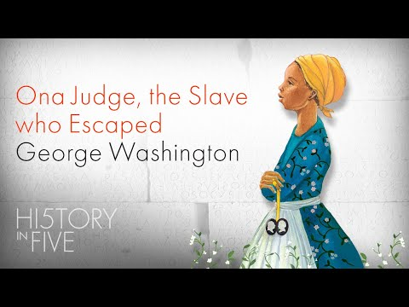
Ona Judge
New Hampshire
On January 1, 1847, the abolitionist newspaper The Liberator published a letter from Reverend Benjamin Chase describing his recent visit with an elderly African American woman near Portsmouth, New Hampshire. The woman, Ona Judge Staines, had fled enslavement at the Washingtons’ household fifty years earlier.
During Washington’s presidency, Judge continued her daily work waiting on Martha Washington—helping her bathe and dress, cleaning and mending her clothing, organizing her personal belongings, and anything else her she required.
On May 20, 1796, as the Washingtons prepared to return to Mount Vernon for the summer, Ona Judge fled.

Slide 32
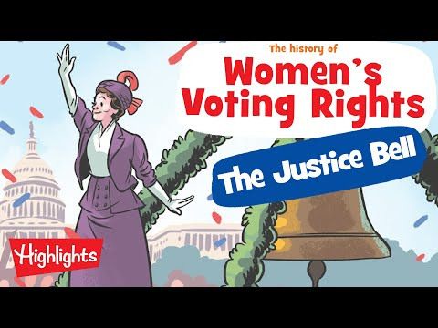
Alice Paul
New Jersey
Alice Paul advocated for and helped secure passage of the 19th Amendment to the US Constitution, granting women the right to vote. Paul next authored the Equal Rights Amendment in 1923, which has yet to be adopted.

Slide 33
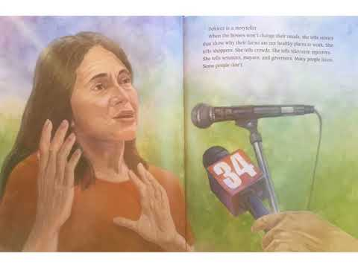
Dolores Huerta
New Mexico
Dolores Clara Fernández Huerta (born April 10, 1930) is an American labor leader and civil rights activist who, with Cesar Chavez, is a co-founder of the National Farmworkers Association, which later became the United Farm Workers (UFW). Huerta helped organize the Delano grape strike in 1965 in California and was the lead negotiator in the workers' contract that was created after the strike.
Huerta has received numerous awards for her community service and advocacy for workers', immigrants', and women's rights.

Slide 34

Sonia Sotomayor
New York
Sonia Maria Sotomayor (born June 25, 1954) is an associate justice of the Supreme Court of the United States. She was nominated by President Barack Obama on May 26, 2009 and has served since August 8, 2009. Sotomayor is the first Hispanic and Latina member of the Court.

Slide 35
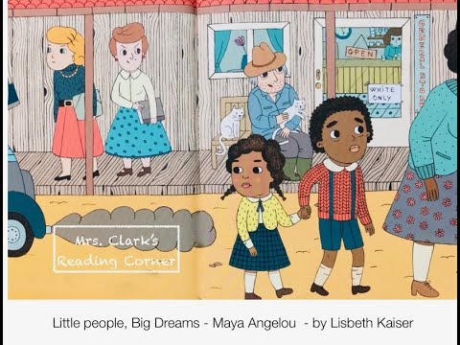
Maya Angelou
North Carolina
Marguerite Annie Johnson; April 4, 1928 – May 28, 2014) was an American poet, memoirist, and civil rights activist.
She published seven autobiographies, three books of essays, several books of poetry, and is credited with a list of plays, movies, and television shows spanning over 50 years.
She received dozens of awards and more than 50 honorary degrees. Angelou is best known for her series of seven autobiographies, which focus on her childhood and early adult experiences. The first, I Know Why the Caged Bird Sings (1969), tells of her life up to the age of 17 and brought her international recognition and acclaim.

Slide 36
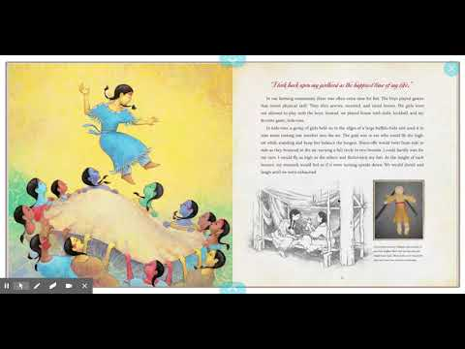
Buffalo Bird Woman
North Dakota
Waheenee, also referred to as the Buffalo Bird Woman (ca. 1839-1932) was a traditional Hidatsa woman who lived on the Fort Berthold Reservation in North Dakota.
Her Hidatsa name was Waheenee, though she was also called Maaxiiriwia (variously transcribed as Maxidiwiac and Maxi'diwiac).
She was known for maintaining the traditional lifestyle of the Hidatsa, including gardening, cooking, and household tasks. She passed on the traditional ways of her culture and oral tradition through interviews with Gilbert Wilson, in which she described her own experience and the lives and work of Hidatsa women.

Slide 37

Maya Lin
Ohio
Lin has designed numerous memorials, public and private buildings, landscapes, and sculptures.
Although she is best known for historical memorials, she is also known for environmentally themed works, which often address environmental decline.
According to Lin, she draws inspiration from the architecture of nature but believes that nothing she creates can match its beauty.

Slide 38

Mary Blair
Oklahoma
Mary Blair (born Mary Browne Robinson; October 21, 1911 – July 26, 1978) was an American artist, animator, and designer. She was prominent in producing art and animation for The Walt Disney Company, drawing concept art for such films as Alice in Wonderland, Peter Pan, Song of the South and Cinderella.
Blair also created character designs for enduring attractions such as Disneyland's It's a Small World, the fiesta scene in El Rio del Tiempo in the Mexico pavilion in Epcot's World Showcase, and an enormous mosaic inside Disney's Contemporary Resort.
Several of her illustrated children's books from the 1950s remain in print, such as I Can Fly by Ruth Krauss. Blair was inducted into the group of Disney Legends in 1991.

Slide 39
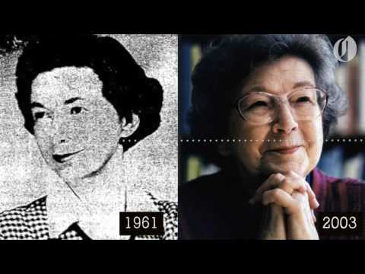
Beverly Cleary
Oregon
Beverly Atlee Cleary (born April 12, 1916) is an American writer of children's and young adult fiction.
One of America's most successful living authors, 91 million copies of her books have been sold worldwide since her first book was published in 1950.
Some of Cleary's best known characters are Ramona Quimby and Beezus Quimby, Henry Huggins and his dog Ribsy, and Ralph S. Mouse.

Slide 40
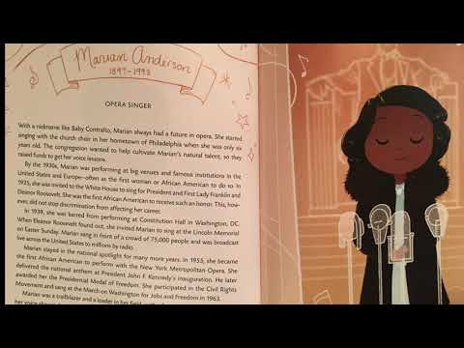
Marian Anderson
Pennsylvania
Marian Anderson (February 27, 1897 - April 8, 1993) was an American contralto singer.
She was the first African American to sing at the Metropolitan Opera House in New York City.

Slide 41

Ida Lewis
Rhode Island
On March 29, 1869, two soldiers and a young boy pushed a small boat into the icy waters of Newport Harbor.
The soldiers needed passage to the nearby Fort Adams and the boy told them he knew how to navigate the turbulent waters of the harbor quickly and safely. The trio hadn’t been at sea for very long when a snowstorm descended upon Rhode Island.
The waves became more and more choppy and soon, the boat overturned. The boy was quickly lost, succumbing to the freezing waters. The soldiers managed to grab hold of the upside down boat and clung to it, helplessly.
From the shore, a twelve-year-old girl saw the capsized boat and knew immediately what she needed to do. Running to her own boat without pausing to put on her coat or shoes, the girl rushed into the dangerous harbor and rowed towards the dying men. That girl was Ida Lewis.
Many members of Ida Lewis’ community disapproved of her skills in swimming and rowing. They told Ida it was un-ladylike to row boats. Ida wasn’t deterred.

Slide 42
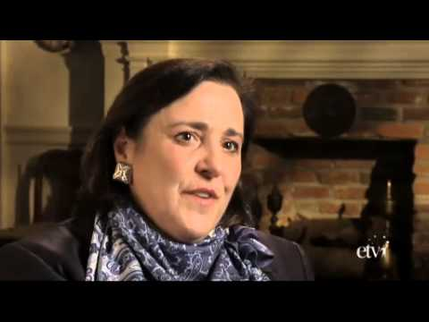
Lucille Godbold
South Carolina
Lucile Ellerbe Godbold (May 31, 1900 – April 5, 1981) was an American track and field athlete. She competed in the long jump and several running and throwing events at the 1922 Women's World Games, also known as the First International Games for Women, and won a gold medal in the shot put and a bronze in the javelin throw; she finished fourth in the 300 m and 1000 m races.

Slide 43

Sue Hendrickson
South Dakota
Susan Hendrickson (born December 2, 1949) is an American explorer and fossil collector. Hendrickson is best known for her discovery of the remains of a Tyrannosaurus rex in South Dakota on August 12, 1990.
Her discovery was one of the most complete skeletons of Tyrannosaurus known to science.

Slide 44
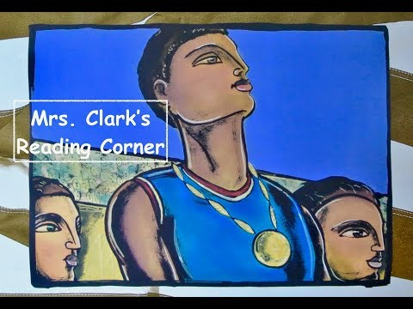
Wilma Rudolph
Tennessee
Wilma Rudolph was born in 1940. Wilma was small and was often sick. By the time she was 5, she’d become ill with scarlet fever and polio. Back then, there was no vaccine for polio.
Children with the disease often died. Wilma survived, but her left leg was twisted, and she couldn’t walk. She got around by hopping on her right leg. “My doctors told me I would never walk again,” she said. “My mother told me I would. I believed my mother.”
Every week, Wilma and her mother or aunt traveled 100 miles round-trip to the closest hospital that treated Black people, so Wilma could receive treatment for her leg.After several years of treatment, Wilma once again surprised everyone by taking off the brace and walking by herself. She had been diligently practicing with the goal of one day being able to run, jump, and play games like everyone else. And eventually, that’s exactly what she did.
Wilma loved playing basketball and running track and field. When she was 14, the women’s track coach from Tennessee State University saw her compete. He told Wilma, the girl once unable to walk, that she had the potential to become an outstanding runner.
Wilma qualified for the 1956 Summer Olympics in Melbourne, Australia. At 16, she was the youngest member of the track-and-field team. She won bronze in the 400-meter relay. Four years later, she entered the 1960 Olympics, in Rome, Italy. She became the first American woman to win three gold medals in one Olympics.

Slide 45

Selena Quintanilla
Texas
Selena Quintanilla–Pérez (April 16, 1971 – March 31, 1995), known as simply Selena, was an American singer-songwriter, actress and fashion designer. She was named the "Queen of Tejano music" and was also known as the "Mexican Madonna". Selena was born as the last child of a Mexican-American father. She released her first LP record at the age of 12 with her Selena y Los Dinos band.
At the 1987 Tejano Music Awards, she won the Female Vocalist of the Year award. She won this award eight times in a row. Selena signed a record agreement with EMI Latin in 1989. She released five Spanish-language albums with them, each having chart and sales success.

Slide 46
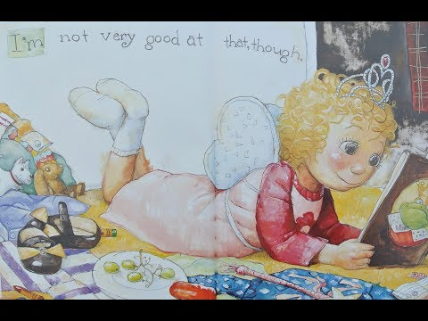
Alice Kasai
Utah
As a civil rights leader in Utah, Alice Kasai devoted her life to empowering, mentoring, and advocating for the rights of Japanese Americans and other disenfranchised groups.
Despite experiencing firsthand the injustices of racial bigotry, she remained patriotic, optimistic, and relentless in her lifelong activism on behalf of Japanese Americans as well as minority and women’s rights on a broader scale.

Slide 47
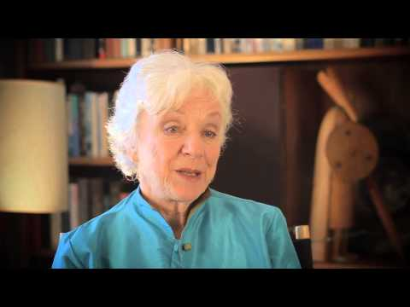
Madeleine Kunin
Vermont
Madeleine May Kunin (born September 28, 1933) is an American diplomat and politician. She was the 77th Governor of Vermont from 1985 until 1991, as a member of the Democratic Party.
She also served as United States Ambassador to Switzerland from 1996 to 1999. She was Vermont's first and, to date, only female governor as well as the first Jewish governor of Vermont.

Slide 48

Ella Fitzgerald
Virginia
Ella Jane Fitzgerald (April 25, 1917 – June 15, 1996), was an American jazz singer. She was called "Lady Ella", the "Queen of Jazz", and the "First Lady of Song".
Her voice spanned three octaves. She could sing very high notes and very low notes. She was famous for her scat singing. She won 14 Grammy Awards. She was awarded the National Medal of Art and the Presidential Medal of Freedom.

Slide 49
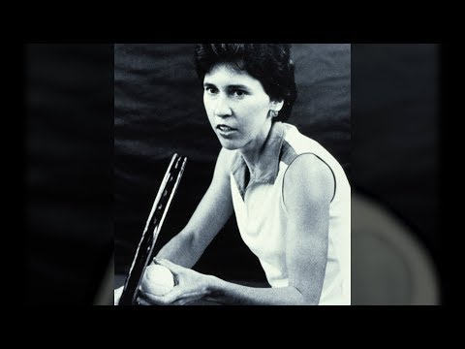
Patricia Bostrom
Washington
Patricia Bostrom is considered the greatest women’s tennis player in UW history, but it’s her role as a pioneer for gender equality in college sports that she is most proud of.

Slide 50
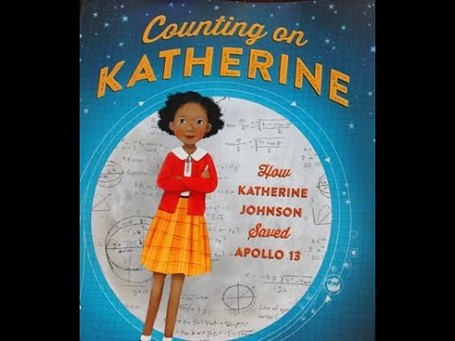
West Virginia
Katherine Johnson
Katherine Johnson loved math.
Early in her career, she was called a “computer.”
She helped NASA put an astronaut into orbit around Earth. And then she helped put a man on the Moon.

Slide 51
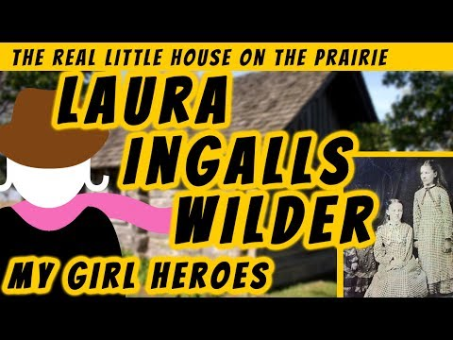
Laura Ingalls Wilder
Wisconsin
Laura Elizabeth Ingalls Wilder (February 7, 1867 – February 10, 1957) was an American writer, mostly known for the Little House on the Prairie series of children's books, published between 1932 and 1943, which were based on her childhood in a settler and pioneer family.

Slide 52
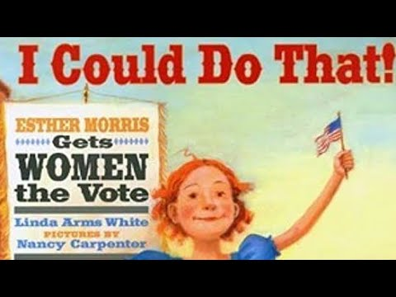
Esther Morris
Wyoming
American suffrage activist and public official Esther Hobart McQuigg Slack Morris played a major role in gaining voting rights for women in Wyoming. The passing of legislation there was the first success of the movement for national woman suffrage.

