Slide 1


Dear Teacher -
You are a SUPERHERO! Never discount all that you do day in and day out. You are having such a profound impact on countless students’ lives. Always remember when times are difficult that nothing is ever impossible with love and a positive outlook. Thank you so much for all that you do. I love to share the activities I make because it makes my heart so happy to help others in any small way I can. There’s always something good going on around you so stay focused on the good. Love and support one another. Teaching is a profession unlike any other where we truly need one another so be that teacher for someone who needs you. Our world is in desperate need of loving acts of kindness. Spread it like wildfire.
Your Teacher Friend - Christy

Slide 2
The following slides are meant to be shared. All of the slides were made by me and none of the activities have been purchased or copied from other sources including the poems which I wrote. Clipart, videos, and links of course are not my own. I just wanted to let you know in case anyone is concerned about sharing due to copyright infringement.
You are a SUPERHERO!

Slide 3



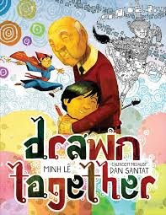

Read Across America Week
Monday, March 1st | “Mixed - A Colorful Story” | Wear a Silly Outfit
Tuesday, March 2nd | “ “The Girl Who Thought in Pictures” | Dress as a Famous Person
Wednesday, March 3rd | “Girl Running” | Wear Your Favorite Team’s Colors
Thursday, March 4th | “D “Drawn Together” | Wear Something to Celebrate Your Culture
Friday, March 5th | “The World Needs More Purple People” | Wear Your Favorite Color
Celebrating Our Differences

Slide 4

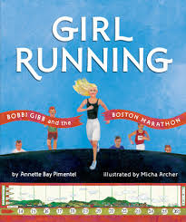

Book Summaries
Arree Chung's MIXED: A Colorful Story is at once a contemporary and emerging classic about accepting others, joining hands together to live in love, and about how a single voice can change the tides to restore the unity in community. In this story the Reds, Yellows, and Blues all live together in “color harmony”.
Her unique mind allowed her to connect with animals in a special way, helping her invent groundbreaking improvements for farms around the globe! The Girl Who Thought in Pictures: The Story of Dr. Temple Grandin is the first book in a brand new educational series about the inspirational lives of amazing scientists.
The inspiring story of the first female to run the Boston Marathon comes to life in stunningly vivid collage illustrations. Because Bobbi Gibb is a girl, she's not allowed to run on her school's track team. ... She bravely sets out to prove the naysayers wrong and show the world just what a girl can do.
Drawn Together by Minh Le is a children's book about a young boy spending time with his grandfather. They don't speak the same language, eat the same food, or like the same TV. When the boy pulls out his markers and paper and begins drawing, his grandpa disappears and returns with a sketch book and a paint brush.
In THE WORLD NEEDS MORE PURPLE PEOPLE, a little blond girl named Penny Purple speaks directly to the reader and launches right into a lesson on "How to be a purple person." She explains that "Purple is a magic color made when red and blue work together." Then she goes on to list five steps to becoming a purple person:

Slide 5
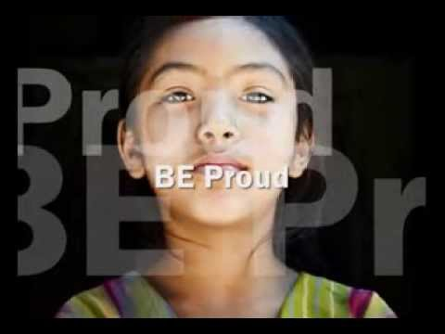
As you go on your journey through this life, always, always remember there is NO ONE out there exactly like YOU. YOU are BEAUTIFUL, YOU are UNIQUE, YOU are SPECIAL, YOU have something to offer this world that no one else does because you’re YOU with unique gifts and talents. YOU can make a difference .. yes...YOU!
Do not EVER for one millisecond allow anyone or anything stop you from achieving your dreams in this life. You are so much more capable than you will ever truly realize. You’re braver, stronger, smarter, and more beautiful than you know. Do you know what makes you even more beautiful? Having a beautiful heart. Being loving, kind, compassionate, caring, and accepting of ALL people no matter what. If we could just for one moment put our differences aside, we would find that we are all much more alike than we have ever realized. We need to stop judging a book by its cover, and accepting others for who they are and realizing everyone has a story that we have no idea about. Be bold and be that person who isn’t afraid to be who they are and make a difference to make our world more beautiful and loving for all.
The Power of ONE!

Slide 6




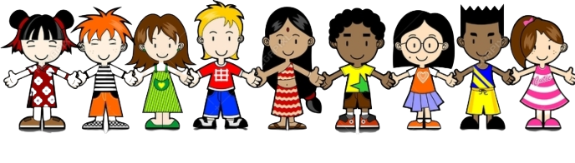
The World is a Rainbow
We are ALL
SPECIAL!
We each have GIFTS!
“Look Beyond My Skin tone”
Look beyond my skin tone, the color of my hair, the shape of my nose; it’s Italian I declare!
Please don’t judge me for my looks for looks have no bearing; it’s the nature of my being and whether I am caring.
It’s the words I speak daily to others who pass me by, I wish to make them smile and never make them cry.
The color of my skin you see may be different than your own but it’s the content of my character that matters and not my skintone.
~ Mrs. Ganoe
Let’s ALL
Show LOVE!

Slide 7

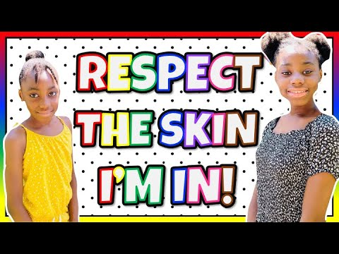


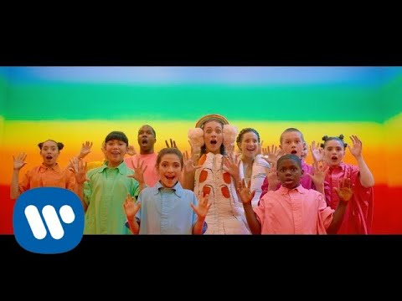
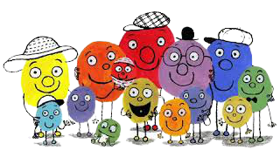
A Colorful Story
Day 1

Slide 8


Reading Comprehension
Which color was the loudest?
Which color was the coolest?
Which color was the brightest?
Everyone lived in harmony until Red said what?
Which color was too cool to respond to what Red said?

Slide 9
Reading Comprehension
After what Red said, what did the colors decide to do?
A Yellow met a Blue and fell in love. What did they do?
Together, the Yellow and the Blue created what new color?
After the colors saw the possibilities, what did they do?
Together, the Yellow and the Blue created what new color?
With all the new colors, what did the colors do?

Slide 10
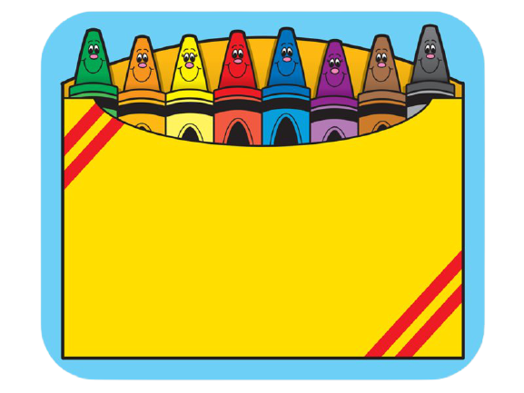
Why is it important to get to know different kinds of people?
It is important to get to know different kinds of people because (Type here)

Slide 11
Do you think a place is more beautiful with just three colors or with many colors?
A place is more beautiful with (Type here)

Slide 12
Story Elements
Characters
Type.
Setting
Type.
Problem
Type.
Solution
Type.

Slide 13

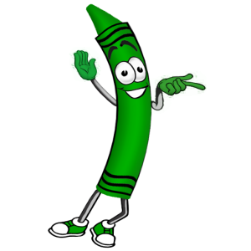

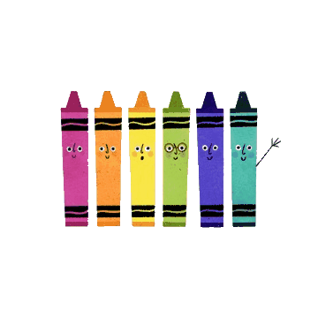

On the colored
pencils, tell me what happened first, next, and last in the story.
First, (Type here)
Next, (Type here)
Last, (Type here)

Slide 14
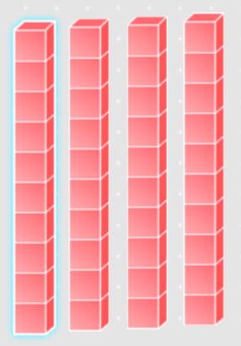
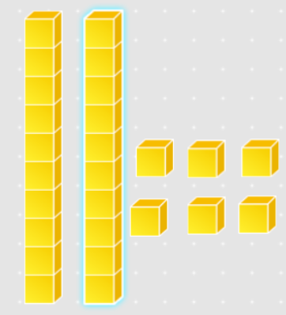
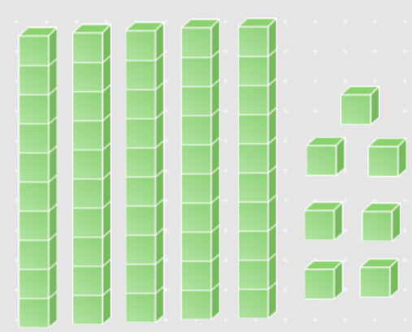


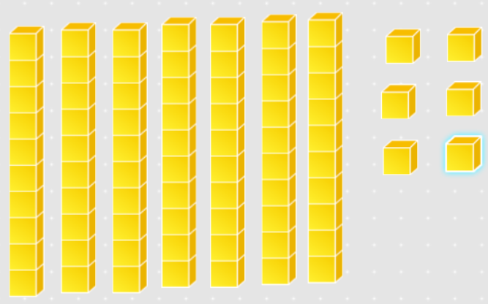
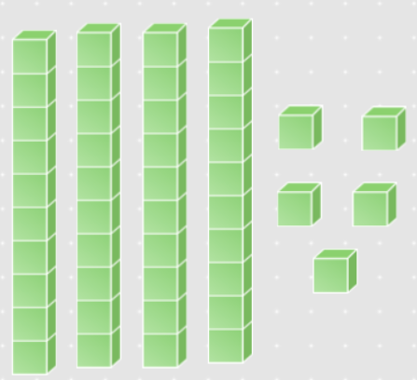
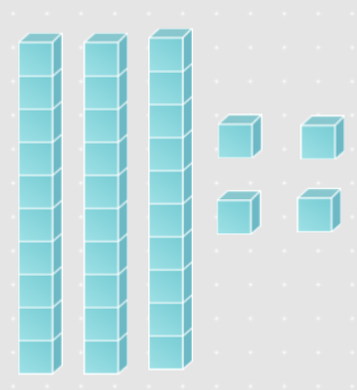
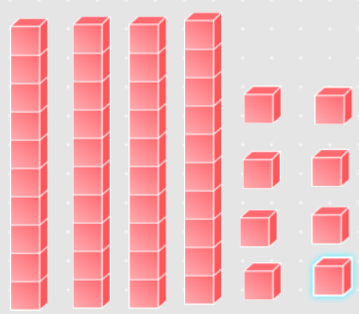
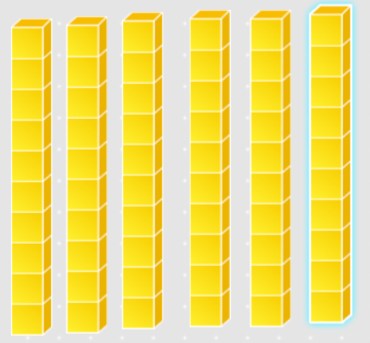
Directions: Count the base ten blocks on each box of crayons. Find the sum that matches it and place it on the box.
104
48
76
113
40
57
26
60
34
45

Slide 15


Directions: Read the word on each rainbow. Find the sun with the word that rhymes and place it above the rainbow.
rest
sink
bill
stock
chess
slip
tell
slab
sting
still
smell
press
grab
flip
track
drink
block
swing

Slide 16






Real
Nonsense
sun
vol
rup
beg
map
cap
tov
dof
lis
leg
pit
fip

Slide 17

You are so loved!
You are perfectly YOU!

Slide 18


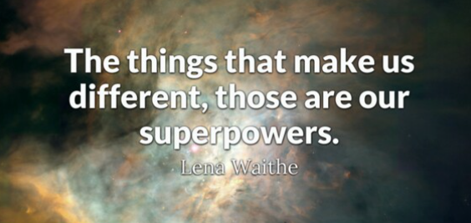

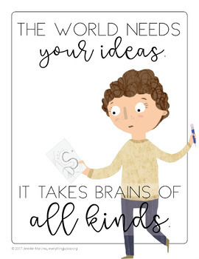

Slide 19
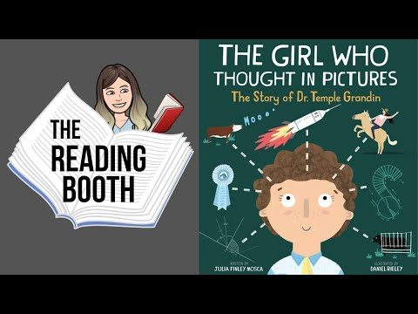
Day 2
Temple Grandin
“We all are YOUnique”
The way you think is just as unique as the color of your skin.
Some people can solve problems fast and others don’t know where to begin.
The fact we all think differently truly is quite exciting because you may be good at math and I may be good at writing.
With the gifts that we’ve been given, we can help to change the world starting with every child; every boy and every girl.
~ Mrs. Ganoe

Slide 20

Temple never gave up on herself and her goals once she figured out what she was passionate about. What happened because she never gave up?
Type here.

Slide 21
Temple was different and that’s what made her special. What makes you special? Why do you think this way?
Type here.

Slide 22

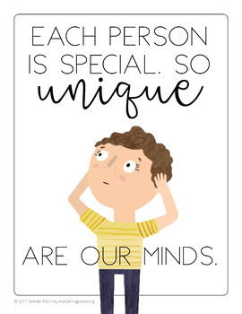
What was Temple’s
unique idea? How did she use it to help change the world for the better?

Slide 23
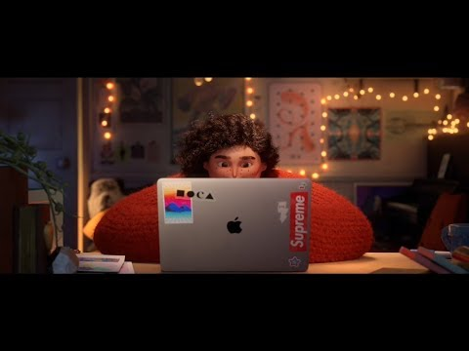


Don’t Hide Your Gifts - Share them with the World !

Slide 24
What gift or passion do YOU have? How can you use it to help change the world for the better?
Type here.
“Meant to be Shared”
We each have gifts we’re meant to share; each one is so unique. Some may have the gift of compassion and others the gift to speak. It’s important to share our gifts with everyone we know because that is how to change our world and watch kindness begin to grow.
~ Mrs. Ganoe

Slide 25
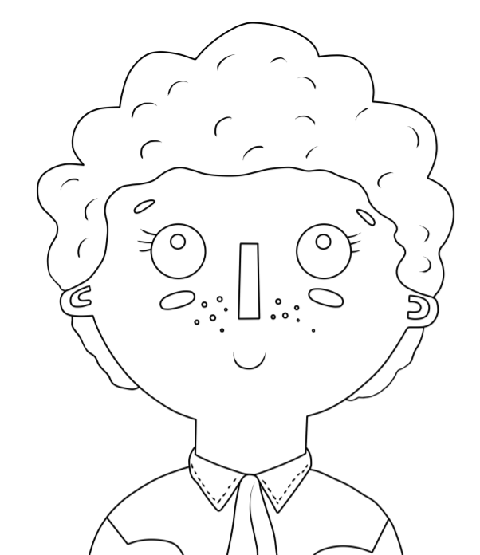
What are some adjectives you can use to describe Temple Grandin?
Type.
Type.
Type.
Type.
Type.
Type.

Slide 26

About Temple Grandin
What made Temple different from other children her age?
Why do you think Temple’s mother said, “You should all be ashamed.”
How did Temple respond when other children were unkind to her?
Why did Temple need to go away to her aunt’s house?
Why does Temple like cows so much? What do they have in common?
How do you think Temple’s teachers encouraged her?

Slide 27
About Temple Grandin
What problem did Temple want to solve?
How was Temple different than other women at that time?
How did Temple help farms? What would have happened if she listened to peoples’ negativity?
How did Temple make a positive impact on our world?

Slide 28

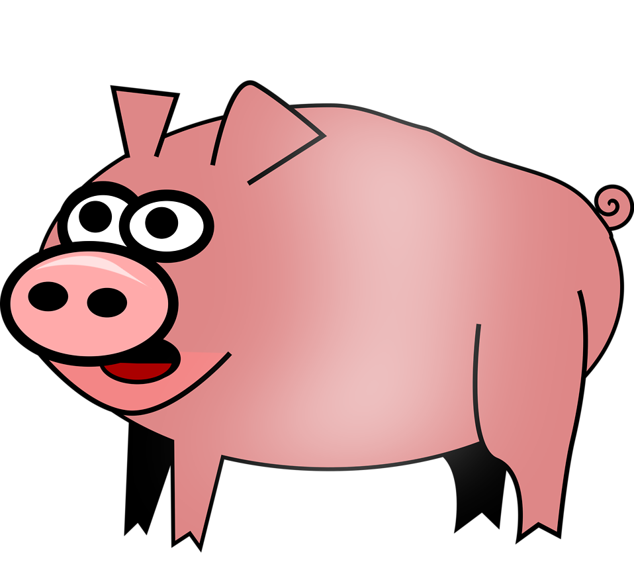
Directions: Solve the double digit addition equations either on paper by drawing the base ten blocks or by going to https://www.coolmath4kids.com/manipulatives/base-ten-blocks . Find the apple with the sum and click and drag it to the pig’s mouth. Pigs like eating fruit. :)
100
70
90
70
100
80
90
50
30 + 40
60 + 40
20+30
10+40
70+20
80+10
50+30
90+10

Slide 29
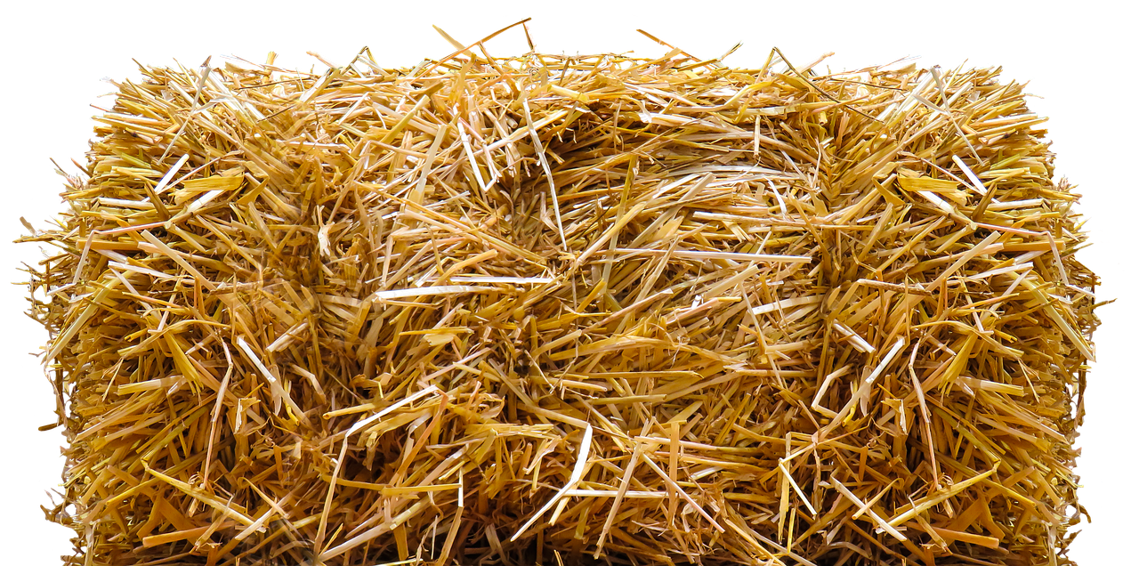
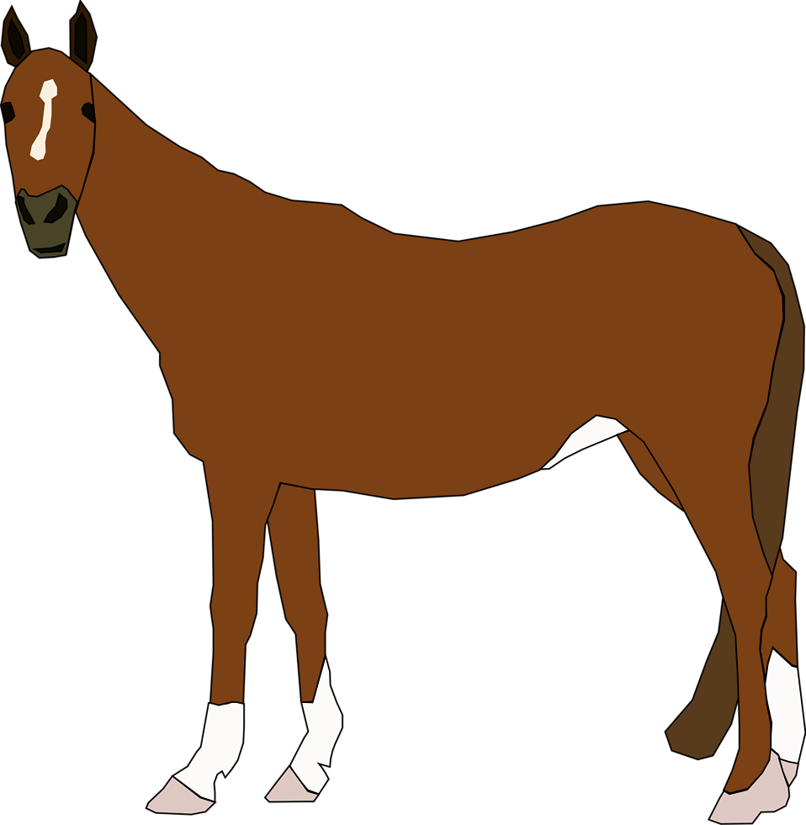
Directions: Read the word on each horse. Find the matching rhyming word on the hay bales. Click and drag the hay bale under the horse.
stick
by
brass
pack
stall
stuck
blend
Roy
trick
buck
mall
mass
black
friend
my
boy

Slide 30


Real
Nonsense
Read each word on the sheep. Sort the sheep under each barn.
pov
sit
bun
rem
poj
cap
tap
mif
mud
gop

Slide 31
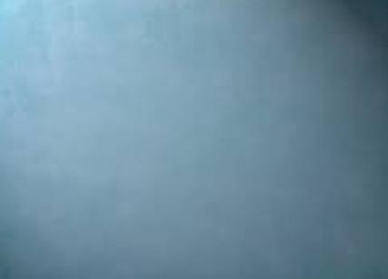
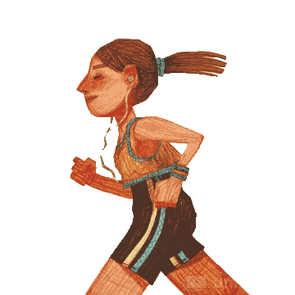

Bobbi Gibb and the Boston Marathon
Day 3

Slide 32
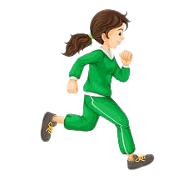
What did Bobbi want to do?
What was keeping her from doing what she wanted?
What did she need to wear at school?
Was she allowed to run track? Why? Why not?
What did she wear when she would run?
How long is a marathon?
Were women allowed to run the Boston Marathon? Why?
When did she find time to run?

Slide 33
What did Bobbie wear on her feet?
What did Bobbi wear when it was cold and snowing?
How did Bobbi end up running in the Boston Marathon?
What did the crowd do when they found out it was a girl running in the race?
Would you ever do something like this? Why/why not:
Why didn’t Bobbi allow the rule of no girls allowed stop her?
How did Bobbi change the world for the better?
When Bobbi decided to take a trip across the country, what did she do?

Slide 34
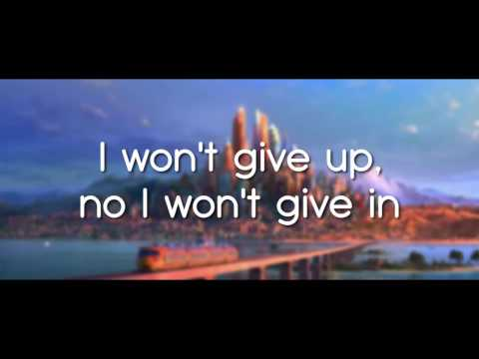
“Don’t Ever Stop”
When you have a passion that sets your heart on fire; don’t ever let anything or anyone tell you that you can’t have what you desire.
If you only keep on trying; keep pressing on each and every day, that passion that lies inside you will surely come your way.
Don’t ever stop believing in the amazing person you are because others who watch your determination will see that you’re a STAR!
~ Mrs. Ganoe
You!

Slide 35
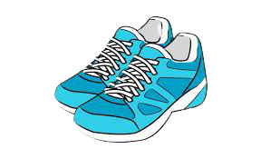

Brave Like Bobbi
Type Here.
On the next page, respond to one of the questions being asked below. You must write at least 3-4 sentences. Use the writing checklist to help you.
When was a time when you were brave and didn’t let anyone or anything stop you?
If you were Bobbi, what would you have done to be able to run in the Boston Marathon? Is this the same or different than what Bobbi did?

Slide 36

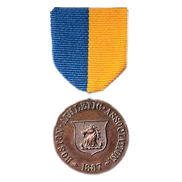
Directions: Solve each addition problem on the marathon medals. Look for the running sneaker with the sum that matches. Click and drag the sneaker next to the medal.
13
8+7 =
9+8 =
5+4 =
17
20
9
12+6 =
7+6 =
15+5 =
18
15

Slide 37
Directions: Solve each subtraction problem on the marathon medals. Look for the running sneaker with the sum that matches. Click and drag the sneaker next to the medal.
14
20-6 =
18-8 =
15-9 =
8
6
2
7-4 =
5-3 =
11-3 =
10
15

Slide 38

Directions: Read the word on each running shirt. Find the racing bib with the word that rhymes and place the bib under the word on the shirt.
Bobbi G.
class
Bobbi G.
stick
brass
brick
snack
Bobbi G.
sunny
Bobbi G.
pack
frog
Bobbi G.
smog
Bobbi G.
bike
Bobbi G.
red
Bobbi G.
mother
funny
said
like
other

Slide 39

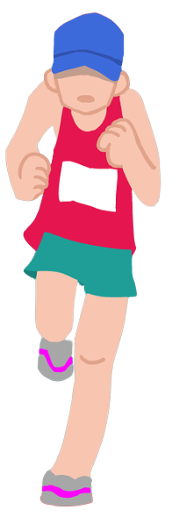
Real
Nonsense
soj
rat
fap
mop
soj
pen
fan
wep
fin
mul

Slide 40
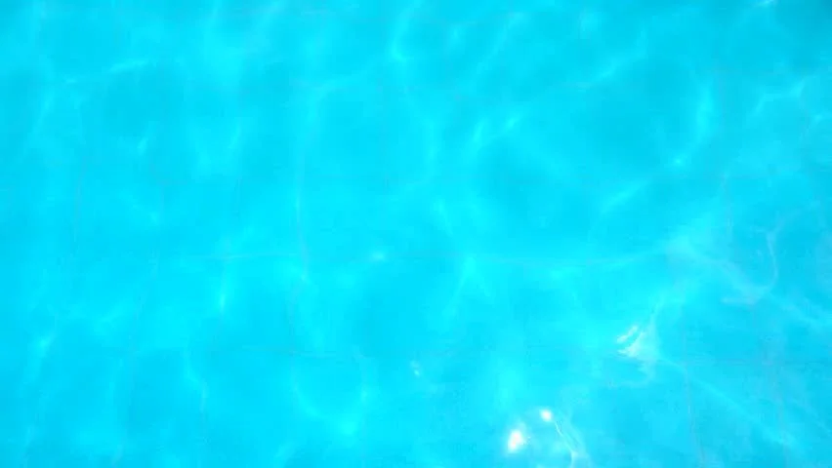
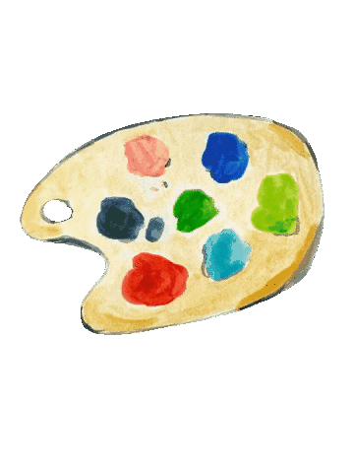

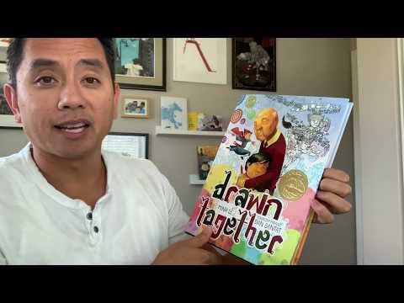
Day 4

Slide 41

82
110
25
27
53
44
19
30
SKETCH
SKETCH
SKETCH
SKETCH
Ten more than 17?
Ten more than 20?
Ten more than 34?
Ten more than 9?
SKETCH
SKETCH
SKETCH
SKETCH
Ten more than 43?
Ten more than 72?
Ten more than 15?
Ten more than 100?

Slide 42

Directions: Read the word on each paint palette. Find the paintbrush with the word that rhymes and place it on the paint palette.
free
cry
trim
stink
bike
drank
drum
crop
see
think
from
like
shrank
why
slim
drop

Slide 43

Real
Nonsense
pet
rip
rop
bag
dog
lin
nes
kos
tan
nuz
ran
fom

Slide 44
Comprehension Questions
How did the boy feel when he realized how different he and his grandfather were?
Why should we appreciate one anothers’ differences?
What do you think the word, “Diversity” means?
What are three things the boy and his grandfather did not have in common?
How did the boy and his grandfather begin to communicate?
Is it okay to be different from someone and still be their friend? Why/why not?

Slide 45
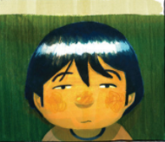
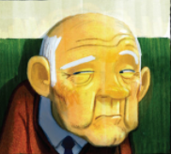
Similarities and Differences
Type here.
Type here.
Type here.
Directions: Thinking back to the story, “Drawn Togther”, think about the boy and his grandfather. How are they the same? Type your answer in the yellow part of the circles. How are they different? Type the boy’s likes in his side of the circle and the grandfather’s likes on his side.

Slide 46


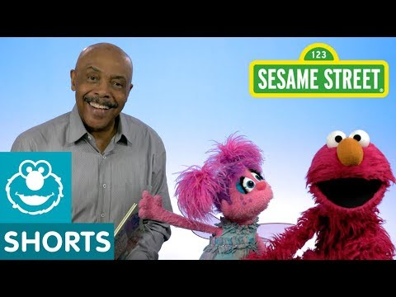

Type here.
How can we appreciate one anothers’ differences in our virtual classroom?
Give me at least three ways and use complete sentences.

Slide 47



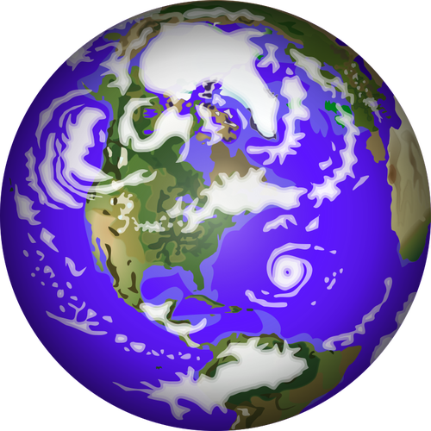

Day 5
“Me and You”
I have black hair, you have red; my eyes are green like Uncle Ned’s. Your eyes shine like icy blue glass all of us are different in our class.
I can run, you can cook, he can dance and she reads books.
I like funny movies and you like scary, adventure ones are the best for Harry.
I am very short and you are quite tall, I like the season of summer and you like fall.
I am not the strongest reader while you read like a pro, you can run pretty fast and I run pretty slow.
My family is from the U.S. while yours is from Peru; we may be very different but we have similarities too.
We both are human beings with very caring hearts; not judging by the book is where love and kindness starts. When we look for the good in others rather than the bad, our world will begin to change and be happy rather than sad.
~ Mrs Ganoe
pev
Love One Another

Slide 48
Directions: In the story, “The World Needs More Purple People”, they told you the steps in become one yourself. Read the sentences on each heart. Place the hearts in order below.
Ask questions.
Use your voice.
Work hard.
Laugh a lot.
Be the real you.
1
2
3
4
5

Slide 49

Take Time to Get to Know ME
This is ME!
My name is: Type here.
My family is from (Country) Type here.
I speak (Language(s)): Type here.
Insert a picture of yourself here.
My family’s favorite tradition is:
Holidays my family celebrates: Type here.
My favorite food is:
I am happy when: Type here.
I am sad when:

Slide 50
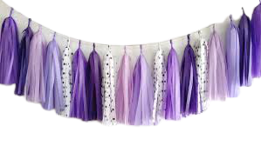
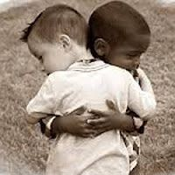
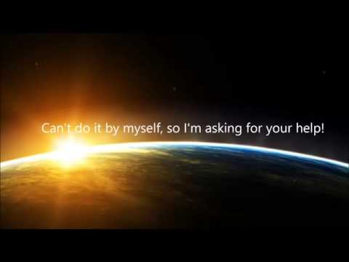
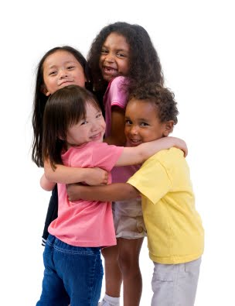
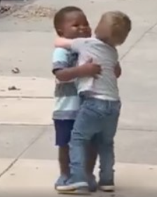

Together We Can Change the World.

Slide 51


Directions: Solve the addition problems then click and drag the purple heart with the sum and place it in the middle of the red and blue people.
51
23
22
41
21
23
27
42
20 + 7 =
18 + 5 =
34 + 8 =
18 + 6 =
14 + 9 =
12 + 10 =
43 + 8 =
16 + 5 =

Slide 52

Directions: Read the word on each globe. Find the purple heart that rhymes. Click and drag it on top of the globe.
stash
fast
flint
cart
thrill
bent
cost
back
raft
dust
trash
sent
craft
frost
still
stack
print
blast
rust
part

Slide 53
Read each word. Click and drag the word onto the globe for, “Real” or “Nonsense.”
Real
Nonsense
pev
dov
red
hib
sun
fob
mat
tul
dab
fun

Slide 54

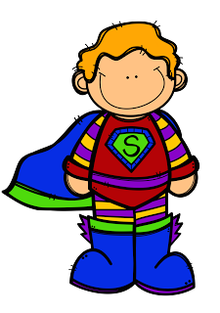
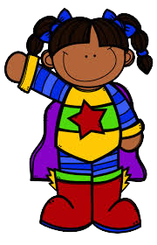
If you could have any superpower to help change our world and bring more happiness, what woud it be and why?
Type here.

Slide 55



Listen to some calming music while you write.
Type here.
Where is your favorite calming place? This is a place you are happy and at peace. Answer in complete sentences (At least 4) on the paper to the right.

Slide 56
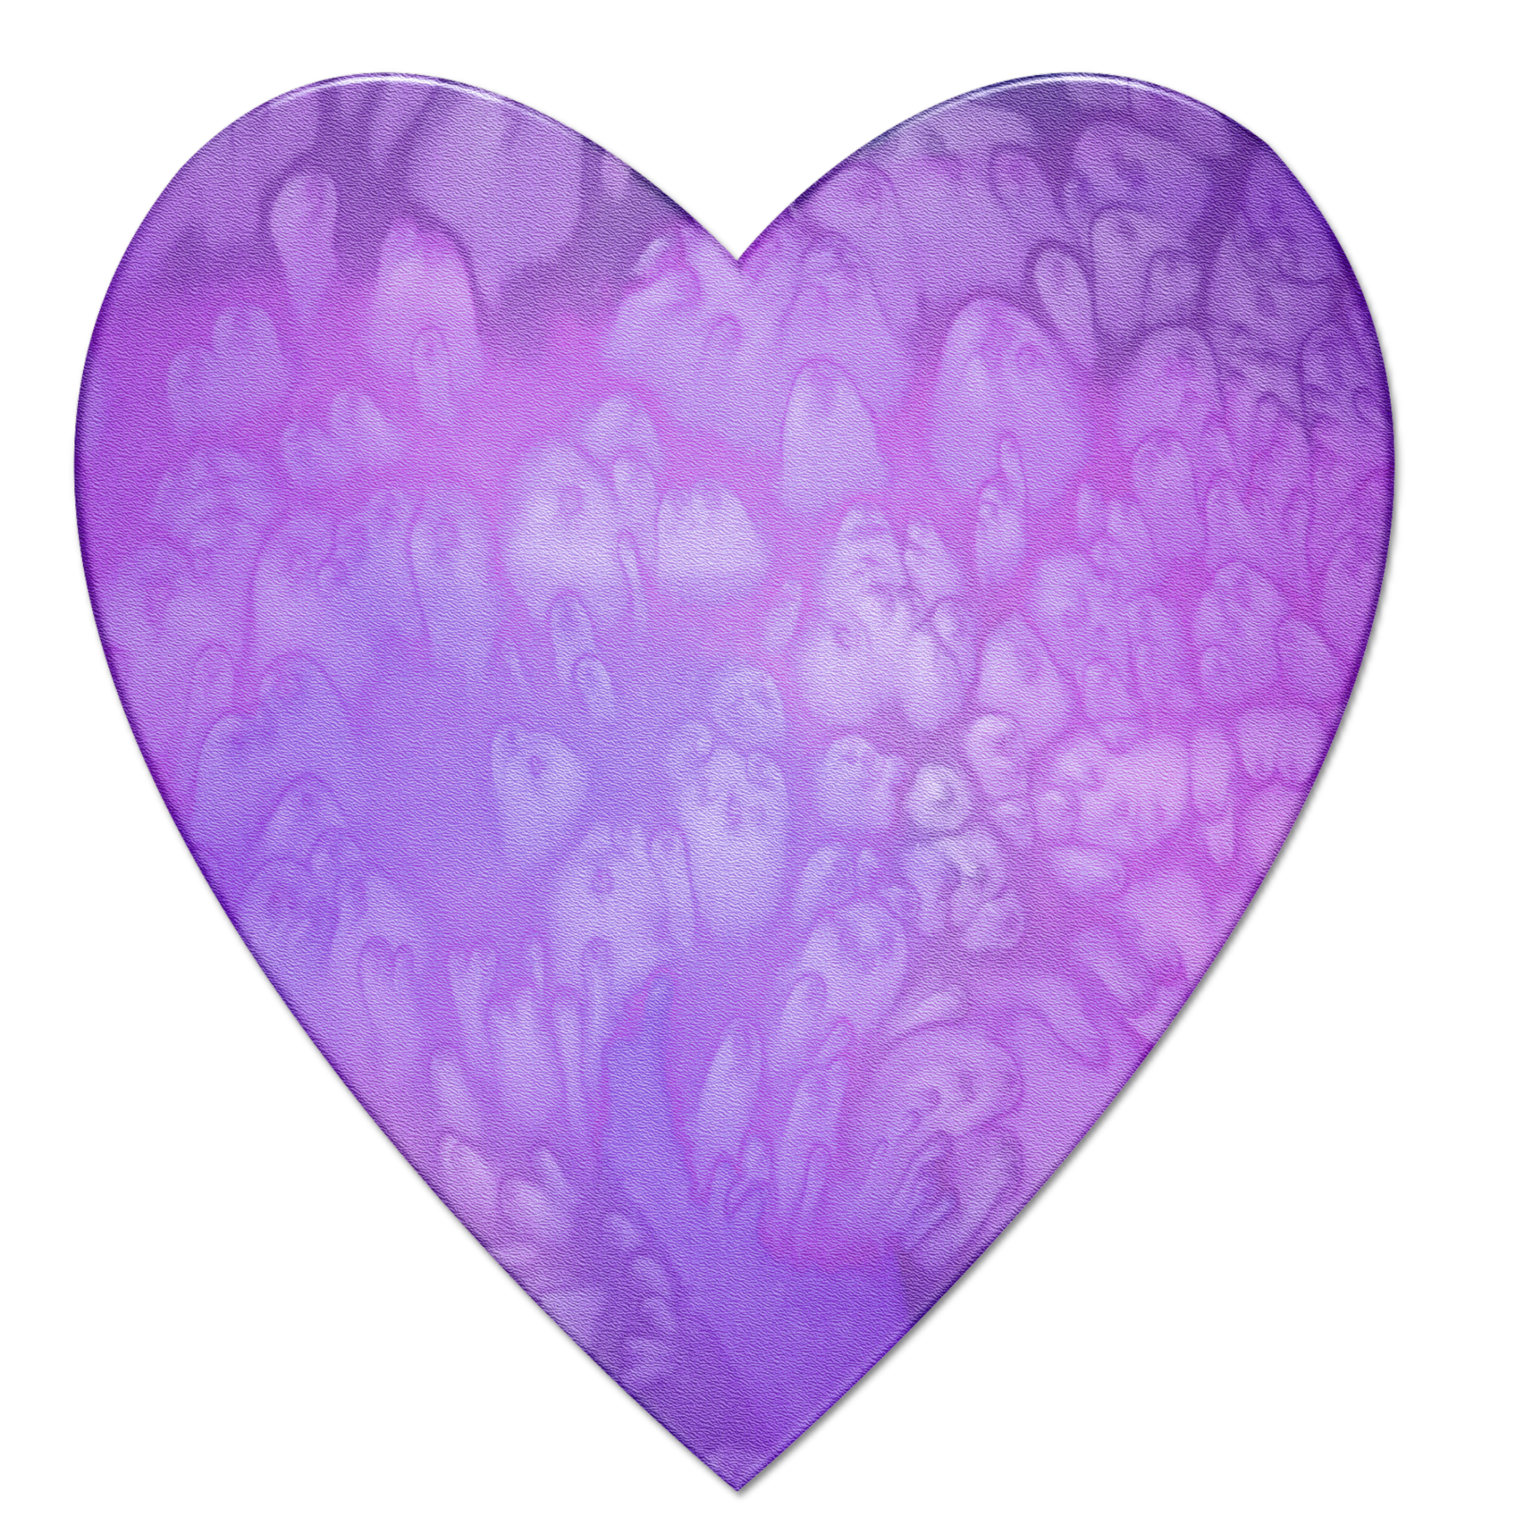

Why do you think the world is in need of more purple people? How can you be a purple person? Write your response on the heart.
The world is in need of more purple people because (Type here)
You are Awesome!
I like you just the way you are.
Fragile … please take care. Words and actions can hurt.

Slide 57



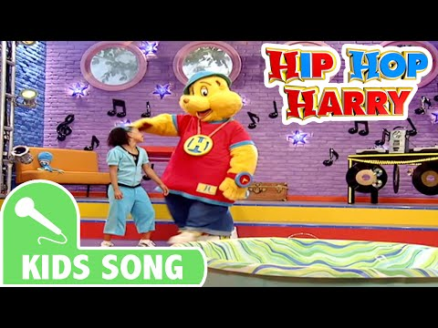
Spread
Kindness
Kindness is a Choice
Each and every day we have the choice to be kind; it’s something we all need to keep in mind.
If someone treats you rudely and maybe unfair, we need to be reminded that they really do care. Sometimes events happen throughout our day where they may affect what we do and say.
We need to be mindful of how we react because
once words are said, you can’t take them
back. If we just took a moment to
be a little more kind, share our gifts
with others and let our lights
shine, our world would
change from hate to love
And this is what we all need to be
reminded of.
~ Mrs. Ganoe

Slide 58



I like you just the way you are.

Slide 59
















Do All Things with Kindness

Slide 60
Make time for the people in your life (Friends and Family): Make a phone call to talk with them, visit and bring a picture, make a special baked good and take the time to talk, invite a friend over, etc.
Donate: There are so many children out there who don’t have the toys and clothes like you do so take them time to go through them and donate them to other children who would love to have them.
Pay it Forward: If someone does something kind for YOU, do something kind for someone else and hopefully they will do the same and before we know it, more and more people are happy and smiling.
Volunteer: Help someone without expecting something in return. Help a neighbor carry in groceries, help out at your school where you can and be there for your classmates.

Slide 61
5. Let go of expectations: Never do something for someone with expecting something in return. That’s not being a genuinely kind person. Do nice things for others because you WANT to and not for the compliments and recognition for it. Be genuinely KIND.
6. Share something: If you have toys that you love to play with and someone wants to play with it, ask them to play with you. If a friend is in need of crayons or a pencil, offer to share yours with them. At this time though we have to be careful what we are sharing because of germs but if someone wants to swing at recess and there aren’t any available, get off of yours and give it up to another classmate.
7. Stop judging others: This means that we look at someone, listen to only a little bit of what they say, or listen to what others say about them and make quick snap judgments without getting to know the person. This is NOT being a kind person. Always get to know someone for yourself and give them person a chance to let you get to know who they are.

Slide 62
8. Pay a compliment: Compliments can go a LONG way!!! Tell a friend you like their outfit, they look so beautiful when they smile, they’re great at reading, drawing or math, they have good ideas, they’re

Slide 63






Misc. Kindness Videos

Slide 64






Overcoming Adversity

Slide 65




Slide 66

Additional Diversity Activities
https://www.thecurriculumcorner.com/thekindercorner/diversity-differences-make-us-unique/ (This one has a cute diversity lesson using white and bro wn eggs to show how although the colors are different, the insides of the eggs are the same).
https://funlearningforkids.com/teaching-diversity-crafts-activities/
https://www.pbs.org/parents/crafts-and-experiments/learning-to-appreciate-diversity-through-play
https://www.mylemarks.com/store/c32/Diversity_and_Inclusion_Worksheets.html
https://www.theedadvocate.org/ways-to-promote-diverse-cultures-in-the-classroom/
https://www.gettingsmart.com/2016/10/student-activities-to-promote-diversity-inclusion-and-empathy/
https://theeverymom.com/diverse-childrens-books/
https://bookroo.com/books/topics/obstacles-and-adversity

