Slide 1













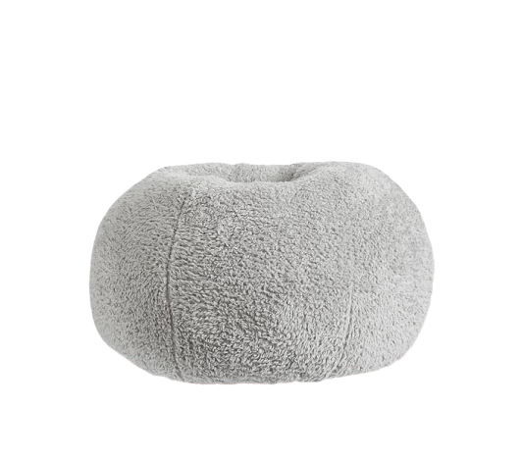

Created By:
Melissa Bussey

Slide 2












Created By:
Melissa Bussey

