Slide 1

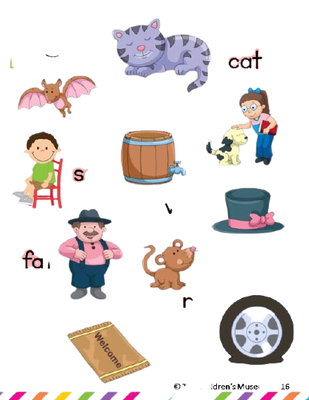

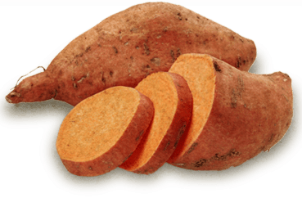
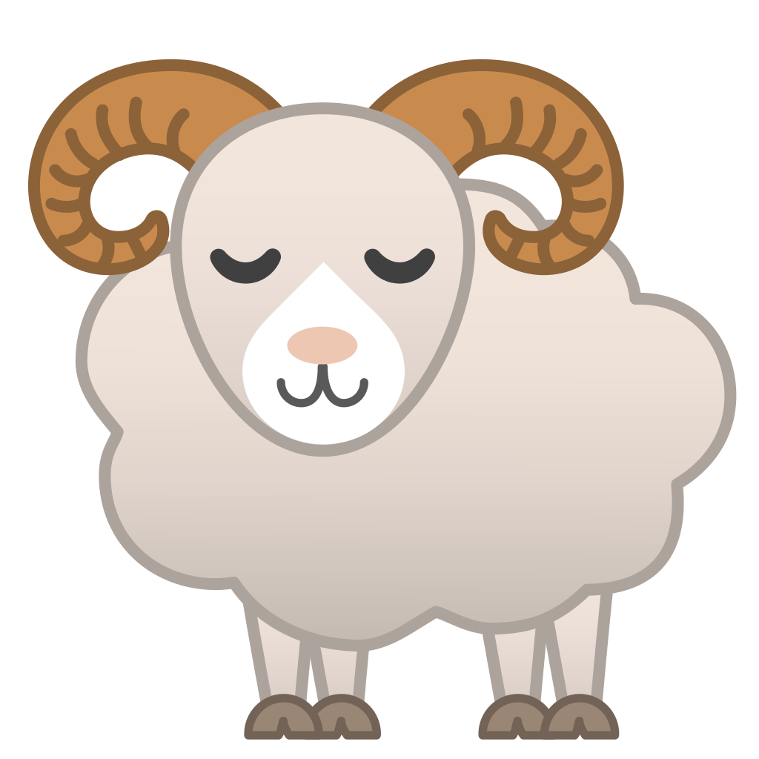
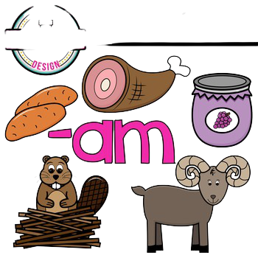
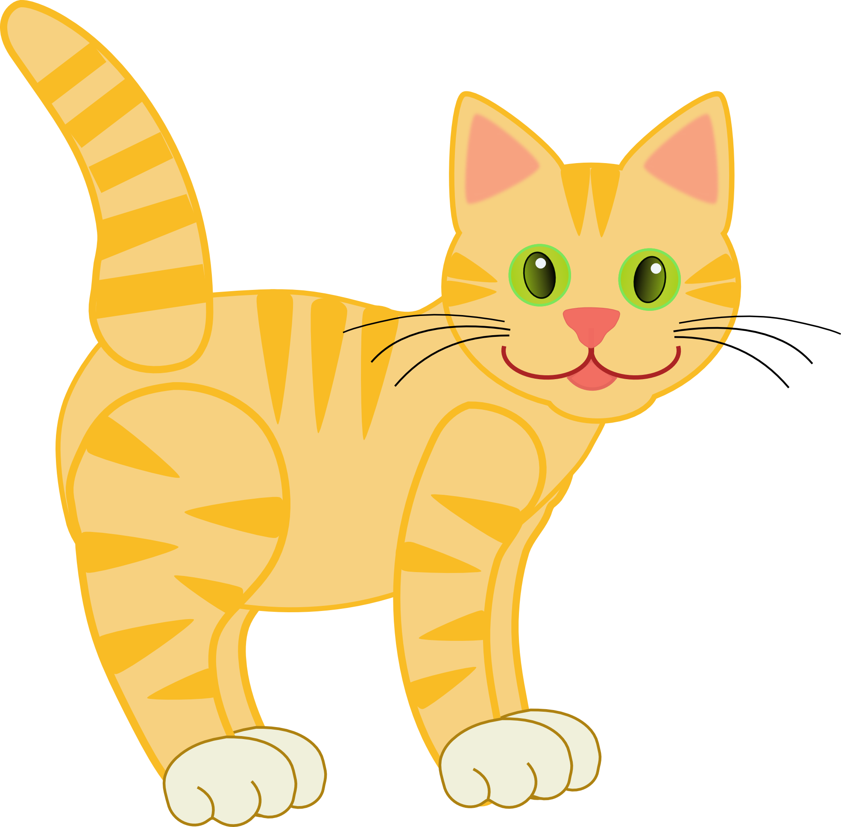

Read Across America rhyming slides
hat
yam
sat
ram
am
at
jam
cat
bat
ham

Slide 2
Directions: Match the pictures with the words. Then copy words and pictures to the next slide and sort them into the right word family box.
bat
sat
cat
hat
ham
yam
jam
ram

Slide 3
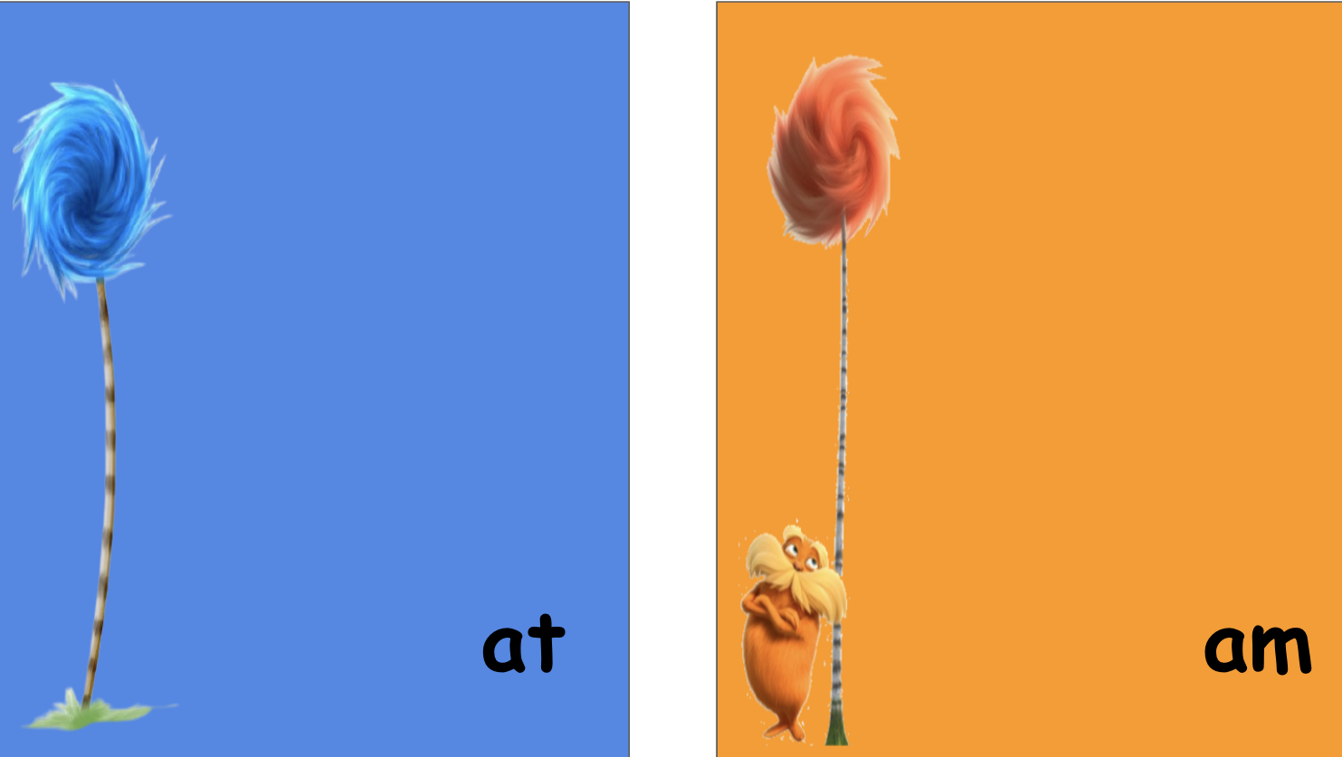

Slide 4
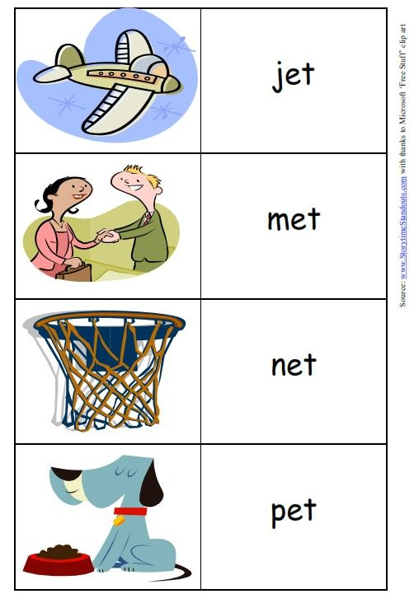


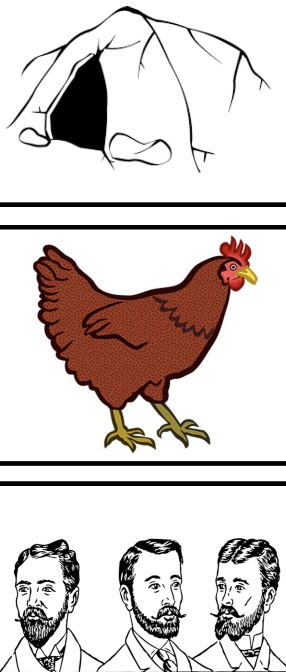
Directions: Match the pictures with the words. Then copy words and pictures to the next slide and sort them into the right word family box.
den
men
pen
hen
pet
net
jet
met

Slide 5
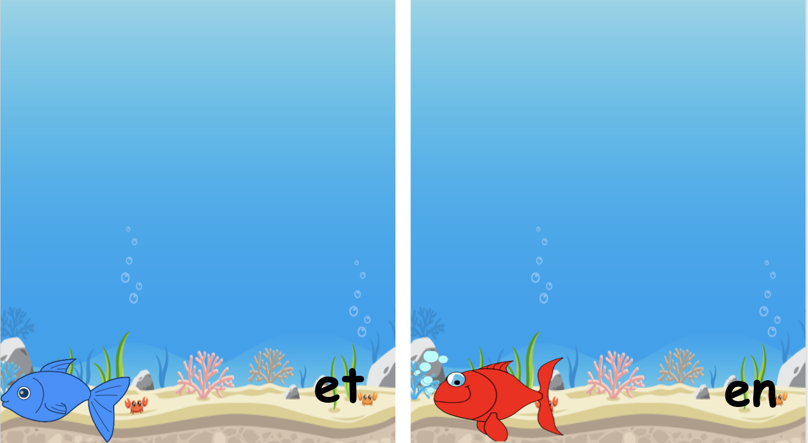

Slide 6
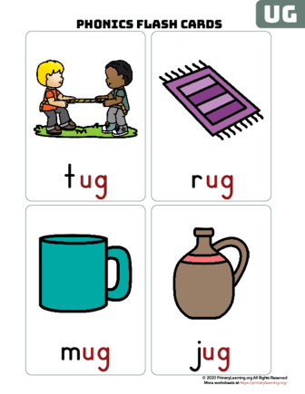
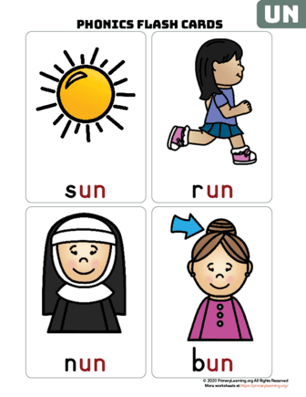
Directions: Match the pictures with the words. Then copy words and pictures to the next slide and sort them into the right word family box.
nun
bun
run
sun
mug
rug
jug
tug

Slide 7


Slide 8
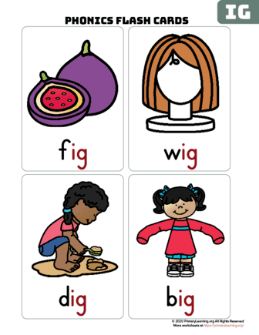
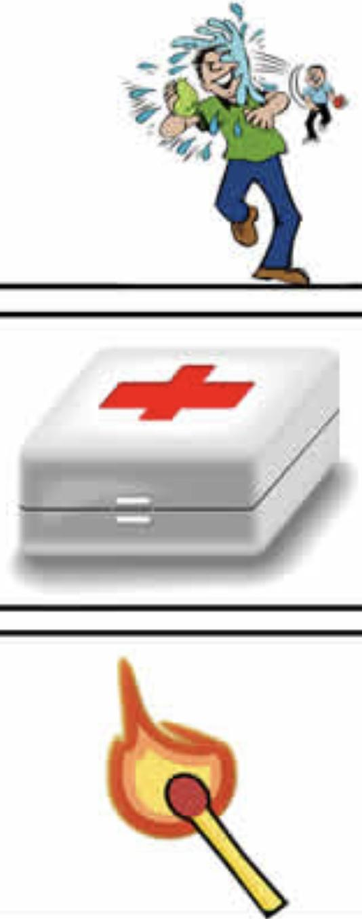


Directions: Match the pictures with the words. Then copy words and pictures to the next slide and sort them into the right word family box.
lit
sit
bit
kit
fig
wig
dig
big

Slide 9
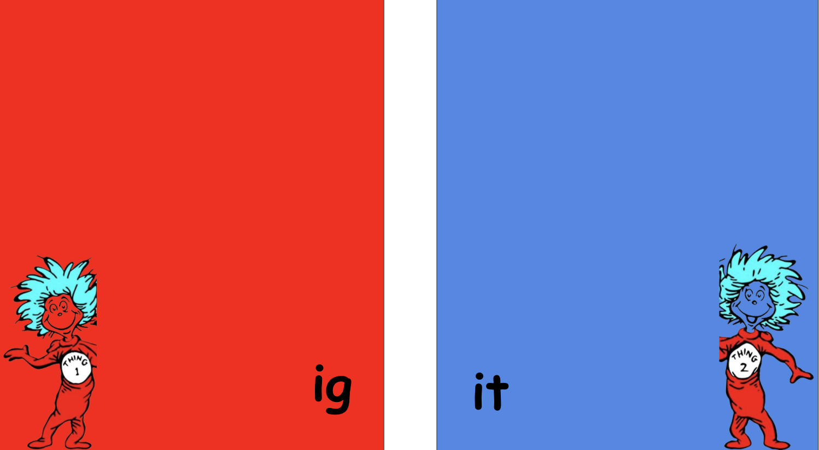

Slide 10
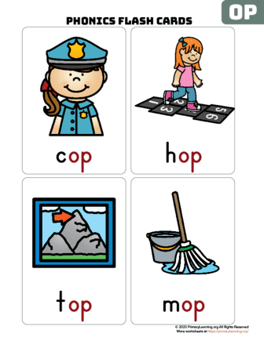
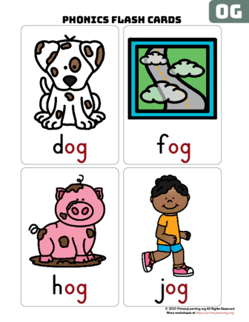
Directions: Match the pictures with the words. Then copy words and pictures to the next slide and sort them into the right word family box.
cop
mop
top
hop
dog
hog
jog
fog

Slide 11


