Slide 1
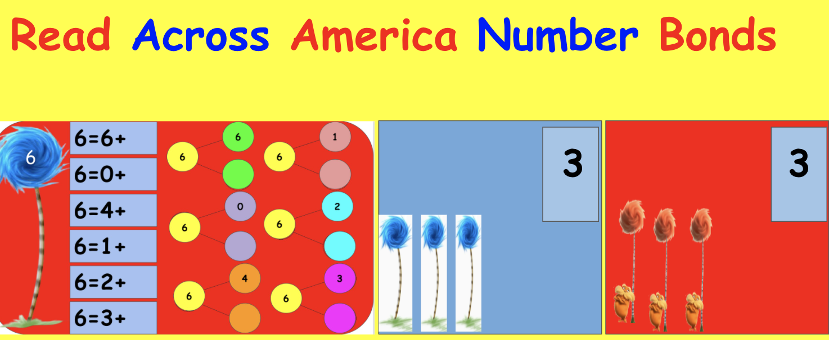

Slide 2

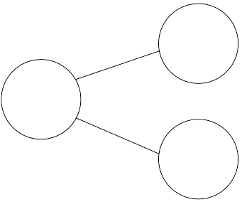
6=6+
6
1
6
6
6
6=0+
6=4+
0
2
6
6
6=1+
6=2+
4
3
6
6
6=3+

Slide 3
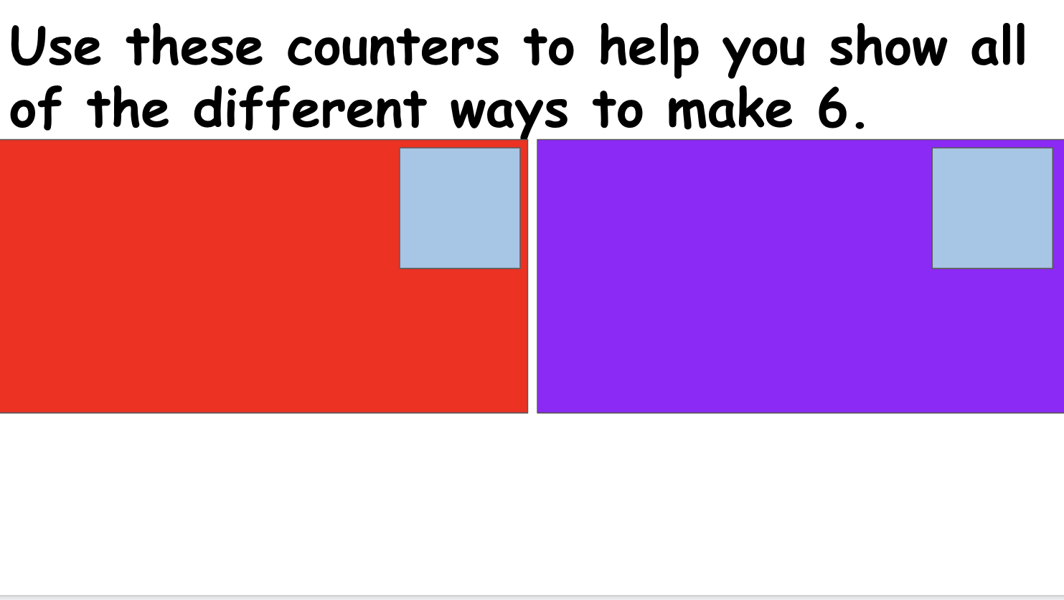

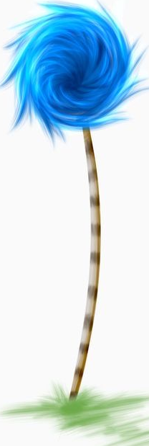

Slide 4
7=6+
6
1
7
7
7
7=0+
7=4+
0
2
7
7
7=1+
7=2+
4
3
7
7
7=3+

Slide 5
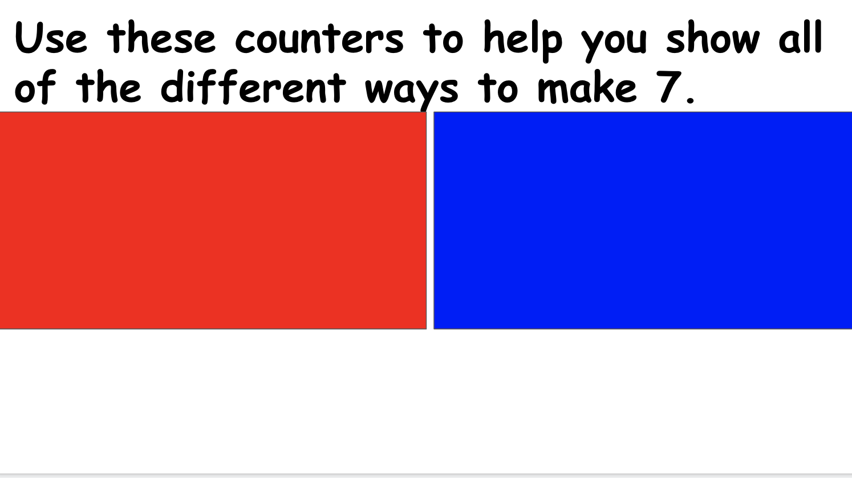
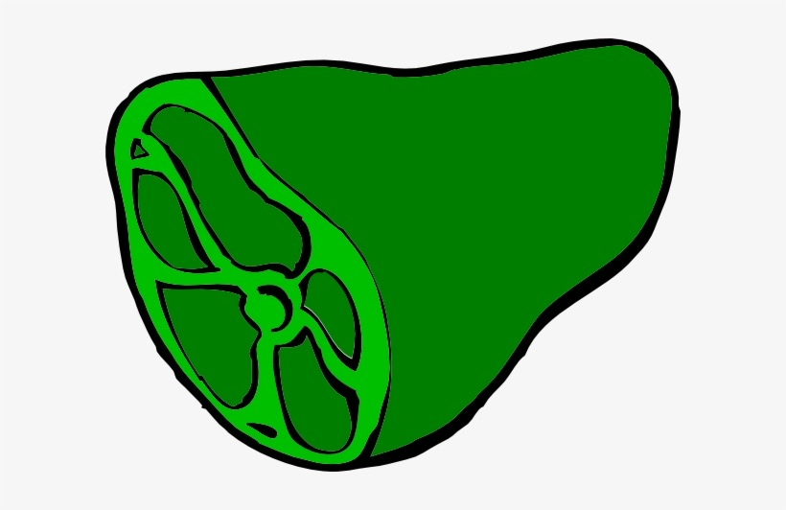
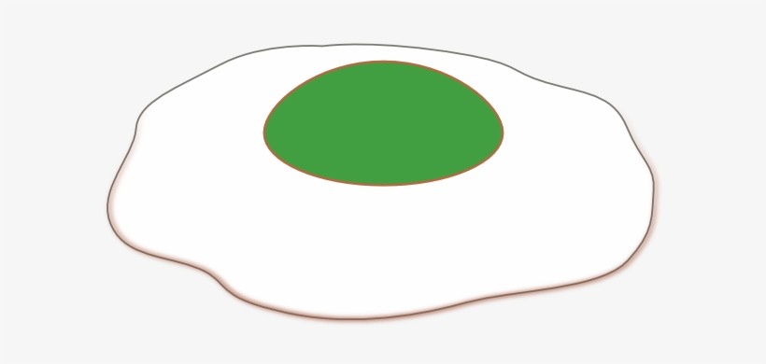

Slide 6
8=6+
6
1
8
8
8
8=0+
8=4+
0
2
8
8
8=1+
8=2+
4
3
8
8
8=3+

Slide 7
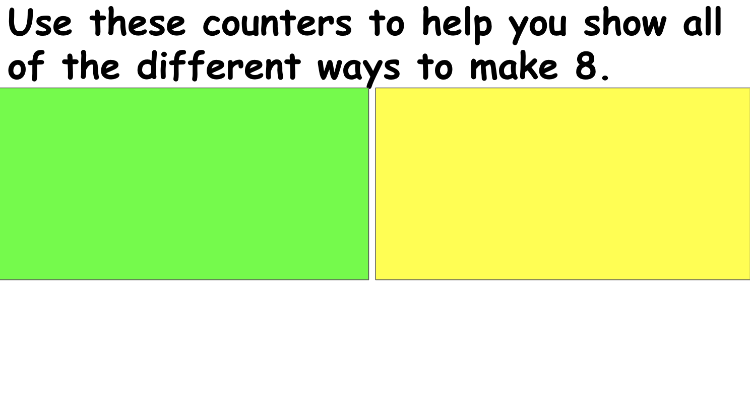
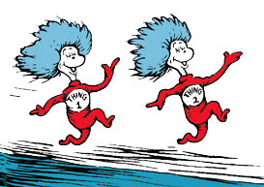

Slide 8
9=6+
6
1
9
9
9
9=0+
9=4+
0
2
9
9
9=1+
9=2+
4
3
9
9
9=3+

Slide 9
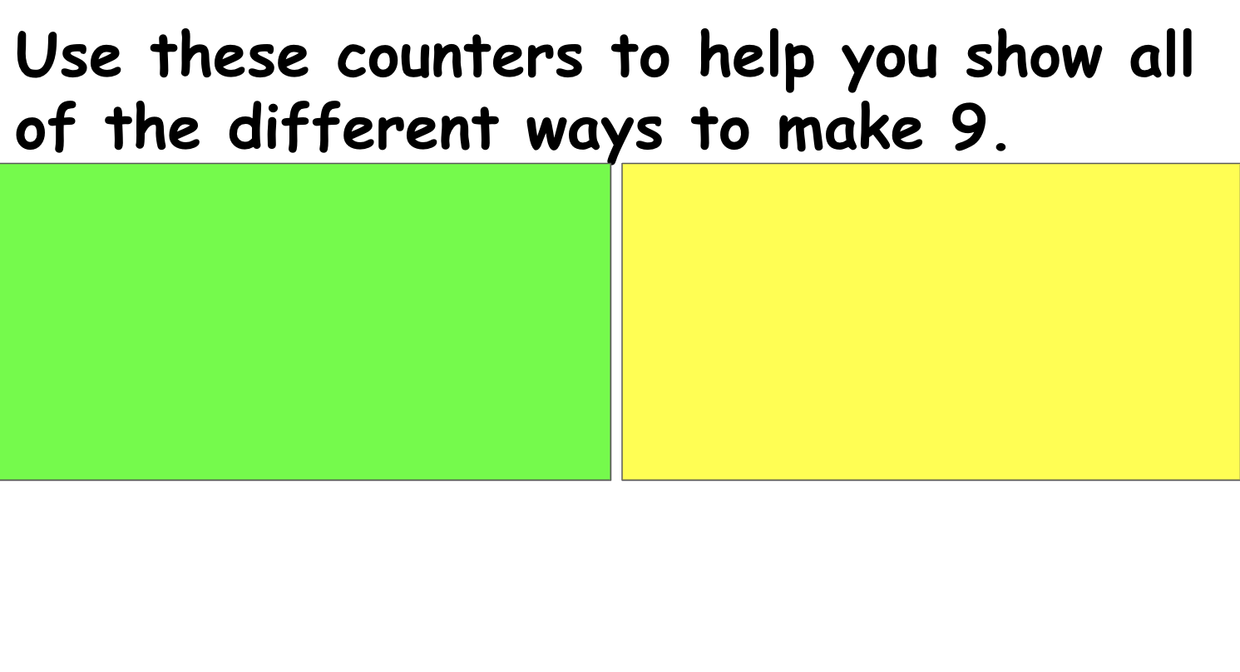
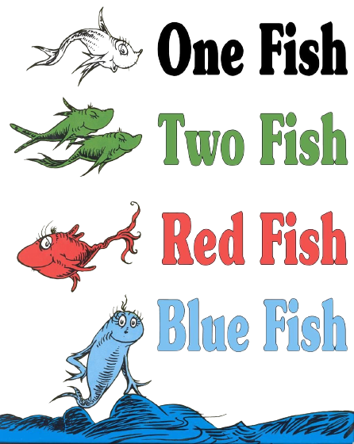

Slide 10
10=6+
6
1
10
10
10
10=0+
10=4+
0
2
10
10
10=1+
10=2+
4
3
10
10
10=3+

Slide 11
