Slide 1
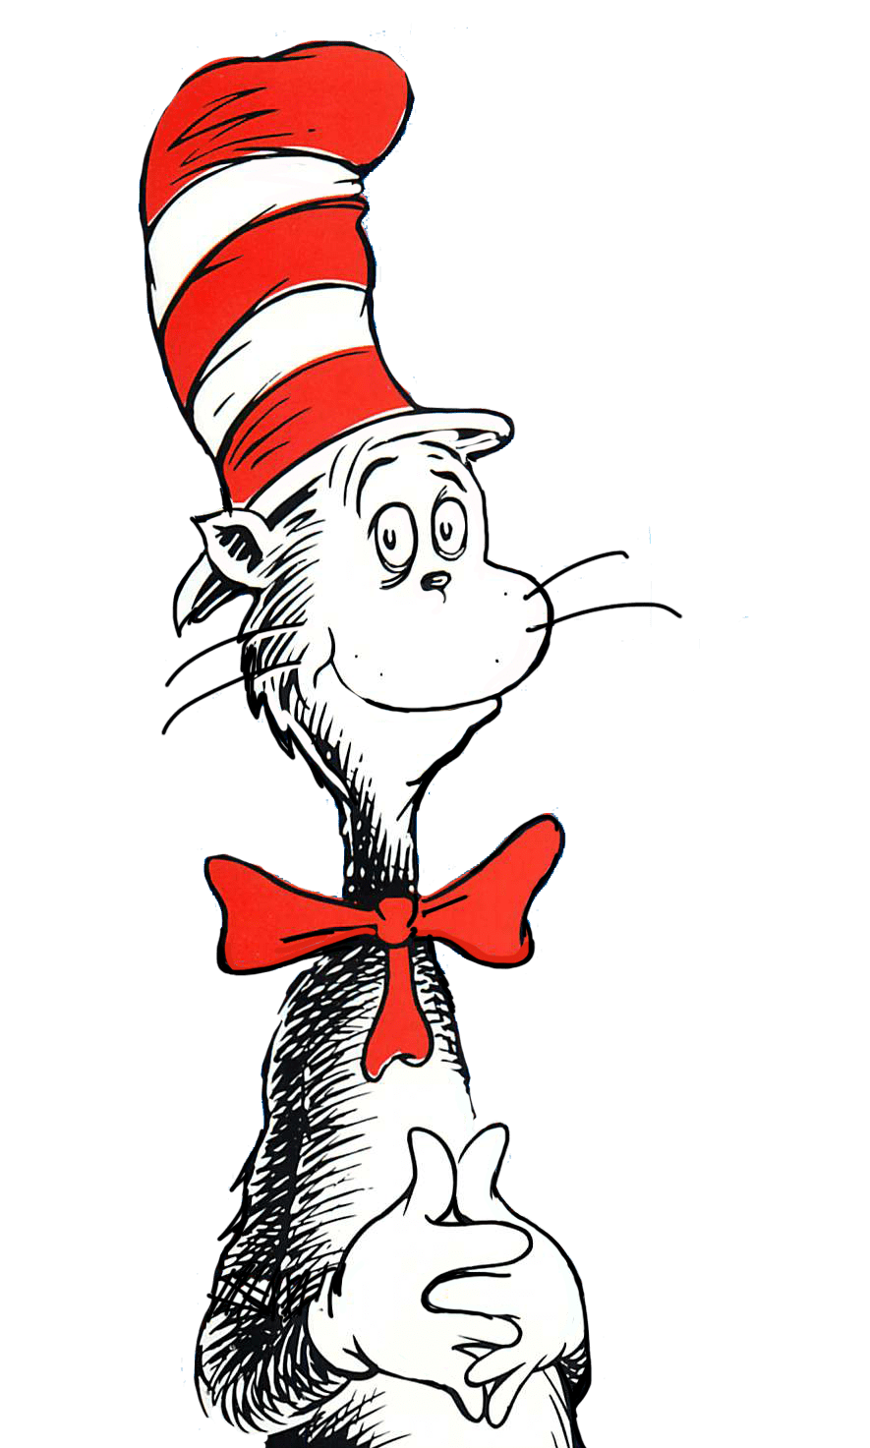
Read Across America Day

Slide 2
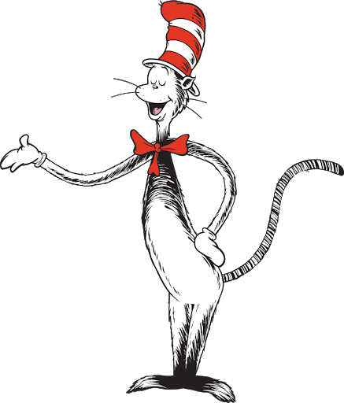
What is Read Across America?
Celebrated on March 2.
The day was established by the National Education Association (NEA) in 1998 to help get kids excited about reading.
This day is the author of Dr. Seuss birthday!

Slide 3

Read Across America Day Song

Slide 4

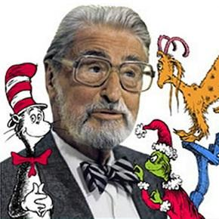
Who is Dr. Seuss?

Slide 5
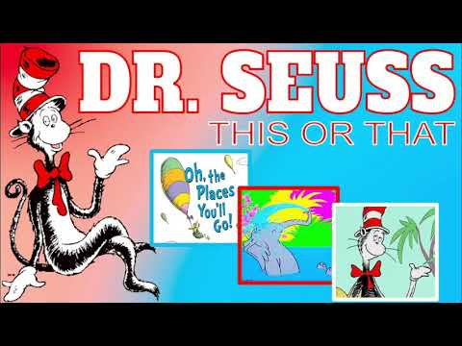
Let’s Work it Out...Dr. Seuss Style!

Slide 6
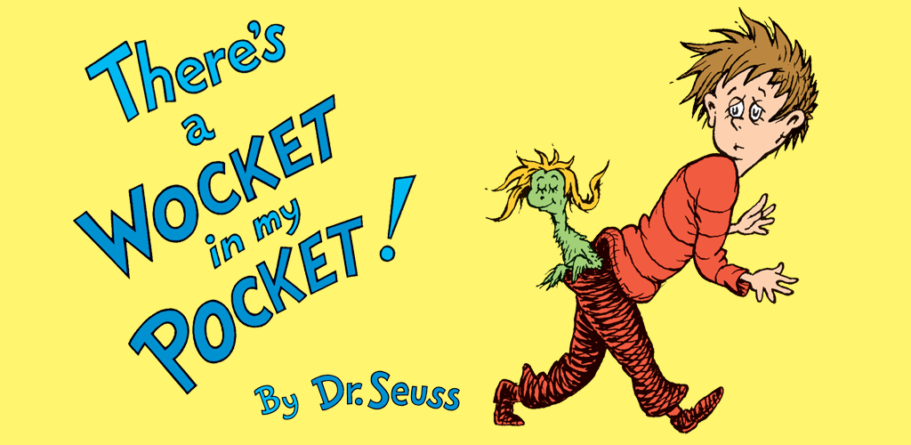

Slide 7
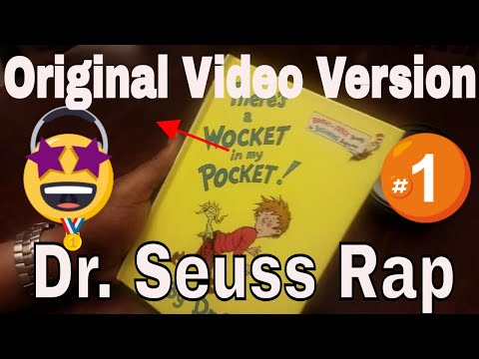


Slide 8
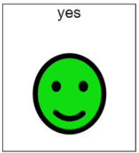
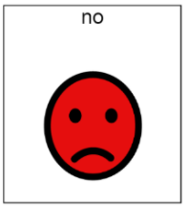
Did you like the book?

Slide 9
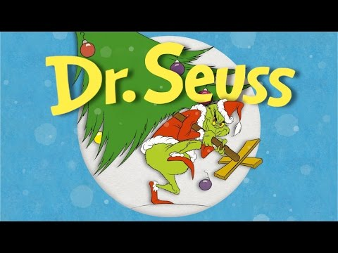

Let’s Rhyme!
Why does Dr. Seuss rhyme? (song)
Jack Hartmann: Make a Rhyme Song

Slide 10
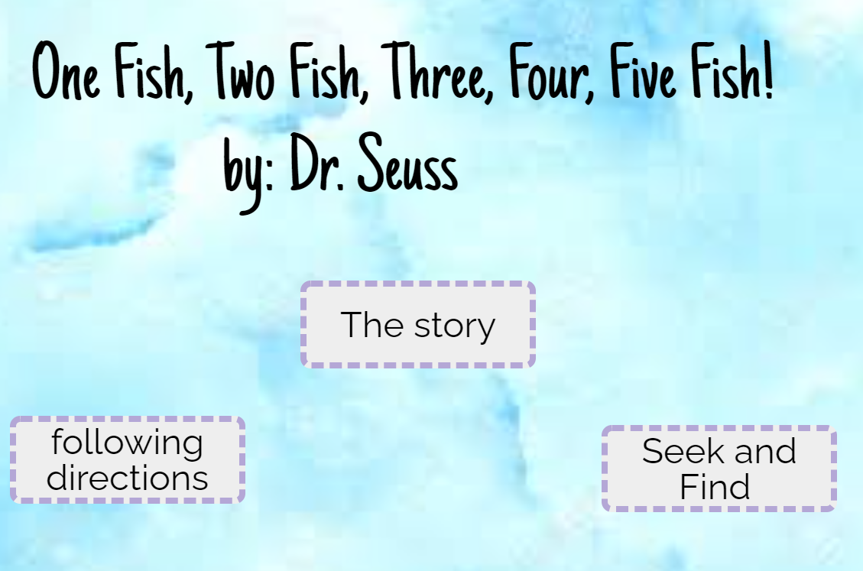
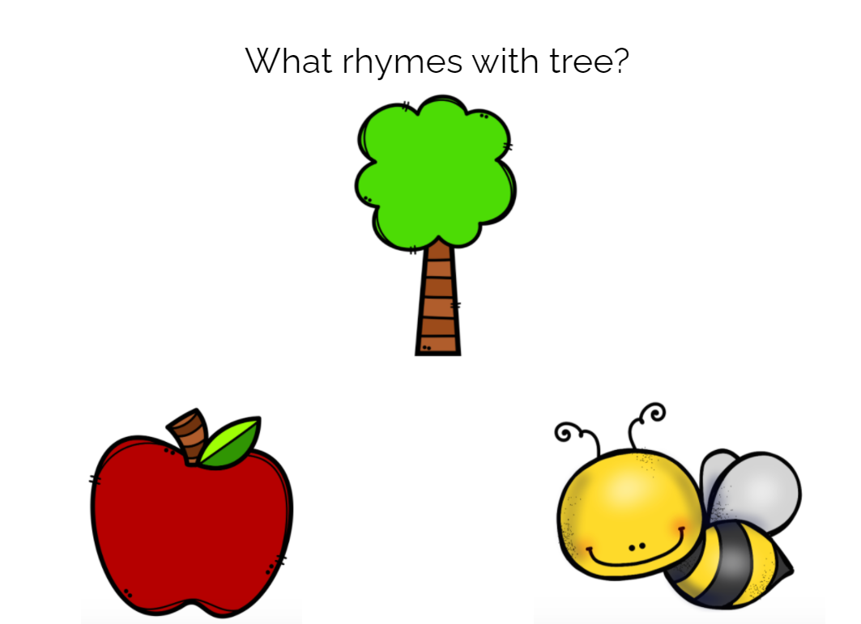
Boom Cards!
One Fish, Two Fish Activity
Rhyming Activity

Slide 11




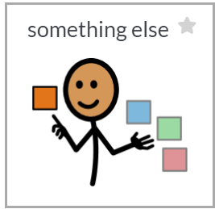
What Dr. Seuss book is your favorite?
The Cat in the Hat
Horton Hears a Who
Green Eggs and Ham

Slide 12
Dr. Seuss Mad Lib
(number) fish, (number) fish, (color) fish, (color) fish.
Black (noun), blue (noun), old (noun), new (noun).
The following slides have choices to for students to pick from to fill in the blanks.

Slide 13
Pick two numbers.
3
10
18

Slide 14
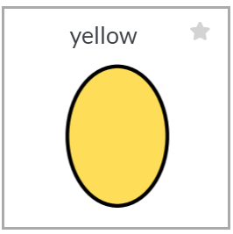
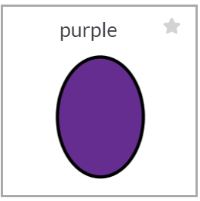
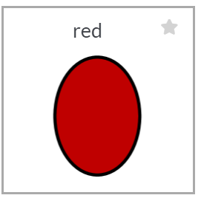
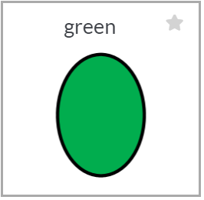
Pick two colors.

Slide 15
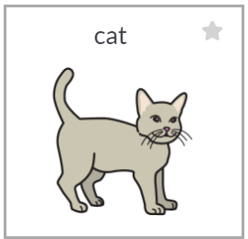
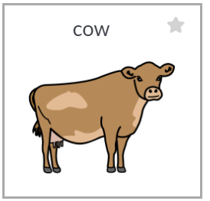

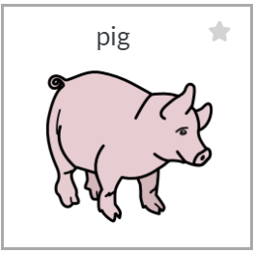
Pick two animals (nouns).

Slide 16
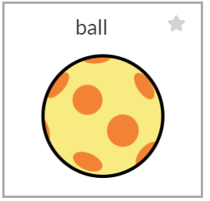
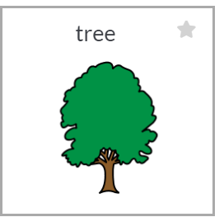
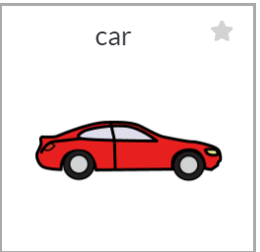

Pick two objects (nouns).

Slide 17

