Slide 1
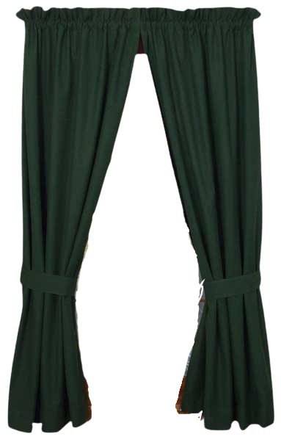

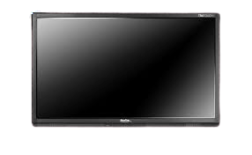
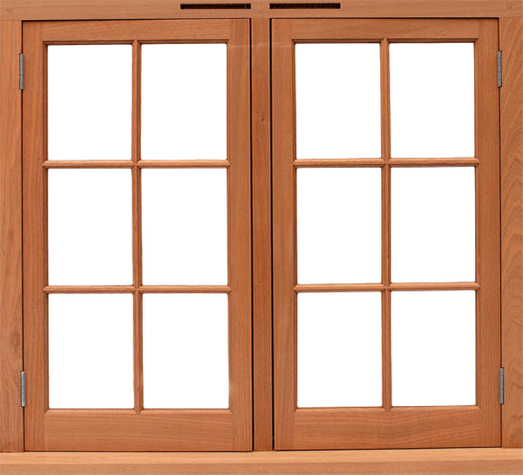
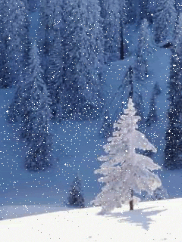

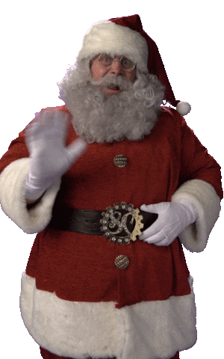

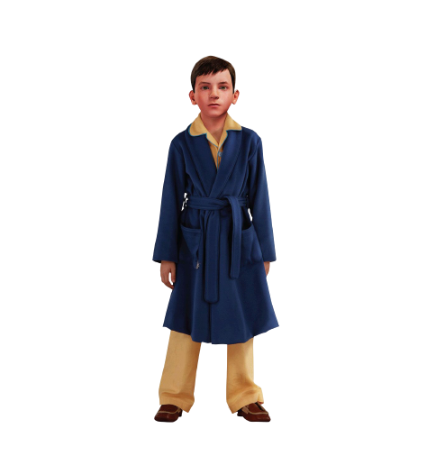
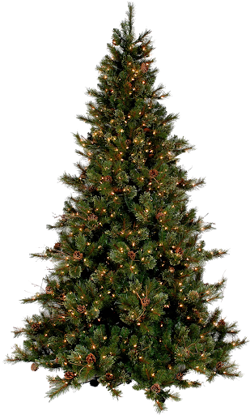

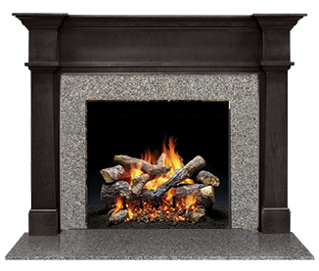
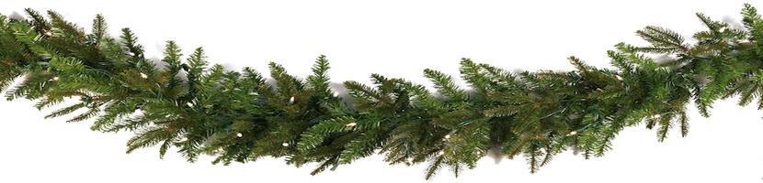


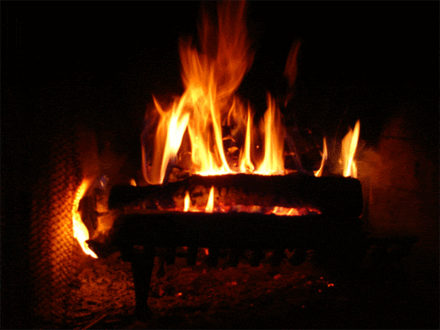
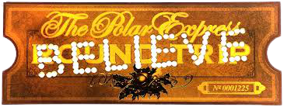

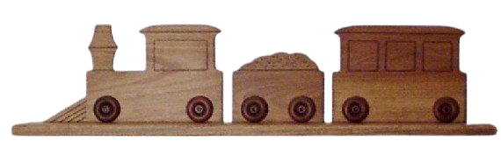



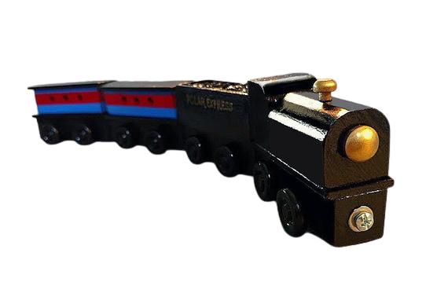
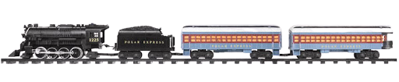

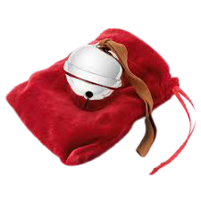

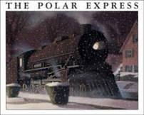
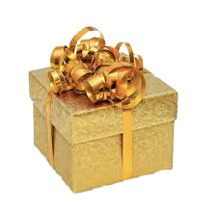
The Polar Express
Notes:
The arrows point to objects you can click on.

Slide 2
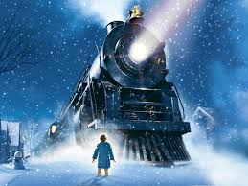
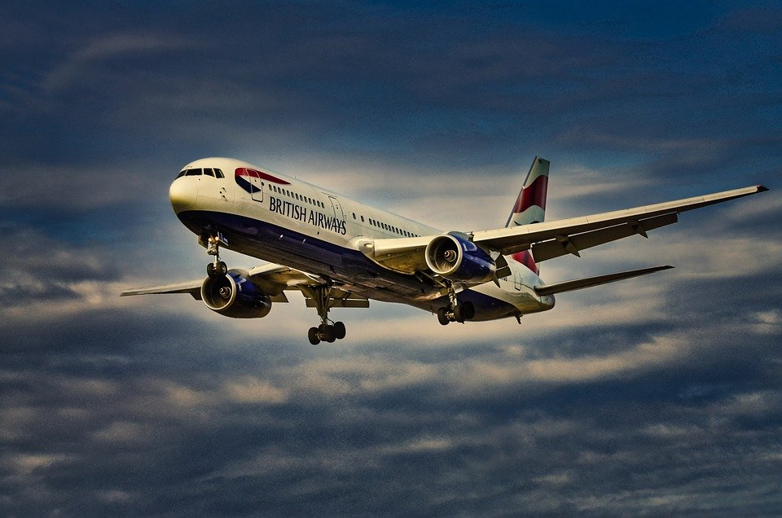
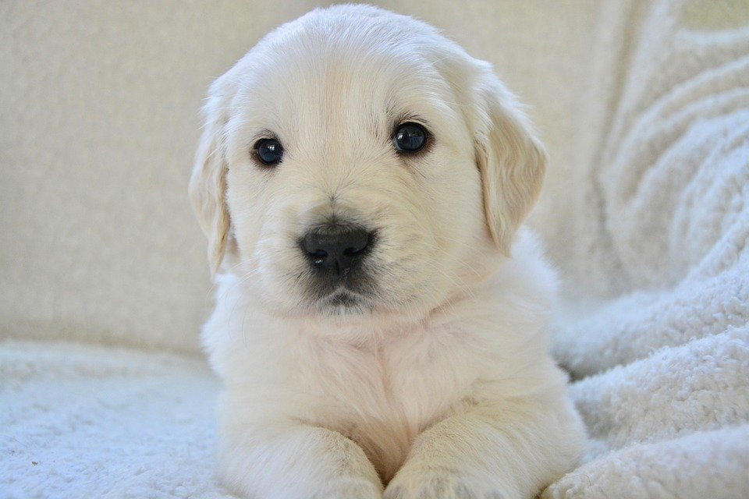
What does the boy see outside?
TRAIN
AIRPLANE
PUPPY
Notes:
The slide will not go to the next slide until they click the right answer.

Slide 3

What does the boy see outside?
TRAIN
AIRPLANE
PUPPY
Notes:
The slide will not go to the next slide until they click the right answer.

Slide 4
The Polar Express
Notes:
The arrows point to objects you can click on.

Slide 5
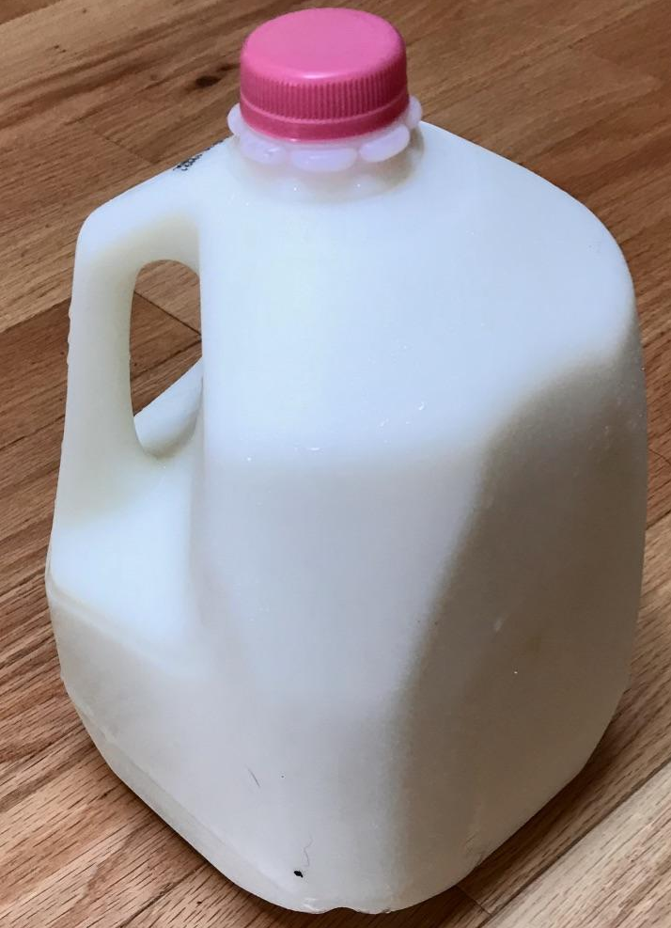
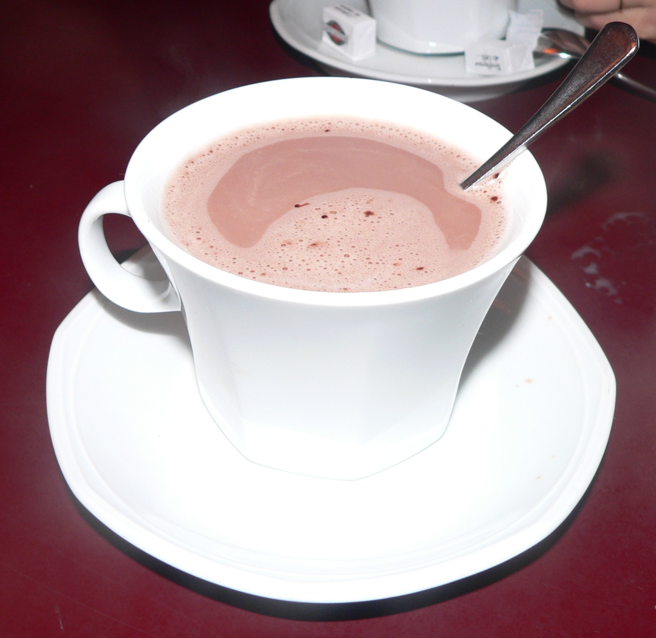

What do the children drink?
MILK
HOT COCOA
JUICE
Notes:
The slide will not go to the next slide until they click the right answer.

Slide 6
What do the children drink?
MILK
HOT COCOA
JUICE
Notes:
The slide will not go to the next slide until they click the right answer.

Slide 7
The Polar Express
Notes:
The arrows point to objects you can click on.

Slide 8
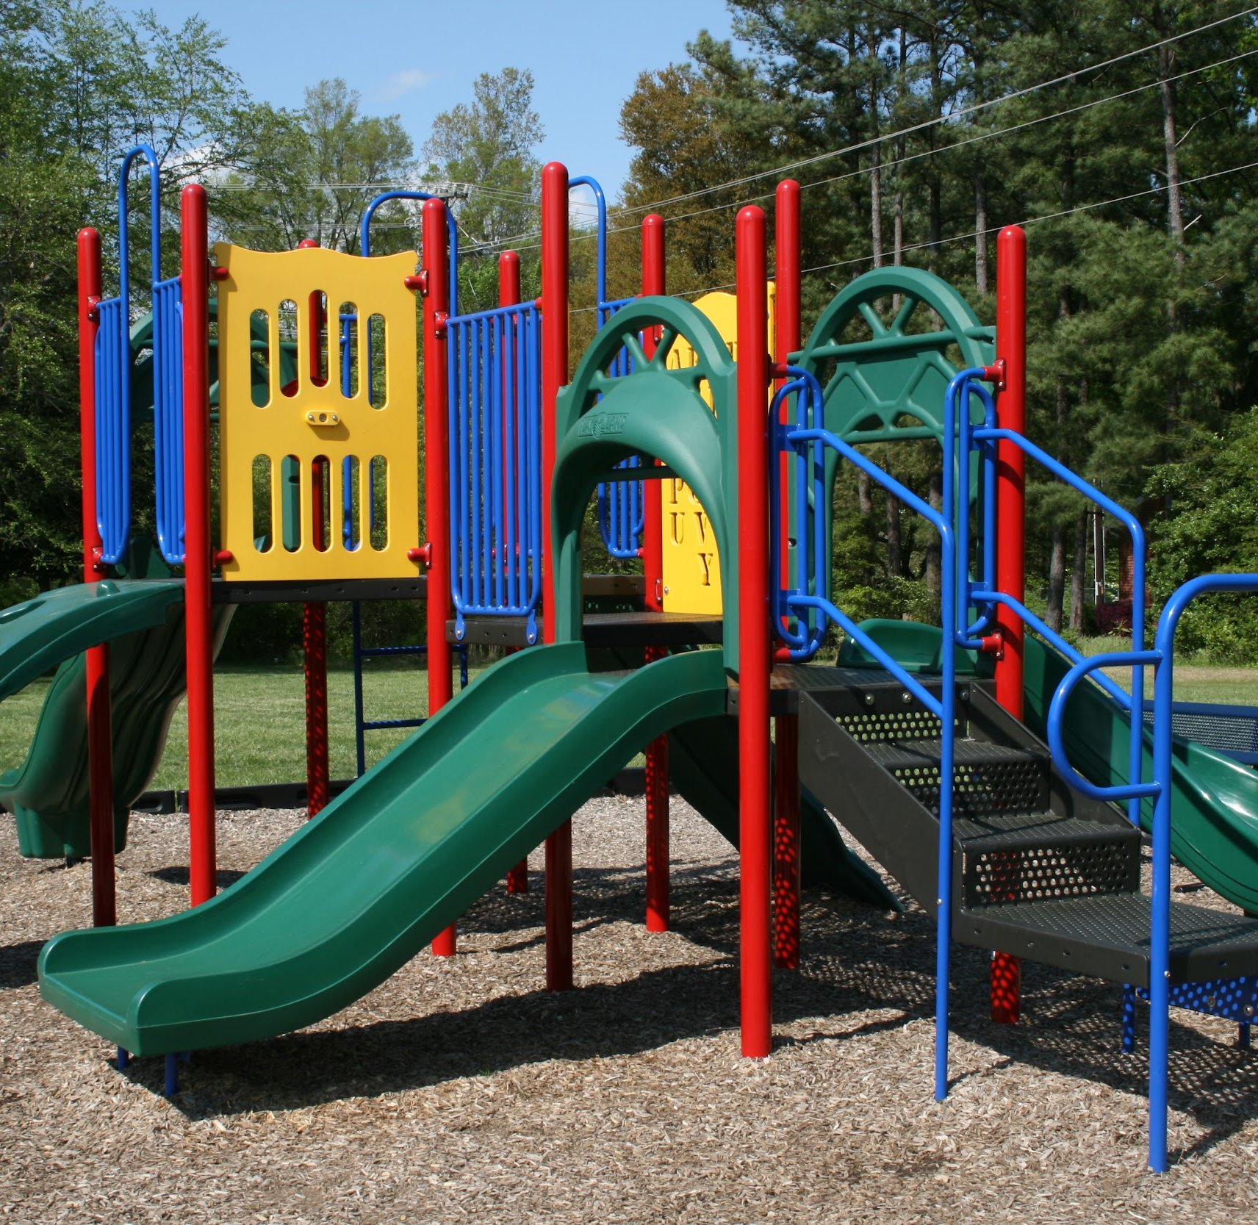
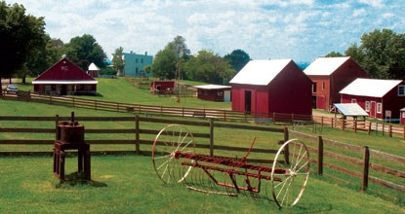
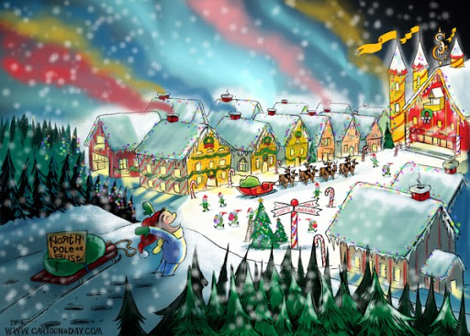
Where did the train go?
FARM
PLAYGROUND
NORTH POLE
Notes:
The slide will not go to the next slide until they click the right answer.

Slide 9
Where did the train go?
FARM
PLAYGROUND
NORTH POLE
Notes:
The slide will not go to the next slide until they click the right answer.

Slide 10
The Polar Express
Notes:
The arrows point to objects you can click on.

Slide 11
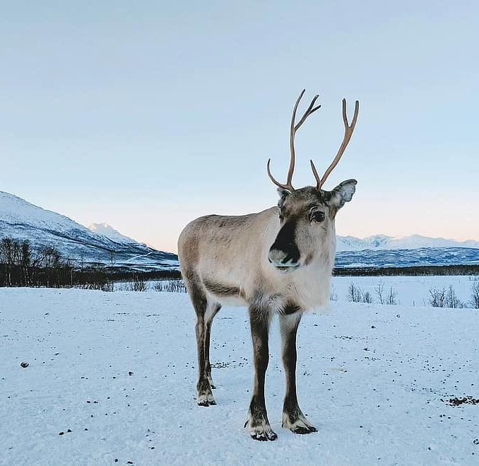
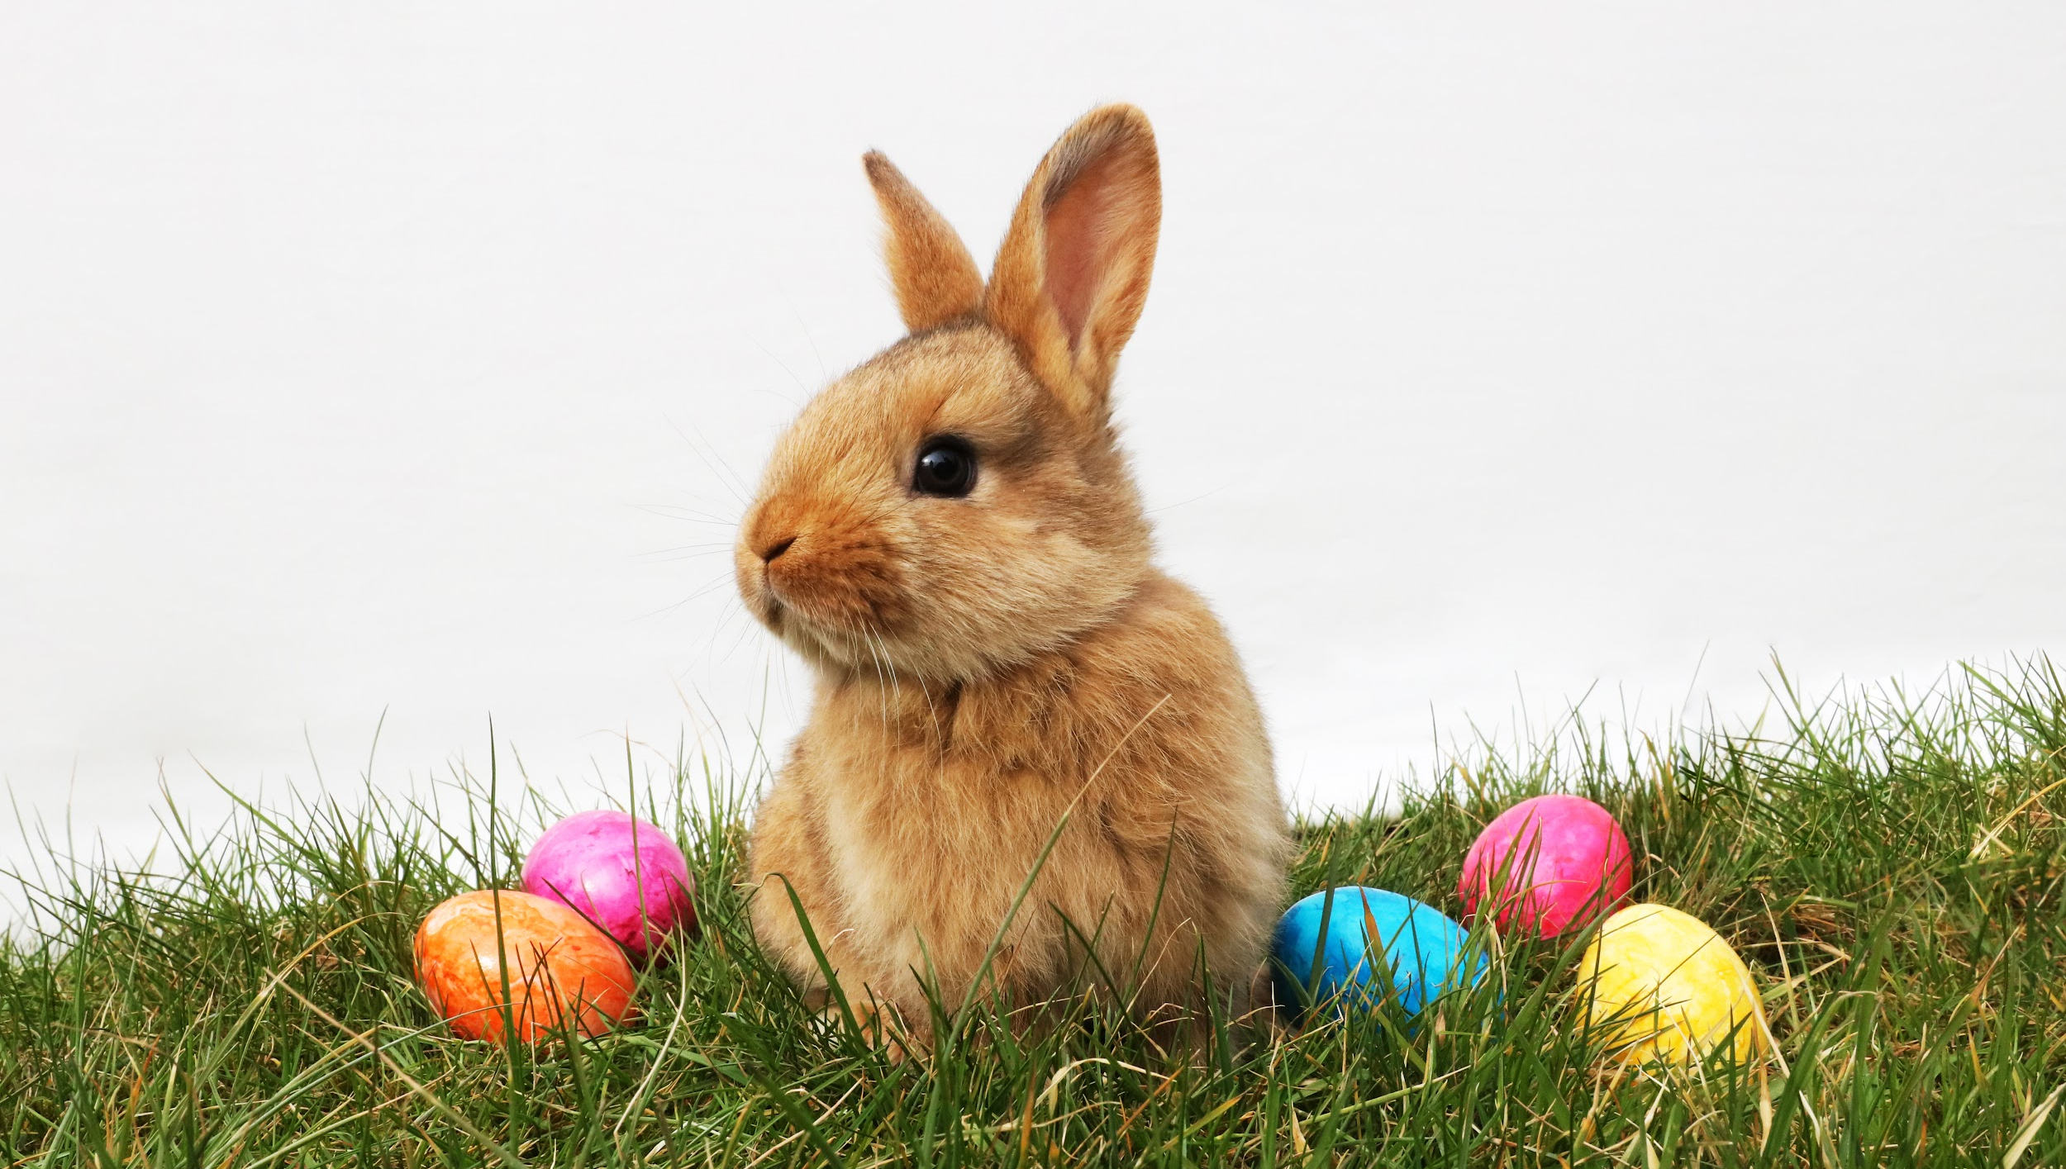
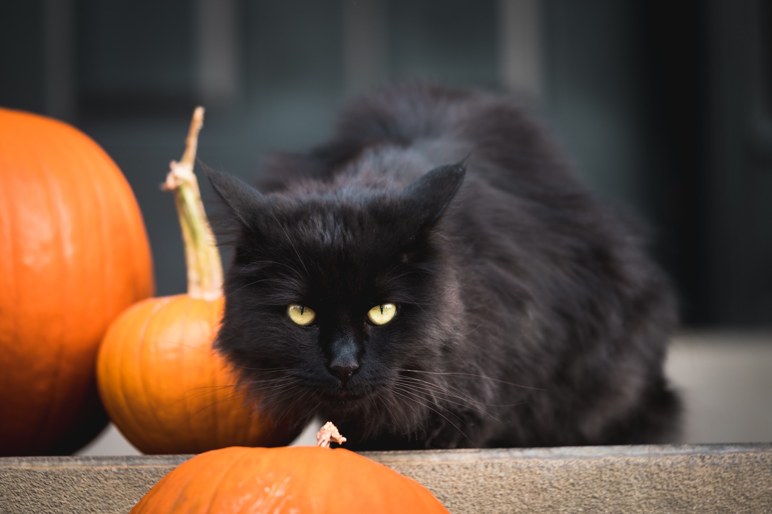
Who was wearing the silver bells?
BUNNY
REINDEER
CAT
Notes:
The slide will not go to the next slide until they click the right answer.

Slide 12
Who was wearing the silver bells?
BUNNY
REINDEER
CAT
Notes:
The slide will not go to the next slide until they click the right answer.

Slide 13
The Polar Express
Notes:
The arrows point to objects you can click on.

Slide 14
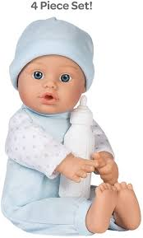
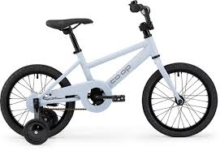
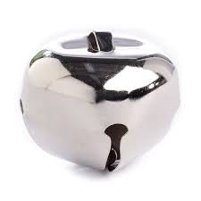
What was the first gift of Christmas?
DOLL
BIKE
BELL
Notes:
The slide will not go to the next slide until they click the right answer.

Slide 15
What was the first gift of Christmas?
DOLL
BIKE
BELL
Notes:
The slide will not go to the next slide until they click the right answer.

Slide 16
The Polar Express
Notes:
The arrows point to objects you can click on.

Slide 17



How did he feel when he lost the bell?
SAD
EXCITED
TIRED
Notes:
The slide will not go to the next slide until they click the right answer.

Slide 18
How did he feel when he lost the bell?
SAD
EXCITED
TIRED
Notes:
The slide will not go to the next slide until they click the right answer.

Slide 19
The Polar Express
Notes:
The arrows point to objects you can click on.

Slide 20
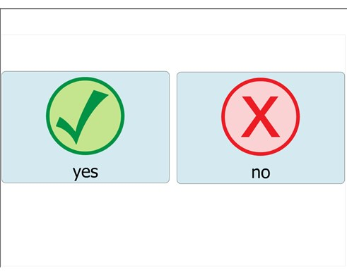
Did the parents hear the bell?
Notes:
The slide will not go to the next slide until they click the right answer.

Slide 21
Did the parents hear the bell?
Notes:
The slide will not go to the next slide until they click the right answer.

Slide 22
The Polar Express
Notes:
The arrows point to objects you can click on.

Slide 23

I can hear the bell if I...
Notes:
The slide will not go to the next slide until they click the right answer.

Slide 24

Notes:
The slide will not go to the next slide until they click the right answer.

