Slide 1






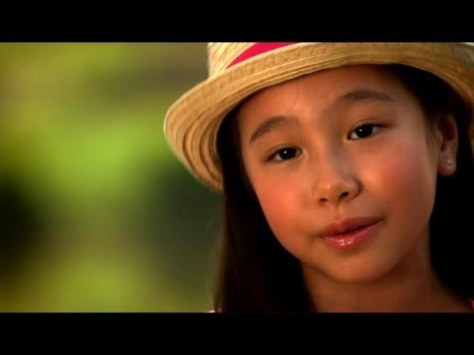












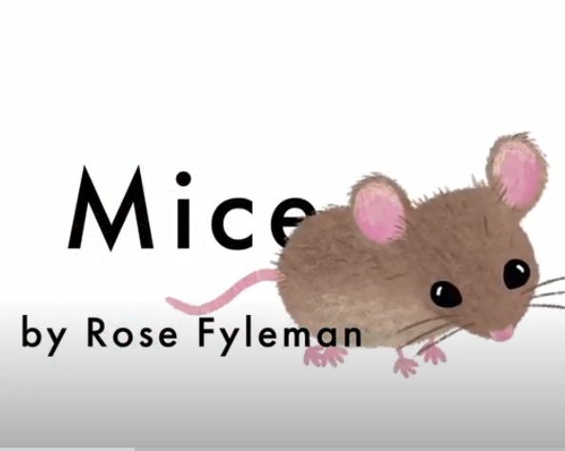







EPIC
Notes:
PLEASE MAKE A COPY

Slide 2

