Slide 1
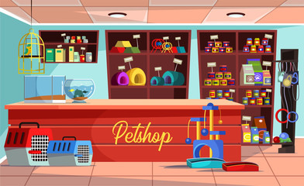
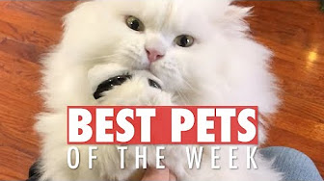

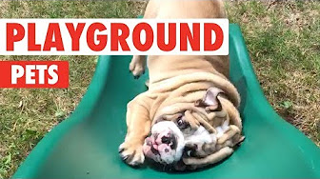

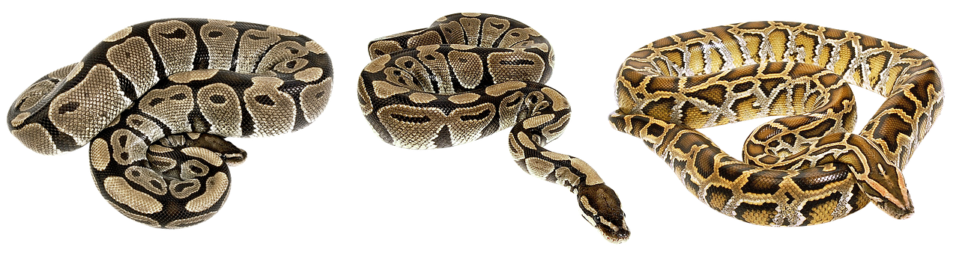
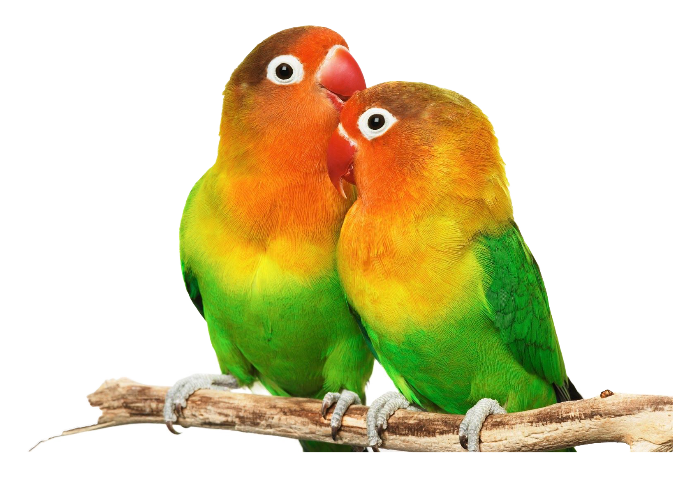
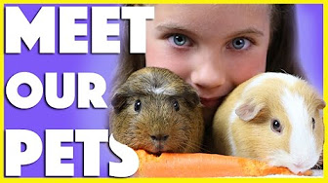




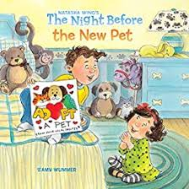
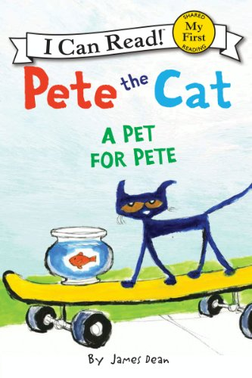
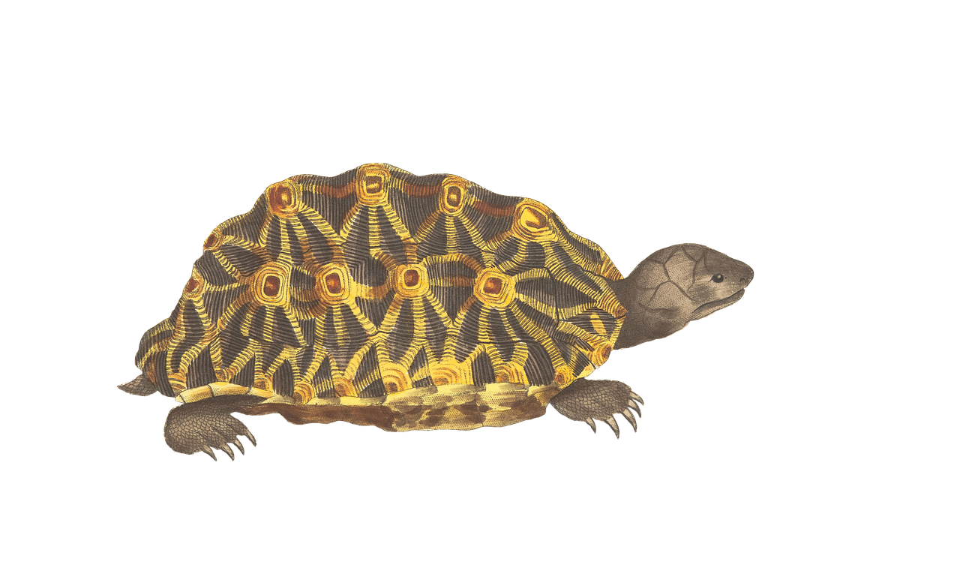
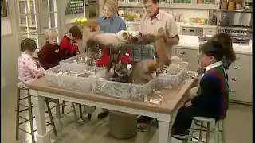
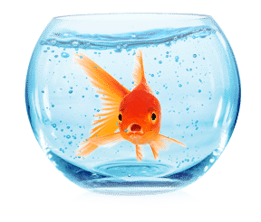


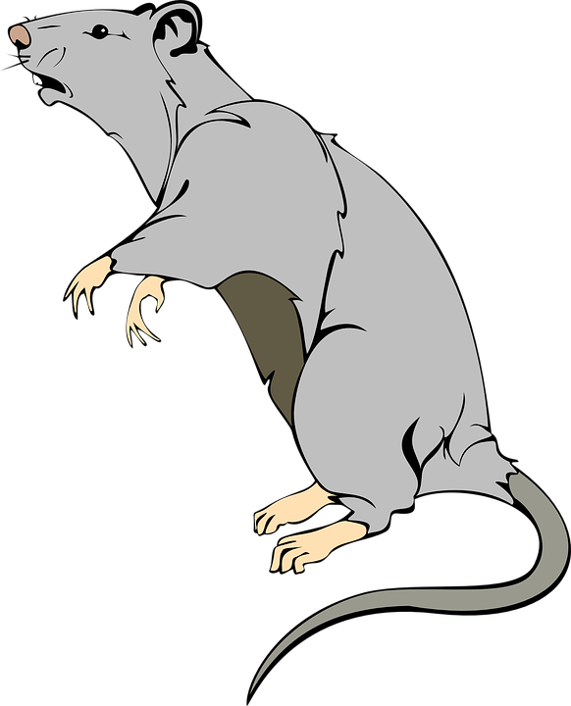
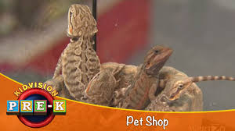
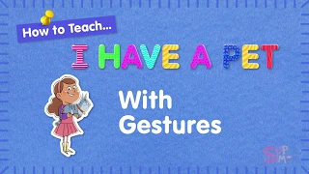
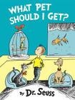

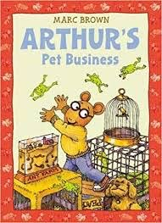
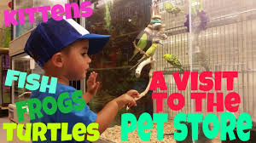


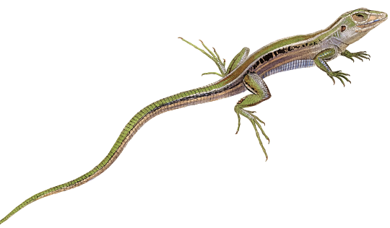
Notes:
Welcome to our Pets Study Virtual Library!
https://www.simplykinder.com/virtual-field-trips-for-kindergarteners/
Background: https://stock.adobe.com

Slide 2
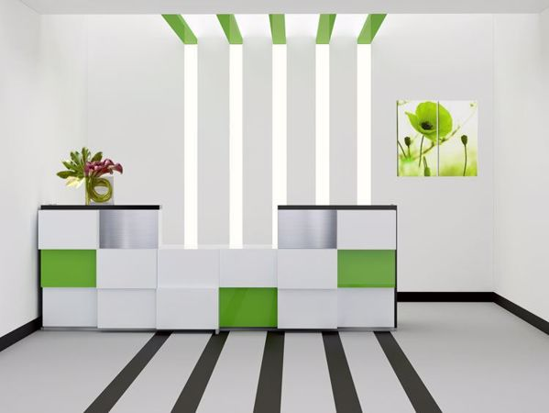

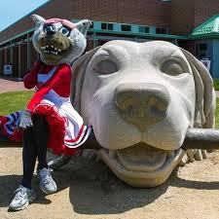





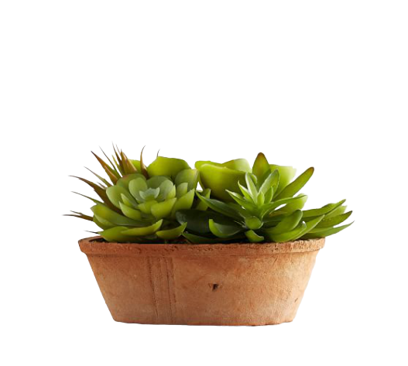
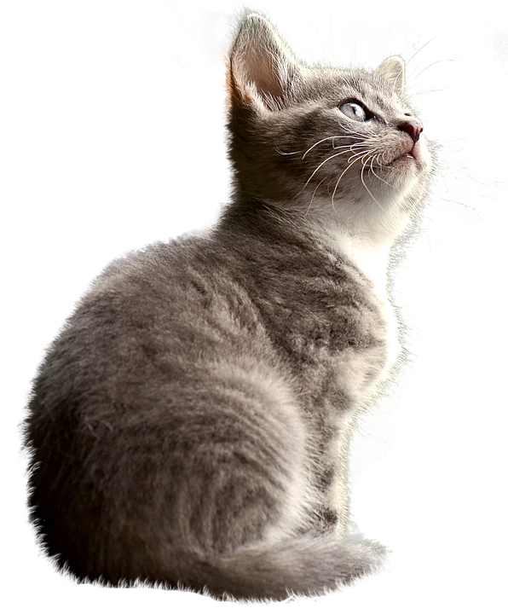



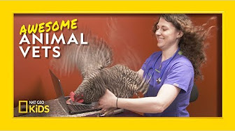

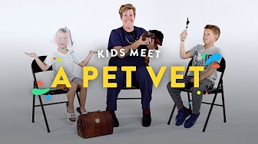
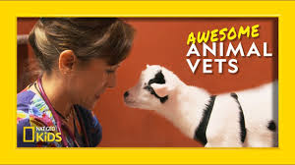
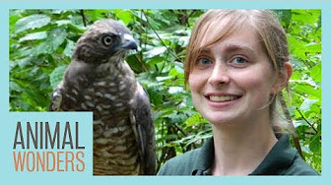
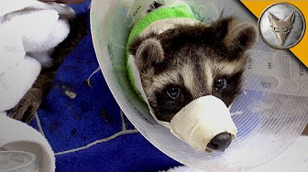
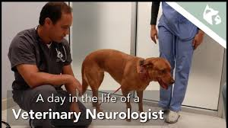


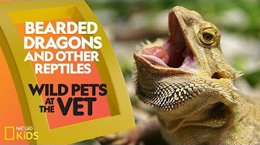


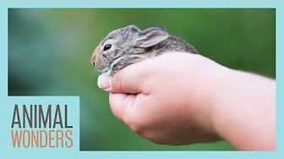
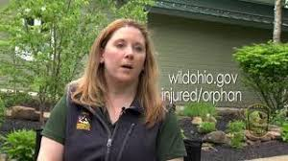
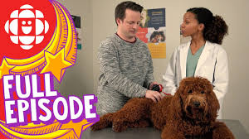
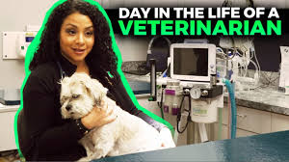
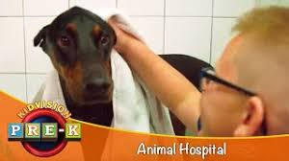
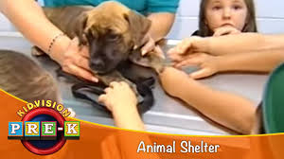
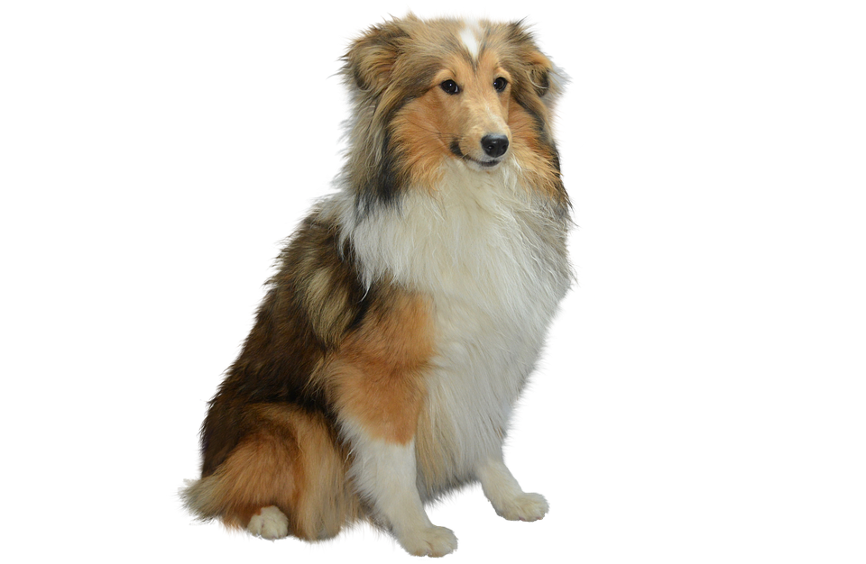
Notes:
Welcome to the Veterinarian Office!
Strong Office Background from https://pin.it/3oso2L9

Slide 3




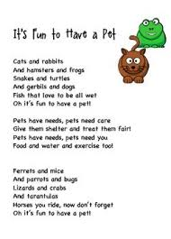




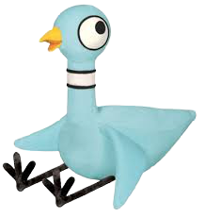


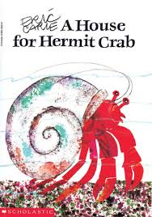

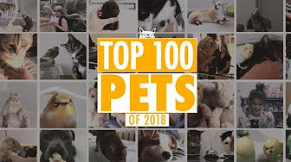



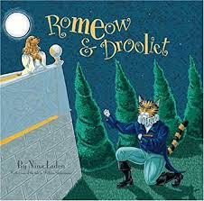




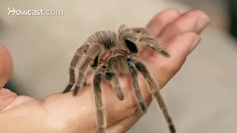



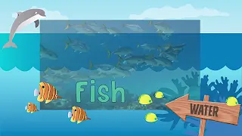
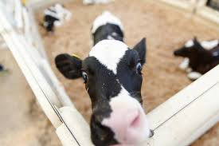
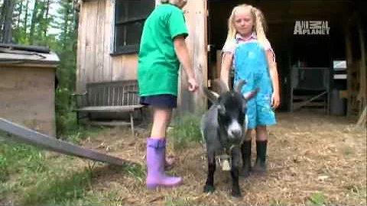



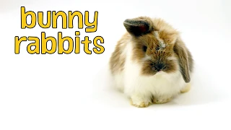
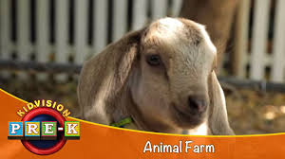
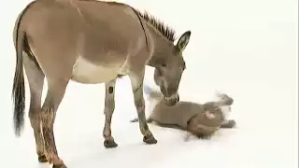
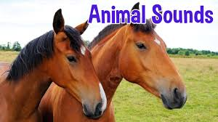
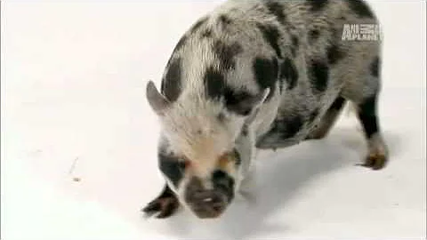



Notes:
Pets Galore!
Pet Poster links to YouTube playlist

Slide 4





































Notes:
Cats
Cookies week

Slide 5


















































Notes:
Play the Safe Game poster is linked to a video about kids and dog safety
Carl
Whistle for Willie
Please Puppy Please
Dog a Doughnut

Slide 6
























Notes:
Stella’s and Kora Lee’s hero dog collection slide
Super Dog is a YouTube playlist link
Storm Dogs of the Drowned City is an audible collection of a chapter book, no pictures from YouTube
Background photo by Rustina DT Sharpe, 2019

Slide 7


































Notes:
A dog-gone good variety of videos and games!

Slide 8








Notes:
Can a zoo animal be a pet?
https://www.simplykinder.com/virtual-field-trips-for-kindergarteners/
Background: https://pngtree.com/freebackground/cartoon-zoo-cute-green-poster-background_1081776.html

Slide 9


This Pet library is a work of love- for reading, discovering, learning, playing and all kinds of joyful adventures and for teaching children.
Not all links were created by me, and, when possible, their origin will be noted at the bottom in the speaker notes.
Nothing can be sold on Teacher’s Pay Teachers or any online store, this would violate copyright laws.
I hope that you enjoy your learning adventures!
Thank you, Rustina DT Sharpe
March, 2021
Notes:
Disclaimer Slide
Resources:
YouTube
Google
Conscious Discipline

Slide 10
Notes:
DEAR TEACHERS: This slide is for you to add a photo of you and your pets. If you are unable to do so, please email to me. Thanks!

