Slide 1



Remote learning:
Miss Schultz’s schedule:
Welcome to:
PE is going to look a little different this semester! With our plan to currently be fully remote, all my PE classes will be aimed towards personal & lifelong fitness! This will enable you to learn, move, and grow as an individual from the comforts of your own home!
physical
education
physical
education
1st Hr
8:00-8:35 ▪ PE
2nd Hr
8:40-9:15 ▪ PE
3rd Hr
9:20-9:55 ▪ Advisory
4th Hr
10:00-10:35 ▪ TBF
5th Hr
10:40-11:15 ▪ Sports PE
6th Hr
11:20-11:55 ▪ PE
7th Hr
12:00-12:35 ▪ Plan period
▪OFFICE HOURS ▪
1:10-3:10
With:
Miss Schultz
Tips to help you succeed in my class:
Attend my class
Mon.-Fri. with punctuality
Dedicate time to move & show up for your
mind & body
Check your email & Blackboard every day
Communication is KEY! Utilize your email & office hours
Email:
schultzm@oths.us

Slide 2



rules &
expectations
Attendance
-Every student MUST join live on Blackboard Collaborate at the beginning of each class period.
-Students that are not signed on within the first 5-10 minutes will be marked tardy/absent
-Further instructions will be given after live attendance is taken
-Please note that the entirety of every class period will not be spent live
Grading
This course will function on a
total point system
Participation points (5/day) will be earned daily in a variety of ways:
-Activity log
-Discussion Board
-Participation in live sessions
Other weekly assignments, quizzes, & projects will be assigned
-Pts. to be determined per item
class objectives:
(included but not limited to)
be respectful &
kind at all times
Understand the importance & physical/mental health benefits of personal & lifelong fitness
Get moving & stay active
Understand & utilize
all the components of fitness into regular fitness routine
be an advocate
for yourself
Understand & apply principles of fitness (overload, progression, & FITT) into regular fitness routine
Ask for help when
you need it
Keep an open mind
Participate in a variety of activities that focus on each component of fitness
Have a growth mindset
Develop skills necessary to exercise comfortably & enjoy physical activity
HAVE FUN !
Develop skills necessary to build & maintain own personal fitness routine & become a lifelong mover
this syllabus is subject to change at any point during the semester

Slide 3

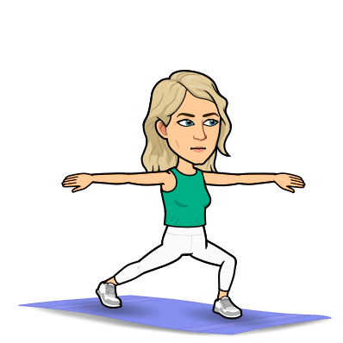
Class
Structure
Mindfulness
Monday
Intuitive
Tuesday
Each day corresponds by color with the circles to the right.
This will be the basic layout of what to expect each day.
Please note that some weeks will differ & this is subject to change.
Every other week = live PowerPoint with form &/or discussion board & quiz
Off weeks = variety of given workouts & activities;
Fill out activity log
What does your mind & body need today?
Choose your own 30 min. activity
Fill out activity log
Walking
Wednesday
Walking will be the activity; every Wednesday!
It will be done for time, distance, pace, etc.
Fill out activity log
Monday
Tuesday
Thriving
Thursday
Flexibility / Fun
Friday
Wednesday
There will be a variety of higher intensity workouts &/or activities provided on these days
Fill out activity log
Thursday
The focus on Fridays will mostly be on flexibility. Activities will vary.
Fill out activity log
Friday

