Slide 1
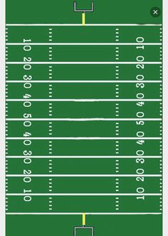

Hook

Slide 2
OUT

Slide 3

SLANT

Slide 4
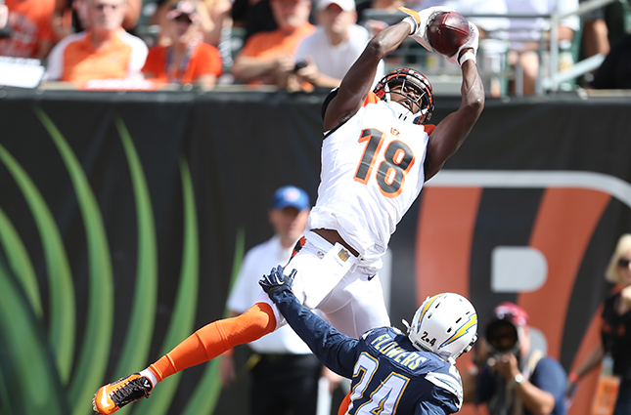
POST

