Slide 1
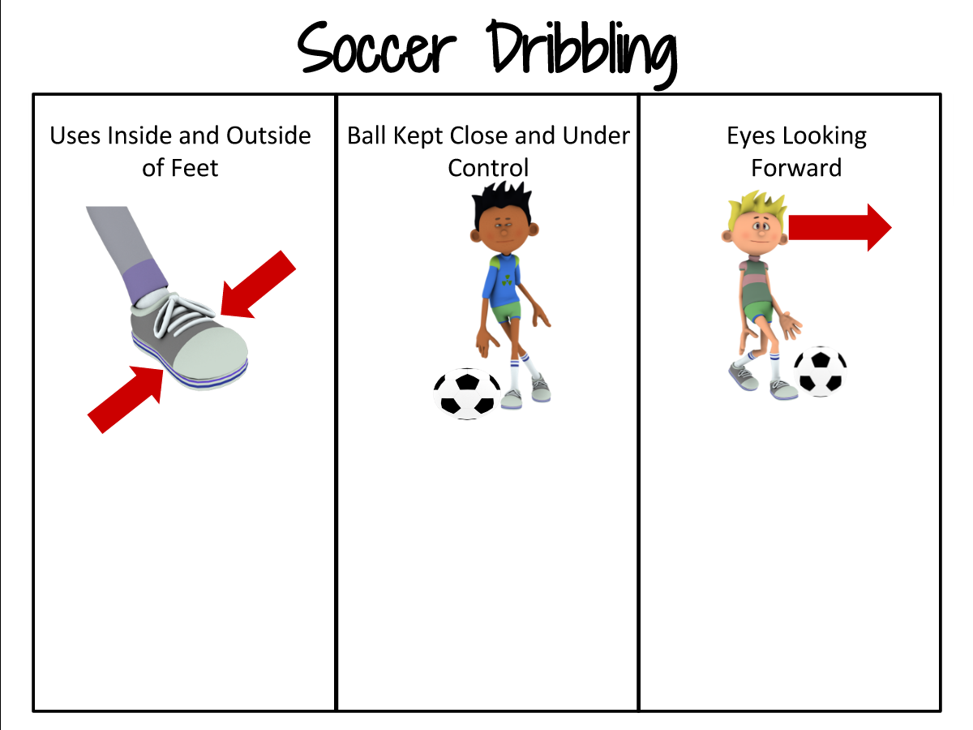
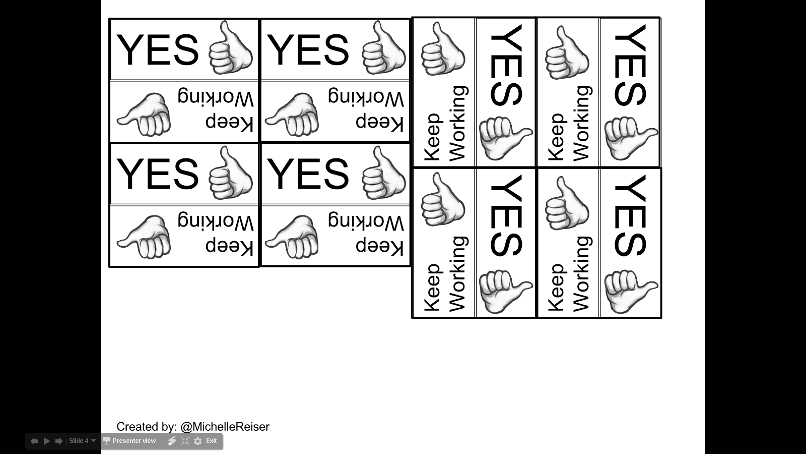
Spin Peer Assessment
Editable Template
For Any Skill
Created by: @MichelleReiser

Slide 2
Getting Started
Edit the assessment by clicking each label on slide 3 to add your custom cues (labels appear when slide 3 is open for editing).
  Title= Skill name
  Subtitle= Skill cues
  The light grey boxes are guides for sizing any images you may be adding. If no images are added, they can be deleted and the text size for the skill cues can be increased.
Cut out the Yes/Still Working text boxes, and using a paper fastener attach one below each cue onto the front sheet of the dry erase pocket (they can also be added directly to the assessment paper).
  Laminating the text boxes before attaching the fastener will make it more durable.
These cards have been used as a peer assessment during stations, game play, or while practicing during an activity.
Created by: @MichelleReiser

Slide 3
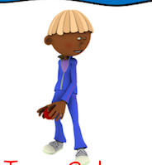
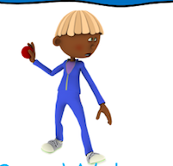
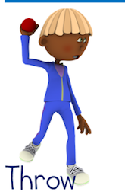
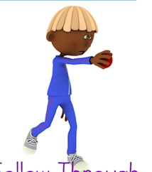
Overhand Throwing
Turn Side to Target
Step With Opposite Foot
Throw and Follow Through

Slide 4

YES
YES
YES
YES
Keep
Working
Keep
Working
Keep
Working
Keep
Working
YES
YES
YES
YES
Keep
Working
Keep
Working
Keep
Working
Keep
Working
Created by: @MichelleReiser

Slide 5

Image Sources:
The clipart used in this assessment were acquired from the following sources:
Soccer Players and Ball:
Images copyright Away With The Pixels http://www.awaywiththepixels.com
Thumbs up Image:
by Dmatt333
https://commons.wikimedia.org/wiki/File:Thumbs_up_icon_fixed.png

