Slide 1
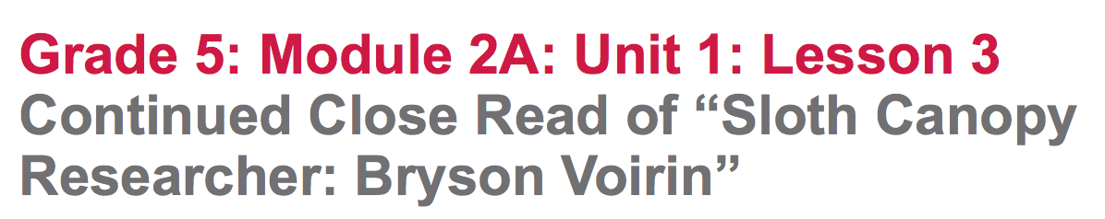

Slide 2
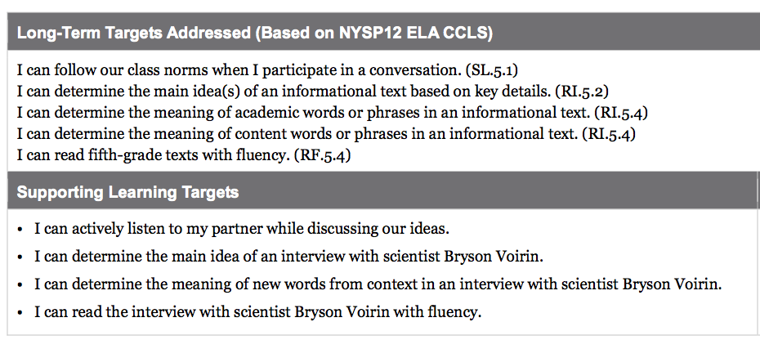

Slide 3
Opening
Engaging the Reader: Rainforests of Panama (5 mins)

Slide 4
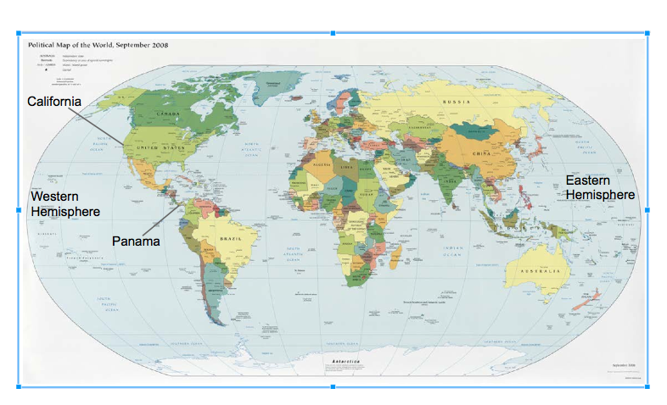
What hemisphere do we live in?
What hemisphere is Bryson Voirin researching in?

Slide 5
A. Engaging the Reader: How Do You Learn? (10 minutes)

Slide 6
Work Time
A. Text-Dependent Questions: “Sloth Canopy Researcher: Bryson Voirin” Remaining Interview Questions and Answers (15 Min.)

Slide 7
We are going to continue reading the interview with Bryson Voirin, paying attention to key vocabulary as well as to text features that help you find information about rainforests.

Slide 8
“I can determine the main idea of an interview with scientist Bryson Voirin”
“I can determine the meaning of new words from context in an interview with scientist Bryson Voirin.”
Recall the meaning of the word determine.

Slide 9
*** Students to briefly review the “gists” they wrote about Questions 1 to 3 of the interview in their journal.

Slide 10
Students get into pairs in their table group.
• Teacher: Read the remaining questions and answers of the interview
(4 through 7) aloud - students to follow along in their text.
*Pass out the Text Dependent Questions Page*
• Students work with their partner first to discuss and then to write answers to the four text-dependent questions.
(15-20 min)

Slide 11
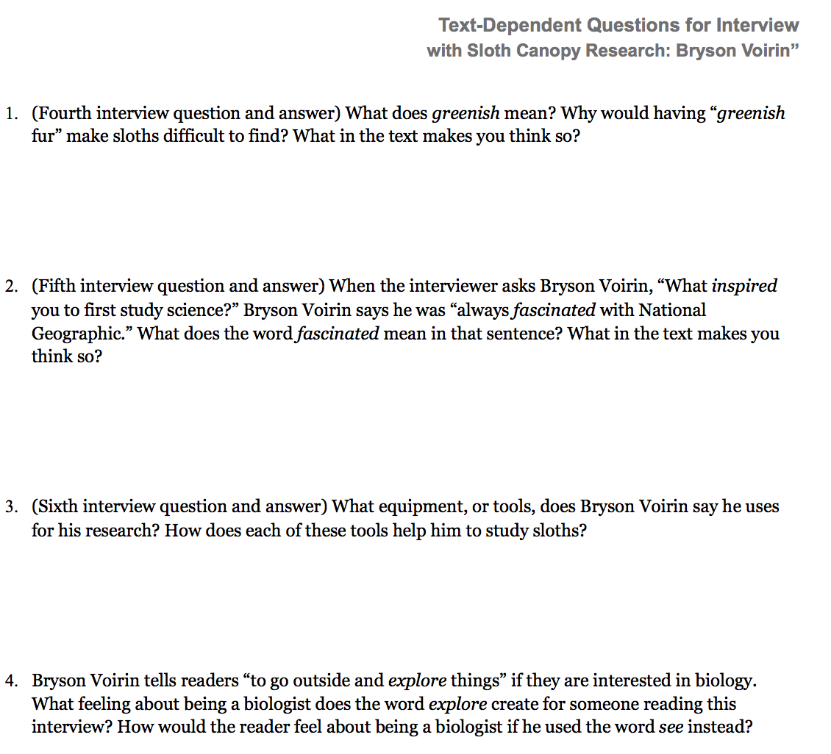

Slide 12
B. Rereading: What Else Can We Learn from Bryson Voirin’s Research about the Rainforest? (15 minutes)

Slide 13
You will reread the entire interview with your partner, looking for new things you can learn about the rainforest.

Slide 14
Learning target
“I can read the interview with scientist Bryson Voirin with fluency.”
Focus on the word fluency,
reminding students to remember what reading with fluency looks and sounds like.

Slide 15
In your student pairs to determine your roles:
One person will be the interviewer, and the other will be Bryson Voirin.
5 minutes to read aloud.

Slide 16
Discuss the new things they were able to learn about rainforests during this read of the interview. Remember, add your new learning to the L column in your journals. (Do not have students share out now, as they will share out during the debrief.)

Slide 17
C. Determining Words in Context
(10 min.)
“Why do you think scientists choose such specific words when communicating about their research?”

Slide 18
* “What does the word issue mean in this context?”
I used to imagine I was one of the scientist in each issue, exploring unknown lands or catching wild animals.
Is it academic or scientific?
Add to your academic glossary
Issue: a magazine published on a single topic/date

Slide 19
• Unknown Ask yourself, “What does the prefix un- mean?
What does the word root known mean?”
Is it academic or scientific?
Add to your academic glossary
Unknown: something that is not known

Slide 20
Academic Glossary Words
normal; usual; everyday
* typical =
* move about =
* advice =
go different places; not stand still; walk, etc.
guidance on how to do something; how to accomplish something, etc.

Slide 21
A. Debrief: What Have We Learned Now about the Rainforest? (10 min.)

Slide 22
CLOSING
“What is one new thing you have learned about the rainforest from the interview with Bryson Voirin?” (Share from L column on chart)

Slide 23
HOMEWORK
Writing in Notebook:
pretend to be Bryson Voirin and answer one more question:
“What would you like to explore further in the rainforest? Why?”
Write your answer to this question (copy before leaving).

