Slide 1
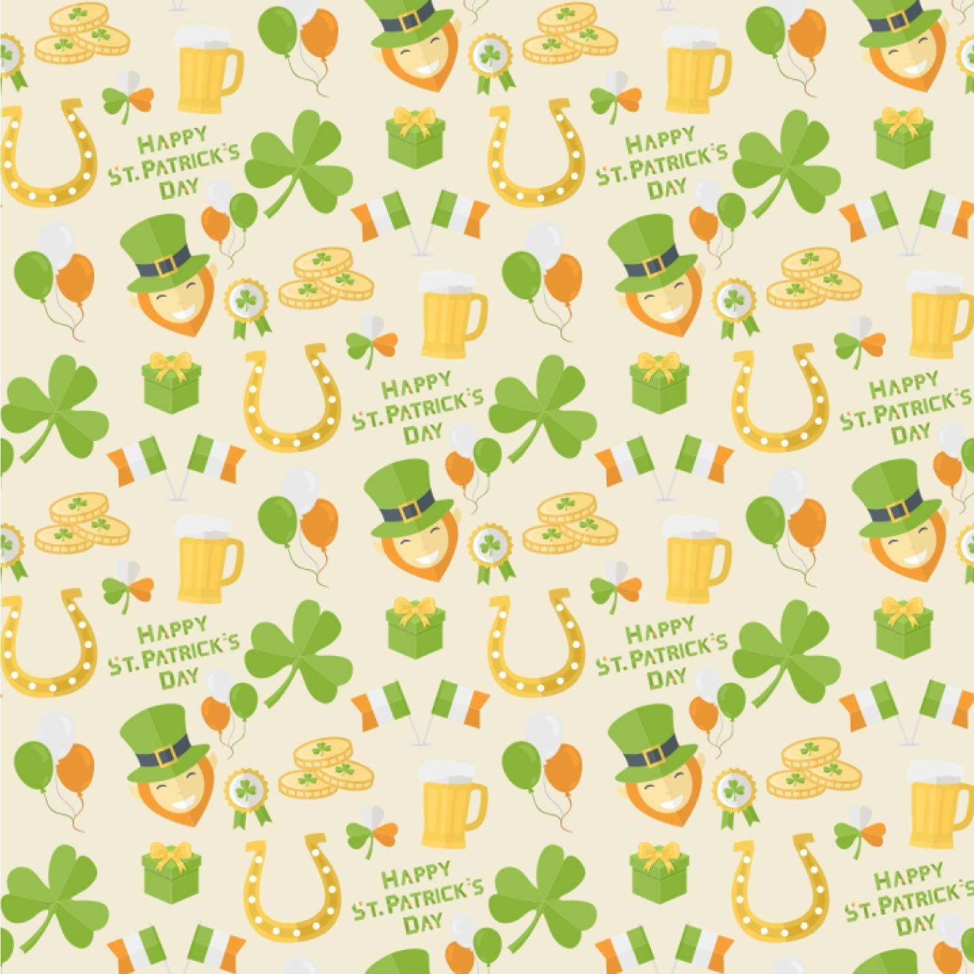
Name That
St’ Patrick’s Day Zoom Picture

Slide 2
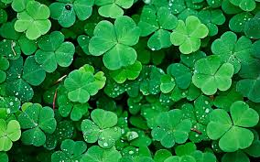
What am I ?

Slide 3
4 leaf clover

Slide 4

What am I ?

Slide 5
Rainbow

Slide 6
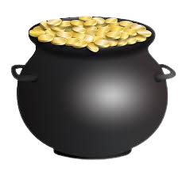
What am I ?

Slide 7
Pot of Gold

Slide 8

What am I ?

Slide 9
Horseshoe

Slide 10
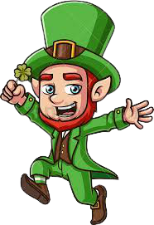
What am I ?

Slide 11
Leprechaun

Slide 12
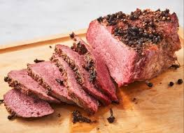
What am I ?

Slide 13
Corn Beef

Slide 14

What am I ?

Slide 15
Pipe

Slide 16
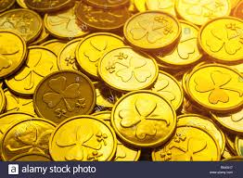
What am I ?

Slide 17
Gold Coins

Slide 18
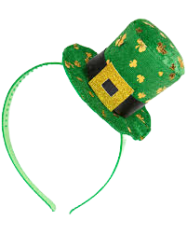
What am I ?

Slide 19
St. Patrick’s Day Headband

Slide 20
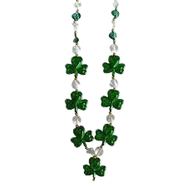
What am I ?

Slide 21
Necklace

Slide 22
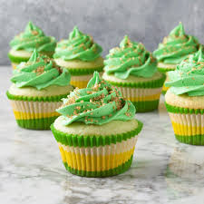
What am I ?

Slide 23
St. Patrick’s Cupcake

Slide 24

What am I ?

Slide 25
St. Patrick’s Snoopy

Slide 26
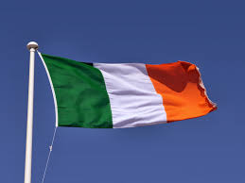
What am I ?

Slide 27
Irish Flag

Slide 28

What am I ?

Slide 29
Lucky

Slide 30
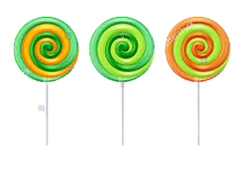
What am I ?

Slide 31
Lollipops

Slide 32
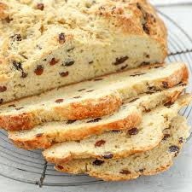
What am I ?

Slide 33
Irish Soda Bread

