Slide 1

Ms. Happy’s Morning Meeting
March 2021

Slide 2
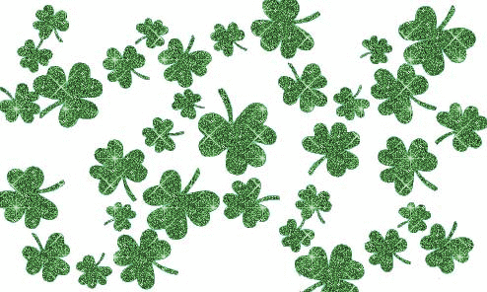

Our Class Rules:

Slide 3
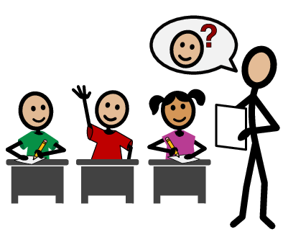
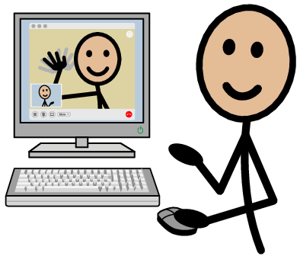

Attendance 3/1/2021
Students

Slide 4
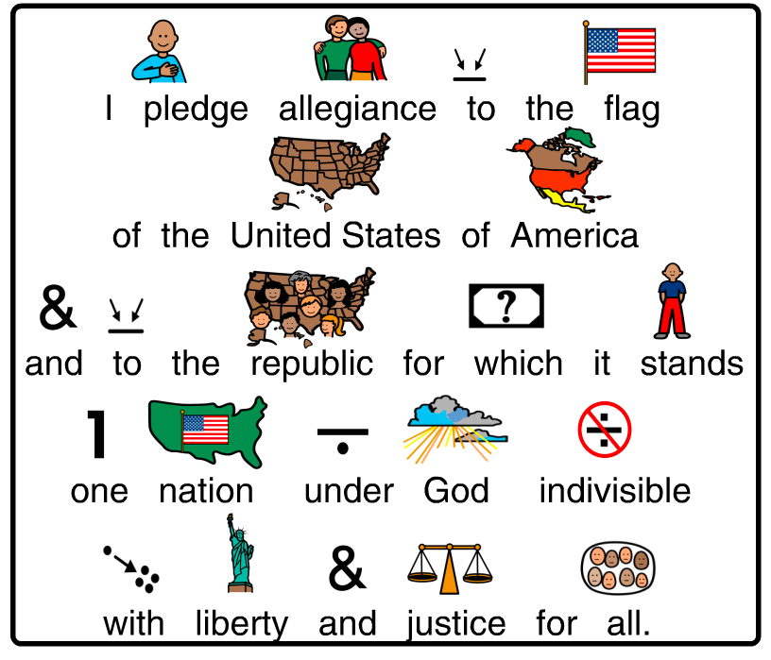
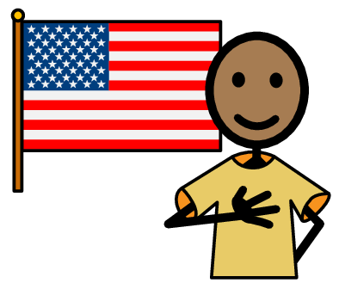
We will say the Pledge

Slide 5
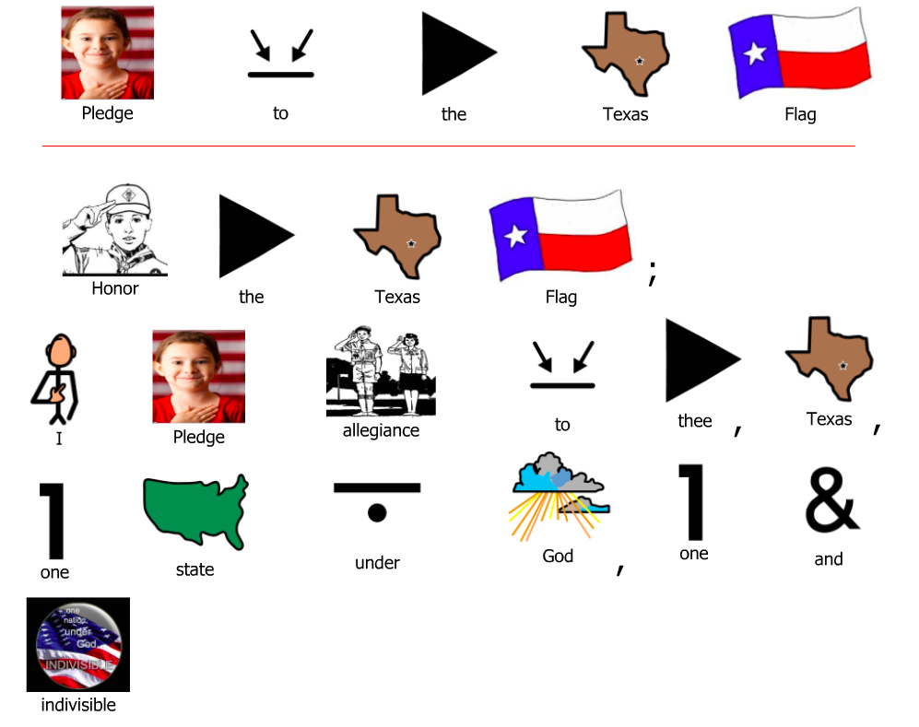

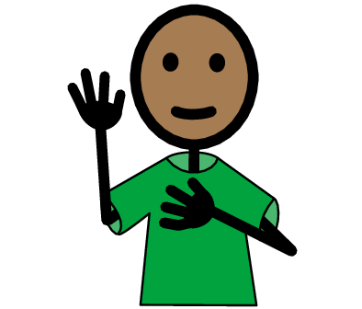
We will say the Texas Pledge

Slide 6
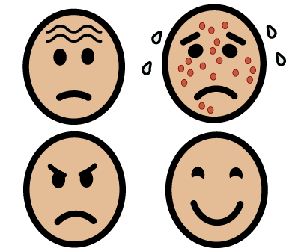
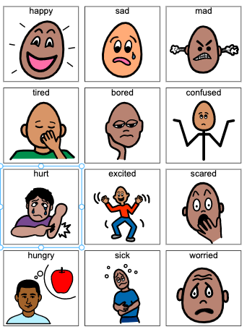
How are you feeling today?
Check in:

Slide 7
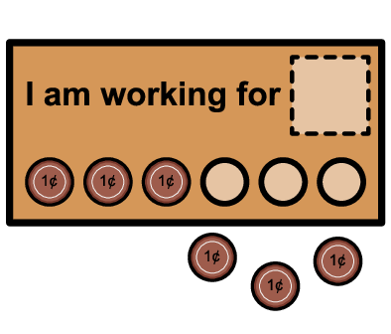

Working for:
What are you working for today?

Slide 8
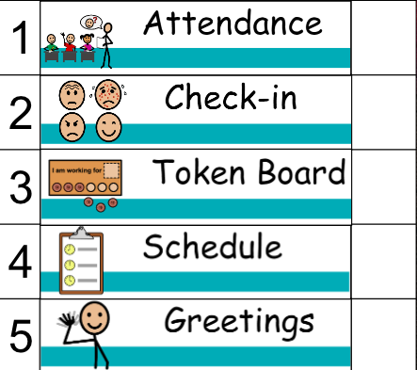
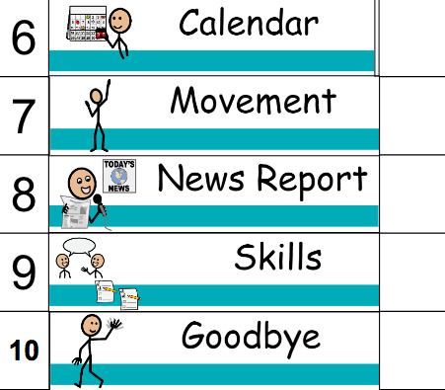

Check Schedule:

Slide 9
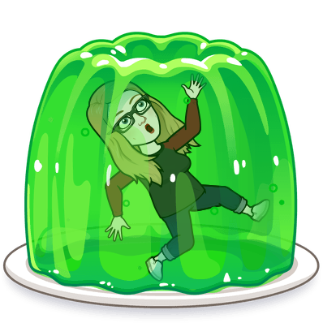
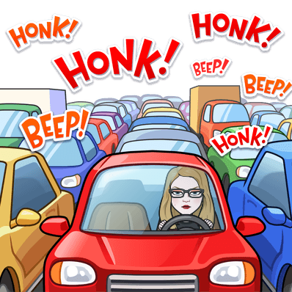
Daily Check in:
Would You Rather
Snowball fight B. Build a snowman
Trapped in jello B. Trapped in traffic

Slide 10


Daily Check in:
Would You Rather
Snowball fight B. Build a snowman
Dress as the green light B. Dress like the red light

Slide 11


Daily Check in:
Would You Rather
Snowball fight B. Build a snowman
Drink your green B. Or eat your greens

Slide 12
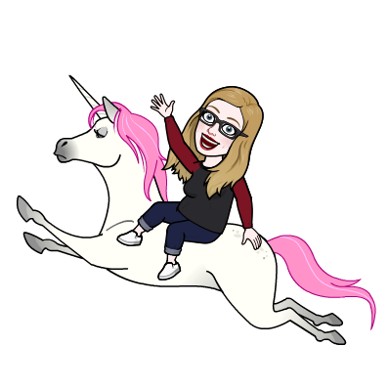
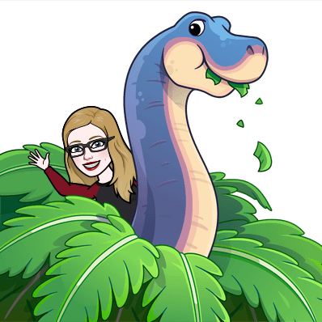
Daily Check in:
Would You Rather
Snowball fight B. Build a snowman
Ride a dinosaur B. Ride on a unicorn

Slide 13

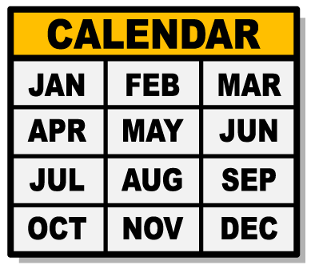
First Greeting Then Calendar

Slide 14
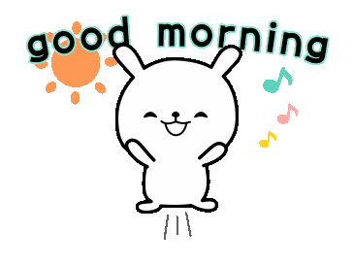
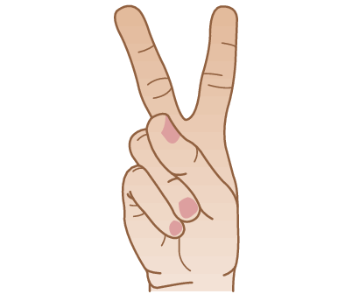



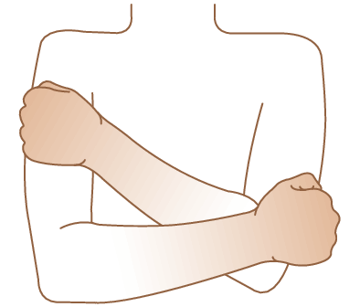
Greetings!

Slide 15
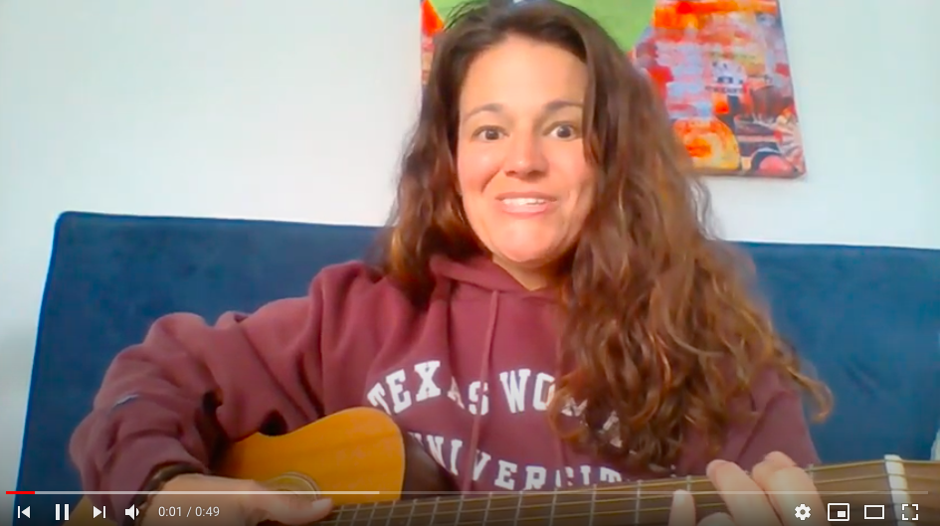
Notes:
Monday song

Slide 16
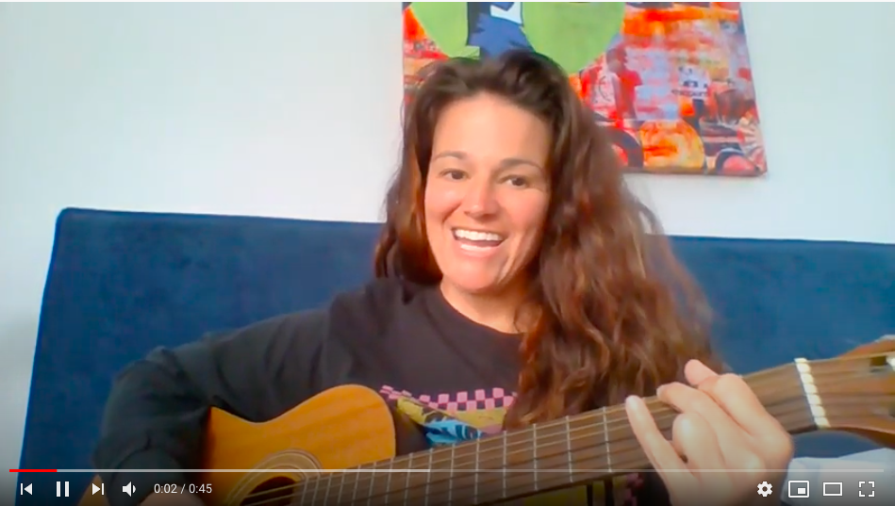
Notes:
Tuesday morning song

Slide 17
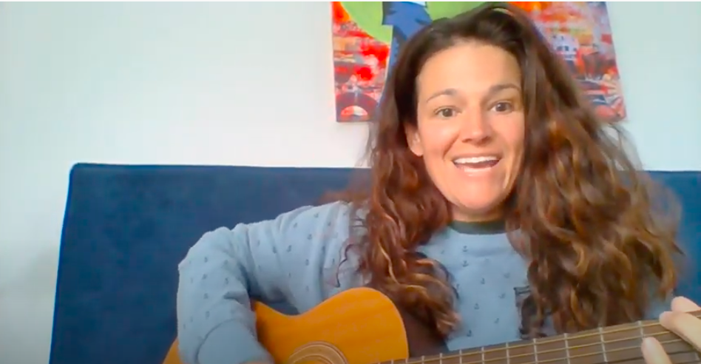
Notes:
Wednesday morning song

Slide 18
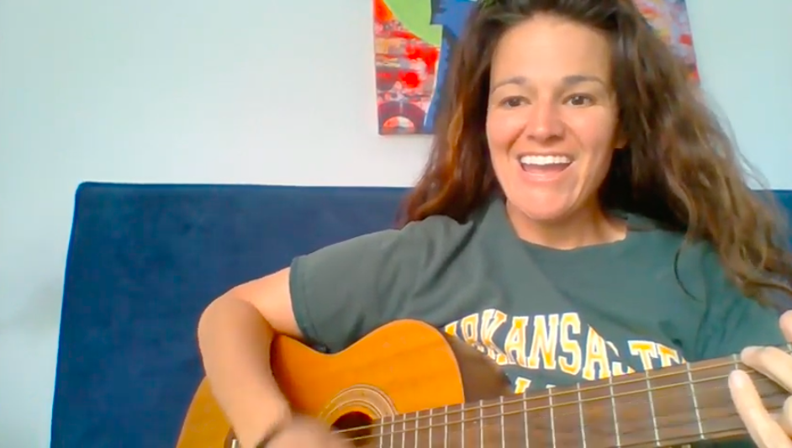
Notes:
Thursday morning song

Slide 19
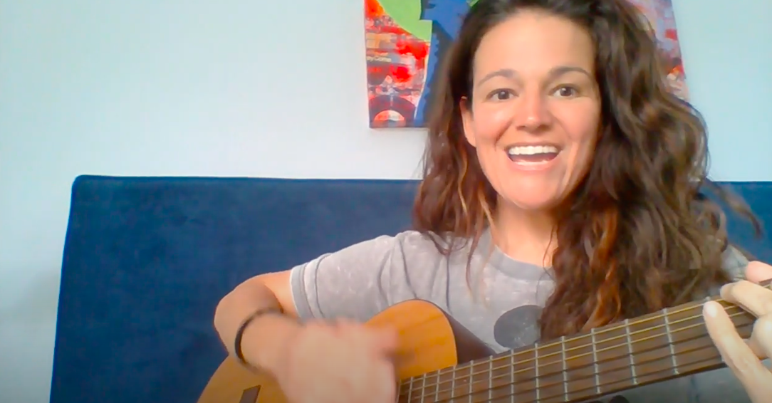
Notes:
Friday morning song

Slide 20
Calendar
Today’s date is March 1, 2021
3/1/2021
Let’s find it on a calendar!

Slide 21
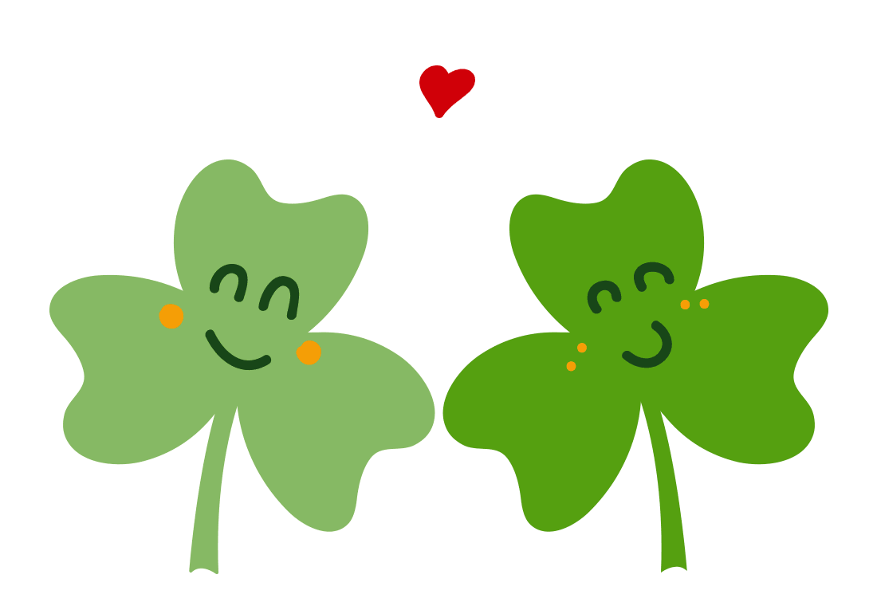








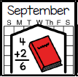

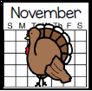

The month is:

Slide 22
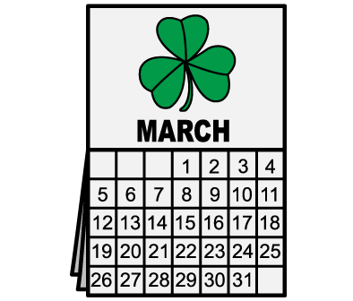
I can spell the month!
h
M
c
r
a

Slide 23





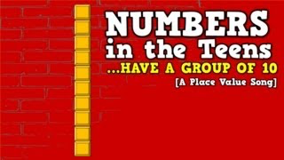



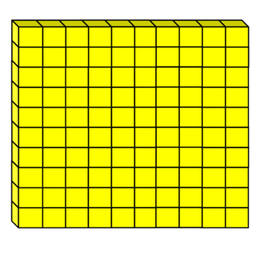
March 2021
Sun | Mon | Tue | Wed | Thur | Fri | Sat
 | 1 | 2 | 3 | 4 | 5 | 6
7 | 8 | 9 | 10 | 11 | 12 | 13
14 | 15 | 16 | 17 | 18 | 19 | 20
21 | 22 | 23 | 24 | 25 | 26 | 27
28 | 29 | 30 | 31
Hundreds | Tens | Ones
1 | 1 | 9
How many days have we been in school?

Slide 24



Count Down Till Summer!
 |  |  |  | 5
 |  |  |  | 10
 |  |  |  | 55
 |  |  |  | 60
 |  |  |  | 15
 |  |  |  | 20
 |  |  |  | 65
 |  |  |  | 70
 |  |  |  | 25
 |  |  |  | 30
 |  |  |  | 75
 |  |  |  | 80
 |  |  |  | 35
 |  |  |  | 40
 |  |  |  | 45
 |  |  |  | 50

Slide 25



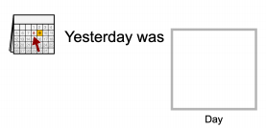





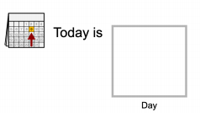









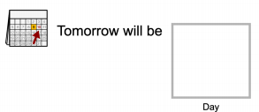




Calendar:

Slide 26
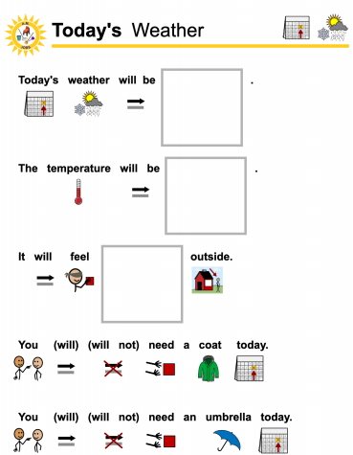















Slide 27
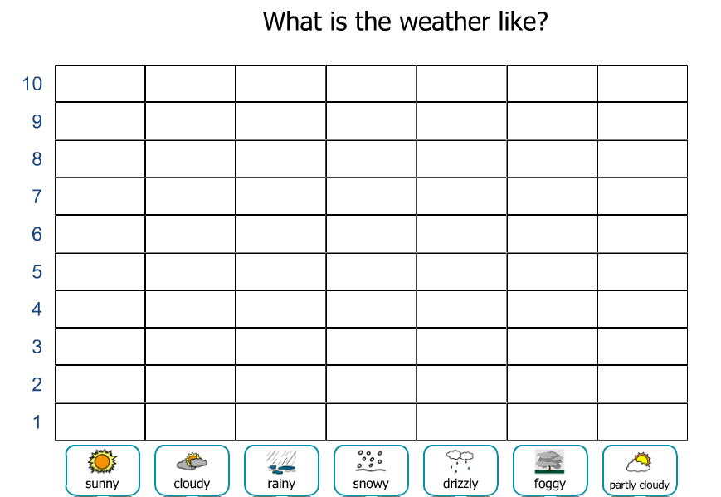
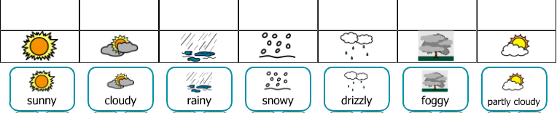
March

Slide 28
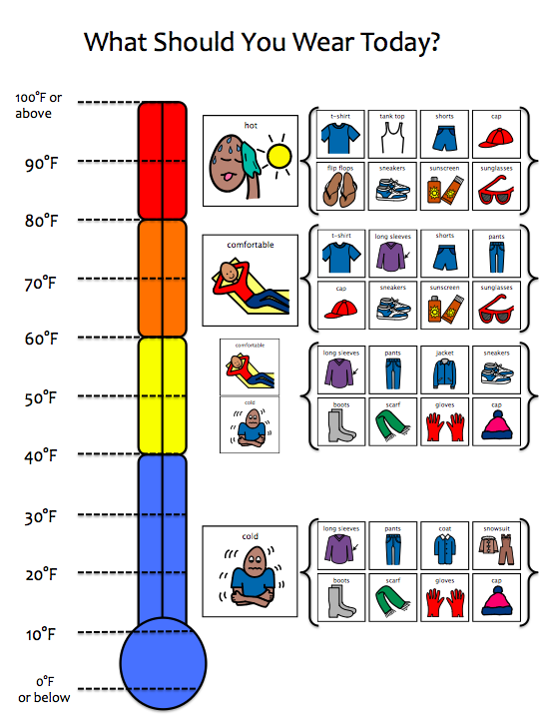
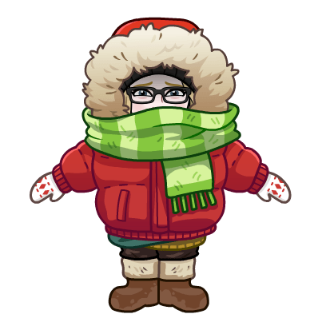


Slide 29

Joke of the Day!
Why did the leprechaun climb over the rainbow? To get to the other side!
How can you spot a jealous shamrock? It will be green with envy!
What do you call a big Irish spider? Paddy long legs!
Why do leprechauns prefer dollar bills to coins? Because they’re green!
Why did the leprechaun turn down a bowl of soup? Because he already had a pot of gold!

Slide 30
Joke of the Day!
Why did the leprechaun walk out of the house? He wanted to sit on the Paddy O’!
Why do leprechauns hate running? They’d rather jig than jog!
Why are so many leprechauns florists? They have green thumbs!
Why do leprechauns recycle? They like to go green!
What’s a leprechaun’s favorite cereal? Lucky Charms!

Slide 31
Joke of the Day!
What happens if you cross poison ivy with a four-leaf clover? You get a rash of good luck!
What do you call a leprechaun who gets sent to jail? A lepre-con!
What happens when a leprechaun falls into a river? He gets wet!
How is a good friend like a four-leaf clover? They’re hard to find!
What kind of bow can’t be tied? A rainbow!

Slide 32
Joke of the Day!
Why do people wear shamrocks on St. Patrick’s Day? Regular rocks are too heavy.
What’s big and purple and lies next to Ireland? Grape Britain!
What would you get if you crossed a leprechaun with a Texan? A pot of chili at the end of the rainbow!
Knock-knock! Who’s there? Irish. Irish who? Irish you a happy St. Patrick’s Day!
Knock-knock! Who’s there? Warren. Warren who? Warren anything green for St. Patrick’s Day?

Slide 33
Check Schedule:

Slide 34


First Movement Break | Then News Report

Slide 35
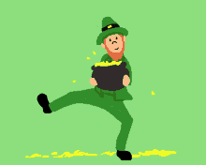
Movement Break
Notes:
Dance like a leprechaun

Slide 36
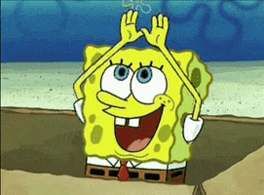
Movement Break
Notes:
Stretch your arms like a rainbow

Slide 37
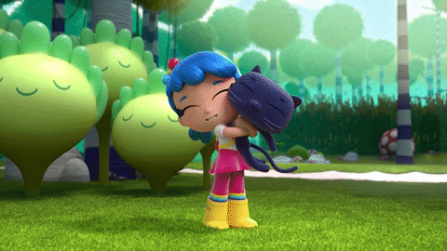
Movement Break
Notes:
Twirl break

Slide 38

Movement Break
Notes:
Trot like a pony

Slide 39
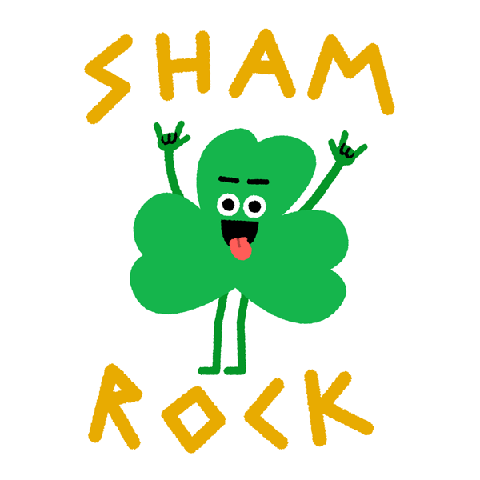
Movement Break
Notes:
Dance like a shamrock

Slide 40
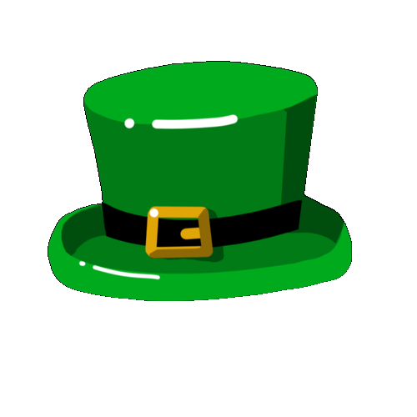

Let’s Check The News!

Slide 41

Let’s Check The News!

Slide 42
Let’s Check The News!

Slide 43
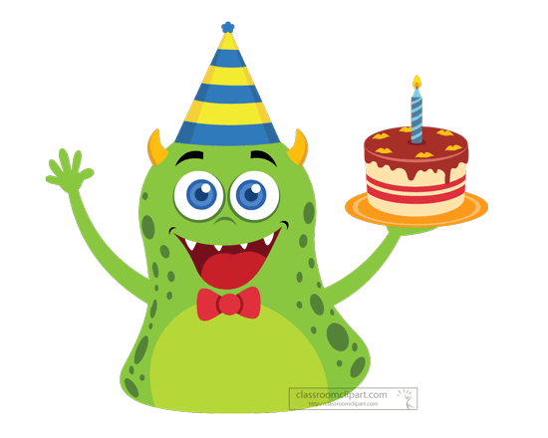
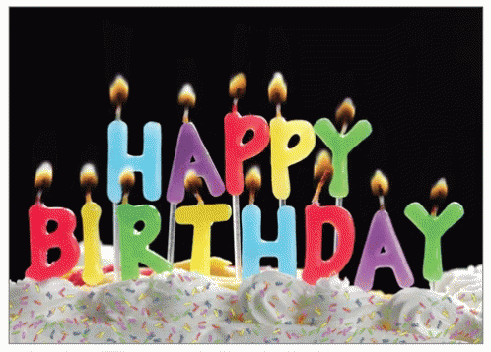
Happy Birthday!!
Luis 3/9
Rose 3/24

Slide 44
Check Schedule:

Slide 45
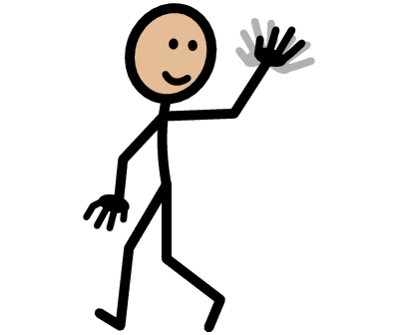

First Skill of the Week | Then Goodbye
Notes:
Dance like a shamrock

Slide 46

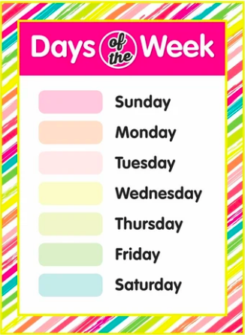






Order Day's of the Week
Notes:
Dance like a shamrock

Slide 47

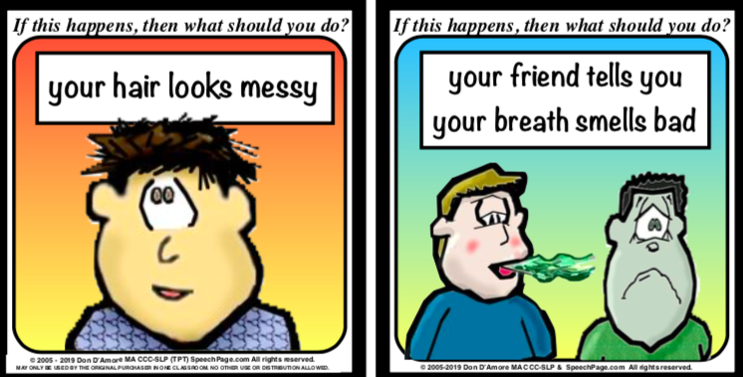
Notes:
Dance like a shamrock

Slide 48
Notes:
Dance like a shamrock

Slide 49
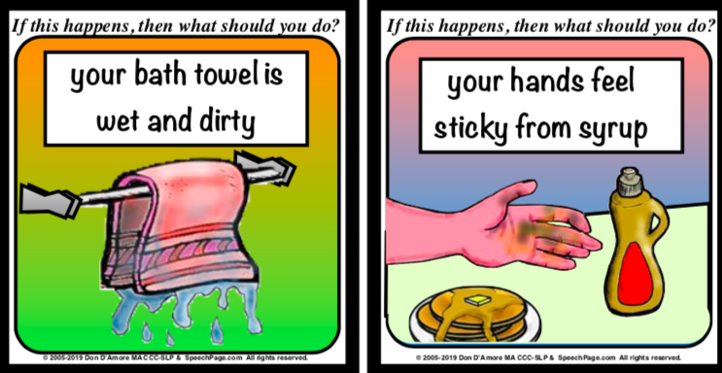
Notes:
Dance like a shamrock

Slide 50
Notes:
Dance like a shamrock

Slide 51

Notes:
Dance like a shamrock

Slide 52
Notes:
Dance like a shamrock

Slide 53

Goodbye!!
Notes:
Dance like a shamrock

Slide 54

Goodbye!!
Notes:
Dance like a shamrock

Slide 55
Thank you!

Slide 56
WE MADE IT TO
Spring Break!!

