Slide 1
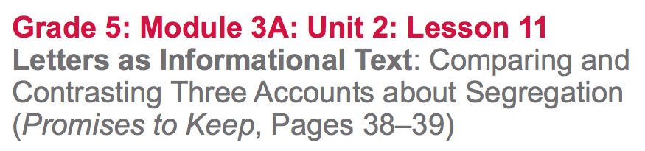

Slide 2
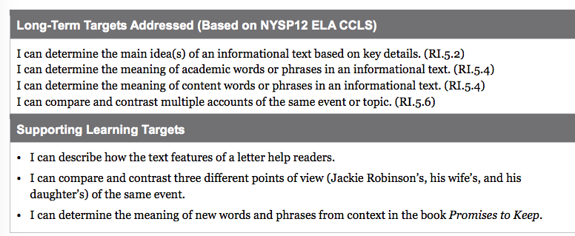

Slide 3
Opening
Engaging the Reader (10 mins)

Slide 4
Last night for homework you read about what happened from 1946-1947, that made Jackie Robinson famous and changed history.

Slide 5
We will be recording facts about what happened in Jackie Robinson’s life and in America during these two years.
Choose just one page that you read for homework to reread (30, 31, 33, 34, or 36), in order to identify one fact about Jackie Robinson’s life from that page.

Slide 6
What is one fact your found about Jackie Robinson’s life?
What does the book tell us about what was happening in America at this time?

Slide 7
B. Review Learning Targets (5 mins)
Look at page 39...what type of informational text do you see?
*I can describe how the text features of a letter help readers.
* I can compare and contrast three different perspectives of the same event.

Slide 8
Work Time
Letters as Informational Text (10 mins)
Lets add “letter” to our anchor chart.
What are some features of a letter?
Text features of a letter include an introduction, date, and signature.

Slide 9
B. Reading for the Gist: How Jackie Robinson Experienced Segregation (15 mins)
Turn to page 38 and reread that text independently. As you read, think about:
How did Jackie Robinson’s teammates treat him?
How did this change over time?

Slide 10
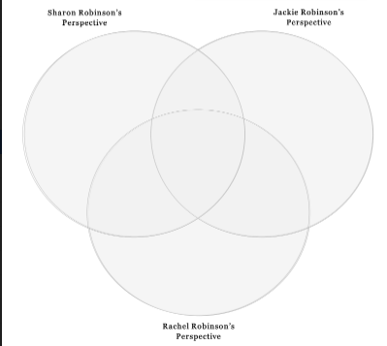
We are focusing on how 3 different people saw an event from their experience.

Slide 11
Write a sentence that summarizes Sharon Robinson’s perspective on her father’s experience during his early months with the Dodgers.

Slide 12
Turn to page 39.
Who wrote this letter? How do you know?
What is your evidence in the text?
Who do you think received this letter? What is your evidence?

Slide 13
Focus your attention on the last two sentences at the end of the second paragraph (“The newspapermen…”)
What does Jackie Robinson say his aim is?
What does the word aim mean?

Slide 14
Recall what Jackie Robinson’s promise might be, and what the evidence is for your idea. You can take a look back at page 29 to reread the last 3 paragraphs.

Slide 15
In the “Jackie Robinson” circle, write a sentence that summarizes Jackie’s thoughts about his early months in the Dodgers.

Slide 16
C. Compare/Contrast Different Accounts of the Same Event (15 mins)
Read the text that is in italics at the bottom of page 39.
Who is the speaker in these paragraphs? How do you know?

Slide 17
Talk with your partners about how Rachel Robinson remembers Jackie’s early years in Major League Baseball.

Slide 18
These pairs of words are closely related. Find them in the text and use your strategies to determine their meaning.
Pessimism and despair
Victim and martyr
Triumphs and victories

Slide 19
Pessimism: Belief that the worst will happen
Despair: lack of hope
Victim: person who is harmed by another
Martyr: person who chooses to suffer for a cause
Triumphs: great victories
Victories: wins or successes

Slide 20
In the “Rachel Robinson” circle, write a sentence that summarizes Rachel’s thoughts about Jackie’s early months on the Dodgers.
Work with your group to determine what all three of these points of view have in common.
Fill that into the intersection of the 3 circles.

Slide 21
Closing and Assessment
Debrief learning targets
“I can compare and contrast three different points of view (Jackie Robinson’s, his wife’s, and his daughter’s) of the same event.”

Slide 22
Closing
In your notebook, record one way that the three points of view are different, and one way in which they are the same.

Slide 23
Homework
Read pages 40-45
Write the gist in your notebook

