Slide 1
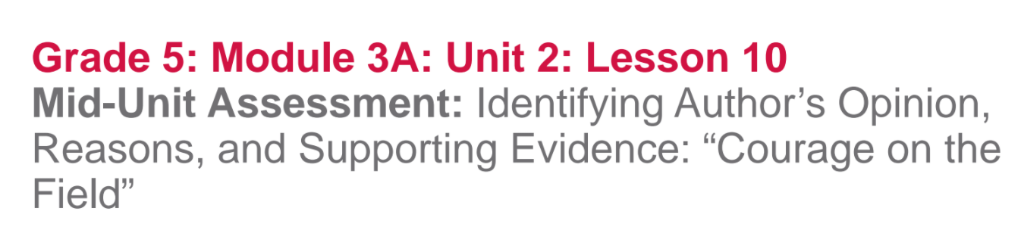

Slide 2
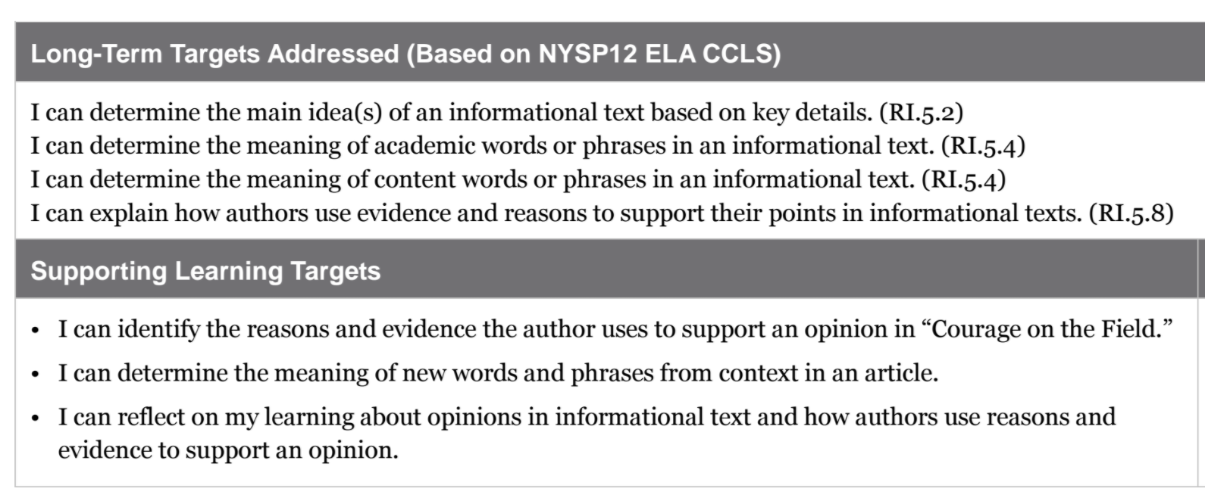

Slide 3
Opening
Engaging the Reader: Alphabet Review (10 mins)

Slide 4
Remember that in this unit we are focusing on Jackie Robinson, and individual who was shaped by society but who also changed society. Now that you have closely read parts of Promises to Keep, in which the author, Sharon Robinson, expresses several opinions about her father, you will use what you have learned to identify another author’s opinion about Jackie Robinson and the reasons and evidence that support that opinion.

Slide 5
Each of you will receive one alphabet index card to participate in an Alphabet Review, using our Jackie Robinson and Life in America Anchor chart, as well as your vocabulary cards.

Slide 6
When you receive your letter card, you are to write at least one word or phrase with that letter of the alphabet on your card.
Your word should be something important that you’ve learned that relates to our topic: how Jackie Robinson was influenced by events in society and how he influenced society.

Slide 7
Line up around the room in alphabetical order according to your index cards.
Share out your word or phrase with the class.

Slide 8
B. Review Learning Targets
I can identify the reasons and evidence the author uses to support an opinion.
I can determine the meaning of new words and phrases from context in an informational article.
I can reflect on my learning about opinions in informational text and how authors use reasons and evidence to support an opinion.

Slide 9
Key terms:
Identify: find out; decide; determine
Evidence: facts; proof; data; information
Opinion: point of view; position on an issue
Explain: give details, make clear, give reasons
Support: reinforce; provide evidence
Context: words and sentences around another word or phrase.

Slide 10
Work Time
Review Opinion and Supporting Reasons and Evidence (5 mins)

Slide 11
In a moment you will be taking an assessment in which you will be reading to identify an opinion as well as reasons and evidence to support that opinion.

Slide 12
You will now have a few minutes to look back at our class anchor charts to review the ways that authors share their opinions and support these opinions with reasons and evidence.

Slide 13
Look specifically at your opinions, reasons, and evidence graphic organizers. Consider and discuss:
What did I learn about authors’ opinions and about how authors support their opinions with reasons and evidence?

Slide 14
B. Mid-Unit Assessment
For this mid-unit assessment, you will independently read a new article about Jackie Robinson.
You will begin by reading this new text closely, using vocabulary strategies to help you determine the meaning of new words.

