Slide 1
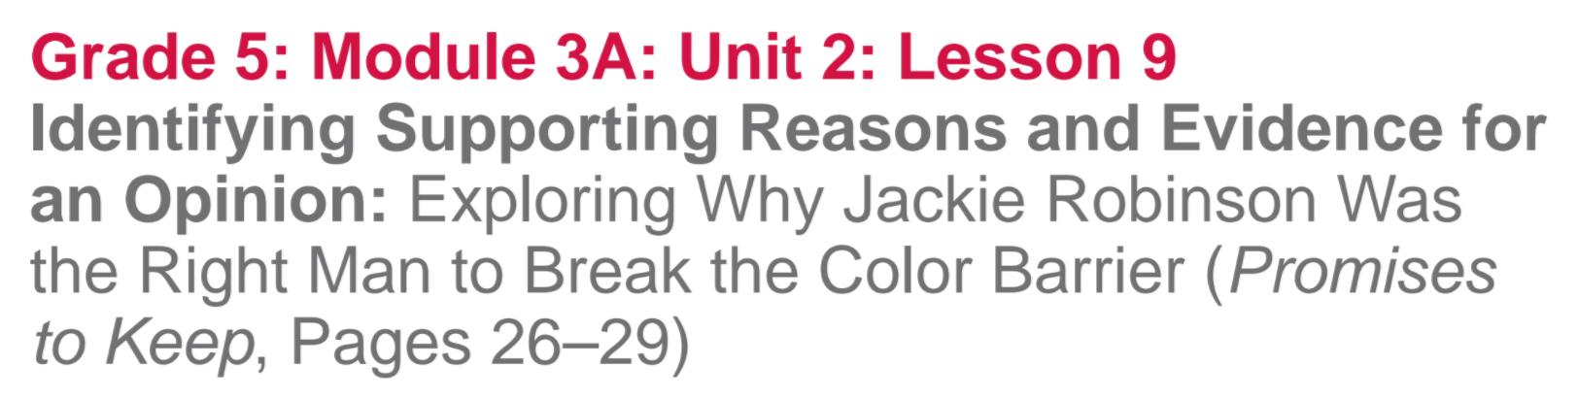

Slide 2
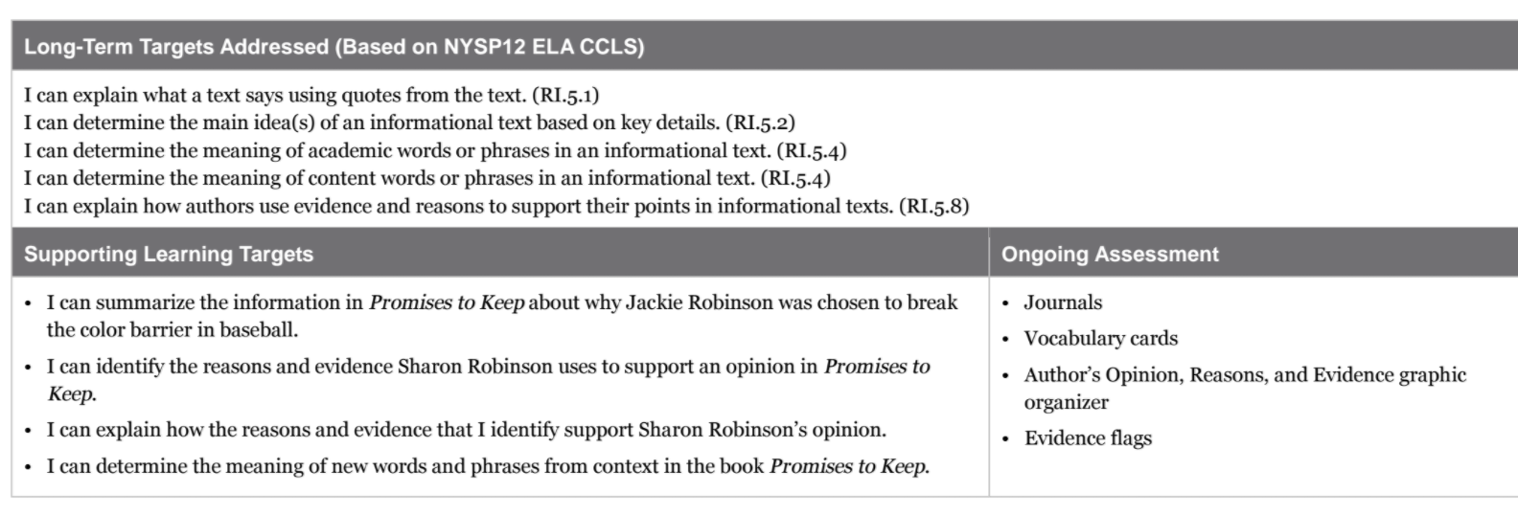

Slide 3
Opening
Review Homework and Engaging the Reader (5 mins)

Slide 4
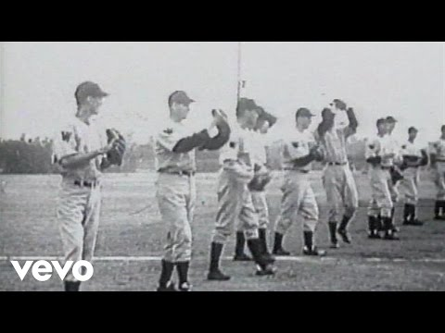
Milling to Music
You are going to meet with at least 3 other students to share the gist statements about pages 26-29 that you had to write for homework.

Slide 5
We have read that many Americans, including journalists, started to ask questions about discrimination in Major League Baseball.
Today we will read to learn about how Branch Rickey and Jackie Robinson worked together to make professional baseball and integrated sport.

Slide 6
Work Time
First Read: Getting the Gist about Jackie Robinson Being the Right Man to Break the Color Barrier in Baseball (10 mins)

Slide 7
Learning Target
I can summarize the information in Promises to Keep about why Jackie Robinson was chosen to break the color barrier in baseball.

Slide 8
Pages 26-29
Look closely at these pages to identify the text features.
What features do you see? How do they help the reader?

Slide 9
First Read
During a first read, we typically read for the gist. Follow along silently as you hear the first read of the text on pages 26-29.

Slide 10
Discuss with your group
What is the gist of the selection?
Why was Jackie Robinson chosen to break the color barrier in baseball?
Record the gist in your notebook.

Slide 11
B. Second Read: Identifying the Author’s Opinion, Reasons, and Evidence (25 mins)
I can identify the reasons and evidence Sharon Robinson uses to support an opinion in Promises to Keep
I can explain how the reasons and evidence that I identify support Sharon Robinson’s opinion.

Slide 12
We have been working on identifying an author’s opinion and supporting reasons throughout this module.
What do we mean by reasons?
WHY the author believes an opinion
What is evidence?
FACTS and details to support an opinion

Slide 13
What do we often do during a second reading?
Today we will be reading to identify the main ideas and details, which is reading to locate specific ideas.

Slide 14
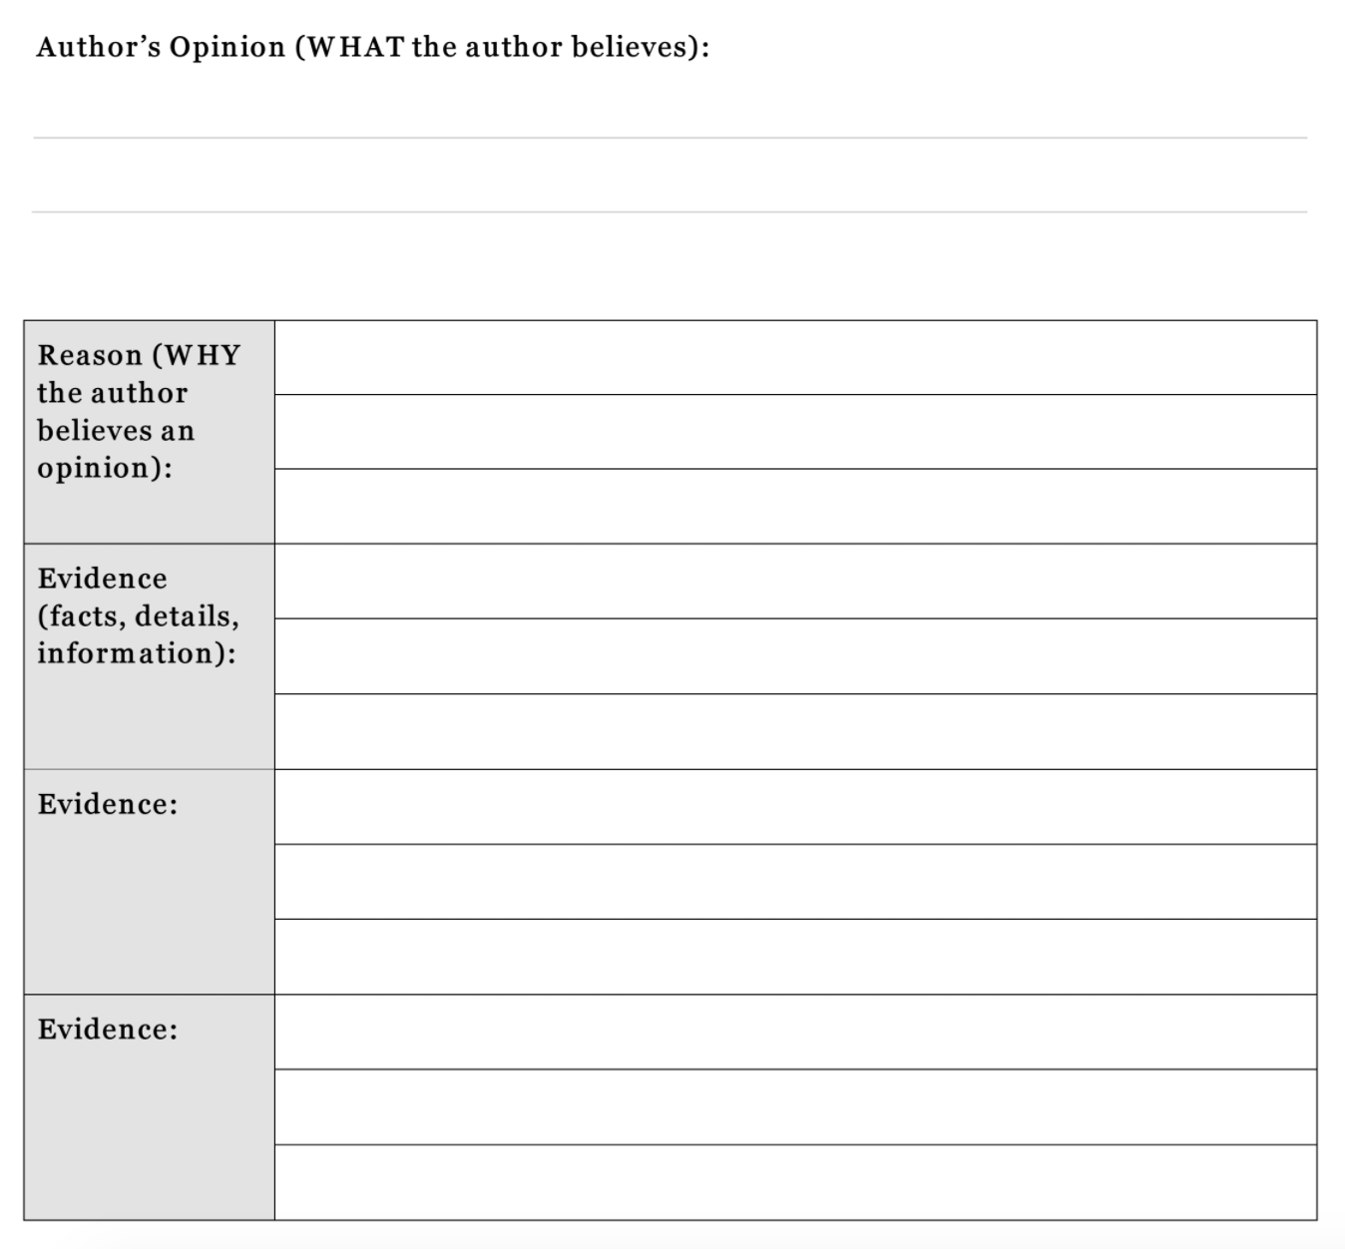
Create this
organizer in your
notebook.

Slide 15
First, you are going to work with your group members to determine the author’s opinion: “WHAT the author believes to be true.”
Look at the last 3 paragraphs on page 27 while I re-read them.

Slide 16
Discuss in your group:
What OPINION does Sharon Robinson share with us about Jackie Robinson’s ability to integrate baseball?

Slide 17
What judgement word is in this opinion?
Record the author’s opinion in your graphic organizer.

Slide 18
You are going to work with your group members to complete the lesson 9 task card.

Slide 19
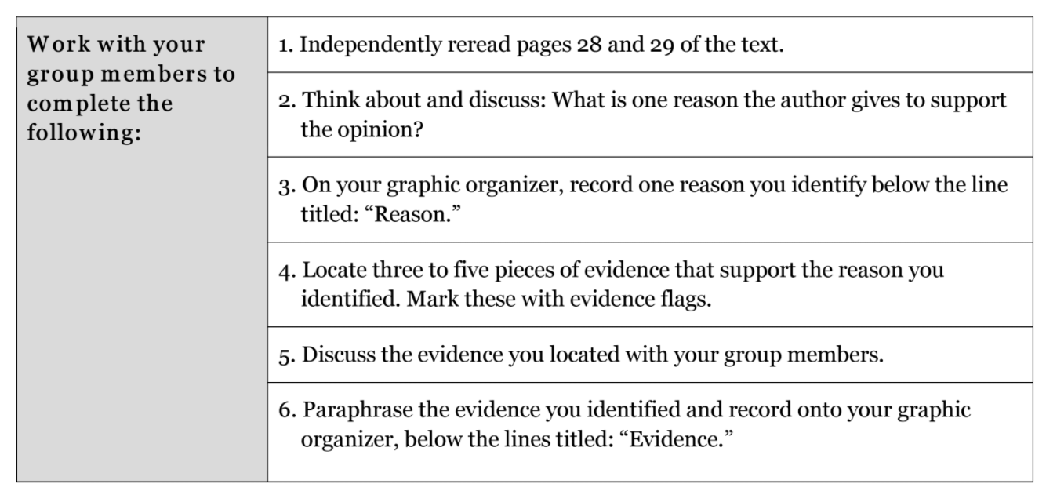

Slide 20
What are some reasons and evidence that you identified in this section of text?

Slide 21
C. Key Vocabulary to Deepen Understanding (15 mins)
I can determine the meaning of new words and phrases from context in the book Promises to Keep

Slide 22
You have been working on this target throughout the year by developing your ability to determine the meaning of new words in a variety of texts.
What is the purpose of finding the meaning of key or unknown vocabulary?

Slide 23
Each of you will receive 6 index cards. Record the following words:
series, monologue, right injustice, determination, nonviolence, Noble Experiment
Go back into the text to use context clues and apply vocabulary strategies to help determine the meaning of each word

Slide 24
Series:
Monologue:
Right injustice:
Determination:
Nonviolence:
Noble Experiment:
sequence , one after another
uninterrupted speech
correct unfairness or a wrong
strength of mind; willpower; purpose
peacefulness
A different or new approach or strategy, for the purpose of improving something

Slide 25
Closing and Assessment
Debrief and Reviewing Learning Targets

Slide 26
Let’s look at the Jackie Robinson anchor chart.
As we read today, we learned more information about Major League Baseball.
Turn and talk with a partner about details we could add to the far right-hand column of the anchor chart

Slide 27
Homework
NONE

