Slide 1
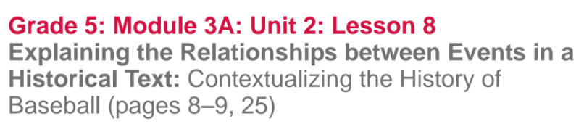

Slide 2
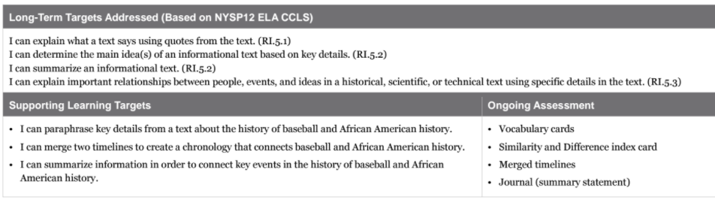

Slide 3
Opening
Homework Review (5 mins)
*Take out the vocabulary cards that you completed for homework.

Slide 4
In Module 2, when we studied Meg Lowman, you sorted the vocabulary words into two categories: academic and scientific...you’ll do something similar today.
Sort your vocabulary words into academic and domain-specific words, which are all about baseball and history.

Slide 5
B. Engaging the Reader (5 min)
Have out the similarity and difference card from your homework.
Turn to page 8 and look at our text features anchor chart.

Slide 6
Look at the timeline on page 8 and 9 and discuss with your group how a timeline helps the reader of informational text.
What do you remember about this timeline?

Slide 7
Turn to page 25 and look at the timeline on the right side of the page.
For homework you examined this timeline, and the one from page 8-9. For homework you had to write one similarity and one difference between them.
Share, not discuss with your group.

Slide 8
Work Time
Paraphrasing Key Details in Two Timelines: Events in African American History and Events in Baseball in America (25 mins)

Slide 9
Learning Target
I can paraphrase key details from a text about the history of baseball and African American history.
Turn to a partner and tell them what paraphrase means,.

Slide 10
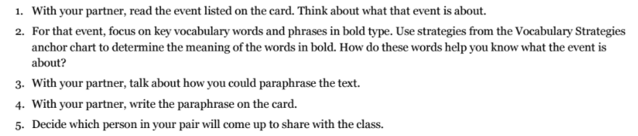
At each table group, you will pair up (may be some groups of 3, and each pair of students will be assigned one set of timeline cards, either African American History, or Baseball History, You must:

Slide 11
“Vocabulary Strategies” Anchor Chart
*Read words and phrases before and after the word for hints
*Think about parts of the word that I already know (prefix, suffix, root (cognates))
*Think about what kind of word it is (noun, verb, adjective, etc.)
*Substitute another word that would make sense

Slide 12
The spokesperson for each African American History group needs to come to the front of the class with the index card for your event.
Line yourselves up in chronological order.
Read the date, event, and your paraphrase to the class.
Repeat with baseball history.

Slide 13
B. Exploring Relationships between Events: Forming One Timeline (10 mins)
Learning Target:
I can merge two timelines to create a chronology that links baseball and African American History.
What does merge mean?

Slide 14
Cut your cards apart...
Merge your cards...in other words, put together the two different timelines, so you can see how events in both timelines connect to one another.
What do you need to pay attention to when creating a timeline.

Slide 15
Discuss with your group members anything you notice about the events now that they are in one timeline.
On your timeline, write a statement comparing and contrasting the information.

Slide 16
C. Writing a Summary Statement: Connections Between African History and Baseball in America (10 mins)
Learning Target:
I can summarize information in order to connect key events in the history of baseball and African American history.

Slide 17
What do you recall from previous modules about what it means to summarize?
To summarize is to write a short statement about the main ideas of the text.

Slide 18
Complete the following in your group:
Review and discuss the merged timeline
Think about and discuss: How can I summarize the information about the events in the timeline AND write a summary statement of the text?
On your own, write a 1 to 2 sentence statement comparing and contrasting the key events

Slide 19
Closing and Assessment
Debrief and Review Learning Targets (5 mins)

Slide 20
Focus on the Jackie Robinson & Life in America anchor chart.
Discuss with your groups any new information that should be added, or previous information that should be clarified.

Slide 21
