Slide 1
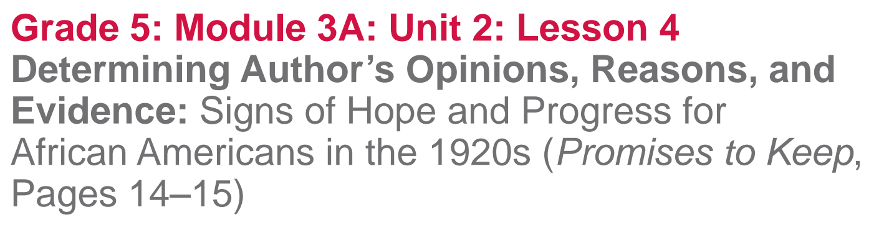

Slide 2
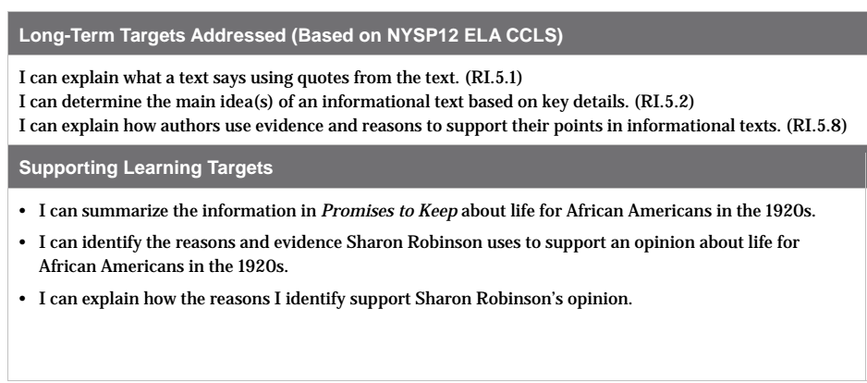

Slide 3
Opening
Homework Review (5 minutes)
Meet with a partner to share the Great Migration Venn diagram and your vocabulary cards that you completed for homework.

Slide 4
B. Engaging the Reader: Life in the 1920s for African Americans (10 minutes)
Remember, we are learning about what life was like for African Americans in the United States both before and during Jackie Robinson’s life. This will help you better understand the impact Jackie Robinson made on American society as he overcame barriers of segregation and racism.

Slide 5
Tea-Party-Protocol
You are going to use the Tea Party protocol to read information about famous African Americans to help you make inferences about what life was like for African Americans in the 1920s

Slide 6
Each of you will receive a card with information about a famous African American who lived during the 1920s...at least 3 of you will receive the same card

Slide 7
Tea Party Protocol
On your own, read the information on your card
Made an inference about what life was like for African Americans, based on the information.
Write your inference on the back of your card.

Slide 8
You will circulate around the room and do the following:
First, find the individuals who have the SAME information
Then, discuss the similarities (compare) and differences (contrast) between your inferences
Finally, meet with at least one other peer who has a different piece of information to discuss your inferences with.

Slide 9
Return to your seats and talk with a partner:
What did you infer about what life was like for African Americans during the 1920s?

Slide 10
Work Time
First Read: Getting the Gist about Life for Americans in the 1920s (10 mins)

Slide 11
Learning Target
I can summarize the information in Promises to Keep about life for African Americans in the 1920s

Slide 12
Text Features
Look at pages 14 and 15 to identify text features that you notice as part of a biography.
How do these text features help us as readers?

Slide 13
1st Read
We’re going to read to determine the gist.
Follow along silently as you hear a first read of the main text on pages 14-15.
Think and discuss what is the gist of this passage?
What was life like for African Americans’ in the 1920s?

Slide 14
B. Guided Practice: Identifying Reasons and Evidence that Support the Author’s Opinion (15 mins)
Learning Target:
I can identify the reasons and evidence Sharon Robinson uses to support an opinion about life for African Americans in the 1920s

Slide 15
Sharon Robinson shares many opinions throughout this book.
What is an opinion?

Slide 16
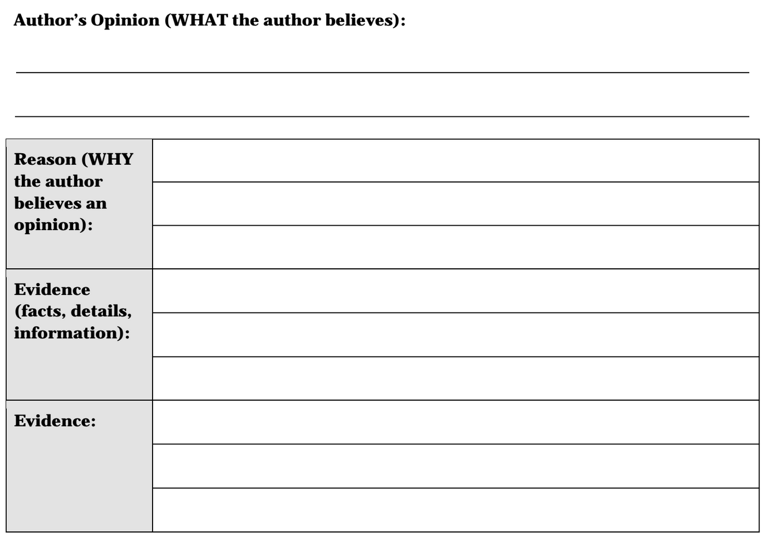
Remember that in unit 1, you determined the author’s opinion within small chunks of text. In this unit, you will determine the author’s opinion for a passage, or several pages of text.

Slide 17
Author’s will let us know “what” they think (their opinion) somewhere within the passage of text.
Author’s support their opinions by providing reasons and evidence.

Slide 18
The “Reasons” section is a new element you will begin to identify in an author’s argument.
An author’s opinion is WHAT the other believes. The reasons an author provides to support an opinion tells us WHY the author believes the opinion.

Slide 19
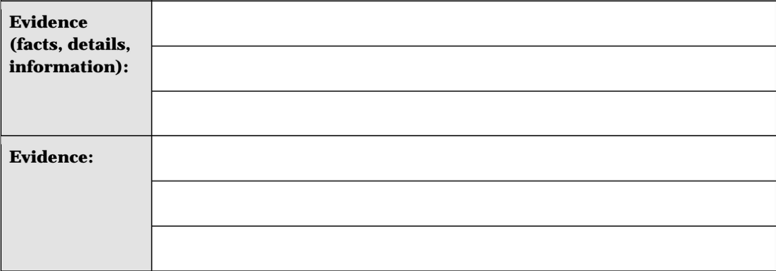
Notice the EVIDENCE sections. What do you recall that evidence is?

Slide 20
The “Reasons” section is a new element you will begin to identify in an author’s argument.
An author’s opinion is WHAT the other believes. The reasons an author provides to support an opinion tells us WHY the author believes the opinion.

Slide 21
You will now work with your group members to determine the author’s opinion--WHAT the author believes--for the passage on pages 14 and 15.
Follow along silently as I read the first two paragraphs on page 14 aloud

Slide 22
Discuss with your group:
WHAT is the author’s opinion about life for African Americans in the 1920s?
How is this an opinion?
Can it be argued?
Can someone disagree?

Slide 23
Now we will read the third paragraph to determine one reason WHY Sharon Robinson believes there were signs of hope and progress for African Americans in the 1920s

Slide 24
As I read this paragraph aloud I heard that there were several black-owned and operated newspapers. I think this is part of WHY Sharon Robinson believes there were signs of hope and progress for African Americans in the 1920s, because we learned that before the 1920s African Americans had been enslaved, segregated, and would have been kept from owning a business.
How can we paraphrase this?

Slide 25
3-4 minutes to complete with your group
Reread the 3rd paragraph to identify evidence about newspapers owned and run by African Americans.
Mark the evidence you locate
Discuss with your group members the evidence you locate.

Slide 26
What evidence did you locate in this paragraph about newspapers owned and managed by African Americans?
How can we paraphrase these responses so that we can add them to the graphic organizer?

Slide 27
In the next step of Work Time, you will work in your groups to identify another reason and supporting evidence for Sharon Robinson’s opinion that there were signs of hope and progress for African Americans in the 1920s

Slide 28
C. Small Group Practice:
Identifying Reasons and Evidence That Support the Author’s Opinion (15 mins)

Slide 29
Focus your attention on Paragraph 4 (the main paragraph on page 15, starting: “There was also a small but growing…”

Slide 30
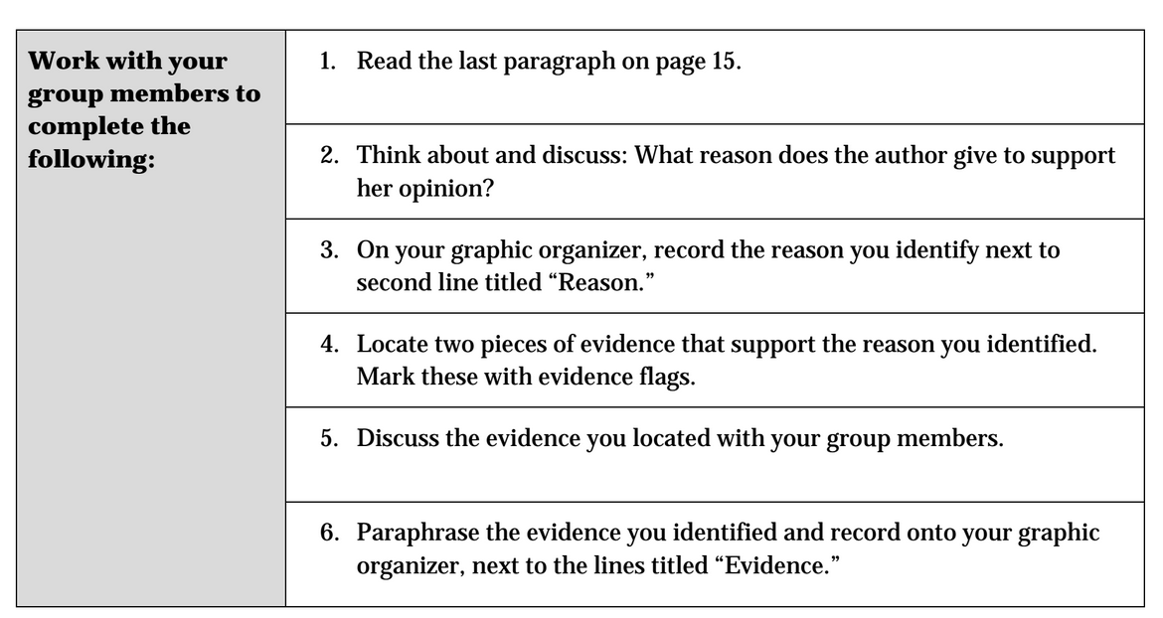

Slide 31
Share out the reasons and evidence you identified to support the author’s opinion.
How do the reasons and evidence you identified in paragraph 4 support the author’s opinion that there was progress of African Americans in the 1920s?

Slide 32
Closing and Assessment
Debrief (5 mins)
Let’s take a look at our Jackie Robinson and Life in America Anchor Chart

Slide 33
As we read today we learned many more details about what life was like in America for African Americans in the 1920s

Slide 34
Take 1 minute to turn and talk with a partner about the details that you could add to the far right-hand column of the anchor chart about what was happening in America in the 1920s

Slide 35
Review Learning Targets-Thumb-O-Meter
I can summarize the information in Promises to Keep about life for African Americans in the 1920s.
I can identify the reasons and evidence Sharon Robinson uses to support an opinion about life for African Americans in the 1920s

Slide 36
Homework-3 Index Cards
Read pages 16-19 of Promises to Keep
On 1 index card, write a gist statement on this section of the text
2 vocabulary cards: Harlem Renaissance and resistance

