Slide 1
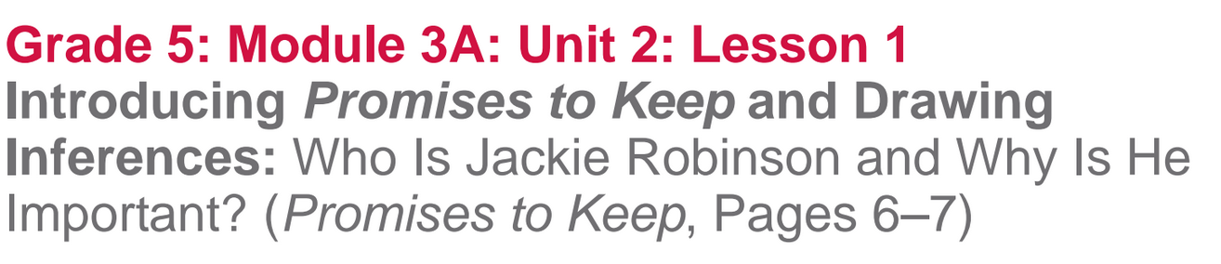

Slide 2
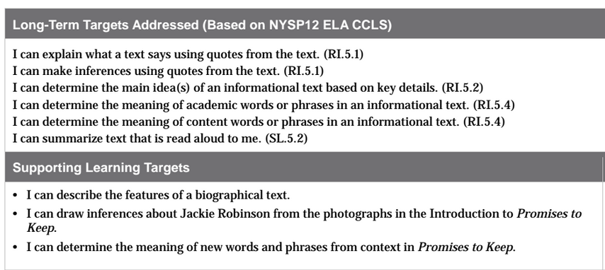

Slide 3
Opening
Biography as Informational Text (10 mins)

Slide 4
Learning Target
I can describe the features of a biographical text.
Let’s add “biography” to our features of informational text anchor chart.
Think about the definition of a “biography”

Slide 5
BIOGRAPHY
Where have we seen the prefix “bio-” before?
What does it mean?
The root graph means to write, so biography means to write about someone’s life.
What are some features of a biography?
How do those features help the reader?

Slide 6
Learning Target
I can describe the features of a biographical text.
Let’s add “biography” to our features of informational text anchor chart.
Think about the definition of a “biography”

Slide 7
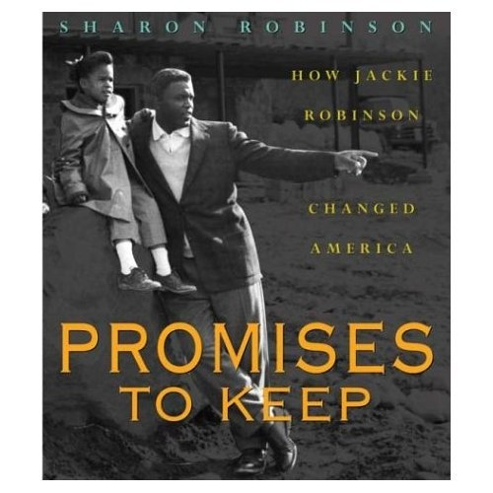
Work Time
Picture Walk through Promises to Keep (10 mins)

Slide 8
Promises to keep
This book is Promises to Keep: How Jackie Robinson Changed America by Sharon Robinson. What kind of book do you think it is?
What features do you predict it will have?

Slide 9
Learning Target
I can draw inferences about Jackie Robinson from the photographs in the Introduction to Promises to Keep

Slide 10
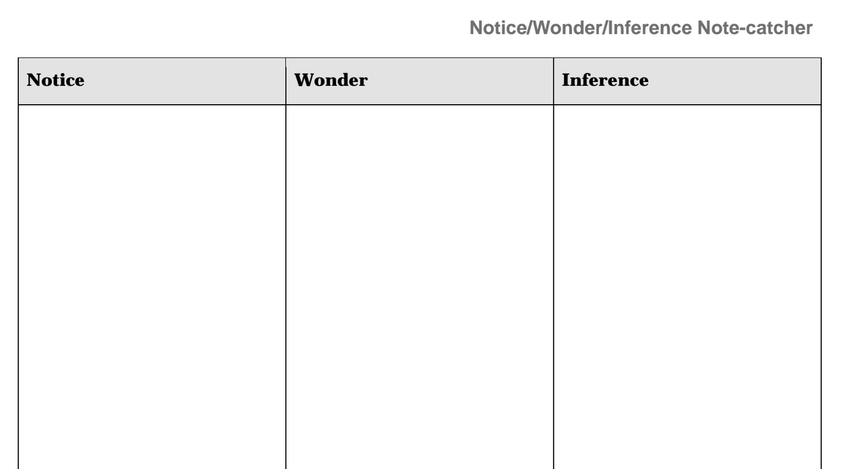
Take out your journals and draw the same three-column chart on the next blank page.
What we see and hear directly.
Questions
Ideas we have based on what we see and hear.

Slide 11
Turn and share your notes with a partner.

Slide 12
Picture Walk (5-7 mins)
You will now do a Picture Walk through the book. Page through the book, looking at the pictures and continues to notice, wonder, and draw inferences from the pictures.
Share your new note.

Slide 13
What are photographs and captions in a book called?
Why are they important in this book?

Slide 14
Work Time
B. Building Background Knowledge: Reading the Introduction of Promises to Keep (25 mins)

Slide 15
Turn to the introduction on page 6.
What does the word introduction mean?
It has the same beginning as introduce, but introduce is a verb, and introduction is a noun.

Slide 16
We are now going to read the introduction to the book. Follow along, as I read aloud.

Slide 17
Talk in your groups about the gist of the Introduction.
Write a gist statement on the next page of your journals.
Reread the introduction on your own, recording additional notes in your Notice/Wonder/Inferences note-catcher

Slide 18
C. Key Vocabulary to Deepen Understanding (10 mins)
Learning Target:
I can determine the meaning of new words and phrases from Promises to Keep

Slide 19
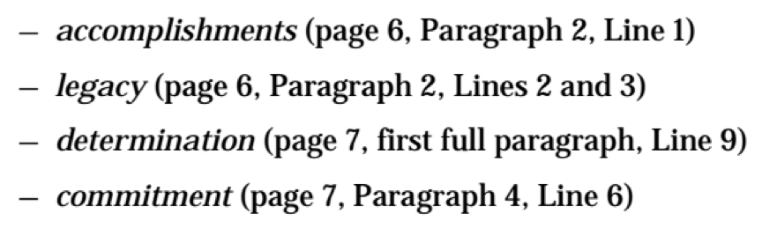
Key Vocabulary
Locate the following words in the introduction
Write one word on each index card.
Use context clues to find the meaning

Slide 20
Definitions
Accomplishments: achievements
Legacy: something (either good or bad) that is handed down from the past
Determinations: extreme drive to do or accomplish something.
Commitment: a sense of loyalty or strong belief in an idea.

Slide 21
Closing and Assessment
Debrief and Review Learning Targets (5 mins)

Slide 22
Think of one piece of evidence that indicates that you met one of the learning targets, and share your thoughts with a neighbor.

Slide 23
Homework
Reread the introduction to Promises to Keep
On one card answer this question.
What does Sharon Robinson admire about her father, Jackie Robinson?
On 3 new cards write: biography, biographical, introduction. On the back draw or define it.
Bring as ADMIT ticket.

