Slide 1


Slide 2
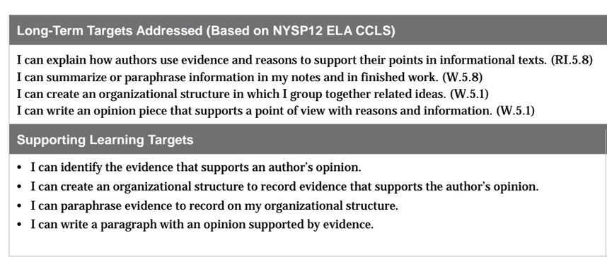

Slide 3
Opening
Homework Review and Engaging the Writer (10 mins)

Slide 4
You have learned a great deal about the importance of sports in American culture through reading others’ opinions about this topic.
Understanding this compelling topic is preparing you for unit 2, when you will go more in depth about how American athletes have opportunities to influence social change in America.

Slide 5

Today you will be milling to music to share, with at least 2 other partners, your homework index cards that respond to the question: “In what ways do sports play an important role in American culture? Support your answer with at least 2 pieces of evidence from the text.
Add your vocabulary cards to your
envelope.

Slide 6
In the next lesson you will take the on-demand unit assessment where you will have the opportunity to write your opinions about sports in American culture, and support your opinions with evidence from the informational articles that you’ve read in this unit.

Slide 7
Work Time
Sorting Evidence: Sports in America (15 mins)

Slide 8
Now we will read another chunk of the article “Sports in America” in order to identify more key details about sports in American culture.

Slide 9
Learning Target
I can identify the evidence that supports an author’s opinion.
Remember that in the previous lesson you closely read one chunk of “Sports in America” to identify the author’s opinion and supporting evidence.

Slide 10
What do you remember about the author’s opinions and supporting evidence in the article “Sports in America” from lesson 5?
During today’s lesson, you will write a paragraph using one of the author’s opinions from that article, and locate evidence to support the opinion by participating in an evidence sort.

Slide 11
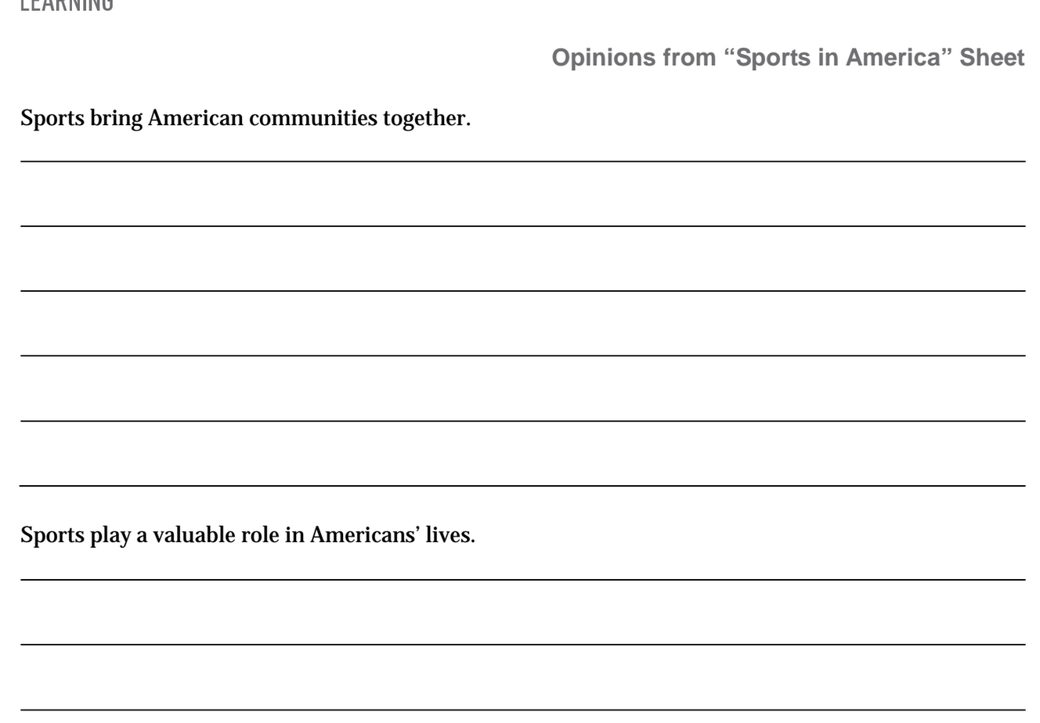
During your discussions in lesson 5 about the author’s opinions from the article “Sports in America,” I heard many of you identify opinions similar to these.
Restate the opinions in your own words.
Which opinion most interests you and why?

Slide 12
Turn to a new page in your journals and write the opinion you chose at the top of the page.
Sports bring American communities together
OR
Sports play a valuable role in Americans’ lives
(pass out evidence strips and glue sticks)

Slide 13
You are going to sort through the evidence strips to identify the evidence that supports the opinion that you just recorded.

Slide 14
For example, if I was most interested in writing about the opinion “Sports bring American communities together,” I would need to read the evidence strips to determine which ones support my opinion.

Slide 15
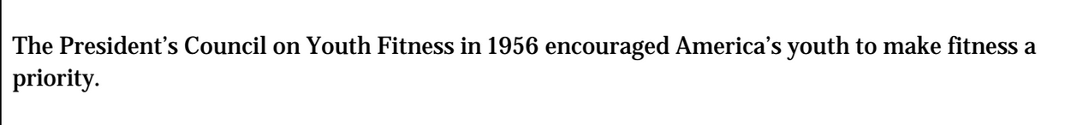
If I look at the evidence strip, I don’t think it supports my opinion because it doesn’t mention anything about community groups or Americans enjoying sports together.

Slide 16
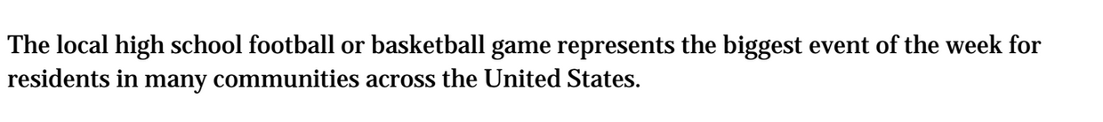
If I examine this piece of evidence, I think that it does support my opinion because it shares information about people in a community coming together to watch sports.

Slide 17
In your groups:
Take turns reading each of the evidence strips out loud and discuss as a group which opinion each piece of evidence supports. Some may support both opinions.
Take the evidence strips that support your opinion and glue them into your journal below where you wrote your opinion.

Slide 18
B. Planning: Creating an Organizational Structure for My Writing (15 mins)
Learning Targets:
I can create an organizational structure to record evidence that supports the author’s opinion
I can paraphrase evidence to record on my organizational structure.

Slide 19
The purpose for creating an organizational structure is to record paraphrased evidence to keep track of key ideas and details from texts.
You will then use the notes of paraphrased evidence as a reference to write your paragraphs.

Slide 20
For this lesson, you have been given an opinion as a starting point for your writing, and you’re mostly focused on organizing evidence.
In the next lesson, you will work as writers to form your own opinions.

Slide 21
What do you recall about tools you have used to organize your ideas from previous lessons?

Slide 22
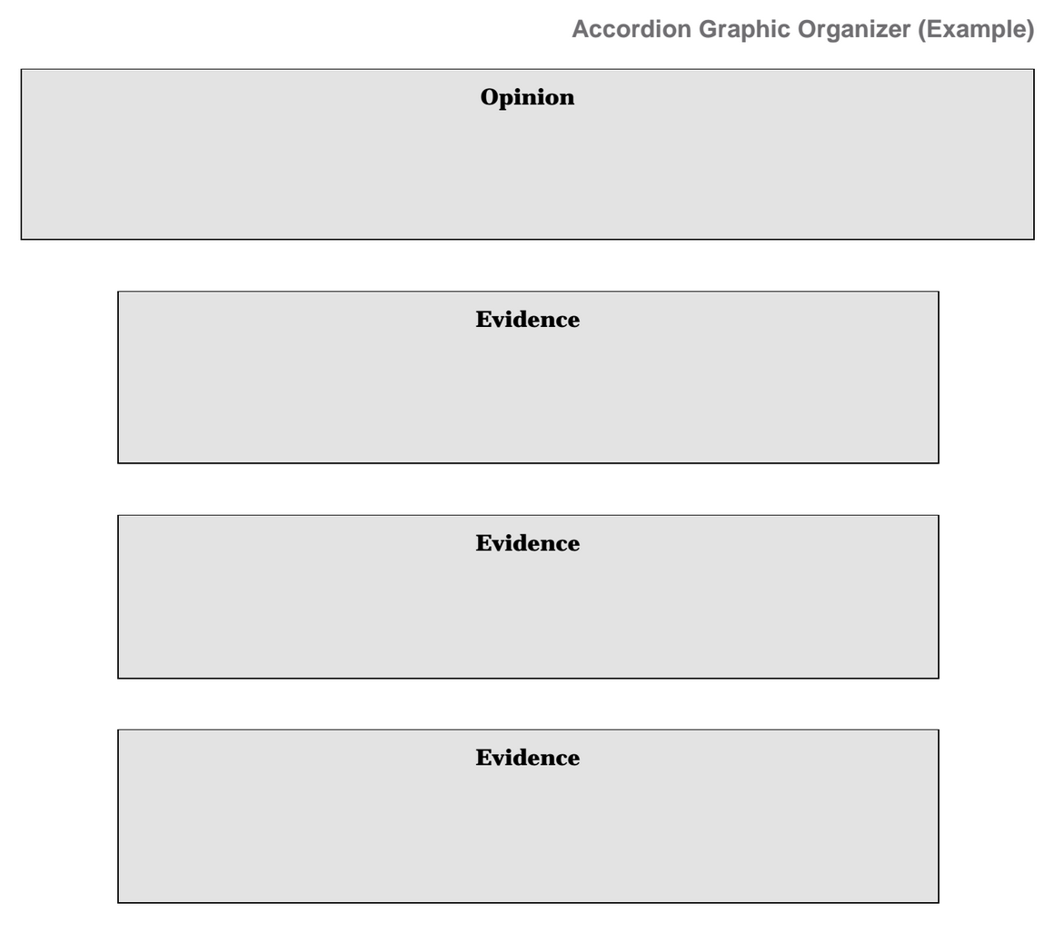
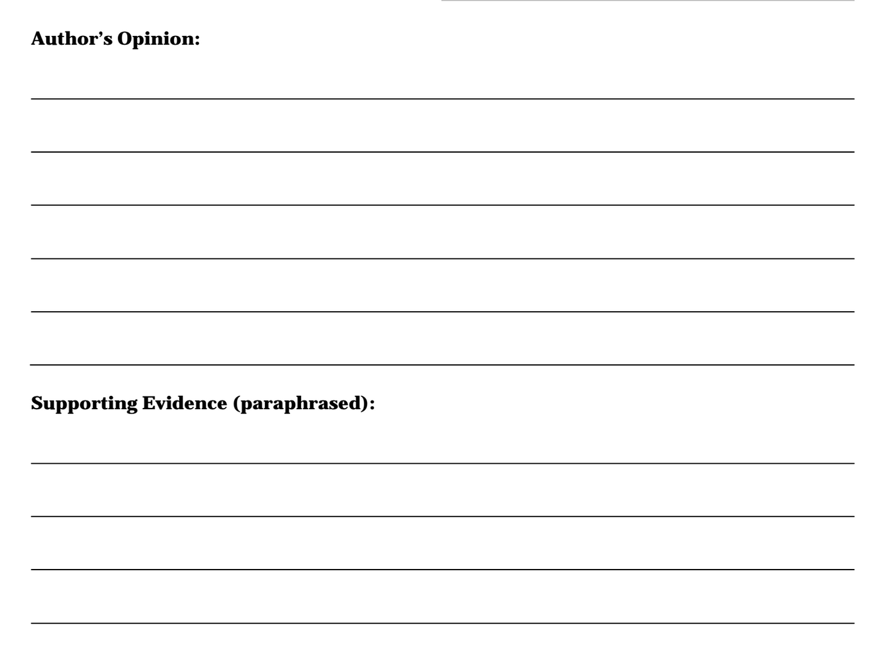
You’ve seen these organizers before, and have used them both as readers and writers. Today, you will choose one of these two organizers to help you as a writer.

Slide 23
On the graphic organizer you choose, you will record the author’s opinion that you chose during work time A. You will then paraphrase and record the evidence from the evidence strips you glued into your journal below your opinion.
You will use this graphic organizer as a reference for your writing in the next step of the lesson.

Slide 24
Talk with your elbow partner:
Which of the organizers do you choose, and why?

Slide 25
On a new page in your journals:
Write the words “Author’s Opinion” at the top of your organizer.
Create a space for each evidence strip you glued into your journal
Above each space, write the word “evidence”

Slide 26
8-10 mins to complete the following:
Record the author’s opinion you chose to focus on at the top of your organizer
Reread each evidence strip and paraphrase; then record each piece of paraphrase evidence in its own evidence space on your organizer
Share paraphrased evidence with group members for feedback

Slide 27
C. Paragraph Writing: Opinion and Evidence (15 mins)
Learning Target
I can write a paragraph with an opinion supported by evidence.
Who can restate the target in their own words?

Slide 28
Success Criteria
Think back to previous modules, what were the criteria for a good paragraph?
Complete sentences
Indent first sentence
Correct punctuation
Correct grammar

Slide 29
You have 10 minutes to:
Turn to a new page in your journal
Indent and write the author’s opinion you recorded as a complete sentence
Below the opinion, write supporting evidence in complete sentences to support the author’s opinion. Use the evidence you paraphrased and recorded onto your graphic organizer.

Slide 30
EARLY FINISHERS
Praise-Question-Suggest
Does the first sentence clearly state an opinion about sports in America?
Does the evidence support or connect to the opinion?
Does the paragraph include key vocabulary from the article?

Slide 31
Closing and Assessment
Debrief and Review of Learning Targets
(5 mins)

Slide 32
What was some new evidence you identified today that supports the opinion that sports are a valuable part of American Culture?

Slide 33
Review Learning Targets (Thumb-O-Meter)
I can identify the evidence that supports an author’s opinion
I can create an organizational structure to record evidence that supports the author’s opinion
I can write a paragraph with an opinion supported by evidence.

Slide 34
Homework
Locate all of the articles we have read in this unit and reread one of them

