Slide 1
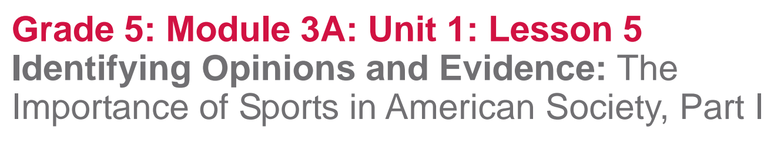

Slide 2
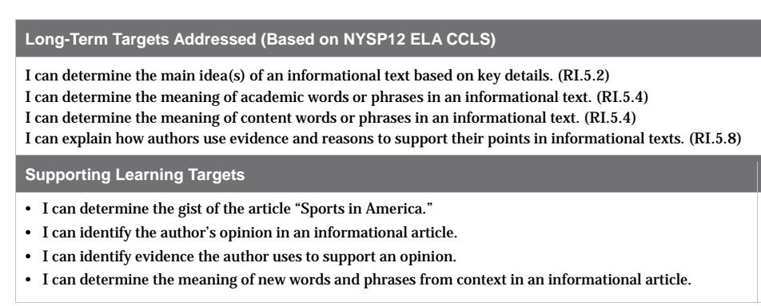

Slide 3
Opening
Engaging the Reader and Review Learning Targets (5 mins)

Slide 4
Congratulations on completing the mid-unit assessment. Through all of your close reading about play and sports, you are really building knowledge about the value of sports in our lives. This knowledge will help you consider how athletes can influence our society, in unit 2

Slide 5
Turn and talk
Based on what you have read so far, what do you think is the role of sports in American culture?
Today you will read an article about sports in America to learn more about the role of sports in American culture.

Slide 6
Learning Targets
I can determine the gist of the informational article “Sports in America.”

Slide 7
Work Time
Read-aloud and Rereading for Gist: “Sports in America” (15 minutes)
Take out your journals and look at the article “Sports in America”

Slide 8
What do we typically do when we receive a new text?
This is another complex text, so I will read it aloud first while you follow along.
Remember, the main goal of a close read is to pay very careful attention to text, rereading and continuing to think about it more precisely.
https://drive.google.com/open?id=1J1nF7GmwAi2uwYvpnlBk9hwQWlmsyqPyBxl5LfNDfkMqq !Q ty2 @ 2

Slide 9
You are now going to reread the article in chunks, just for gist.
Later, small groups will focus on just one chunk in more detail.
Get started with the first chunk of text. Reread this on your own, annotating for gist and writing clarifying questions in the margins as you need to.

Slide 10
Talk with your group about your annotations and questions.
Work together to go back in the text to find the answers to your questions.

Slide 11
Repeat the same process with chunks 2-6
Reread
Annotate for gist, and write clarifying questions
Discuss annotations and questions with group members
Return to the text to find answers

Slide 12
Overall Gist
Discuss the overall gist of the article with your group.
What is this article mostly about?
Write a gist statement on the next page of your journal.

Slide 13
B. Jigsaw to Identify Opinion and Evidence (20 mins)
I can identify the author’s opinion in an informational article
I can identify the evidence the author uses to support an opinion.

Slide 14
We’re going to be using the jigsaw protocol to dig into four chunks of this article in more detail.
Turn to a new page in your journal and create an Opinion and Evidence graphic organizer just like we used with our previous text.
You’ll work with your groups to first think about the author’s opinion and then again to think about the evidence.

Slide 15
Chunks 1, 2, 3, and 5
For round 1, take 4-5 minutes to:
Reread your chunk of the article
Think about: What is the author’s opinion in this chunk?
Jigsaw to discuss what you think and why
On your graphic organizer, record the author’s opinion

Slide 16
Share out what the author’s opinion is for each chunk.

Slide 17
Round 2 (7-9 minutes)
Independently reread your chunk of text
Identify and text code with an E, evidence the author uses to support the opinion
Jigsaw to discuss the evidence you identified with your group members
Record paraphrased evidence for each chunk of text.

Slide 18
C. Key Vocabulary to Deepen Understanding (15 mins)
I can determine the meaning of new words and phrases from context in an informational article.
*8 index cards per student*

Slide 19
Society, vehicles, values, promoting, typical, popular, rituals, and gather
Record each word on its own index card
Go back into the article to use context clues and apply vocabulary strategies to help you determine the meaning of each word.
Write a synonym or short definition for the word and draw a picture to show the meaning on the back of each card.

Slide 20
society:
vehicles:
values:
promoting:
typical:
popular:
rituals:
gather:
Culture; humanity; all the people who live in a particular place or nation
Ways to accomplish something; tools
Strong beliefs; ethics; standards; principles; morals
Advancing or furthering a cause (or organization)
Usual; normal; average; standard
Common; widespread; generally liked by the public
Ceremonies; repeated behaviors or events
Meet; get together; group

Slide 21
Revise our thinking 3-4 minutes
Reread your paraphrased evidence from Work Time B
Based on new understanding about the vocabulary, discuss:
  Did I identify any evidence that doesn’t suppor the author’s opinion?
  Did I use key vocabulary correctly?
Revise evidence by deleting or crossing out evidence that doesn’t support the author’s opinion, or rewrite the evidence.

Slide 22
Consider and Discuss in Groups
Which of the key words strikes you as important for understanding the value of sports in American culture and why?

Slide 23
Closing and Assessment
Debrief and Review of Learning Targets
(5 mins)

Slide 24
You’re close reading today helped you learn a great deal more about the importance of sports in American culture.
What was some new information we learned today about how sports are valuable in American culture?

Slide 25
Review Targets--Thumb-O-Meter
I can identify the author’s opinion in an informational article
I can identify the evidence the author uses to support an opinion
I can determine the meaning of new words and phrases from context in an informational article

Slide 26
