Slide 1


Slide 2
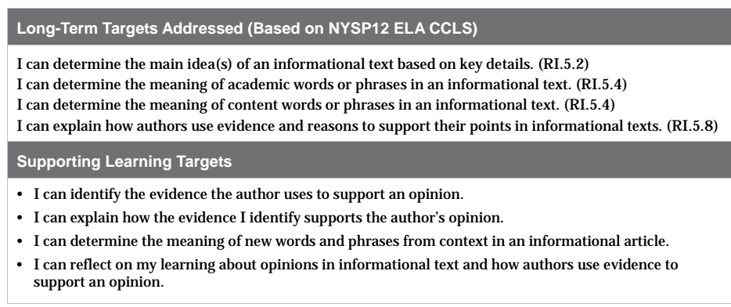

Slide 3
Opening
Homework Review: Admit Tickets (5 mins)
Turn in your index cards that responded to the questions: “In what ways are sports valuable to Americans? Support your answer with at least two pieces of evidence from the text.

Slide 4
Remember that in this unit we are focusing on the role that sports play in American culture. Now that you have viewed a variety of images and closely read one article in which the author expresses several opinions about the importance of sports in people’s lives, you will use what you have learned to select an opinion about the role of sports in our lives.

Slide 5
You are going to participate in a word sort, using only ONE of your vocabulary cards.
Notice the two opinions word sort cards posted in the room.

Slide 6
Two Opinions
People learn valuable skills from sports
Sports entertain people

Slide 7
You have 3 minutes to:
Choose the statement you most agree with and stand by that card
Use evidence from the article--and key vocabulary from your cards, to discuss with others why you agree with the opinion.

Slide 8
B. Review Learning Targets (5 mins)
I can identify the evidence the author uses to support an opinion
I can explain how the evidence I identify supports the author’s opinion
I can determine the meaning of new words and phrases from context in an informational article

Slide 9
Identify: name; decide; determine
Evidence: facts; proof; data; information
Claim: opinion; point of view; position on an issue
Explain: give details; make clear; give reasons
Support: reinforce; provide evidence; make claim stronger
Context: words and sentences around another word or phrase that give a reader hints about what the word means.

Slide 10
Work Time
Review Opinion and Supporting Evidence
(10 mins)

Slide 11
Remember, you will be taking an assessment today.
You will now look back in your journals and the anchor charts to review what you’ve been learning about the role of sports in Americans’ lives and how authors share their opinions and provide support evidence for those opinions in writing.

Slide 12
In your groups...
Look over your Opinion and Evidence graphic organizers. Consider and discuss:
What did I learn about author’s opinions and about how authors support their opinions with evidence?
Groups share out whole class

Slide 13
B. Mid-Unit Assessment (25 mins)
For the mid-unit assessment you will independently read a new article about the importance of sports in America. You’ve been working really hard on reading complex texts, so you’re ready for this!

Slide 14
Close Readers Do these Things
What do we often do after we have read several texts about a topic?
Yes! We read a new text on the topic and respond to text-dependent questions.

Slide 15
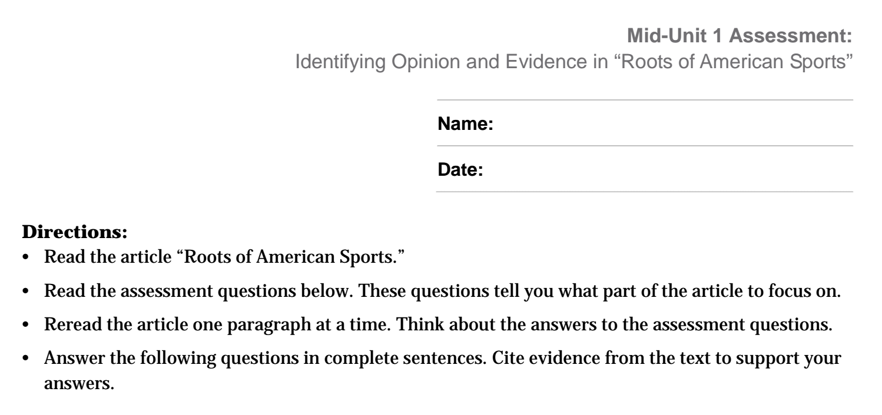
Scan the assessment to see if you have any clarifying questions. Remember to use your journal and anchor charts for support

Slide 16
C. Mid-Unit Assessment Tracking My Progress (10 mins)
I can reflect on my learning about opinions in informational text and how authors use evidence to support an opinion.
You’ve done this type of self-assessment at the end of most assessments. Please work independently.

Slide 17
Closing and Assessment
Sharing: Reflections on Learning Targets (5 mins)
Share your “Tracking My Progress” forms with a partner.
Share out whole class

