Slide 1
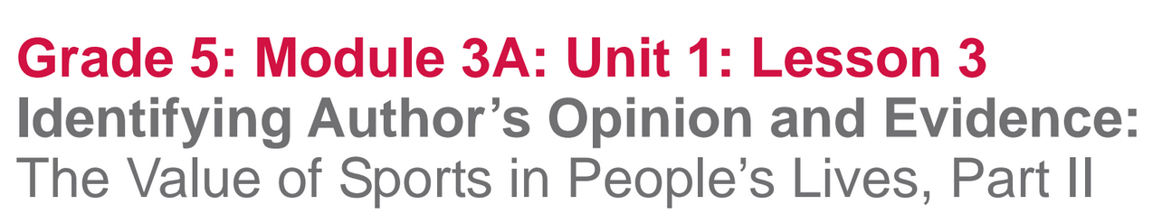

Slide 2
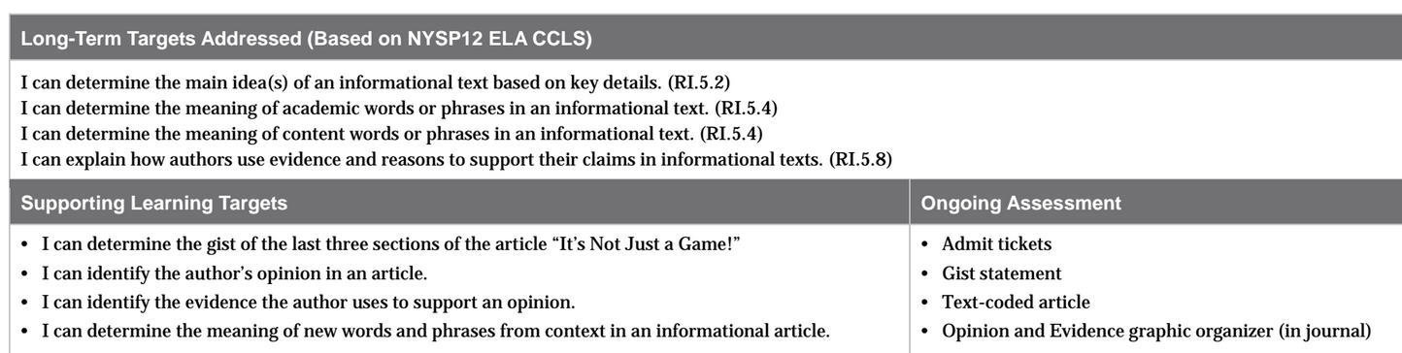

Slide 3
Opening
Homework Review: Admit Ticket (5 mins)
Think back to the quiz-quiz-trade protocol that used in module two to learn and review new vocabulary.

Slide 4
We’re going to do the quiz-quiz part of this protocol with a peer.
You will NOT be trading vocabulary cards.
Turn to a partner and quiz-quiz.
Place your new vocabulary cards in your vocabulary envelopes.

Slide 5
Share your responses to the homework question: “In what ways are sports valuable to people? Support your answer with at least two pieces of evidence from the text.

Slide 6
B. Engaging the Reader and Review of Learning Targets (5 mins)
Remember, this unit focuses on the importance of sports in America.

Slide 7
Turn and Talk
Based on the text you are read so far, what do you think is the importance of sports in American culture?
What evidence from the text supports your thinking?

Slide 8
Today, we will complete our reading of the informational article “It’s Not Just a Game!” to learn more about the role of sports in people’s lives.

Slide 9
What impact do sports have on our lives?
Turn and discuss this idea with a partner

Slide 10
Learning Target
I can determine the gist of the last three sections of the article “It’s Not Just a Game!”

Slide 11
Work Time
First Read: “It’s Not Just a Game!” Part II
(15 minutes)

Slide 12
Take out the article, “It’s Not Just a Game!”
We are going to read the second part of the article today, which is the text below the line.

Slide 13
What do we usually do during the first reading of a text?
I’m going to read the text aloud first since it contains words and phrases that may be unfamiliar, and because it’s enjoyable to hear great text read aloud.

Slide 14
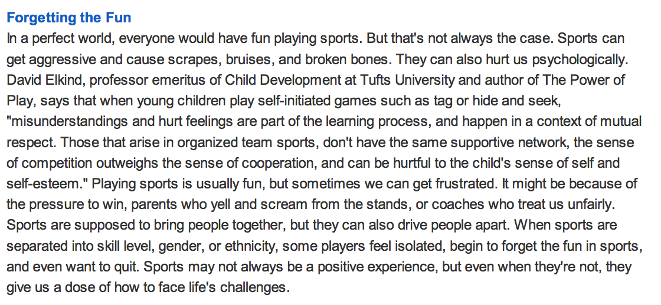

Slide 15
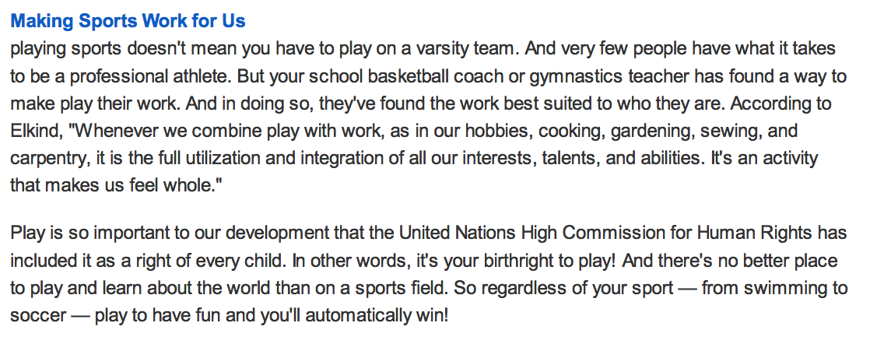

Slide 16
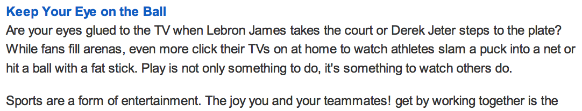

Slide 17
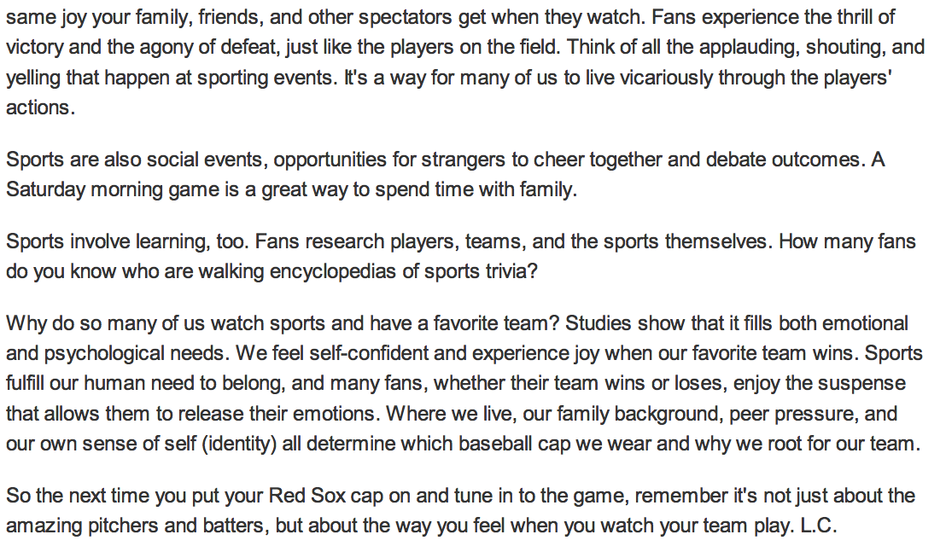

Slide 18
What do we typically do after the text has been read once?

Slide 19
With your group (7-8 mins)
Reread the last 3 sections of the text
Circle unknown or key vocabulary
Try to determine the meaning of unknown words in the text
Think about the gist
Talk with your group about the gist
Write a gist statement on the next page of your journal

Slide 20
Share out gist statements and key words or phrases you identified as well as their meaning.

Slide 21
B. Second Read: Identify Opinion and Evidence (15 mins)
Learning Target:
I can identify the author’s opinion in an article
I can identify the evidence the author uses to support an opinion.

Slide 22
“Making Sports Work for Us”
What do we usually do during a second read of the text?

Slide 23
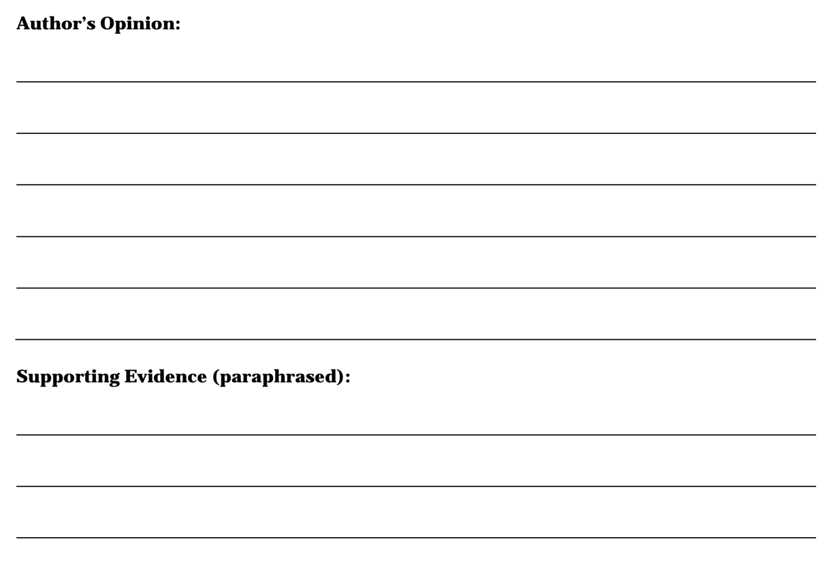
We’re going to use the same graphic organizer from lesson 2 to record what you’ve identified as the author’s opinion and supporting evidence.

Slide 24
We are going to reread this section of the text to determine the author’s claim, just like we did with the first part of the text.

Slide 25
You have 5 mins to do the following with your group:
Reread the last section of the article titles “Making Sports Work for Us”
Think about: What is the author’s opinion in this section
Discuss what you think the author’s opinion is and why you think that.

Slide 26
You have 7-9 minutes to:
Go back through the section titles “Making Sports Work for Us” and reread to identify at least 2 pieces of evidence that author uses to support her opinion
Text code evidence you locate
With your group, discuss the evidence you found
Record paraphrased evidence on your graphic organizer

Slide 27
C. Key Vocabulary to Deepen Understanding (15 mins)
Learning Target:
I can determine the meaning of new words and phrases from context in an informational article

Slide 28
Just like in previous modules, you will work with key vocabulary from the text regularly.
What is the purpose for determining the meaning of key or unknown vocabulary?
What does context mean?
**Pass out 6 index cards per student**

Slide 29
Suited (to), integration, (feel) whole, development, (a) right, regardless
Take 5-6 minutes to complete these tasks:
Record each word on it’s own card
Go back into the article to use context clues and apply vocabulary strategies to help determine the meaning of each word.
Write a synonym or short definition for the word and draw a picture to show the meaning on the back of each card

Slide 30
Was naturally good at; well matched with a person or interests
Suited (to):
Integration:
(feel) whole:
Development:
(a) right:
regardless:
Combination of different parts or qualities
Complete; satisfied
Growth; progress; improvement
A freedom to do something; birthright
No matter what; nonetheless

Slide 31
You have 3-4 minutes to:
Reread your paraphrased evidence from Work Time B
Based on new understanding about vocabulary, think about and discuss:
  Did I identify any evidence that does not support the author’s opinion?
  Did I use key vocabulary correctly in my paraphrased evidence?
Revise evidence using key vocabulary

Slide 32
Consider and Discuss
How does understanding key vocabulary from the text help you identify or better understand the connection between an author’s opinion and evidence the author uses to support an opinion?

Slide 33
Closing and Assessment
Debrief and Review of learning Targets
(5 mins)

Slide 34
Remember, we are reading closely to develop your background knowledge about the role sports play in all Americans’ lives.
This knowledge is foundational to understanding why sports figures can be presented with opportunities to affect society, which you’ll learn about in unit 2

Slide 35
Turn and Talk
What new information did we learn today about how sports are a valuable part of Americans’ lives?

Slide 36
Review Targets-Fist to Five
I can identify the author’s opinion in an article
I can identify the evidence the author uses to support an opinion
I can determine the meaning of new words and phrases from context in an informational article.

Slide 37
During our next lesson, you will take the mid-unit assessment, so it’s important that you understand how to identify an author’s opinion and the evidence they use to support their opinion.
(3 index cards for homework)

Slide 38
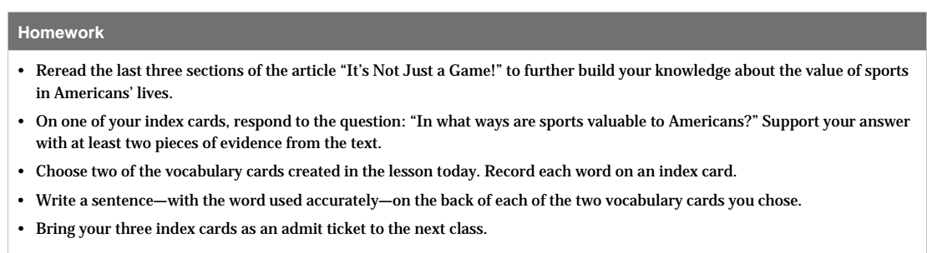

Slide 39
Homework Question
In what ways are sports valuable to Americans? Support your answer with at least two pieces of evidence from the text.

