Slide 1
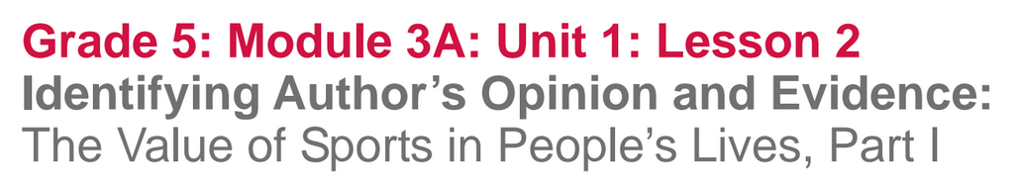

Slide 2
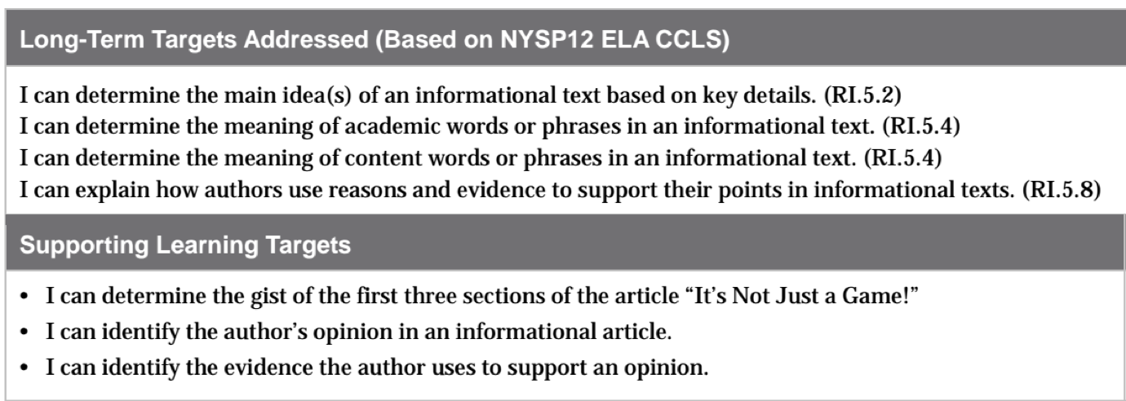

Slide 3
Opening
Engaging the Reader and Review Learning Targets (5 mins)

Slide 4
Remember that in this unit we are building our background knowledge about the importance of sports in American Culture. Today we are going to read an article titled It’s not Just a Game! to learn more about the role of sports in people’s lives

Slide 5
Learning Target
I can determine the gist of the first three sections of the article It’s Not Just a Game!
What does determine mean?
What is the gist?

Slide 6
Work Time
First Read: “It’s Not Just a Game!” Part 1
(15 mins)

Slide 7
Think back to the close reading we did about rainforests in our last module. Discuss with your group members:
What have we learned about close reading routines in our first two modules?
Reading and closely rereading only parts of a text help readers to focus in on key ideas and vocabulary in order to build a deeper understanding of the text.

Slide 8
Close Readers Do These Things Anchor Chart
Read the text to determine the gist; identify key or unknown vocabulary
Discuss the gist and revise if necessary
Reread the text for a specific purpose
Discuss and then record current understanding
Use vocabulary strategies to determine the meaning of unknown words and record them for reference.
Discuss and revise thinking
Reflect on understanding of text and learning targets.

Slide 9
It’s Not Just a Game!
We are only going to read the first part of this article today.
What is usually the first thing we do when we read a new text?

Slide 10
Today, I will read the text aloud first while you follow along. The text is challenging, but it’s also fun to hear great text read aloud when you are starting to think about a new topic.

Slide 11
By Lori Calabrese
Whether you run a race, bounce a basketball, or hurl a baseball home, yon do it because it's fun. Some scientists claim play is a natural instinct — just like sleep. That might explain why sports are likely to be as old as humanity.
Some claim sports began as a form of survival. Prehistoric man ran. jumped, and climbed for his life. Hunters separated themselves by skill, and competition flourished. Wall paintings dating from 1850 B.C., that depict wrestling, dancing, and acrobatics, were discovered in an Egyptian tomb at Bani Hasan. The Ancient Greeks revolutionized sports by holding the world's first Olympic games at Olympia in 776 B.C. But it wasn't until the early nineteenth century, that sports as we know them came into play. (Pardon the pun!) Modern sports such as cricket, golf, and horse racing began in England and spread to the United States, Western Europe, and the rest of the world. These sports were the models for the games we play today, including baseball and football.
All organized sports, from swimming to ice hockey, are considered serious play. There are rules to obey, skills and positions to learn, and strategies to carry out. But Peter Smith, a psychology professor at Goldsmiths, University of London, and author of Understanding Children's Worlds: Children and Play (Wiley, 2009), says, "Sport-like play is usually enjoyable, and done for its own sake."

Slide 12
Different Sports for Different Folks
Sports come in many shapes and sizes. Both team and individual sports have advantages and disadvantages, but most people find that from an early age, they are drawn toward one or the other. In a team sport like soccer, you are part of a group, striving to be a winning team. That means-putting the team ahead of your own accomplishments. You must learn to get along with your teammates and share responsibility. In an individual sport like tennis, you re usually only concerned about your own performance. That can make these sports more challenging.

Slide 13
The Ultimate Value of Sports
Whether it's football or golf, there's little doubt about the value of sports. According to the American Academy of Pediatrics (AAP). "play is essential to the cognitive, physical, social, and emotional well- being of children and youth." Play not only exercises our bodies, it also exercises our minds. Sports teach us about ourselves and our world. We learn how to negotiate plans, settle disagreements, and how to monitor our attitude. The skills we learn playing can be applied to school and work. Since organized sports are a hands-on, minds-on learning process, they stimulate our imagination, curiosity,and creativity. The growing science of play is armed with research claims that play, and thus sports, is important to healthy brain development. We use language during play to solve problems, we use thinking when we follow directions to a game, and we use math skills to recognize averages and odds of each sports play.
Sports also raise our energy level and act as antidepressants. Activity increases the brain's level of chemicals called endorphins, which boost mood. When we start moving and having fun, we feel good about ourselves.

Slide 14
You all reminded us that when we read closely, we often reread to determine the gist of the text.
As we reread, what do we typically do when we encounter unfamiliar or key vocabulary?

Slide 15
In your groups:
Reread the first three sections
Highlight/circle unknown or key vocabulary
Try to determine the meaning of unknown words in the text
Think about the gist: what these sections are mostly about
Talk in your groups about the gist of each section

Slide 16
On the next page of your journal, write a gist statement for this section of the article.

Slide 17
B. Guided Practice: Introduce Opinion and Evidence Graphic Organizer (20 mins)
I can identify an author’s opinion in an informational article.
I can identify the evidence the author uses to support an opinion.

Slide 18
In the article It’s Not Just a Game!, the author shares several opinions about sports and their role in people’s lives.
Share with your partner what you know about the meaning of the word opinion.

Slide 19
One example of an opinion from Module 1 was “I think Esperanza changed from the start to the end of the novel.”
Think and discuss:
How is this statement an opinion?

Slide 20
What does the word evidence mean?
When an author shares an opinion about a topic, he or she provides evidence to support the opinion, so that others will be more likely to agree with the opinion.

Slide 21
Think and Discuss
When we read the novel Esperanza Rising, we had an opinion that “Esperanza changed from the beginning to the end of the novel.” What evidence from the novel did we use to support that opinion?

Slide 22
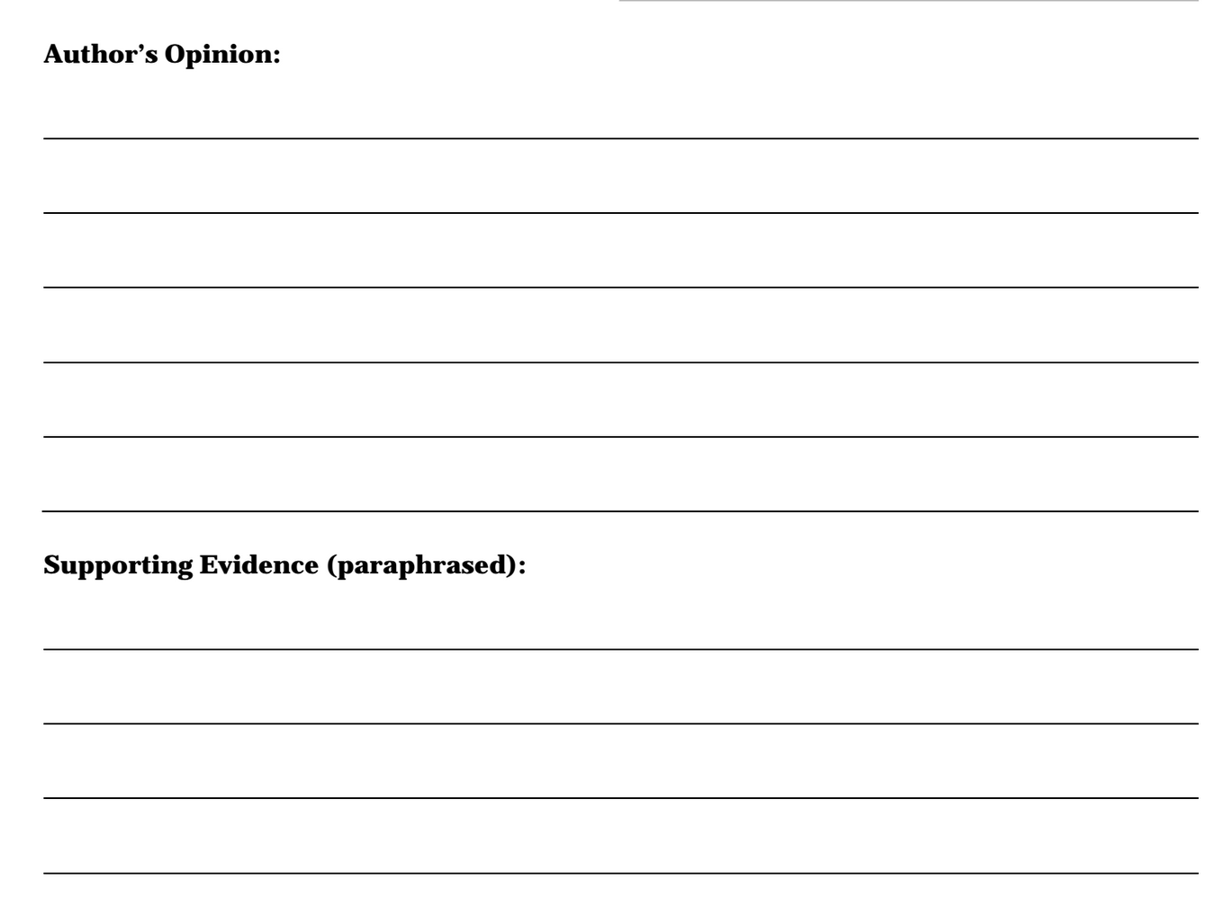
Copy the Opinion and Evidence graphic organizer into your notes.

Slide 23
What do we usually do during the second read of a text?
We reread to locate main ideas and key details.

Slide 24
Notice the “author’s opinion” at the top of the page.
You are going to reread a short section of the text to try and determine the main idea, which is the author’s opinion.

Slide 25
In your groups:
Reread the third paragraph of the article “All organized sports…”
Think about: What is the author’s opinion in this paragraph?
Discuss what you think the author’s opinion is and WHY you think that.

Slide 26
Complete with your group:
Go back through the paragraph and reread to identify at least 2 pieces of evidence the author uses to support her opinion
Text code evidence you locate with an E
Discuss with your group the evidence you identified.

Slide 27
Think back to module 2...what did we learn about paraphrasing?

Slide 28
C. Small Group Practice: Identify Author’s Claim and Evidence (15 mins)
You are going to continue to work on the same learning targets, but now with your small group.
Create a NEW, blank Opinion and Evidence graphic organizer.

Slide 29
You have 5-6 minutes to:
Reread the section titles “The Ultimate Value of Sports”
Think about: What is the author’s opinion?
Discuss ideas about the author’s opinion
Record the opinion on your graphic organizer.

Slide 30
You have 8-10 minutes to:
Independently reread the section titled “The Ultimate Value of Sports”
Identify and text code evidence the author uses to support her opinion
Discuss the evidence you identified
Record paraphrased evidence on your graphic organizer.

Slide 31
Closing and Assessment
Debrief and Review of Learning Targets (5 mins)

Slide 32
Remember that during this unit you are learning more about the role of sports in Americans’ lives so you can better understand why sports figures in particular are presented with unique opportunities to affect social change, which you’ll learn more about in unit 2.

Slide 33
Talk with your partner:
How are sports a valuable part of our lives?

Slide 34
Review Learning Targets
I can identify the author’s opinion in an information article.
Rank your proficiency towards this target with the thumb-o-meter
I can identify the evidence the author uses to support an opinion

Slide 35
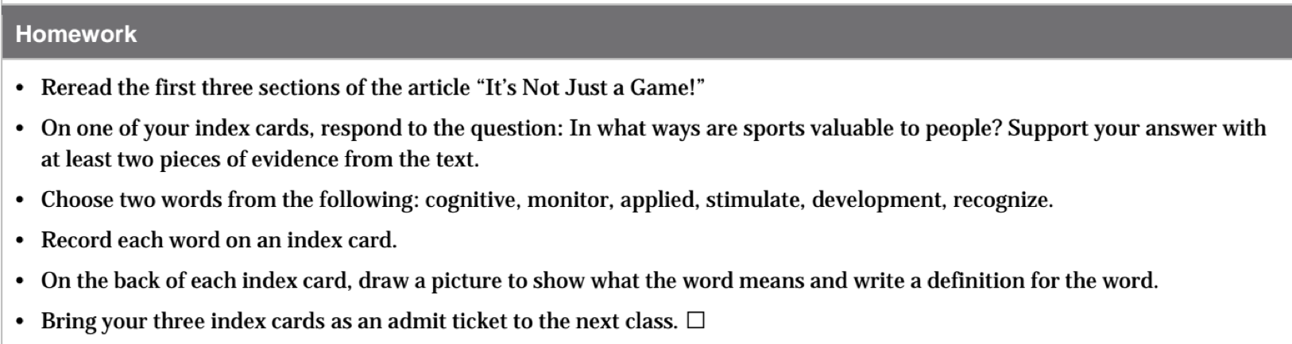

Slide 36
Choose two of the following words:
Cognitive
Monitor
Applied
Stimulate
development
recognize
In what ways are sports valuable to people? Support your answer with at least two pieces of evidence from the text

