Slide 1


Slide 2
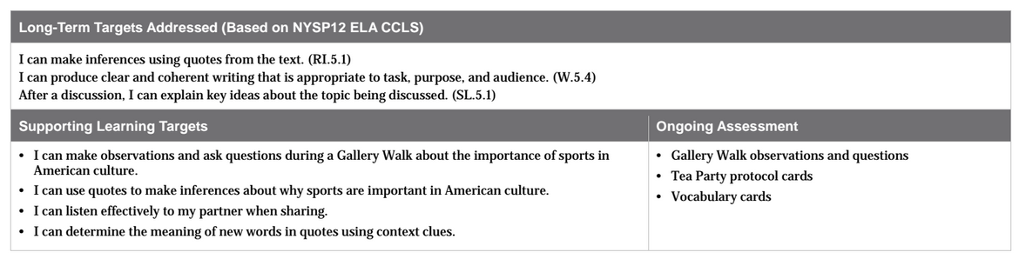

Slide 3
Opening
Gallery Walk: Sports in American Culture
(15 mins)

Slide 4
In this module we will view images and view informational texts to learn about how American athletes broke barriers during the eras in which they lived.
What is a barrier?
Barrier: an obstacle, difficulty, hurdle, limit, etc.

Slide 5
In order to understand how athletes are presented with unique opportunities to break barriers, it is important to first understand the importance of sports in American culture.

Slide 6
Think
What do you think culture is?
Culture: the beliefs, customs, or traditions a group of people or nation share.

Slide 7
Learning Target
I can make observations and ask questions during a Gallery Walk about the importance of sports in American Culture.
What is meant by observations?
Observations: What you see/notice/study/examine

Slide 8
Gallery Walk
During the Gallery Walk, you will record your observations (what you see or notice) and your questions (what you wonder) about the images and text displayed, in your journal.
*Access the files in the Module 3A Unit 1 worksheet folder*

Slide 9

Gallery Walk
Follow along
in your copy of
the text.

Slide 10
Work Time
Inferring from Text: Tea Party Protocol
(20 mins)

Slide 11
Go-Around
Who would like to share out their observations and/or questions about the images and text?

Slide 12
Learning Targets
I can use quotes to make inferences about why sports are important in American Culture
I can listen effectively to my partner when sharing

Slide 13
Think-Pair-Share
What does it mean to quote?
What someone says; in quotation marks
What does it mean to make an inference?
Beliefs based on evidence; logical conclusions

Slide 14
Think-Pair-Share
What does it mean to listen effectively?
Look at the speaker
Don’t interrupt the speaker
Think about what the speaker is saying

Slide 15
You are going to use the Tea Party Protocol to read quotes from well-known historical figures that will help you think more about the role sports play in the lives of Americans.
We used this protocol in Module 2 when we learned about rainforest scientist Meg Lowman.

Slide 16
Each of you will receive a card with a quote or a phrase about sports in American culture.
Read the quote on your card independently
Make an inference about why sports are important in American culture, based on the quote.
Write your inference on the back of your card.

Slide 17
Tea Party
You are going to mingle around the room, reading your quotes and phrases to each other as well as discussing your inferences.

Slide 18
First, find the person that has the same card
Then, discuss the similarities (compare) and differences (contrast) between your inferences
Finally, meet with at least one other peer who has a different quote to discuss the quotes and inferences

Slide 19
What did you infer about why sports are important in American culture?
Hold on to your cards for the remainder of the lesson.

Slide 20
B. Key Vocabulary to Deepen Understanding: Introduction of Vocabulary Cards (15 mins)
Learning Target:
I can determine the meaning of new words in quotes using context clues.

Slide 21
Vocabulary Strategies Anchor Chart
Think about the vocabulary strategies you used in previous modules to determine the meaning of new words using context clues.
The purpose of defining new and key (important) words in text is to help us deepen our understanding of the text.

Slide 22
Your work with vocabulary in this module will be similar to the work you did in Module 2 while reading The Most Beautiful Roof in the World. This time, however, you will record your words on index cards so you can physically manipulate the vocabulary terms you learn during the interactive vocabulary routines that begin in Unit 2

Slide 23
Each of you will receive two 3x5 index cards
Reread the quotes on your Tea Party card
Circle two unknown or key words
Write each word you circled on its own index card
Use context clues to think about what the meaning might be...don’t write a definition yet
Discuss the meaning with your partner
After you’ve discussed both words, write a definition or draw a pictures on the back of the card to show what the word means

Slide 24
C. Revise Inferences: Why Sports Are Important in American Culture (5 mins)
Now that you’ve identified, discussed, and defined new or key terms from the quote on your Tea Party card, revise or rewrite the inference you wrote earlier based on new understandings you have about the vocabulary.

Slide 25
Talk with your partner about what you changed and why

Slide 26
Closing and Assessment
Debrief and Review of Learning Targets
(5 mins)

Slide 27
Why are sports important in American culture?
What did you view or read during the Gallery Walk and Tea Party protocol today to make you think this?

Slide 28
Review Learning Targets
I can make observations and ask questions during a Gallery Walk about the importance of sports in American Culture.
I can use quotes to make inferences about why sports are important in American culture.

