Slide 1


Slide 2
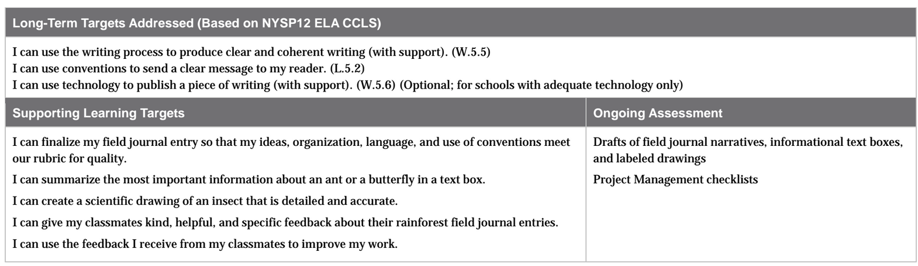

Slide 3
Opening-Learning Targets
I can finalize my field journal entry so that my ideas, organization, language, and use of conventions meet our rubric for quality.
I can summarize the most important information about an ant or a butterfly in a text box.
I can create a scientific drawing of an insect that is detailed and accurate.

Slide 4
Today you will have time to complete all three parts of your field journal entry--the narrative, the text box, and the drawing. We will talk about how you can manage your time so that you get as much work done as possible.

Slide 5
I can give my classmates kind, helpful, and specific feedback about their rainforest field journal entries.
I can use the feedback I receive from my classmates to improve my work.
**During today’s work time, you need to get feedback from a peer and from me to make your work as strong as possible.

Slide 6
Work Time
Finishing Our Rubric: Conventions (10 mins)
What criteria should be included in the conventions section of the rubric?

Slide 7
B. Making a Plan (5 mins)
For the rest of the lesson today, you will be working toward the support targets. By the end of the lesson, you will need to have completed a final draft that includes all 3 components of the product--a journal entry, and information text box, and a scientific drawing.

Slide 8
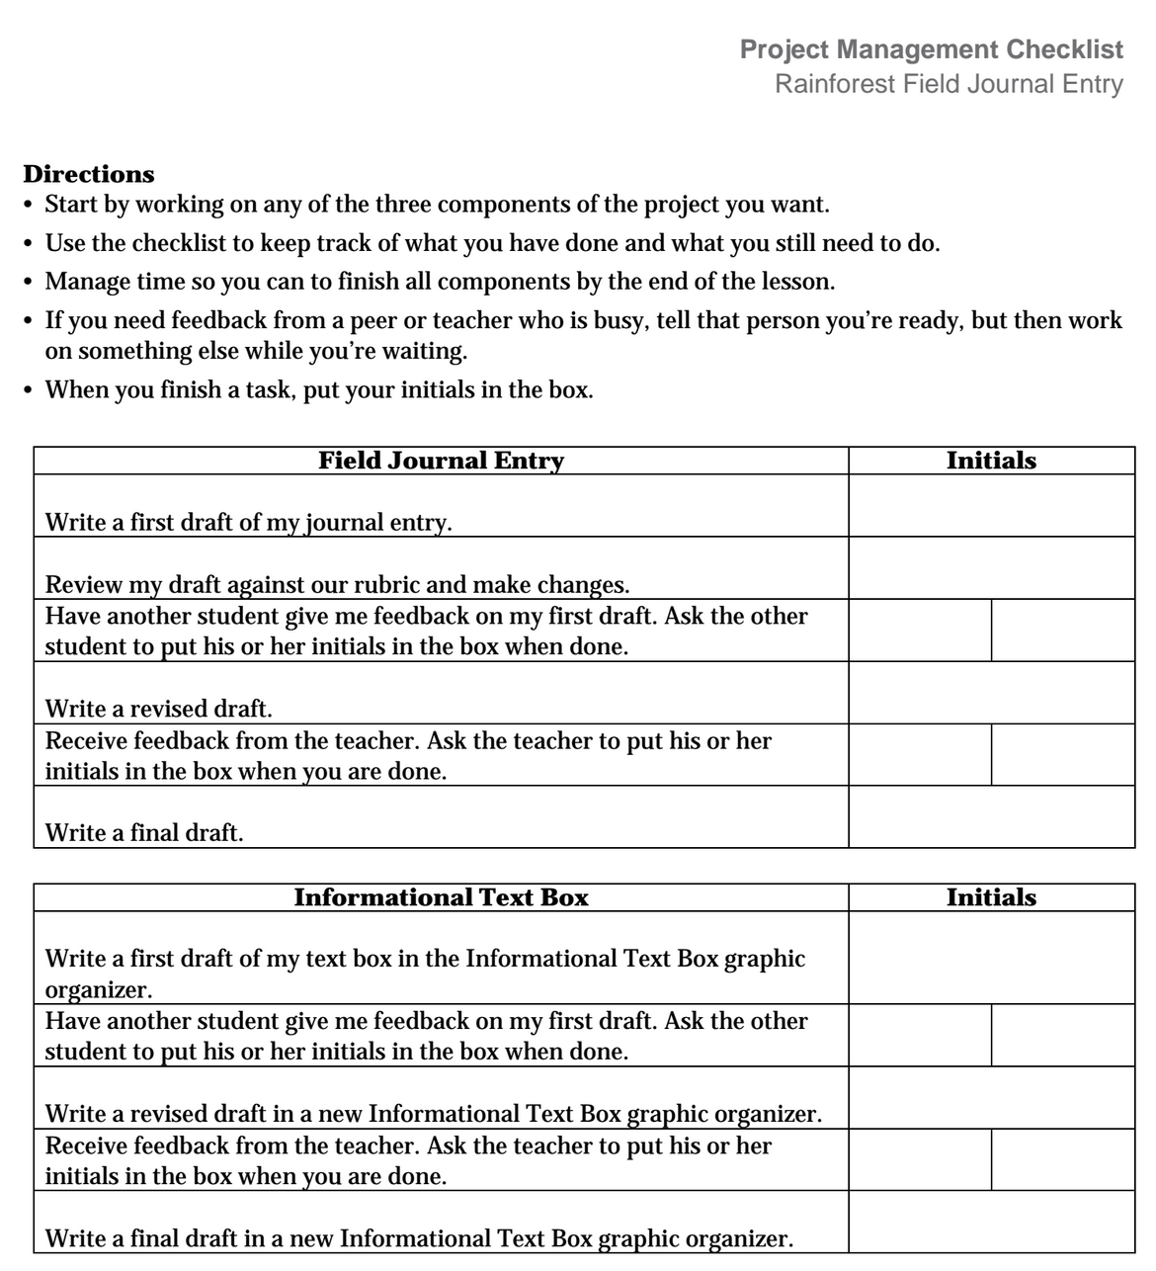
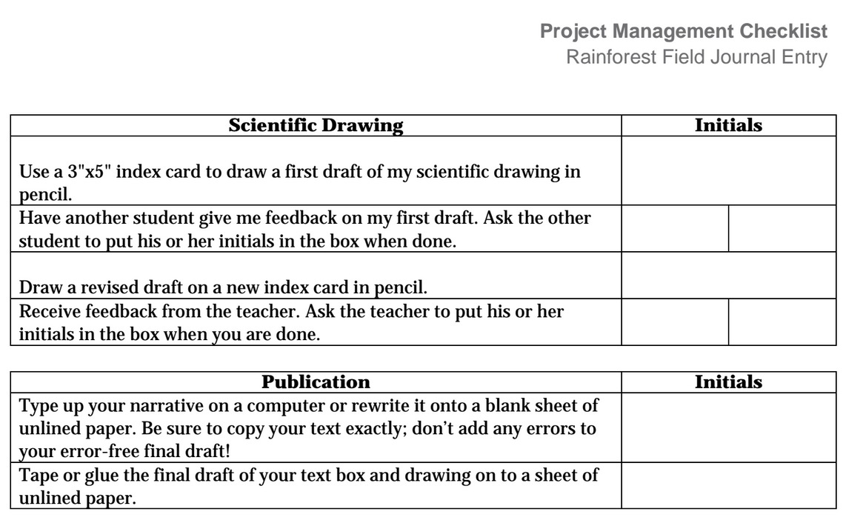

Slide 9
C. Independent Work Time (30 mins)
Note for yourself what component of the project you want to work on first.
Begin working and manage your time as you go

Slide 10
Closing and Assessment
Debrief (5 mins)
Share an exemplary passage from your work that was identified during feedback.

Slide 11
B. Review the Learning Targets (5 mins)
I can finalize my field journal entry so that my ideas, organization, language, and use of conventions meet our rubric for quality.
I can summarize the most important information about an ant or a butterfly in a text box.
I can create a scientific drawing of an insect that is detailed and accurate.

Slide 12
Homework
If you have not finished all of the components of your final product, get feedback from someone at home and finalize your work for class tomorrow.

