Slide 1
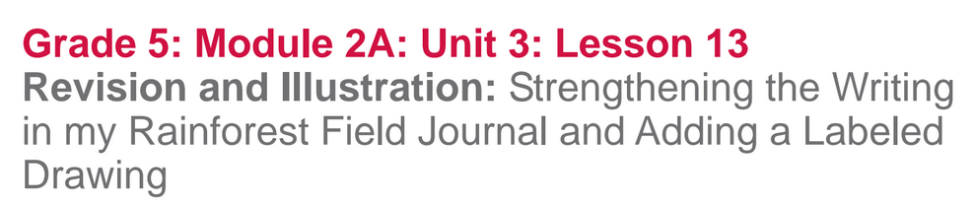

Slide 2
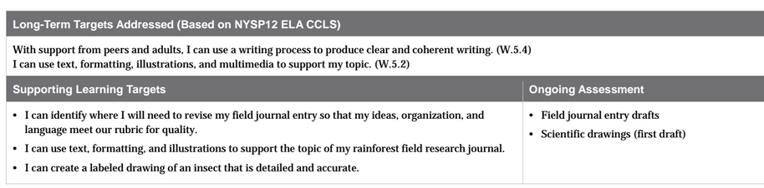

Slide 3
Opening
Review Learning Targets (5 mins)
Today you will be looking at your own writing and making revisions as well as creating the illustrations that will accompany your text.

Slide 4
I can identify where I will need to revise my field journal entry so that my ideas, organization, and language meet our rubric for quality.
In class today you will focus on revising (improving) the ideas. For homework and then again tomorrow you will work on organization, language, and conventions.

Slide 5
I can use text, formatting, and illustrations to support the topic of my rainforest field journal.
What do those words mean?
Formatting is the way a page is laid out, including the relationship of words to pictures

Slide 6
I can create a labeled drawing of an insect that is detailed and accurate.

Slide 7
Work Time
Reflection and Revision (25 mins)
Join your expert groups

Slide 8
Let’s look at an exemplar field journal that meets the criteria for “Ideas” on the Rubric.
How does this show that the author has met the criteria on our rubric for “Ideas”?
**See teaching notes on exemplar paper**

Slide 9
Take out your own rainforest journal entry drafts.
Choose one aspect of quality from the “Ideas” section of the rubric and review your own work by checking to see if it matches the criteria.
Share with your groups a place in your draft that matches all of the criteria, and a place where you need to revise.

Slide 10
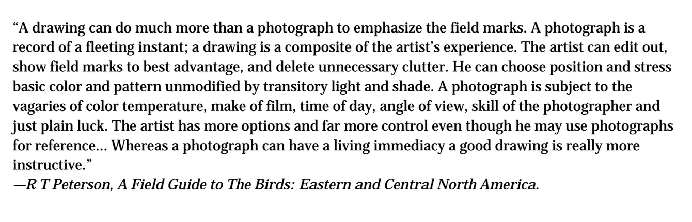
B. Making Detailed Labeled Drawings (25 mins)

Slide 11
Roger Tory Peterson was one of the world’s greatest naturalists, and he has written and edited over 50 different field journal guides on many different topics of natural history.
Reread this quote silently, and then talk with your group about the gist. Try and figure out unfamiliar words from the context clues.

Slide 12
Which did Peterson prefer to put in his field guides--photos or drawings?
Why did he think that drawings are better than photographs for field guides?

Slide 13
Criteria for Detailed and Accurate Labeled Drawings
Shows important features of my insect

Slide 14
Scientific Drawings
Take a moment to examine the illustrations and list everything you notice about these drawings.
We can add those ideas to our Criteria anchor chart

Slide 15
Criteria for Detailed and Accurate Labeled Drawings
Shows important features of my insect
Accurate
Detailed
Realistic
Labeled features

Slide 16
Photos
You are now going to have an opportunity to view some photographs of ants or butterflies to help you with your own drawing.

Slide 17
Drawing Tips from lesson 3
Remember these tips from lesson 3:
Keep your focus on the object you’re drawing, not on your page.
Draw the outline first
Don’t lift the pencil from the page as you draw
Don’t erase

Slide 18
Come to a stopping point in your drawing.
Let’s review the criteria for a detailed drawing and find areas in need of improvement.

Slide 19
Criteria for Detailed and Accurate Labeled Drawings
Shows important features of my insect
Accurate
Detailed
Realistic
Labeled features

Slide 20
Closing and Assessment
Debrief (5 mins)
What is some helpful feedback that you received?

Slide 21
Learning Targets
Let’s self-assess our progress towards our goals:
I can identify where I will need to revise my field journal entry so that my ideas, organization, and language meet our rubric for quality.
I can use text, formatting, and illustrations to support the topic of my rainforest field research journal.

Slide 22
I can create a labeled drawing of an insect that is detailed and accurate

Slide 23
