Slide 1


Slide 2
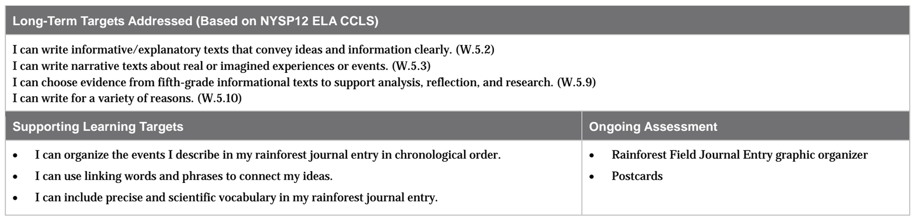

Slide 3
Opening
Unpacking the Learning Targets (10 mins)

Slide 4
Homework
Take out your homework, Rainforest Field Journal Entry graphic organizer.
Share out the ideas from your graphic organizer.

Slide 5
Learning Targets
I can organize the events I describe in my rainforest journal entry in chronological order.
I can use linking words and phrases to connect my ideas.
Today, we will work on organizing and sequencing our writing.

Slide 6
Do the following:
Rearrange the sentences in the correct order.
Find ways to link the sentences.
I washed out the bowl and put it away.
I ate a bowl of cereal.
I poured some cereal into a bowl.

Slide 7
Learning Target
I can include precise and scientific vocabulary in my rainforest journal entry.
Remember, you’ve collected a lot of vocabulary in your glossaries. These words are going to be very useful as you begin to write like scientists.

Slide 8
Work Time
Creating Our Rubric: Organization and Language (10 mins)

Slide 9
Remember that in our last lessons you did your research and made outlines.
We also began our Rainforest Field Journal Entry rubric.

Slide 10
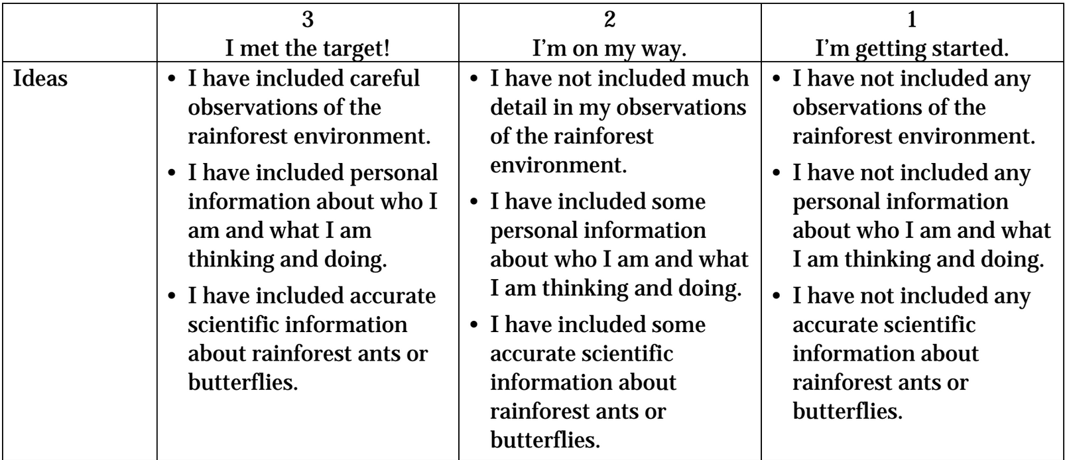
What are the differences between a 2 and a 3?

Slide 11
Organization and Language
Now that we’ve finished the IDEAS section of the rubric, we will now focus on the Organization and Language sections. This will help you today as you turn your outlines into drafts.

Slide 12
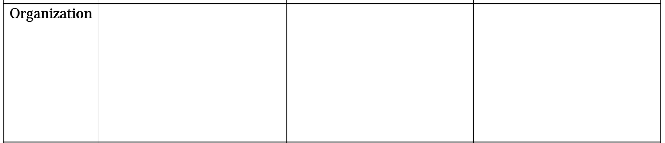
What will you need to do to meet the target of writing a well-organized rainforest field journal entry?

Slide 13
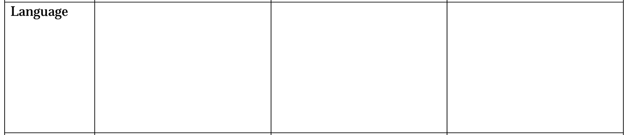
Remember when we read The Most Beautiful Roof in the World and we talked about language the author uses to paint a vivid picture of the rainforest?

Slide 14
On page 12 the author writes that “bats swoop,” “vipers coil,” and “a salamander slinks.”
How would it change the effect on the reader if she had written that “bats fly,” “vipers live,” and “a salamander crawls”?

Slide 15
What criteria belongs in the Language section of the rubric?

Slide 16
B. Writing Practice: Postcards from the Perspective of our Rainforest Scientists
(15 mins)
You are going to practice sequencing events clearly and using precise language by writing a postcard from the perspective of your rainforest scientist.

Slide 17
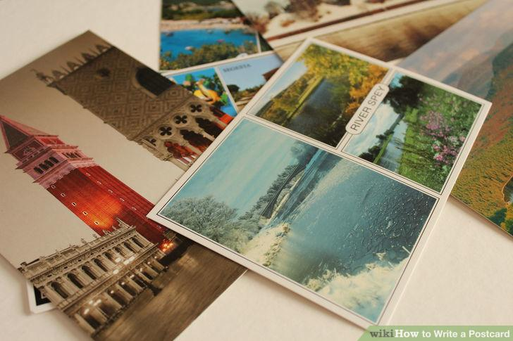
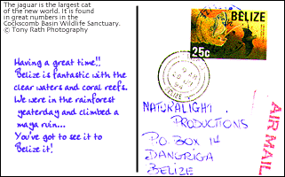
What is a postcard?
Why do people send postcards?
One side typically has a photograph of the location where it was sent from
Other side has a short message
Message usually tells one small piece of information, and also usually lets the recipient know how the sender is doing.

Slide 18
What do you think Meg Lowman would write on a postcard to James and Edward if they weren’t with her?
Let’s write a postcard together.

Slide 19
Today, you will be writing postcards from the rainforest explorers that you created yesterday.
Take out your Rainforest Field Journal graphic organizers from lesson 10 and review your notes on the events that you want to write about.

Slide 20
Pretend your character is writing the postcard near the beginning of their trip, so it should include something about the first event.
Decide who the recipient will be. (person receiving the postcard).
This will not be formally graded, it’s just a chance for you to practice organizing your ideas and writing with specific details from your research.

Slide 21
C. Independent Work Time (20 mins)
Turn to a new page in your notebook because you are now going to start writing the first drafts of your field journal entries.
Put on your “rainforest explorer hats” and pretend that you are really in the rainforest as you start your journal entries.

Slide 22
Remember that all field journal entries start with a date, so you should decide when your rainforest exploration took place.
Describe the first events listed in your graphic organizer. These will be the same events that you wrote about on your postcard, but now you can add more details, descriptions, and precise scientific vocabulary.

Slide 23
Debrief and Exit Ticket (5 mins)
Mingle and share your postcards with your classmates.
Any postcards that you saw that you think we should all see?

Slide 24
Review Learning Targets
I can organize the events I describe in my rainforest journal entry in chronological order.
I can use linking words and phrases to connect my ideas.
I can include precise and scientific vocabulary in my rainforest journal entry.

Slide 25
