Slide 1


Slide 2
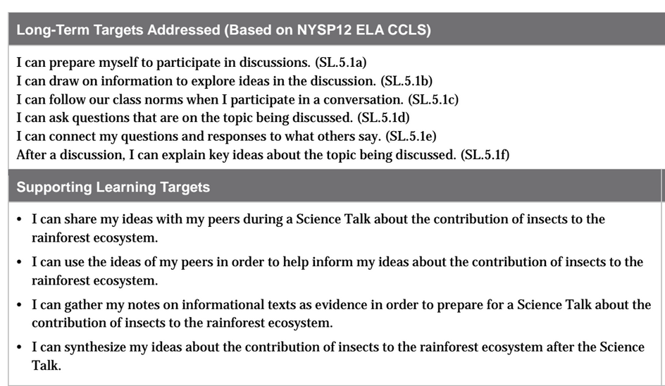

Slide 3
Opening
Engaging the Speaker and Introducing Learning Targets (5 mins)

Slide 4
Congratulations on all of the learning you have done so far in order to become experts on rainforest insects!
Remember, our focusing question: “What is the insect’s contribution to the rainforest ecosystem?”

Slide 5
Think back to the Science Talk you participated in at the end of Unit 1.
Today you will be able to be part of another Science Talk. Remember how last time we did a Science Talk you learned that scientists discuss relevant, or “big” questions? This time, the relevant questions will be the focusing questions of your research.

Slide 6
Work Time
Reviewing Norms for a Science Talk (5 mins)

Slide 7
Learning Targets
I can share my ideas with my peers during a Science Talk about the contribution of insects to the rainforest ecosystem.
I can use the ideas of my peers in order to help inform my ideas about the contribution of insects to the rainforest ecosystem.

Slide 8
Review Science Talk Norms
What does it look like and sound like to share ideas with peers?
What does it look like and sound like to use the ideas of your peers to inform your ideas?

Slide 9
Norms
Not thinking I have the one/right answer to the question
Listen to what other people say
Consider evidence others use when discussing questions

Slide 10
B. Preparing for a Science Talk (5 mins)
LEARNING TARGET
I can gather my notes on informational texts as evidence in order to prepare for a Science Talk about the contribution of insects to the rainforest ecosystem

Slide 11
You should refer to your C/F/Q/R note-catchers in your journals for ideas. You can also use all of the informational texts from this unit for reference.

Slide 12
C. Participating in a Science Talk (25 mins)
You are now going to participate in a Science Talk, like real scientists do.
Make sure to refer to the norms during the science talk to ensure all ideas are heard and respected.

Slide 13
Gather in two concentric circles on the floor, with your journals. Each partner on the inner circle should be facing a partner on the outer circle.

Slide 14
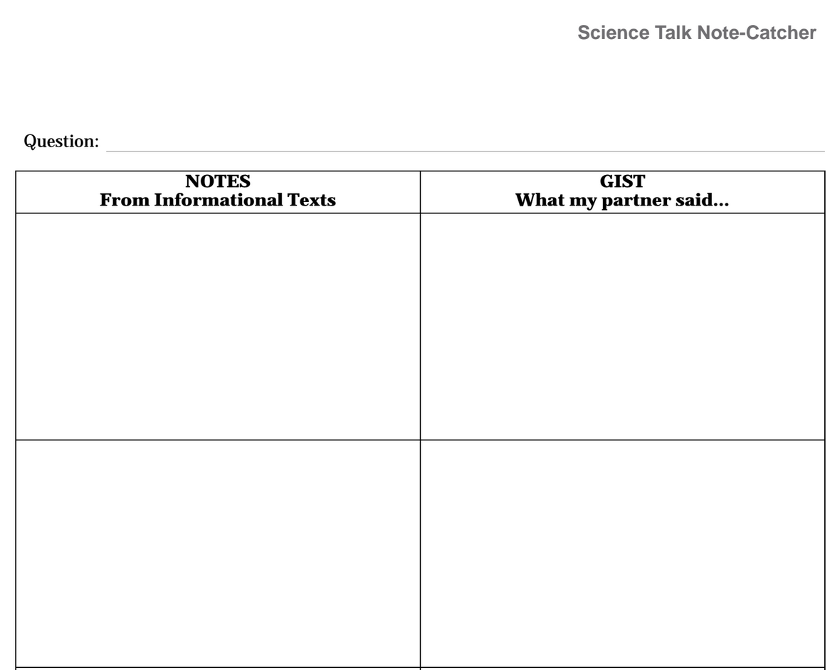
Record the quotes and paraphrases from articles and/or journal notes that you refer to during the discussion of the questions
Write a brief statement of what your partner said the main idea is.

Slide 15
BIG Question
What are the contributions of ants and butterflies to the rainforest ecosystem?
Write the question on your note-catcher.
Remember, as you discuss your ideas about the questions, you will need to use notes you took when you read the scientific informational texts to support your thinking.

Slide 16
D. Synthesizing Information from a
Science Talk (10 mins)
Join your expert groups
I can synthesize my ideas about the contribution of insects to the rainforest ecosystem after the Science Talk.

Slide 17
You just had an opportunity to participate in a Science Talk around the focusing questions for our rainforest insect research.

Slide 18
Discuss with your expert group:
What answers to the question did you and your peers give during the Science Talk?
What notes from the informational texts did you and/or your peers use to support your thinking?

Slide 19
Start a new page in your journal to write a synthesis statement responding to the big question:
What are the contributions of ants or butterflies (choose the one you’re studying) to the rainforest ecosystem? Use evidence and details from the Science Talk to support your response.

Slide 20
Think-Pair-Share
Think about your participation in this Science Talk compared to the first one.
Where you more or less successful in this Science Talk? Why?

Slide 21
Closing and Assessment
Review Learning Targets Debrief (10 mins)

Slide 22
Learning Targets Review
I can share my ideas with my peers during a Science Talk about the contribution of insects to the rainforest ecosystem.
I can use the ideas of my peers in order to help inform my ideas about the contribution of insects to the rainforest ecosystem.

Slide 23
