Slide 1


Slide 2
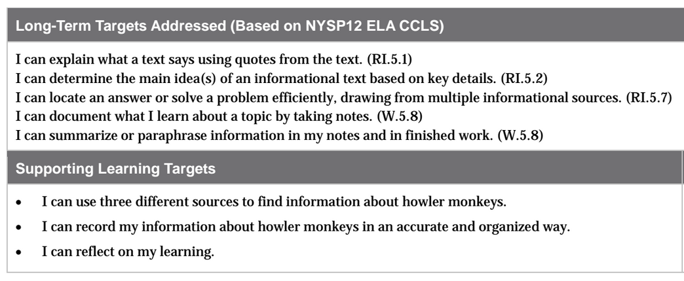

Slide 3
Opening
Review Learning Targets (5 mins)

Slide 4
Today you will be working independently to demonstrate what you have learned about reading and taking notes on informational texts by organizing quotes and paraphrased information into useful categories.

Slide 5
Learning Targets
I can use three different sources to find information about howler monkeys.
I can record my information about howler monkeys in an accurate and organized way.

Slide 6
Talk with your partner about the work you have done and the skills you have learned that are related to your learning targets.

Slide 7
Today you will be reading about an animal that lives in the rainforest, but that is very different from ants or butterflies.
You will be using text, video, and graphic information for your research.
You will be taking organized notes on these texts, including direct quotes and paraphrased information.

Slide 8
Work Time
Mid-Unit Assessment (40 mins)

Slide 9
Think about the C/F/Q/R that you’ve been using to take notes. You will be turning in your notes at the end of the lesson, but you will get them back so that you can use them to write your rainforest field journals.

Slide 10
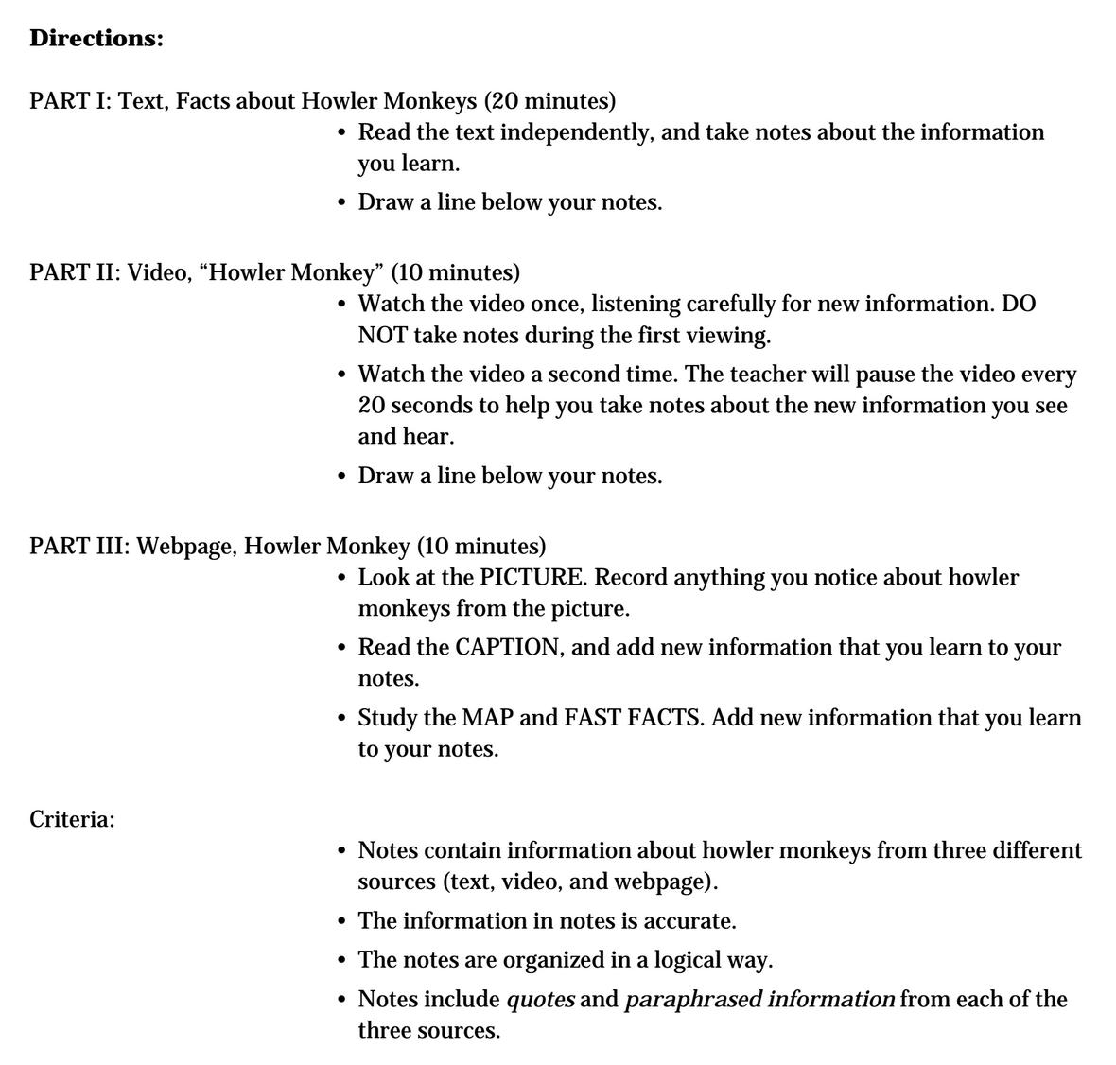

Slide 11
Part 1 (20 mins)
Write your name & date at the top of the lined paper.
You will have 20 mins to read the text and take notes.
STOP taking notes and draw a line across your page showing the end of part 1

Slide 12
Part 2 (10 mins)
You’re now going to watch a video.
You’ll watch it twice: once just to watch and listen, then a second time to take notes.

Slide 14

First Viewing-No Notes

Slide 15

2nd Viewing
When you hear new information you should record it on your paper, below the line that you drew. If you see or hear something in the video that repeats information you took in your notes in part 1, you can put a checkmark by that note to indicate you heard it from the video as well as the text.

Slide 16
2nd viewing...pause every 20 seconds

Slide 17
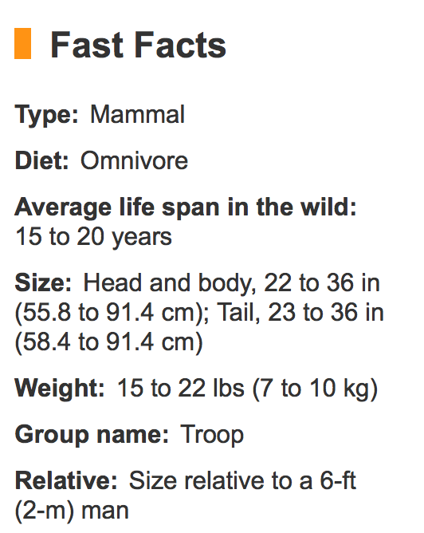

Study the map and the fast facts.

Slide 18
Then take notes on the text.
Source 3 (view as a class for students to take notes on)
Your page as the same text as on the website

Slide 19
B. Learning Target Reflection (10 mins)
I can reflect on my learning
What does the word “reflect” mean?

Slide 20
Tracking My Progress: Mid-Unit Recording Form
You’ve done this before. Your task is to think about how you are progressing toward the learning targets.
Independently complete your progress forms

Slide 21
Closing and Assessment
Debrief (5 mins)
Pair up and share your reflections

Slide 22
