Slide 1


Slide 2
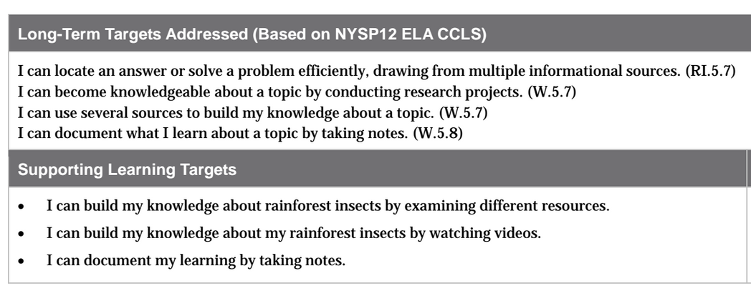

Slide 3
Opening
Homework Review and Introduce Learning Targets (10 mins)

Slide 4
Pre-assessment:
I don’t expect you to know all of the answers to this question, but I want to see what knowledge you already have
Make a list of insects and spiders that live in the area and say what role those insects play in the local ecosystem.

Slide 5
Big Idea
Since insects and spiders are food for many other organisms in the food chain, they are a valuable part of any ecosystem.

Slide 6
Learning Targets
I can build my knowledge about rainforest insects by examining different resources
I can become knowledgeable about my rainforest insects by watching videos
*What do you think you’ll be doing today?*

Slide 7
Work Time
Taking Notes: Using Text Features and Pictures to Find Important Information Quickly (10 mins)

Slide 8
Join your expert group tables and take out your journals and set up a C/F/Q/R on your next blank page.

Slide 9
The focus for today is on learning from studying visual information.
Have you ever heard the expression “A pictures is worth a thousand words?”

Slide 10
Smart readers know how to “read” pictures as well as words, because they know that there is often a lot of valuable information in images.
Today you will view the same image several times, just like you often reread complex text.

Slide 11
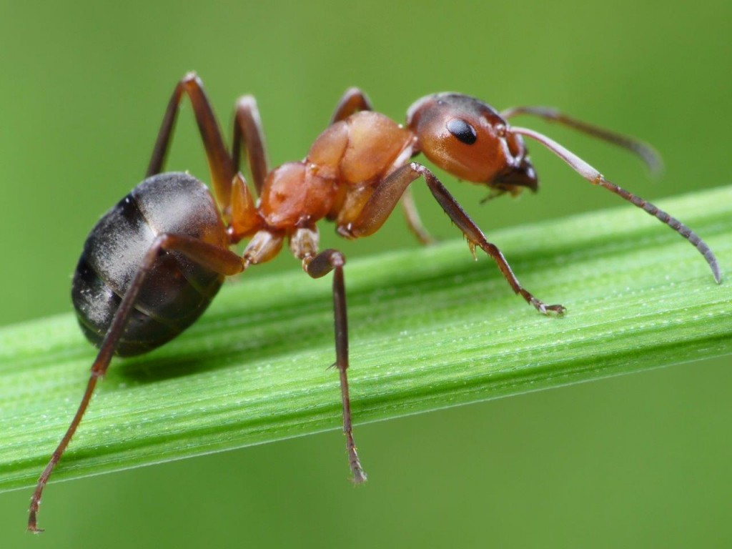
Take notes on your C/F/Q/R:
Two FACTS you observe about the photo
Any QUESTIONS you have looking at the photo

Slide 12
Share with your expert group
What did you learn by just looking at the picture?
How was looking at the picture different from doing research by reading?

Slide 13
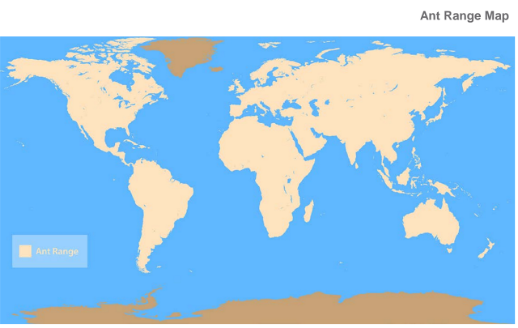
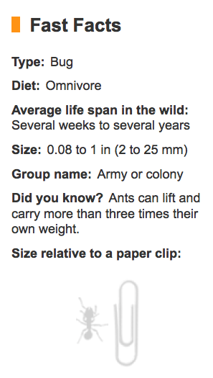
What have you learned about ants from studying this map?
This is an informational text box, and it is a text feature that you’ll be including when you write your rainforest field journals.
What does the key
indicate?
What categories are included?

Slide 14
B. Expert Groups Instruction: Additional Practice and Independent Expert Group Work (15 mins)
Like yesterday, groups studying each topic will work on your own for part of the time, and with my support for part of the time.
*Follow lesson plans*

Slide 15
C. Taking Notes from Videos (20 mins)
You are going to continue to do research by watching a documentary video.
Remember that we learned in unit 1 that documentaries are films or television programs that present information in a factual manner.

Slide 16
Text Features Anchor Chart
Look back at the text features Anchor Chart and review the features of a documentary video.
What can we learn from watching a film that we might not get from reading a book.

Slide 17
This video is about both ants and butterflies. It guest stars another insect as well, a kind of wasp called an ichneumon [ik-NEW-men] wasp.
As you watch the video the first time through, think about how the ants contribute to the life cycle of the caterpillars, and how the caterpillars contribute to the life cycle of the wasp. These are ways that both contribute to the rainforest ecosystem

Slide 18
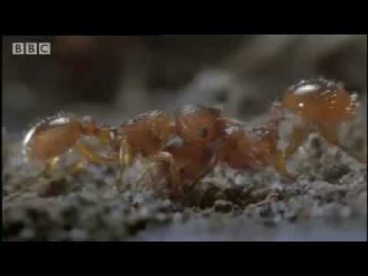

Slide 19
Think-Pair-Share
What did you learn from watching the video about how caterpillars (which eventually become butterflies) or ants contribute to the rainforest ecosystem.

Slide 20
Watch again, pausing to allow students to add to their C/F/Q/R

Slide 21
Closing and Assessment
Reviewing Learning Targets

Slide 23
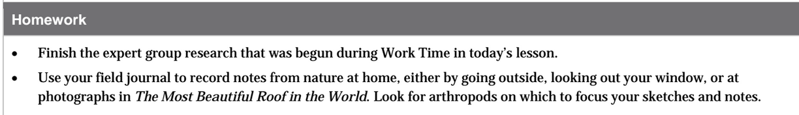
Homework

