Slide 1


Slide 2
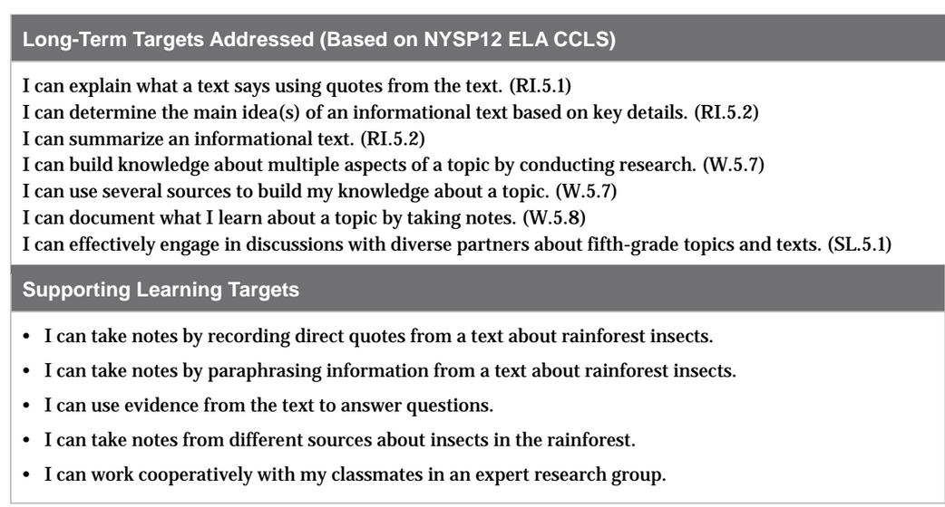

Slide 3
Opening
Homework Review (10 mins)

Slide 4
Return research journals
Think and talk about these questions with a partner:
Who chose to observe the same spot you wrote about before?
Who chose a different spot?
Why did you make that decision?
What impact did it have on your journal entry?

Slide 5
Do you think Meg Lowman returns to the same place in the rainforest?
Why might she do that?
(read aloud pg. 17 “Meg begins…” through paragraph 1 on page 19.)

Slide 6
What did Meg notice when she returned to this same region for many years?
Why did she keep coming back to investigate the same spot?

Slide 7
B. Introducing Learning Targets (5 min)
Remember that we’ve been learning how to quote and paraphrase text in order to do research, as well as how to sort that information into categories.
What’s the difference between quoting and paraphrasing?

Slide 8
I can take notes by recording direct quotes from a text about rainforest insects.
I can take notes by paraphrasing information from a text about rainforest insects.
I can work cooperatively with my classmates in an expert research group.

Slide 9
Work Time
Establishing Expert Groups (10 mins)

Slide 10
One smart thing researchers do is to make sure that they can talk with and learn from other experts who are studying the same or similar topics.
Remember how Meg Lowman sends research findings and reports to other scientists? Although you’ll be doing individual research during this project, you’ll rely on your expert group during the process.

Slide 11
Think-Pair-Share
Talk with your partner about how an expert group could support your research process.

Slide 12
Half of our expert groups will continue to focus on ants, and the other half will research butterflies.
ANT GROUPS: There will be three different ant groups. Even though they are investigating different ant groups, you can collaborate with them, since they have the same topic of ants. The smaller group will be your permanent group.

Slide 13
Discuss with your group the Active Listening Criteria that will help you be a successful group.
Assign 1 person to be the note taker for today.

Slide 14
B. Researching in Expert Groups (30 mins)
You will be working with me for ½ of the time and in groups on your own for the other ½
Create a new C/F/Q/R note-catcher while I pass out Expert Group Folders

Slide 15
BUTTERFLY: Read through each step on your task card and think of any questions you may have about your task. I will answer your questions after I’ve gotten the ant group set with their task card.
ANTS: (see lesson plans)

Slide 16
Closing and Assessment
1 ant expert needs to meet with 1 butterfly expert and share:
1 interesting fact you learned about your rainforest insect today
How well your expert group did in meeting the learning target of working cooperatively together.

