Slide 1


Slide 2
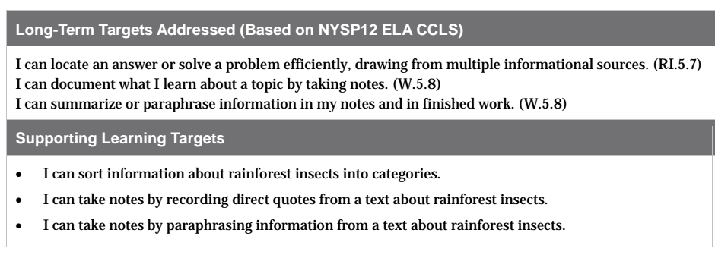

Slide 3
Opening
Homework Review (5 mins)

Slide 4
Take out your field journals and exchange them with a partner.
Focus on how well the writer used precise descriptive language or sensory details.
Give kind, specific, and useful feedback: -Complement
-Question
-Suggestion

Slide 5
Work Time
Creating Categories for Information: A Researcher’s Version of 20 Questions
(10 mins)

Slide 6
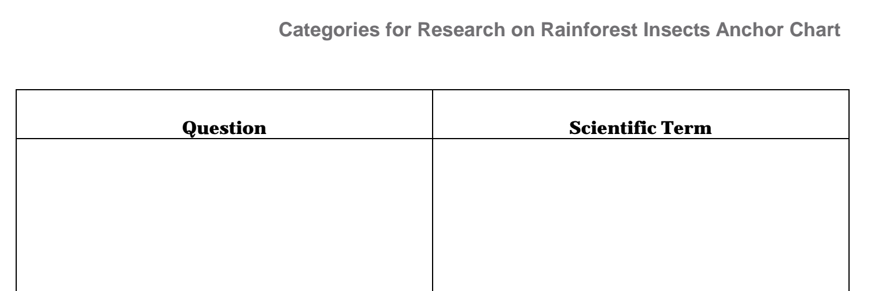
Learning Target
“I can sort information about rainforest insects into categories

Slide 7
You will be gathering a lot of information in the next few days to help you answer the focusing questions: “How do [ants or butterflies] contribute to the rainforest ecosystem?”
As you do your research, the information you find will need to be organized. One way to do this is to group facts into categories that capture the essential characteristics of their insects.

Slide 8
Think about the anchor chart we made in lesson 4.
We left the CATEGORY column blank.
You will go back and fill this in later today, but first you’re going to think a little bit more about what it means to categorize information.

Slide 9
In order to think of these categories we’re going to play a game that’s like 20 questions. In that game you ask yes/no questions to try to guess what someone is thinking of.
In our version, you won’t just ask yes/no questions. You get to ask BIG questions that need more than a yes/no answer.

Slide 10
You can ask any question that will give you important information so that you can quickly guess the animal I’m thinking of in as few questions as possible.
Guess my animal.
Example of a question: Where does this animal live?
The scientific word is habitat

Slide 11
Question
Scientific Term
What do these animals look like?
Physical characteristics
What do they eat?
Food source
Who/What are their enemies?
Predators
How do they have babies?
Life cycle
How do they defend themselves against enemies?
Defenses
What do they do that’s interesting or unusual?
Behavior
Where do they live?
Habitat

Slide 12
B. Sorting Information into Categories
(10 mins)
Now you are going to practice sorting information about rainforest insects and spiders into categories, which will help you be able to fill in the categories column on the Ant Research C/F/Q/R chart from lesson 4.
*Spiders aren’t insects because they have 2, not 3, main body parts. Like insects, they are arthropods, but spiders are in the class called arachnids.

Slide 13
Each of you will receive one Facts about Arthropods strip to use for a mix and mingle activity.
Read your strip
Stand up and mingle. Find a partner to talk with.
As a pair, discuss “Which category on the categories anchor chart does this strip belong with? How do you know?

Slide 14
Use the Facts about Arthropods Sorted into Categories sheet to check how well you did.

Slide 15
C. Vocabulary and Research Time (25 mins)
You’re now ready to return to the chart we began in Lesson 4.

Slide 16
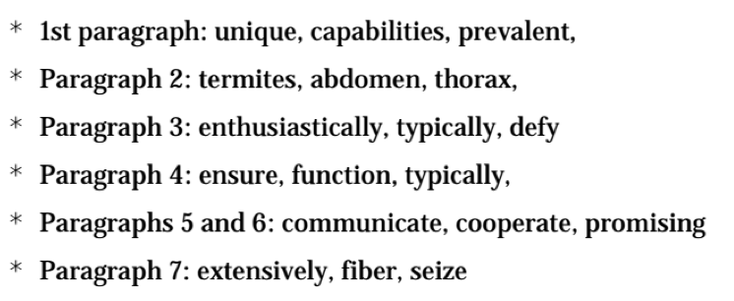
“Ants” text
Read your paragraph silently for the gist, then discuss it with your group
Circle identified words in the paragraph
After I read the page aloud, use context clues to help define the identified words.

Slide 17
Share at your table what you think the words mean.
Once you know the definitions, add them to your glossary (just the words for your paragraph)
Talk to your group about one new piece of information you’ve learned from your assigned paragraph, and record this as a note in your C/F/Q/R by paraphrasing the information.

Slide 18
Work with your group to reread the FACTS that you listed on your C/F/Q/R page, and determine the CATEGORY it would correspond with.
Then, write it in the CATEGORY column next to the fact.
Each fact MUST be assigned a category.

Slide 19
Closing and Assessment
Review Learning Targets (5 minutes)
Let’s use the Fist to Five strategy to see how well you understood what you learned today.

Slide 20
“I can sort information about rainforest insects into categories.”
“I can take notes by recording direct quotes from a text about rainforest insects.”
“I can take notes by paraphrasing information from a text about rainforest insects.”

Slide 21
B. Introducing Research Expert Groups
(5 mins)
In the next lesson, you will begin your research in expert groups.
Groups will be researching either ants or butterflies in order to gather information to create a field journal page.

Slide 22
Ant or Butterfly?
I want to know which expert group you’d prefer to be in and why. I will do my best to make sure everyone gets to research their preferred arthropod.

