Slide 1
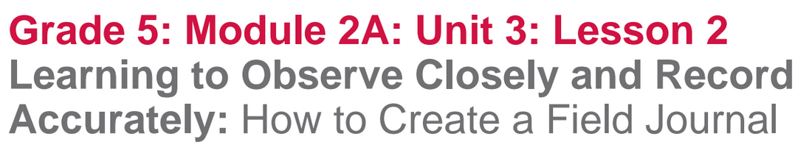

Slide 2
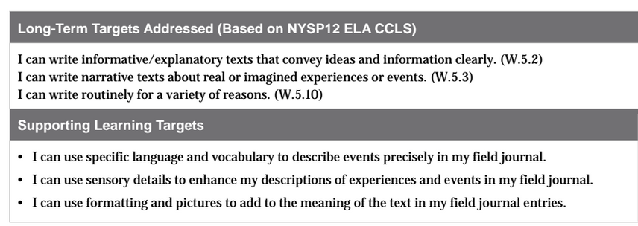

Slide 3
Opening
Engaging the Writer (5 mins)

Slide 4
Think back to the field journals that you looked at yesterday.
Today, you’re going to get to start making your own field journals, just like Meg and other scientists do when they are out exploring the natural world.

Slide 5
Review your Field Journal Note-Catcher from yesterday.
Think-Pair-Share:
**What do scientists record in their field journals? Why?**

Slide 6
B. Introduce Learning Targets (5 mins)
I can use specific language and vocabulary to describe events precisely in my field journal.
I can use sensory details to enhance my descriptions of experiences and events in my field journal.
I can use formatting and pictures to add to the meaning of the text in my field journal entries.

Slide 7
Work Time
Observing and Sketching the Natural World (15 mins)

Slide 8
You are going to take a look at nature to practice observing and recording.
Look out the window...what can we see?
When sketching:
Keep your focus on the object, not the paper
Draw outline first
DON’T ERASE

Slide 9
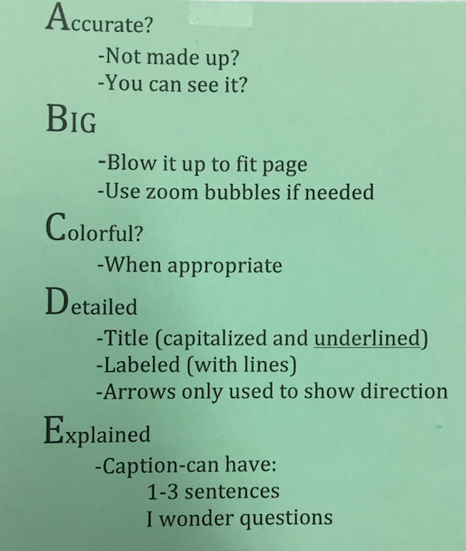
Remember these
rules for making a
scientific drawing from
science class.

Slide 10
Why must scientists such as Meg Lowman sometimes work silently when out in the natural world?
Think about all of the work we’ve done on active listening.
This is such an important application of that skill. Scientists really need to use active listening skills to do their work.

Slide 11
I want you to spend a few minutes closely observing the classroom to prepare for observing in the natural world. Pay attention to:
the shape of the furniture
the quality of light
shadows
things on the wall and ceiling

Slide 12
How can we use descriptive language to describe what we see in the room?
ex: “The desks look brown and hard, as if they came from a tree.”

Slide 13
B. Recording Observations about the Natural World (30 mins)
Scientists often use a field journal to take notes as they observe closely, collect data, and record information about their surroundings.
You will be keeping your own field journal throughout this unit and you will use it for classwork as well as homework.

Slide 14
You will now be going outside to study nature.
While we are outside, remember to be quiet, observant, and respectful of others.
(see lesson plans for outside teaching)

Slide 15
Debrief: Journaling Experience (5 min)
What did you like about observing closely?
What was difficult about it?
Remember, you are going to be research scientists and you’re preparing to do the careful work that it will require to observe in nature in order to create a field journal page.

Slide 16
Review Learning Targets
I can use specific language and vocabulary to describe events precisely in my field journal.
I can use sensory details to enhance my descriptions of experiences and events in my field journal.
I can use formatting and pictures to add to the meaning of the text in my field journal entries.

Slide 17
Homework
Decorate the cover of your journal with nature drawings to make it special and personalized to reflect what you like about and in nature.

