Slide 1


Slide 2
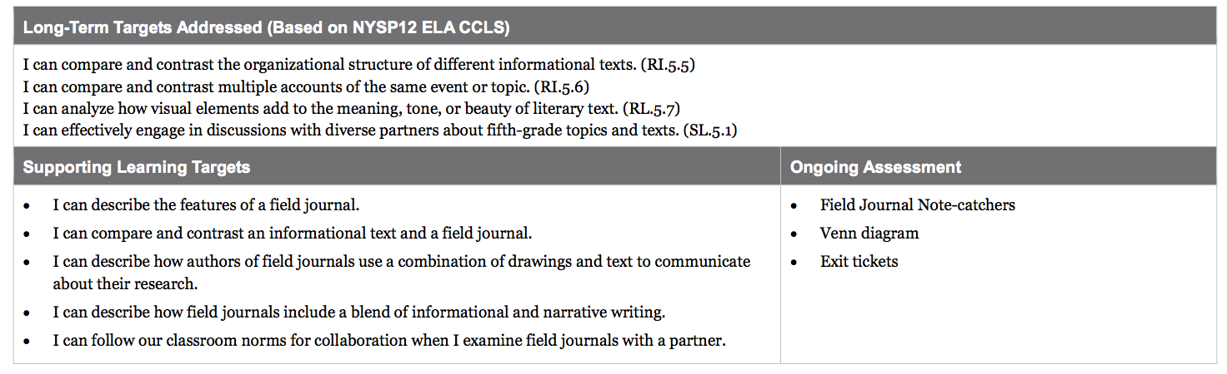

Slide 3
Opening
Mystery Text: I Notice/I Wonder (5 minutes)

Slide 4
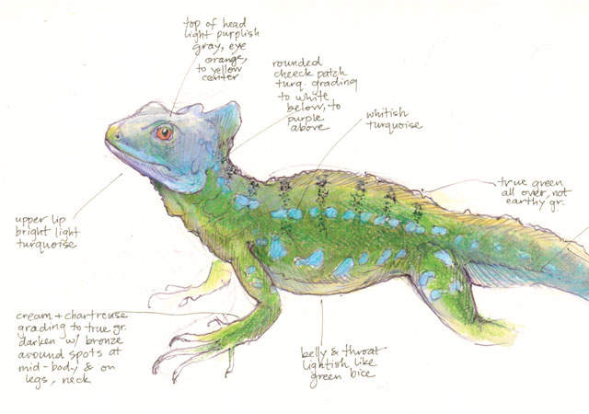
What do you notice about this image?
What do you wonder about it?

Slide 5
B. Introduce Learning Targets (5 min)
I can describe the features of a field journal.
What do we mean by “features”?
Where have we read about
“field journals” before?

Slide 6
You just looked at a page from a field journal. During today’s lesson, you will learn about field journals.
Scientists such as Meg Lowman keep journals like these when they are exploring the natural world.

Slide 7
During our upcoming lessons, you will be receiving your own field journals and you will be learning to take notes on the world around you, just as scientists do.

Slide 8
Learning Targets
I can compare and contrast an informational text and a field journal.
I can describe how authors of field journals use a combination of drawings and text to communicate about their research.
I can describe how field journals include a blend of information and narrative writing.

Slide 9
What is the distinction between informational and narrative texts?
Informational texts provide readers with information about the real world.
Narrative texts tell a story.

Slide 10
Work Time
Examining Examples of Field Journals (20 mins)

Slide 11
Today we are going to look at several different examples from different field journals.
We will be taking notes about this various field journal samples.

Slide 12
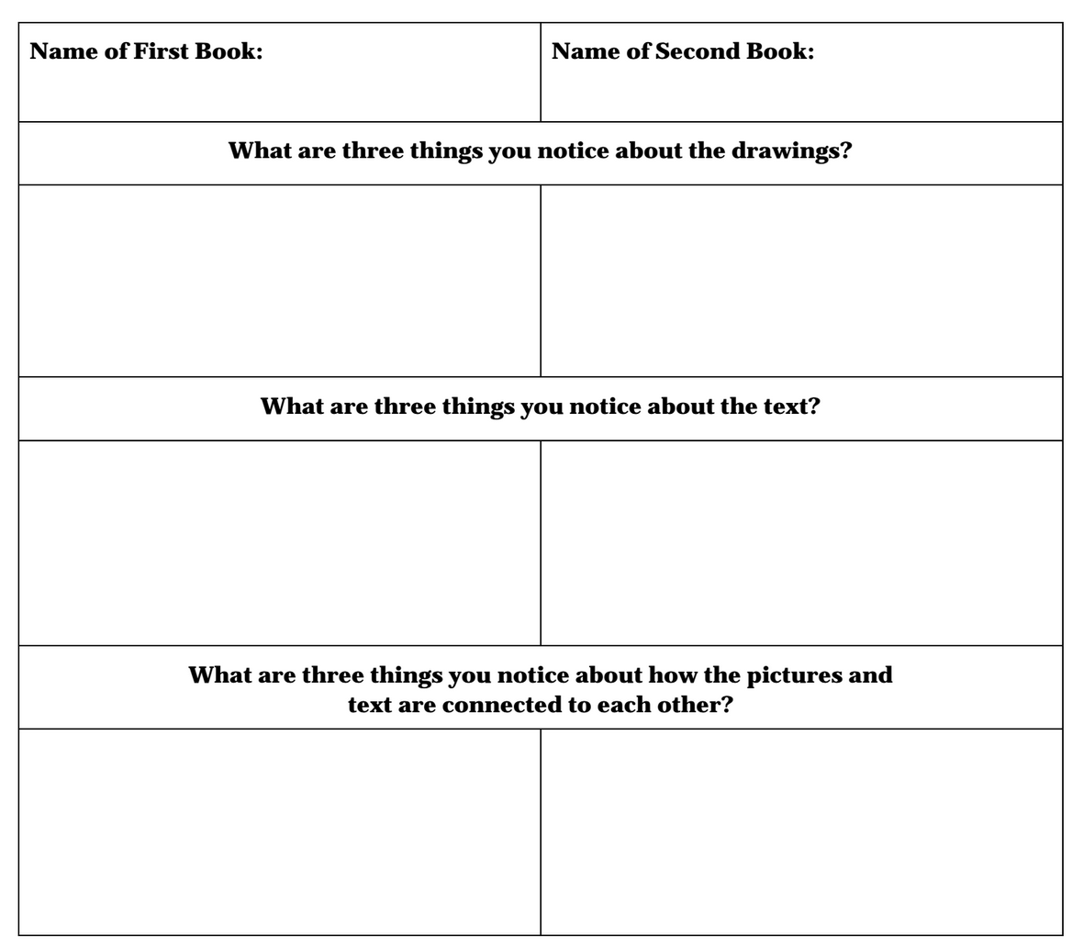
We are going to use this Field Journal Note-Catcher to make observations on select pages from different field journals.

Slide 13
What do you notice about this image?
What do you wonder about it?

Slide 14
We are going to use this Field Journal Note-Catcher to make observations on select pages from different field journals.
EXAMPLE
The drawings and text are mixed together on the page

Slide 15
You will work in pairs to take notes on your Field Journal Note Catcher. You have 10 minutes to complete the note catcher on your one field journal text.
Switch books with the other pair at your group to complete the right-hand column of the note-catcher.

Slide 16
B. Features of Informational Texts: Adding to the Anchor Chart (10 mins)
Let’s add “field journal” to our chart.
What were some features that you noticed that we could add?
How do these features help the reader?

Slide 17
C. Comparing The Most Beautiful Roof in the World to a Field Journal (15 mins)
Trade Field Journal pages with another pair one more time, so you each have a page that is new to you.

Slide 18

Use the Venn Diagram to compare and contrast the text features of the two texts. Remember to record features they have in common in the middle

Slide 19
Closing and Assessment
Debrief: Why Do Scientists Keep Field Journals? (5 mins)

Slide 20
Exit ticket
Write:
Why do scientists keep field journals?

