Slide 1
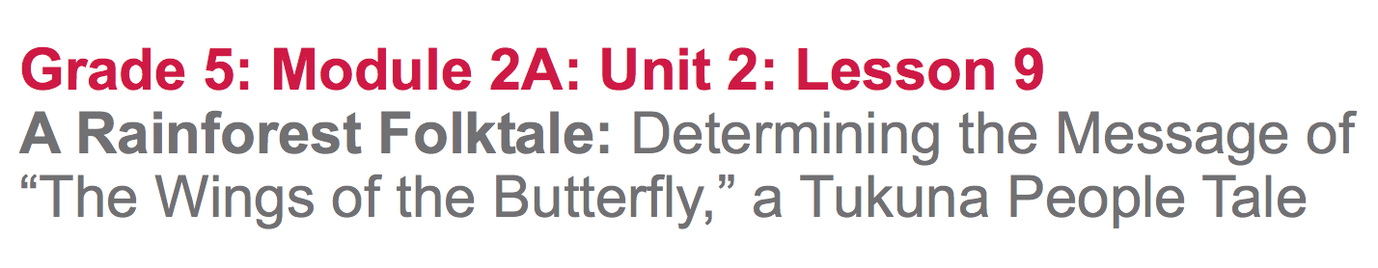

Slide 2
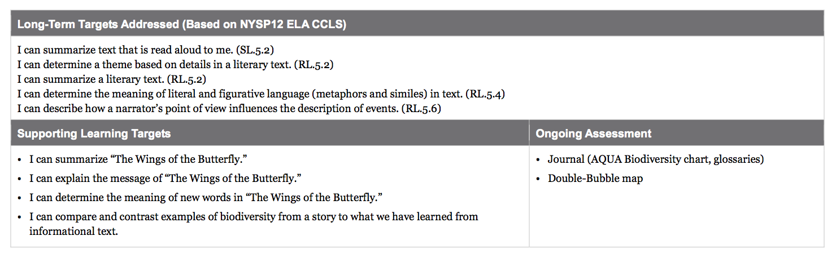

Slide 3
Opening
Reviewing Homework and Engaging the Reader (15 mins)

Slide 4
Take out your journals. Share your synthesis statement and two of the words you added to your glossary with a partner.

Slide 5
We have been learning a lot about the importance of biodiversity through informational texts. Today we will read a short story about the Tukuna people from the Amazon rainforest called “The Wings of the Butterfly,” to help us think about what we can learn about biodiversity from literature as well.

Slide 6
What is meant by the “message of a story”?

Slide 7
Tea Party Protocol
You will now participate in a Tea Party. Each of you will receive a card with a quote or a phrase from the story “Wings of the Butterfly.”

Slide 8
On your own, read the quote or phrase on your card.
Make a prediction about what the message of the story might be.
Write your prediction on the back of your card.

Slide 9
Now, you will mingle around the room, reading to one another and discussing predictions.
First, find the other person that has the same quote or phrase, and compare and contrast your predictions.
Then, meet with at least one other person that has a different quote or phrase.

Slide 10
Back in your group...
Discuss with your group what you predict the message of “The Wings of the Butterfly” will be.
Keep your Tea Party Cards for use in Part A of the Work Time

Slide 11
Work Time
Read-aloud: What is the Message of “The Wings of the Butterfly”? (15 mins)

Slide 12
Learning Targets
“I can summarize the story of “The Wings of the Butterfly.”
“I can explain the message of “The Wings of the Butterfly.”

Slide 13
As I read “The Wings of the Butterfly,” think about:
What is the story mostly about? (summary)
What is the author’s message?
Follow along as I read aloud...

Slide 14
In your groups, discuss:
What is the story mostly about? (summary)
What is the author’s message?

Slide 15
Reread your Tea Party Protocol cards, and review the prediction you wrote.
How was your prediction about the message of this story accurate or inaccurate?

Slide 16
B. Key Vocabulary to Deepen Understanding (10 mins)
“I can determine the meaning of new words in “The Wings of the Butterfly.”
The more you understand key vocabulary about a topic, the better you are able to understand the topic in general.

Slide 17
You’ve been practicing how to figure out words from context, or based on word roots. Remember, it’s less important that you memorize every word than it is that you are learning how to figure out new words in the context of what you read.
Discuss with your group possible definitions or synonyms for the following key words from the story.

Slide 18
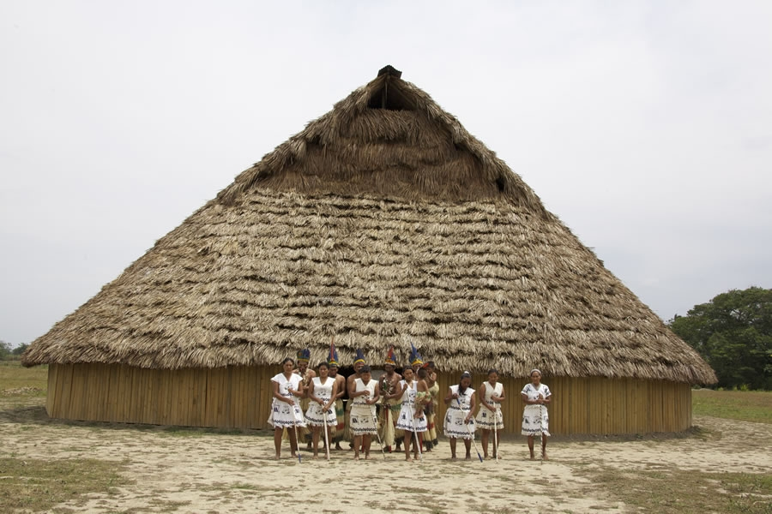
fierce:
indignantly:
conceited:
sorrowfully:
maloca:
uninvited:
wonder:
behave:
understand:
within:
violent; furious; vicious
angrily; furiously
self-important; proud; arrogant; vain
sadly, unhappy
a big pavilion-house where a family lives
not welcome; not wanted
be in awe; marvel
act; perform
know; comprehend; be aware of
a part of ; inside mind/body

Slide 19
What words in the story helped you better determine the message of the story?
How did those words help you determine the message of the story?

Slide 20
C. Taking Notes: Comparing Biodiversity in “The Wings of the Butterfly” and The Most Beautiful Roof in the World (15 mins)
“I can compare and contrast examples of biodiversity from the story and what we have learned from informational text.”

Slide 21
In this unit, we have been closely reading the informational text The Most Beautiful Roof in the World. Now we have also read a short story called “The Wings of the Butterfly.”
Even though short stories are fiction, they can still teach readers a lot about real-life places, events, and things.

Slide 22
Take 5 minutes with your group to look back through “The Wings of the Butterfly” and locate examples of biodiversity (plants and animals) mentioned in the story. Circle the words or phrases that you find.

Slide 23
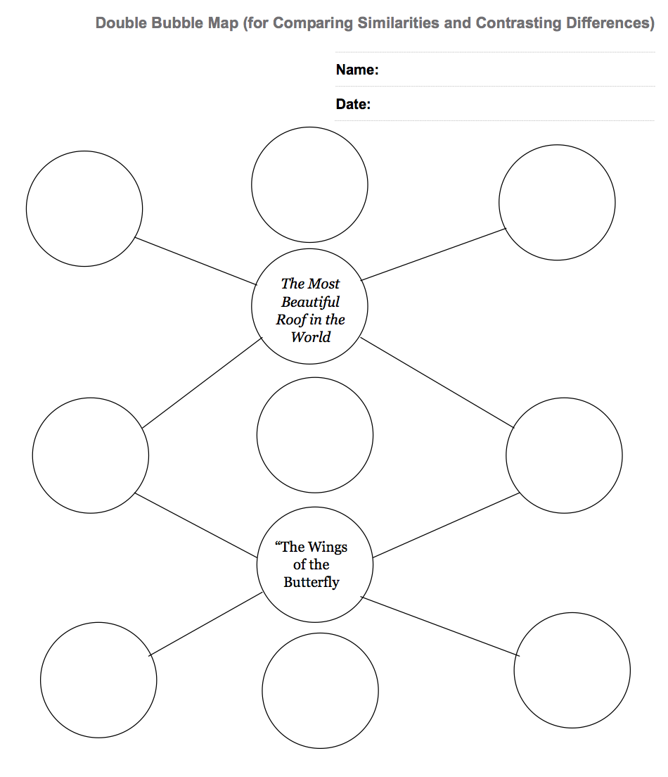
A double bubble map is similar to a Venn diagram because it’s used to compare and contrast two things.

Slide 24
The Double Bubble map is another way, besides a Venn diagram, to organize your thinking about how things are similar and different. You will use the Double Bubble map today to help you focus on identifying a specific number of similarities and differences between the examples of biodiversity mentioned in the story versus what you have learned about biodiversity from informational texts.

Slide 25
We are going to use the AQUA Biodiversity anchor chart to help us compare and contrast with the examples of biodiversity we’ve identified in “The Wings of the Butterfly.”

Slide 26
Most Beautiful Roof in the World
What examples of biodiversity were in the story that are similar to ones we have listed on our AQUA charts?
Complete the last three bubbles on your own.
monkeys
butterflies
native people
“Wings of the Butterfly”
What examples of biodiversity are in the story, but are not on our AQUA chart?
Woodpecker
tinamou bird
sorva fruit

Slide 27
Closing and Assessment
Debrief and Review of Learning Targets
(5 mins)

Slide 28
Please consider:
How does Kathryn Lasky try to convey the same message in her writing as the message of the Takuna tale?
Pair-Share your ideas.

Slide 29
