Slide 1
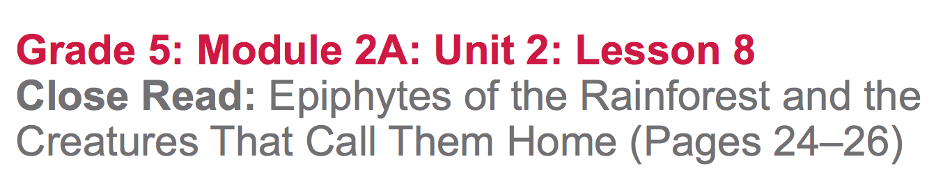

Slide 2
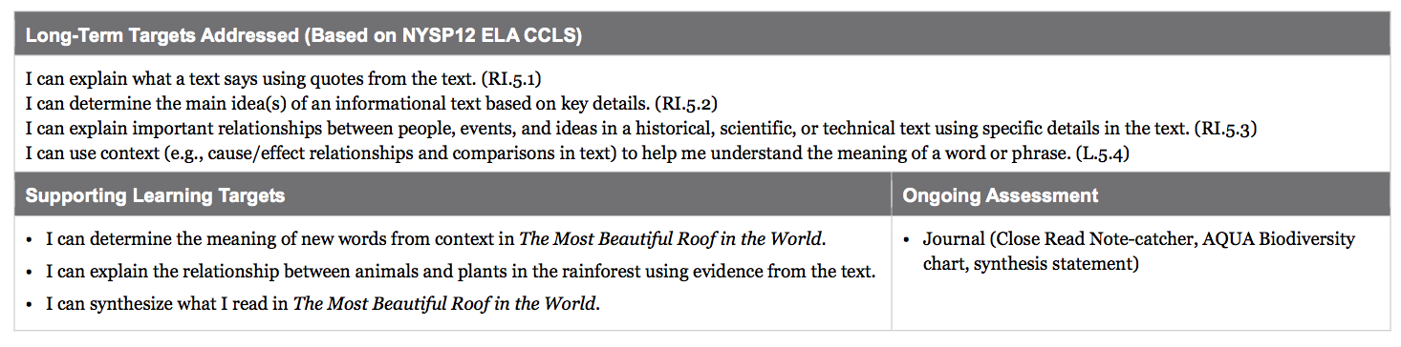

Slide 3
Opening
Reviewing Homework and Engaging the Reader (8 min)

Slide 4
Join your reading groups.
You are going to review your understanding of biodiversity by playing Hot Seat. In Hot Seat, some students will be asked to answer a question or define a vocabulary word, by either sketching it, or by acting it out. You may refer to the AQUA chart, the book, and your journals.

Slide 5
Take the paper out from under your seats and answer the questions or define the vocabulary word aloud one at a time with your group members.
If you don’t have a question, you must say if you agree or disagree with a response and explain your thinking.

Slide 6
Work Time
Read-Aloud: Relationships between Plants and Animals of the Rainforest (12 mins)

Slide 7
Learning Target
“I can explain the relationship between animals and plants in the rainforest using evidence from the text.”
What does relationship mean?

Slide 8
Open your books to page 24 and locate the sentence that begins: “There are many such interlocking relationships.” (stop on p. 26 ...her boys)

Slide 9
Gist
Think about the gist of pages 24-26. Share with your group and be prepared to share with the class.
What is the relationship between the animals and the plants of the rainforest?

Slide 10
With that question in mind, independently reread page 24.
When everyone at your group is finished reading, discuss the question.
What is the relationship between the animals and the plants of the rainforest?

Slide 11
B. Group Read and Discussion: Plant and Animal Interdependence (15 mins)
Remember, we are still working on the first learning target.

Slide 12
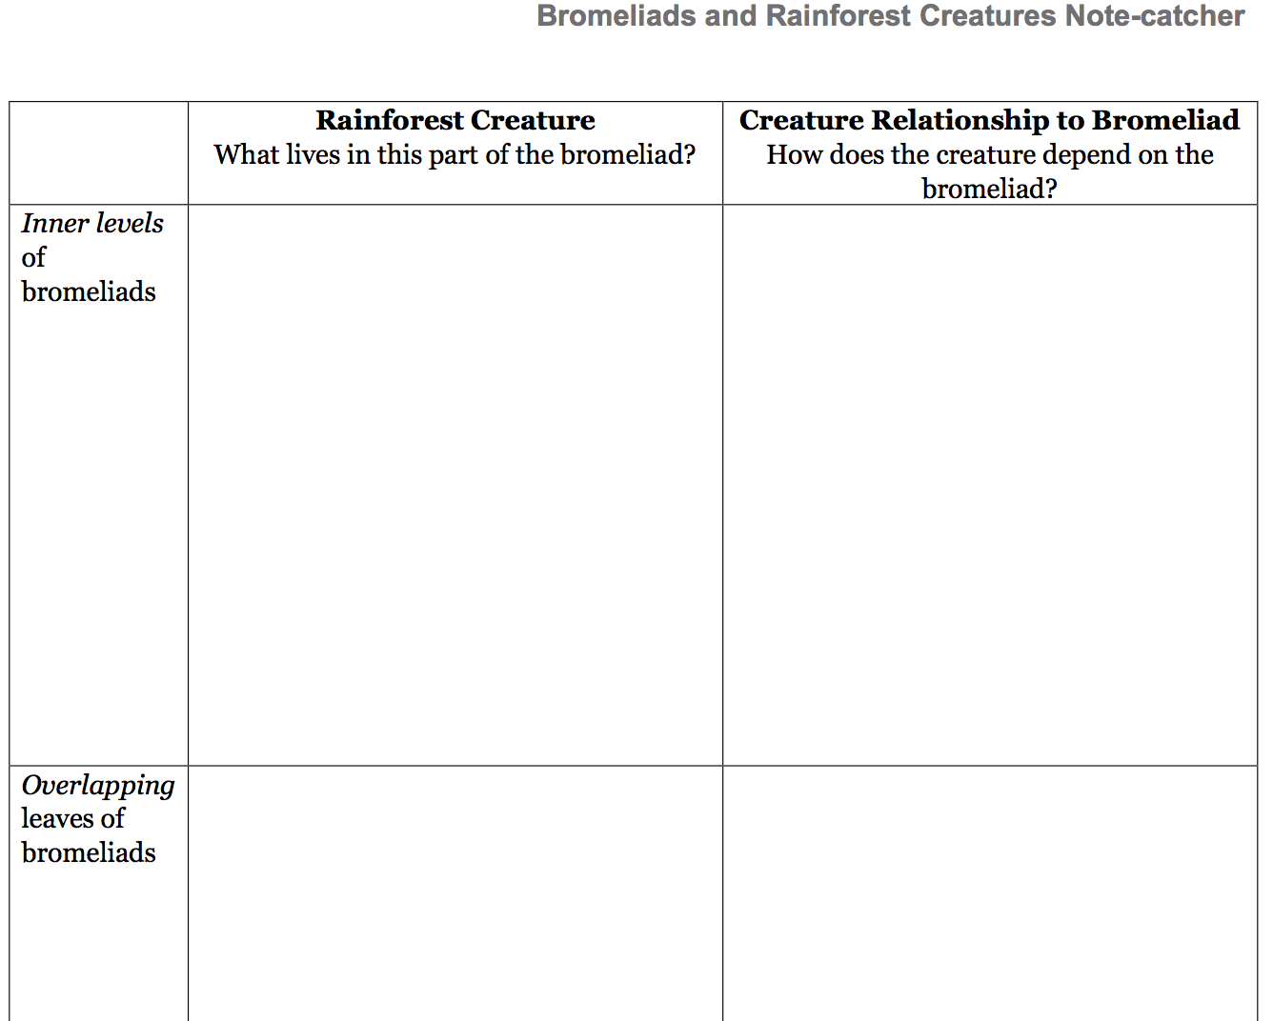

Slide 13
You will reread pages 25-26 independently to think more about how animals and plants depend on each other in the rainforest.
You will use your note catcher to record your thinking. Make sure to use evidence from the text that shows how these creatures depend on bromeliads.

Slide 14
C. Key Vocabulary to Deepen Understanding (10 mins)
“I can determine the meaning of new words from context in The Most Beautiful Roof in the World.
We have been working on this target a lot, particularly since the scientific text has so many challenging words. Continue to use the skills that we have learned.

Slide 15
disturbed
fungus
trudging
hoist
fraction
discarded (24)
bromeliad
hovering
larvae
lurk
overlapping
venomous
disturbance (25)
rare
lungless
inaccessibility
inhabitants (26)
Look back in the text and using the context, try and determine the meaning of these words. It’s not as important to get every single word as it is that you are learning to figure out the meaning of words in context.

Slide 16
After sharing out, revise the evidence on your Bromeliads and Rainforest Creatures Note-catchers based on new understandings of vocabulary.
Pair up with another group and share what you’ve learned about the relationship between bromeliads and creatures of the rainforest.

Slide 17
D. Synthesis Writing (10 mins)
Return to your seats for independent writing.
“I can synthesize what I read in The Most Beautiful Roof in the World.”
What does it mean to synthesize?

Slide 18
On a new page...
Write a synthesis statement in response to this prompt:
Describe the relationship between the animals and the plants of the rainforest and why that relationship is important.
Remember to think about all of the things you’ve learned about plants and animals of the rainforest and how they interact with each other. A strong synthesis statement will combine all of those ideas in a brief summary with details.

Slide 19
Closing and Assessment
Debrief and Review of Learning Targets
(5 mins)

Slide 20
Let’s look back at our AQUA Biodiversity anchor chart.
What new understandings do you have about biodiversity?

Slide 21
